Slide 1
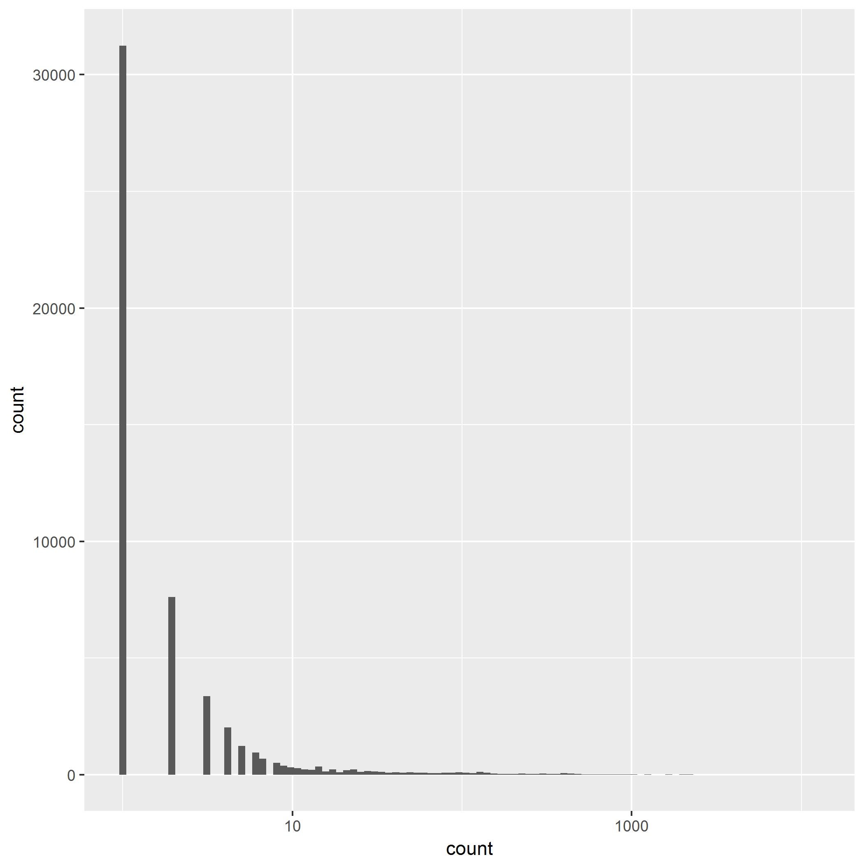
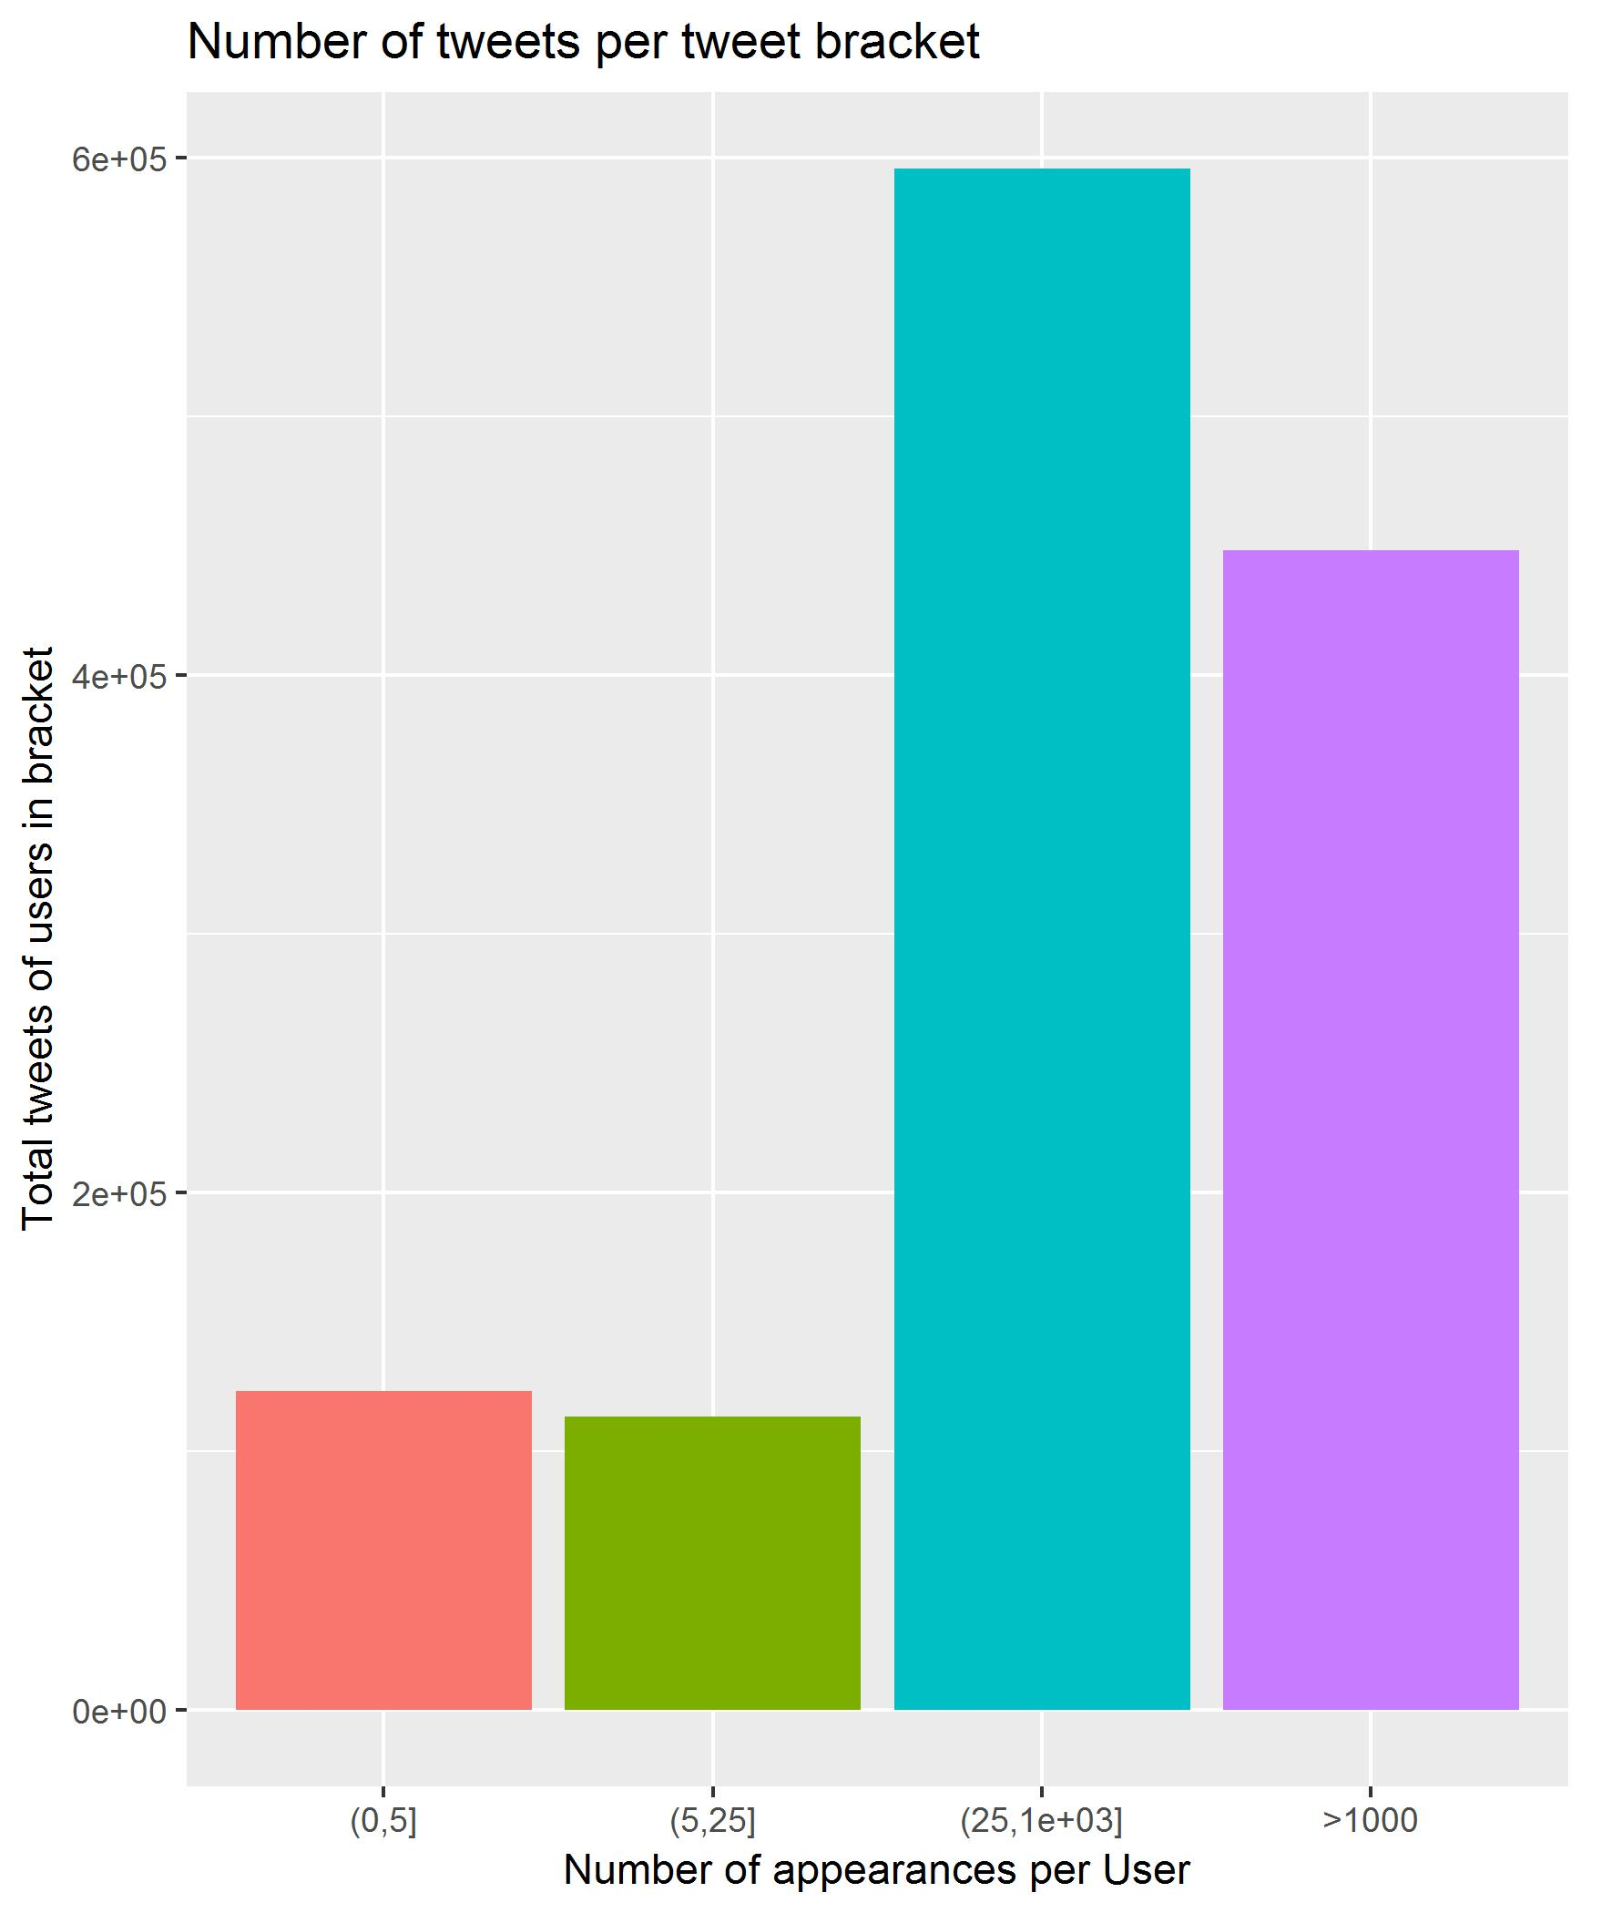
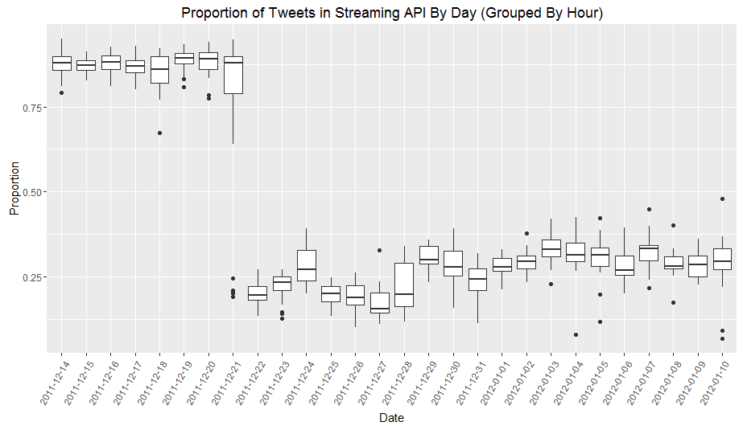
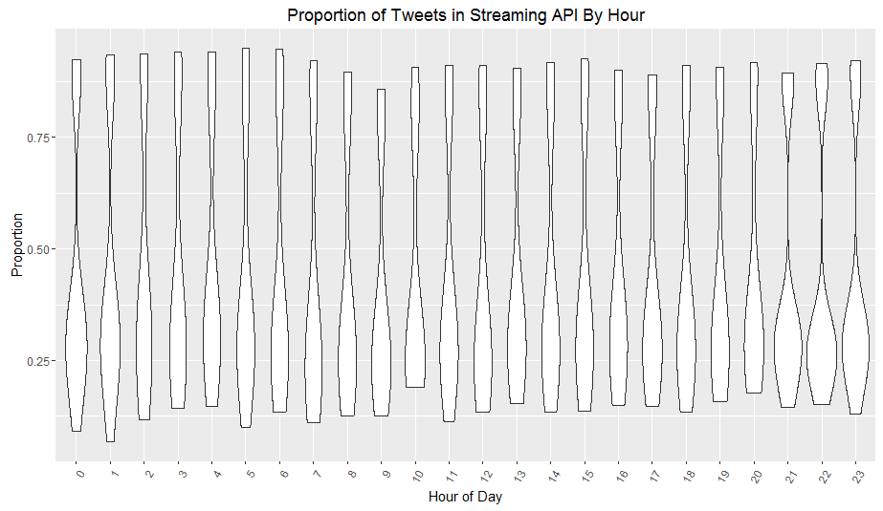
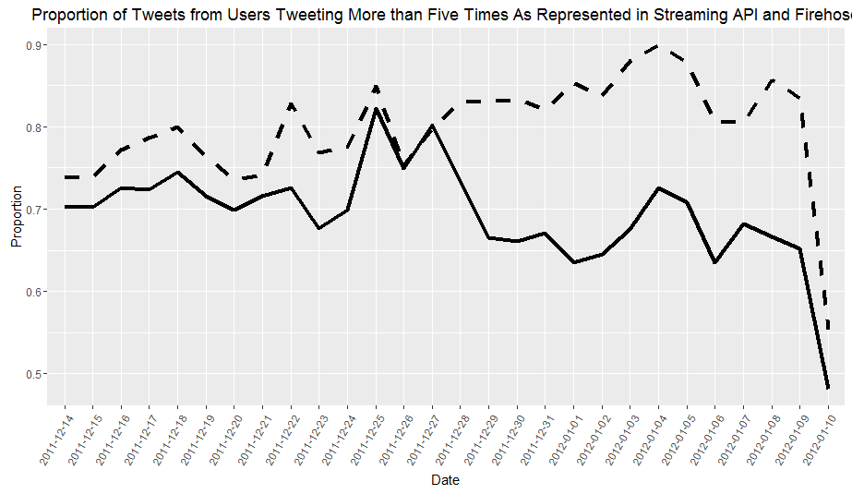
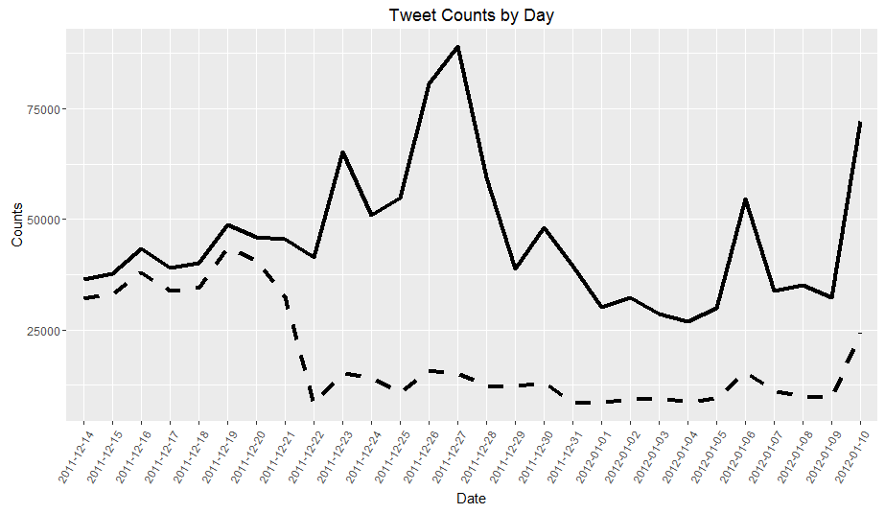
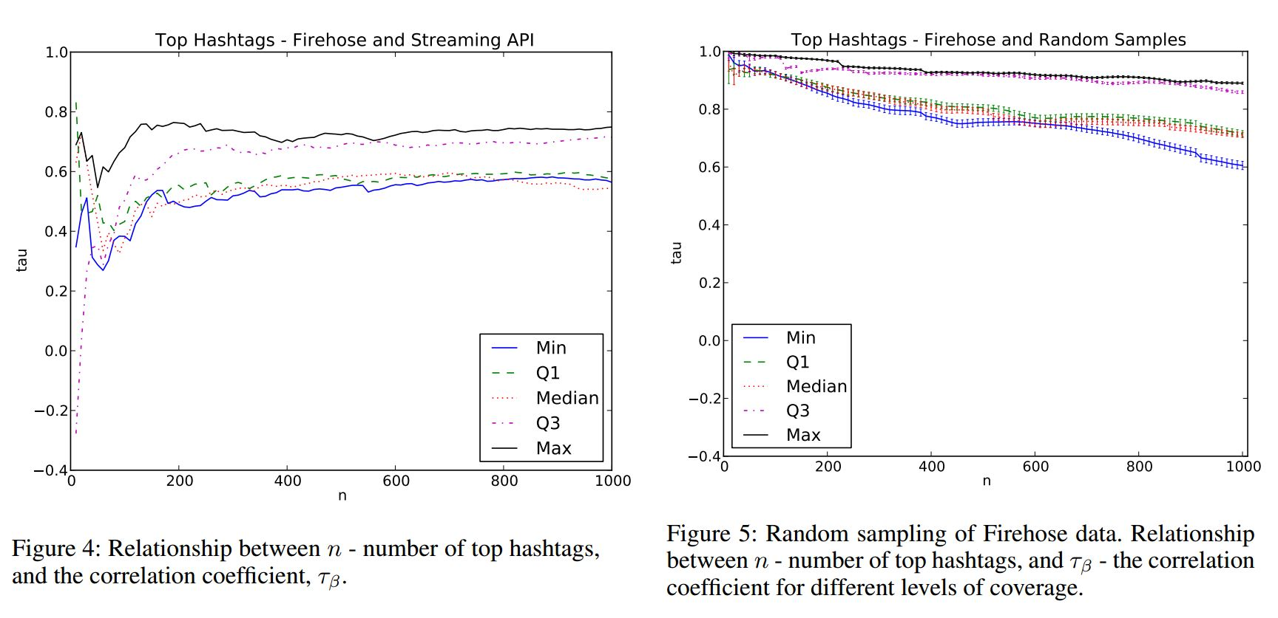
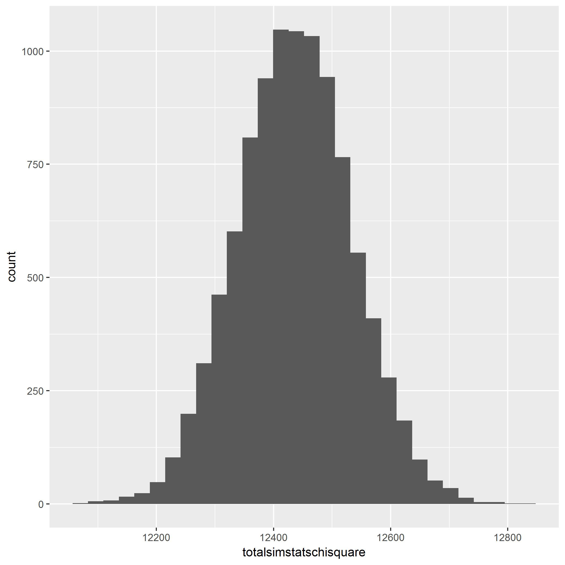
Understanding Bias in Sampling Users with Twitter’s Streaming API
E. Cheng, M. Chen
Abstract
Background
User Analysis
Tweet Analysis
The Twitter Streaming API (Application Programming Interface) is Twitter’s free public interface for accessing real time Twitter data. However, the number of Tweets returned per query is rate limited. Once the field of matching Tweets surpasses a variable threshold, Twitter returns a sample of tweets; however, the sampling scheme used to produce this sample is not publicly documented. Due to the unclear nature of Twitter’s sampling scheme, it is unknown whether there is a bias in the sample of Tweets returned to the user. In our study, we investigate one possible form of bias: size biasing. Thanks to access to both the set of tweets returned by the Streaming API and the full set of Tweets in a small timeframe, we have been able to observe size biased representation of the set of active Twitter users in the period of study. We are interested in further exploring other biases, particularly regarding Tweet text and hashtag content.
Streaming API: Retrieves Tweets by search queries (string, geobox, userID). Returns at most 1% of tweets produced on Twitter in given time frame. Free.
Firehose: Paid service that allows retrieval of all Tweets matching search queries. Priced at over $400/month.
Previous studies demonstrated significant variation in the volume of Tweets returned by Streaming API.²
High volume of Tweets correlates to lower yield in Streaming API. (Figure 1)
Morstatter et. al. determined a significant bias in Tweet text content (Figure 2).
Light users (<5 tweets) make up the majority users in Firehose, but a minority ofTweets (Figure 3).
It was of interest as to whether there would be bias in representation with respect to time.
Figure 3: Histogram of users(left) and tweets(right), categorized by number of tweets sampled by Firehose in the timeframe
Figure 5: Proportion of Tweets represented in Streaming API by hour, grouped by day.
# Tweets total in sampling frame
Representation of low volume users fluctuates significantly depending on total Tweet volume, as visualized in Figure 4. Coverage varies more widely after the 13th day, a similar trend to Fig. 1
Figure 6: Proportion represented in Streaming API by hour of day.
Data Description
Tweet IDs of Tweets from Sampling API. Publicly available. 528,592 elements. (csv)
Tweet IDs of Tweets from Firehose (contains all tweets from (1)). Publicly available. 1,281,066 elements. (csv)
Time, User ID and Tweet IDs of Tweets from Firehose. Courtesy of Fred Morstatter. 1,281,066 rows of 6 variables. (csv)
Figure 4: Proportion of Tweets from accounts with 5+ Tweets in sampling frame. Streaming API (blue) and the firehose (red).
Fig. 5 clearly reflects the trend in Fig. 1
Fig. 6 shows little change in hourly representation, but still reflects Fig. 5 and Fig. 6
Null hypothesis: The distribution of users in the Streaming API is drawn uniformly at random, from user distribution in Firehose.
Alternative: The Streaming API returns a different distribution with high volume users.
SRS of n Tweets drawn from Firehose. n = #of tweets in Streaming API data set. 10k trials.
We reject the null that users are randomly sampled; p < 1/10000
Introduction
Initial Investigation
Conclusions
Produced a script to retrieve Tweets; discovered a large number were no longer available.
Received limited information from Morstatter from original study (time and user ID per Tweet)
Produced data visualizations comparing Tweets from Streaming API vs full Firehose. Noticed interesting trends in volume vs proportion sampled.
Categorize sampled users by Tweet volumes, visualized and quantified differences in representation of high vs low volume users.
Visualized Streaming API representation over time; strong trends over days, no significant trends per hour.
Performed simulation studies to assess bias; found no evidence for bias in Tweets, high probability of size biasing in users.
Figure 1: Tweets returned by Firehose (solid) and Streaming API (dashed) from the same query. This figure appeared in Morstatter’s original study, and was reproduced in this study.
Tweets returned by the Streaming API cannot be said to be biased, but the representation of users in the Streaming API is very likely size biased.
 | EXPECTED ¹ | ACTUAL²
LOW | 225513 | 19634
MEDIUM | 31107 | 5158
HIGH | 1213 | 2042
Acknowledgements
Figure 2, taken from (2). Notable difference between number of hashtags used in Kendall’s tau, and tau. Quartiles refer to proportion of Tweets sampled in Streaming API.
Fred Morstatter and Cristian Vaccarri for providing data from their research.
Professor Deborah Nolan for providing guidance in all aspects of this study.
Chi square value for sample: 13777.35
Table 2, above: Counts of Tweets by users of each bracket.
References
Users appeared to be stratified in volume of Tweets produced (Fig 3, left). We refer to them by the categories described in Table 1.
F. Morstatter, J. Pfeffer, H. Liu, “When is it Biased? Assessing the Representativeness of Twitter’s Streaming API”, 23rd International WWW Conference, pp. 555-556, 2016.
F. Morstatter, J.Pfeffer, H.Liu, K.M. Carley, “Is the Sample Good Enough? Comparing Data from Twitter’s Streaming API with Twitter’s Firehose”, International Conference on Weblogs and Social Media, pp. 400-408, 2013.
JD Wendt, R. Wells, R.V. Field, Jr., S. Soundarajan, “ On data collection, graph construction, and sampling in Twitter”, ASONAM, pp. 985- 992, 2016.
Figure 5 (left). Distribution of simulated Chi squared values.
 | LOW | MEDIUM | HIGH
#Tweets by user in total sampling frame | Less than 5 | 5-25 | Over 25
Table 1: Categorization of users.

