Slide 1
RippleFPGA: A Routability-Driven Placement for Large-Scale Heterogeneous FPGAs
Chak-Wa Pui, Gengjie Chen, Wing-Kai Chow, Ka-Chun Lam, Jian Kuang,
Peishan Tu, Hang Zhang, Evangeline F. Y. Young, Bei Yu
CSE Department, Chinese University of Hong Kong, Hong Kong
Speaker: Jordan, Chak-Wa Pui

Slide 2
Outline
Background
Problem Formulation
Algorithms
Experimental Results

Slide 3
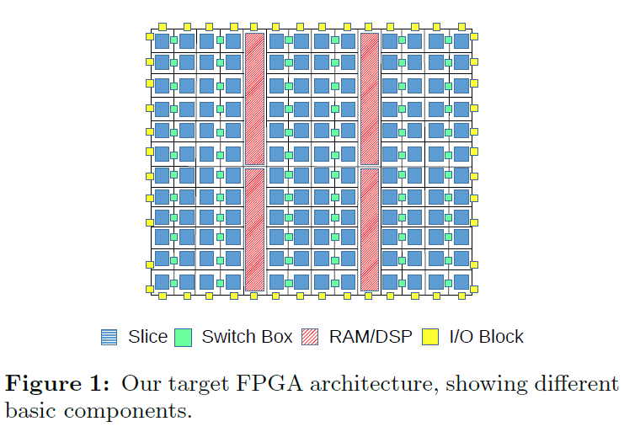
Introduction
As the scale of FPGA grows rapidly, routability becomes a major problem in FPGA placement
The complex architecture of heterogeneous FPGAs yields more sophisticated placement techniques
Architecture sample of heterogeneous FPGA

Slide 4
Previous Works
Three major categories
Simulated annealing based, e.g. VPR
Partitioning-based, e.g. [1]
Analytical approach, e.g. [2][3]
Limitations of previous works
Very few of recent works considering routability
Previous works mainly consider routability in packing
Most of previous works on heterogeneous FPGAs pack logic elements into CLB and seldom change them after packing
[1] Timing-driven partitioning-based placement for island style FPGAs. TCAD2006
[2] Analytical placement for heterogeneous FPGAs. FPL2012
[3] An efficient and effective analytical placer for FPGAs. DAC2013.

Slide 5
Contributions
A framework for heterogeneous FPGA flat placement
Several methods are proposed to reduce routing congestion
Partitioning
Multi-stage congestion-driven global placement
Alignment-aware detailed placement

Slide 6
Problem Formulation
Routability-driven FPGA placement
Given the netlist and architecture of an FPGA
Minimize: routed wirelength measured by VIVADO
Subject to: each logic element has no overlap, no violation to the architecture specific legalization rules

Slide 7
Overview of Our Algorithm
Partitioning
Packing
Routability-Driven Global Placement
Legalization
Routability-Driven Detailed Placement

Slide 8
Overview of Our Algorithm
Partitioning
Packing
Routability-Driven Global Placement
Legalization
Routability-Driven Detailed Placement

Slide 9
Partitioning
Motivation
Unbalance between width and height of the chip
Cannot be resolved by spreading but by reallocating
(a)origin
(b)spreading
(c)reallocation
Comparison of different methods in solving congestion

Slide 10
Partitioning
Solution:
Partition the circuit into sub-circuits using recursive bi-partitioning
Cluster size less than 25% of #cells, cut size less than 5% of #net
Reallocate the cells across the chip as sparse as we can
Maintain relative order of clusters and cells inside the same cluster
Give more space for the cells in spreading while not increase the HPWL too much
cluster2
cluster1
(a)origin
(b)clustering
(c)reallocate

Slide 11
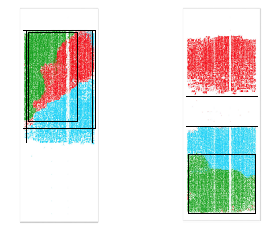
Partitioning
Effect on real test case
(a)w/o partitioning
(b)with partitioning
Comparison of spreading result w/o and with partitioning

Slide 12
Overview of Our Algorithm
Partitioning
Packing
Routability-Driven Global Placement
Legalization
Routability-Driven Detailed Placement

Slide 13
Packing
Short global placement
Forming basic logic elements(BLEs) that consist of only one LUT and at least one FFs
Let the remaining LUTs and FFs be BLEs of itself only
Merging two BLEs into one if their LUTs have many connections
LUT
(a)
(b)
(c)
(d)
(e)
(f)
(g)
BLE
FF
Different type of basic logic elements (BLEs)

Slide 14
Packing
Use maximum weight matching in stage2, weight proportional to distance, only connected LUTs and FFs have edges
In stage3, let the remaining LUTs and FFs be BLEs of itself only
1
3
1
9
5
2
2
4
6
7
4
3
6
5
10
9
10
0
7
8
11
0
11
8
Stage 2
How we do packing in stage2,3

Slide 15
Packing
Use maximum weight matching in stage4, weight proportional to distance and connections between the LUTs of the vertices
1
1
3
4
2
5
1
2
4
2
4
6
7
8
3
3
8
9
0
7
10
0
5
0
7
6
6
11
8
Stage 3
5
How we do packing in stage4

Slide 16
Overview of Our Algorithm
Partitioning
Packing
Routability-Driven Global Placement
Legalization
Routability-Driven Detailed Placement

Slide 17
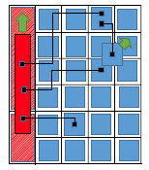
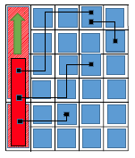
Global Placement
Quadratic placement based on Ripple
Three-stage Optimization
First two stages, optimize wirelength, fix DSP/RAM to their legal position after stage 1
Legalizing DSP/RAM disturbs the global placement result a lot
The third stage optimize routability using inflation (Accumulative)
Same displacement, difference in HPWL
Large displacement

Slide 18
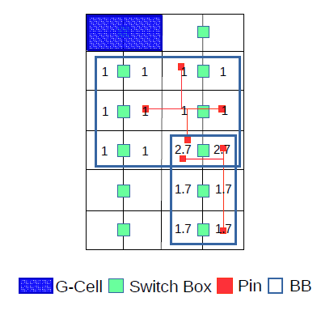





Global Placement
Routing congestion estimation
Probabilistic model
Consider both bounding box and HPWl
$$W_{m}∙{HPWL}_{m}=5$$
$$W_{m}∙{HPWL}_{m}=6$$
#G-Cell$=3$
#G-Cell$=6$

Slide 19
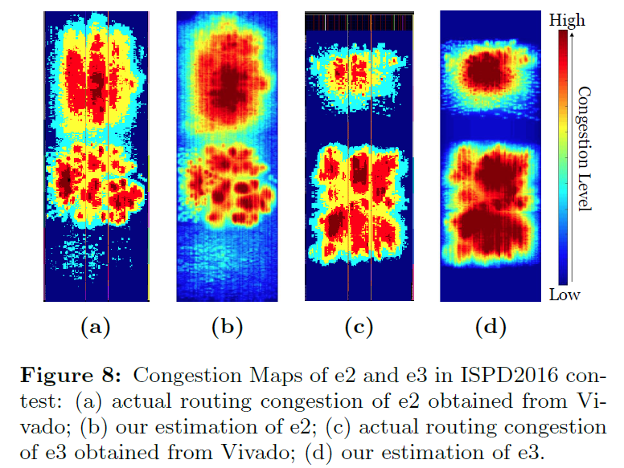
Routing congestion estimation
(a)VIVADO
(b)Ours
(c)VIVADO
(d)Ours
Comparison of the routing congestion estimation obtained by VIVADO and us

Slide 20
Overview of Our Algorithm
Partitioning
Packing
Routability-Driven Global Placement
Legalization
Routability-Driven Detailed Placement

Slide 21
Legalization
Greedy window-based cell by cell legalization process
Start from a small window
Sites inside a window are consider to have same displacement
Sort the sites by an objective function (HPWL)
If cannot be legalized, slowly increase the window size until it’s legalized
Keep BLEs intact unless cannot be legalized

Slide 22
Overview of Our Algorithm
Partitioning
Packing
Routability-Driven Global Placement
Legalization
Routability-Driven Detailed Placement

Slide 23
Detailed Placement
Move to optimal region to optimize HPWL
In both BLE level and CLB level
In CLB level, if the site is occupied, swap the cells if the HPWL does not increase
In BLE level, the BLE can only be moved to a slice if it won’t violate legalization rules
BLE
BLE
CLB

Slide 24
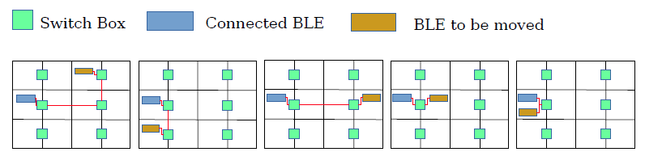
Detailed Placement
If already in optimal region, move to site to optimize alignment(BLE level).
Compute the score of each site by assuming the cell is moved to there and get the alignment score by considering all related nets
Sort the candidate sites by their alignment score, try to move the cell to a site with smaller score
(a)score=5
(b) score=4
(c) score=3
(d) score=2
(e) score=1
Comparison of alignment of different placement

Slide 25
Experimental Result
Design | Ours |  |  | 1st Place |  |  | 2nd Place |  |  | 3rd Place
 | WL | Time(s) | Normalized WL | WL | Time(s) | Normalized WL | WL | Time(s) | Normalized WL | WL | Time(s) | Normalized WL
FPGA-1 | 362563 | 74 | 1 | - | - | - | 379932 | 118 | 1.048 | 581975 | 97 | 1.605
FPGA-2 | 677563 | 167 | 1 | 677877 | 435 | 1.000 | 679878 | 208 | 1.003 | 1046859 | 191 | 1.545
FPGA-3 | 3617466 | 1037 | 1 | 3223042 | 1527 | 0.891 | 3660659 | 1159 | 1.012 | 5029157 | 862 | 1.390
FPGA-4 | 6037293 | 621 | 1 | 5628519 | 1257 | 0.932 | 6497023 | 1449 | 1.076 | 7247233 | 889 | 1.200
FPGA-5 | 10455204 | 1012 | 1 | 10264769 | 1266 | 0.982 | - | - | - | - | - | -
FPGA-6 | 6960037 | 2772 | 1 | 6330179 | 2920 | 0.910 | 7008525 | 4166 | 1.007 | 6822707 | 8613 | 0.980
FPGA-7 | 10248020 | 2170 | 1 | 10236827 | 2703 | 0.999 | 10415871 | 4572 | 1.016 | 10973376 | 9196 | 1.071
FPGA-8 | 8874454 | 1426 | 1 | 8384338 | 2645 | 0.945 | 8986361 | 2942 | 1.013 | 12299898 | 2741 | 1.386
FPGA-9 | 12954350 | 2683 | 1 | - | - | - | 13908997 | 5833 | 1.074 | - | - | -
FPGA-10 | 8564363 | 5555 | 1 | - | - | - | - | - | - | - | - | -
FPGA-11 | 11226088 | 3636 | 1 | 11091383 | 3227 | 0.988 | 11713479 | 7331 | 1.043 | - | - | -
FPGA-12 | 8928528 | 9748 | 1 | 9021768 | 4539 | 1.010 | - | - | - | - | - | -
Comparison of wirelength and runtime of our placer and the top3 winners

Slide 26
Experimental Result
Design | Raw |  | With congestion-driven GP |  | With partitioning |  | With Both
 | WL | Normalized WL | WL | Normalized WL | WL | Normalized WL | WL | Normalized WL
FPGA-1 | 362563 | 1.000 | 364143 | 1.004 | 378029 | 1.043 | 377883 | 1.042255
FPGA-2 | 681418 | 1.000 | 677563 | 0.994 | 696417 | 1.022 | 689360 | 1.011655
FPGA-3 | 4027586 | 1.000 | 3999517 | 0.993 | 3645846 | 0.905 | 3617466 | 0.898172
FPGA-4 | 6037293 | 1.000 | 6087199 | 1.008 | 6265158 | 1.038 | 6357766 | 1.053082
FPGA-5 | - | - | - | - | - | - | 10455204 | -
FPGA-6 | 7801736 | 1.000 | 7723476 | 0.990 | 7016684 | 0.899 | 6960037 | 0.892114
FPGA-7 | 10248020 | 1.000 | 10615672 | 1.036 | 10338763 | 1.009 | 10580828 | 1.032475
FPGA-8 | 9171179 | 1.000 | 9392039 | 1.024 | 8874454 | 0.968 | 9013564 | 0.982814
FPGA-9 | 12954350 | 1.000 | 13437554 | - | - | - | 13834692 | 1.067957
FPGA-10 | - | - | 10372369 | - | 8782789 | - | 8564363 | -
FPGA-11 | - | - | - | - | 11226088 | - | 11688504 | -
FPGA-12 | - | - | 10286583 | - | - | - | 8928528 | -
Comparison of wirelength of different method used in our placer

Slide 27
Thanks

