Slide 1

Clock-Aware UltraScale FPGA Placement with Machine Learning Routability Prediction
Chak-Wa Pui, Gengjie Chen, Yuzhe Ma, Evangeline F. Y. Young, Bei Yu
CSE Department, Chinese University of Hong Kong, Hong Kong
Speaker: Jordan, Chak-Wa Pui
Notes:
Good afternoon everybody, I am Jordan from the Chinese university of Hong Kong. Today I will talk about Clock-Aware UltraScale FPGA Placement with Machine Learning Routability Prediction.

Slide 2
Outline
Background
Problem Formulation
Algorithms
Experimental Results
Conclusion
Notes:
This is the outline of my presentation today. First, I will introduce some background about FPGA placement today. Then I will explain the problem formulation followed by the detailed of our algorithms. Finally, I will show the performance of our placer and draw a conclusion

Slide 3
Introduction
The complex architecture of heterogeneous FPGAs yields more sophisticated placement techniques
The gap between FPGA and ASIC placement becomes smaller
Clock tree routing
Scale
Placement techniques
etc.
As the scale of FPGA grows rapidly
routability becomes a major problem in FPGA placement
…
IO
SLICE
DSP
RAM
Switch Box
…
2x30 sites
15x2 half columns
An illustration of Xilinx UltraScale architecture
5x8 clock regions
An illustration of clock architecture of UltraScale
Notes:
As the technology evolves, the architecture of heterogeneous FPGAs becomes more sophisticated which makes placement even harder. The figure on the right is an illustration of UltraScale FPGA architecture, which is also the targeting architecture of our work. It consists of several kinds of blocks like slice, IO, DSP, RAM. Not only each kind of cell is only allowed to be placed in its corresponding type. There are also some additional rules. For example, two FF can be put into the same half of the slice if they have the same clock. In addition to these constraints, to use the clock tree routing structure of UltraScale, additional rules must be satisfied. This figure is an illustration of UltraScale FPGA clock architecture. The whole chip is divided into clock regions and half columns, where mesh-like routing structure is used to route the clock nets. To utilize this kind of routing structure, the number of clock inside each region and column also needs to be limited, which yields even more challenge in placement.
Moreover the gap between FPGA and ASIC placement is actually becomes smaller in terms of clock tree routing, scale, placement techniques, etc.
Like ASIC placement, routability still remains to be a big challenge since the scale of FPGA designs become larger

Slide 4
Previous Works
Routablility-driven placement for UltraScale FPGAs
RippleFPGA[1]
UTPlaceF[2]
GPlace[3]
Congestion estimation methods in FPGAs
Probabilistic model[1][4]
Global router[2]
[1] RippleFPGA: A routability driven placement for large-scale heterogeneous FPGAs. ICCAD2016
[2] UTPlaceF: A routability-driven FPGA placer with physical and congestion aware packing. ICCAD2016
[3] GPlace: A congestion-aware placement tool for UltraScale FPGAs. ICCAD2016
[4] A congestion driven placementalgorithm for fpga synthesis. FPL2006
Notes:
Besides the traditional FPGA placement like simulated annealing, partitioned-based. Several routability-driven placer for UltraScale FPGA are proposed in last year’s ISPD contests. For example, RippleFPGA is a placer that do placement and packing simultaneously. UTPlaceF will first do packing and then perform quadratic placement on them. GPlace purpose a flat placement method that yields better quality compare to their pack-and-place method.
Since the topic of last year’s contest is routability, different approach are used to estimate the congestion level, like probabilistic model, global router, etc.

Slide 5
Contributions
Several placement techniques for UltraScale FPGAs to meet the challenges of clock constraints, routability, wirelength
A two-step displacement-driven legalization is introduced to remove all clock constraint violations
Chain move is proposed to put a cell into a desired site efficiently
We study the performance of different routability prediction methods in FPGAs
All the above techniques are incorporated into our FPGA placer
Notes:
The contribution of these work can be summarized as follows, first we propose several placement techniques for UltraScale FPGAs to meet the challenges of clock constrains, routability, wirelength
To be detailed, there are three techniques. First, A two-step displacement-driven legalization is introduced to remove all clock constraint violations. Then, Chain move is proposed to put a cell into a desired site efficiently. Finally, we study the performance of different routability prediction methods in FPGAs. We also incorporated all the above techniques to our placer to evaluate their performance.

Slide 6
Problem Formulation
Clock-Aware Routability-driven FPGA placement
Given the netlist and architecture of an FPGA
Minimize: routed wirelength measured by VIVADO
Subject to: each logic element has no overlap, no violation to the architecture specific legalization rules
Notes:
The problem formulation of clock-aware routability-driven FPGA placement is as follows. We are first given the netlist and architecture of an FPGA. Then we need to minimize the routed wirelength measured by VIVADO such that each logic element has no overlap and there is no violation to the architecture specific legalization rules.
The Main difference to last year’s contest is that the placement needs to satisfy the additional legalizations of the clock architecture.

Slide 7
Overview of Our Framework
Flat netlist
Clock planning
Reduce congestion caused by unbalanced routing supply in the horizontal and vertical directions
Partition re-allocation
Legalization
LUTs and FFs are packed into basic logic elements (BLEs) to reduce the inter-connections between sites in routing
Packing
Detailed placement
Machine learning method is used to predict the routing congestion
Global placement
Placed design
Notes:
Before going into details of our methods, I will first introduce our placement framework and how we incorporate those techniques into the framework.
First, we will do partition reallocation, which reduce congestion caused by unbalanced routing supply in the horizontal and vertical directions. Then LUTs and FFs are packed into basic logic elements to reduce the inter-connections between sites in routing. After that an upper-bound lower-bound based global placement is perform. Here is where we use the machine learning method to predict the routing congestion.

Slide 8
Overview of Our Framework
Flat netlist
Violations of the clock region constraint in global placement will be removed
Clock planning
The placement is first legalized such that no violations regarding to rules in ISPD2016.
Then violations of the column region constraint will be removed by half column legalization
Partition re-allocation
Legalization
Chain move is used to improve wirelength and displacement
Packing
Detailed placement
Global placement
Placed design
Notes:
After that, Clock region planning is used to remove all the violations of the clock region constraints. A bounding box will be assign to each cell according to their clock net and they are not allowed to move outside of the box in order to keep the clock region constraints satisfied. Legalization consists of two parts, in the first part, the placement is legalized such that there is no violations of all the rules except the half column rule for example overlapping, slice legalization rule, etc. Chain move is applied in both legalization and detailed placement to improve wirelength and reduce displacement. After all these steps, we will have a legal and optimized placement result.

Slide 9
Overview of Our Methods
Two-Step Clock Constraints Legalization
Chain Move
Machine Learning-Based Congestion Estimation
Notes:
Now I will introduce the details of our methods

Slide 10
Overview of Our Methods
Two-Step Clock Constraints Legalization
Clock Region Planning
Half Column Legalization
Chain Move
Machine Learning-Based Congestion Estimation
Notes:
Our two step clock constraints legalization consists of clock region planning and half column legalization

Slide 11
Two-Step Clock Constraints Legalization
Clock region
Clock constraints of UltraScale FPGAs
Clock region constraints
Bound box of the clock net
Column region constraints
Loads of the clock net
Displacement-driven two-step legalization
Clock region planning
Remove all the clock region violations after global placement
Half Column Legalization
Remove all the half column violations after legalization
Half column
0
0
0
0
1
0
1
1
1
0
0
0
1
0
0
0
1
0
0
0
0
1
1
1
0
0
1
0
1
0
0
0
0
0
0
0
0
0
0
0
0
0
0
0
0
Usage of half column resources
Usage of clock region resources
Notes:
Before talking about details of our algorithms, I will first explain what are the clock constraints in UltraScale FPGAs. The chip is divided into clock region which are further divided into half columns. As you can see from this figure. This is a clock net. A clock net is said to be inside a clock region if its clock region overlaps with the region. However, for half column, a clock net is inside it if one of its loads is inside the column.
As mentions before, clock region planning will remove all the lock region violations after global placement while half column legalization will remove all the half column violations after normal legalization

Slide 12
Two-Step Clock Constraints Legalization
Two-Stage Clock region planning
Assign a bounding box to each cell such that there will be no violation if they stay in the box
Shrink Stage
Expand Stage
Notes:
The main idea of our clock region planning is to assign a bounding box to each cell according to its clocks such that the cell will not cause any violation as long as it stays in its box. Our object is to remove the violations with minimum disturbance to the global placement result. To remove the violation, we will iteratively shrink the bounding box of each clock. Each time, we will shrink the BB of the clock in the most overflowed clock region such that it induces smallest displacement. Following is an illustrative example.

Slide 13
Two-Step Clock Constraints Legalization
Two-Stage Clock region planning
Assign a bounding box to each cell such that there will be no violation if they stay in the box
Shrink Stage
iteratively shrink the bounding box of each clock
shrink the BB of the clock in the most overflowed clock region such that it induces smallest displacement. Move the corresponding cells to the boundary.
Expand Stage
1
2
2
1
0
1
2
2
1
0
1
2
2
1
0
1
2
3
2
1
1
2
2
2
1
1
2
2
2
1
2
3
4
2
1
2
3
3
2
1
1
2
2
2
1
1
2
3
2
1
1
2
2
2
1
1
2
2
2
1
1
1
1
0
0
1
1
1
0
0
1
1
1
0
0
Notes:
The main idea of our clock region planning is to assign a bounding box to each cell according to its clocks such that the cell will not cause any violation as long as it stays in its box. Our object is to remove the violations with minimum disturbance to the global placement result. To remove the violation, we will iteratively shrink the bounding box of each clock. Each time, we will shrink the BB of the clock in the most overflowed clock region such that it induces smallest displacement. Following is an illustrative example.

Slide 14
Two-Step Clock Constraints Legalization
Two-Stage Clock region planning
Assign a bounding box to each cell such that there will be no violation if they stay in the box
Shrink Stage
Expand Stage
iteratively expand the bounding box of each clock
increase the width/height of the clock BB with highest cell density by 1 unit
1
2
2
1
0
1
2
2
1
0
1
2
2
2
1
2
2
2
2
2
1
2
2
2
1
1
2
2
2
1
1
2
2
2
1
2
2
2
2
2
1
2
2
2
1
1
2
2
2
1
1
2
2
2
1
…
2
2
2
2
2
1
2
2
2
1
1
2
2
2
1
1
2
2
2
1
2
2
2
2
2
1
1
1
0
0
1
1
1
1
1
1
1
1
1
1
2
2
2
2
2
Notes:
Since the disturbance to the global placement is mostly affected by the size of the bounding box, if each bounding box can be the whole chip, there will be no disadvantage. So, we will iteratively expand the bounding box of each clock after shrink stage. Each time, we will only increase the width/height of the clock BB with highest cell density by 1 unit. Following is an illustrative example.

Slide 15
Two-Step Clock Constraints Legalization
Half Column Legalization
All the future movement cannot induce any new half column violation
Iteratively select the most overflow column and remove the clock s.t. the smallest displacement is induced
Each load will be moved to its nearest site in another half column
Notes:
The second step of our clock constraint legalization is half column legalization. After it, we forbid all the move that will induce new violations. We will iteratively select the most overflow column and remove the clock such that the smallest displacement is induced. To be specific, each load of the clock will be moved to its nearest site in another half column.

Slide 16
Overview of Our Methods
Two-Step Clock Constraints Legalization
Chain Move
Machine Learning-Based Congestion Estimation
Notes:
Next, I will talk about a detailed placement technique we use in this work which is chain move.

Slide 17
Chain Move
c₀
rgn₀
c₁
rgn₁
c₂
Why?
Reduce the quality loss due to sequential placement
General Algorithm
Generate a sequence of cell moves such that,
all of cells involved are legal after the move
the objective is improved
DFS-based
Limit the number of trials of each cell and the length of the chain
The objective is optimized by selecting the candidate sites of each cell
c₃
rgn₂
Notes:
The motivation of chain move in our work is to remove the quality loss due to sequential placement. As shown in this figure, it will generate a sequence of cell moves such that all of cells involved are legal after the move and the objective is improved. This chain is found by a DFS-based algorithm. Basically, start with a cell, it will try to move it to its candidate sites. If it’s not successful, it will remove one of the cells in the candidate sites in order to move in. The removed cell becomes the next cell to be moved. The search end if the cell can be moved to its candidate sites without removing the cell. To balance quality and runtime, we limit the number of trials of each cell and the length of the chain. The Objective is optimized by selecting the candidate sites of each cell, which I will explain later with examples.

Slide 18
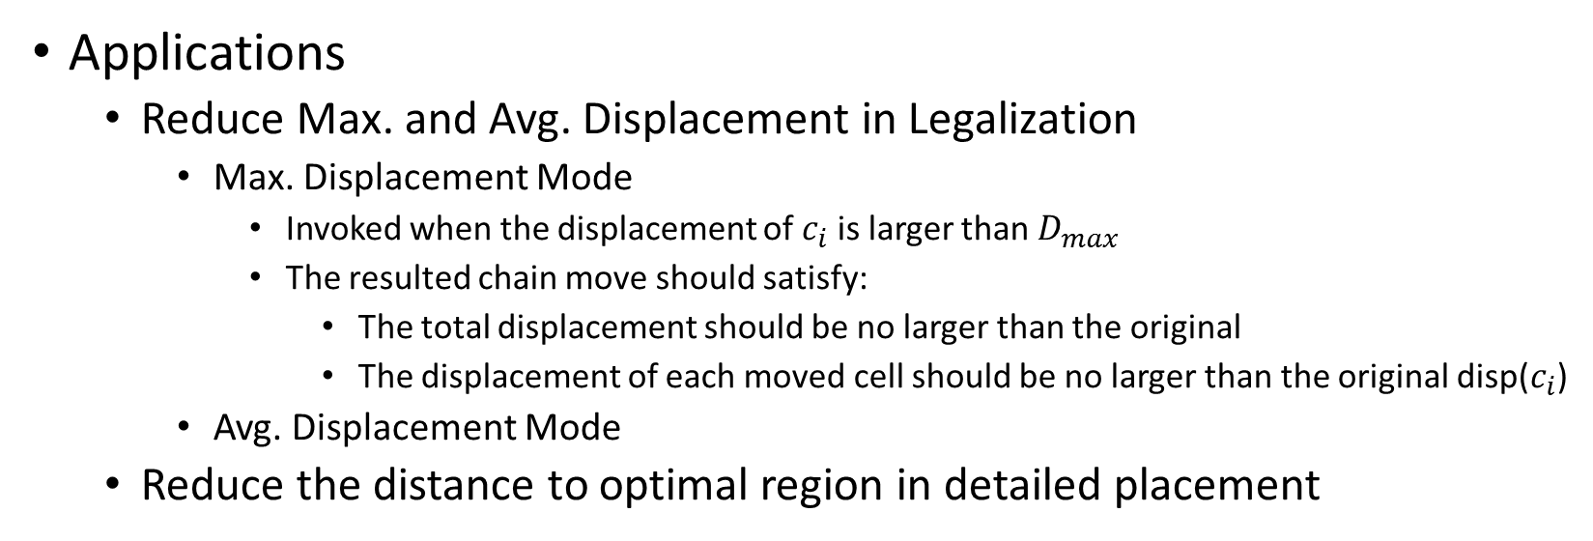
Chain Move
c₈
c₈
c₁
c₂
c₃
c₁
c₂
c₃
c₄
c₅
c₆
c₇
c₄
c₅
c₆
c₇
Applications
Reduce Max. and Avg. Displacement in Legalization
Max. Displacement Mode
Invoked when the displacement of $c_{i}$ is larger than $D_{max}$
The resulted chain move should satisfy:
The total displacement should be no larger than the original
The displacement of each moved cell should be no larger than the original disp($c_{i}$)
Avg. Displacement Mode
Reduce the distance to optimal region in detailed placement
Notes:
As mentioned before, Chain move is used in legalization and detail placement to optimize displacement and wirelength respectively. There are two objectives in legalization, one is max displacement and the other is avg. displacement. Max displacement mode is invoked when the displacement of a cell is larger than a threshold. And the resulted chain move should satisfy the following. … as you can see from the figure.

Slide 19

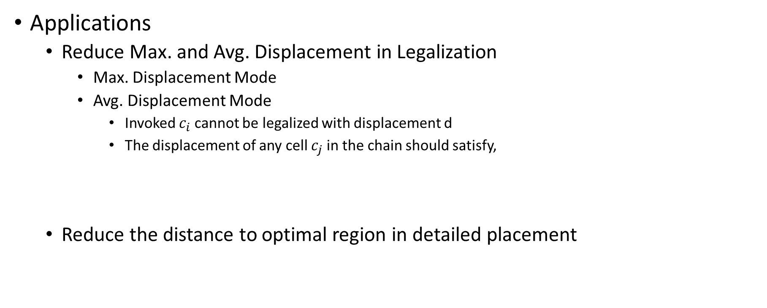
Chain Move
c₂
c₂
c₂
c₂
c₁
c₃
c₄
c₁
c₃
c₄
c₅
c₅
Applications
Reduce Max. and Avg. Displacement in Legalization
Max. Displacement Mode
Avg. Displacement Mode
Invoked $c_{i}$ cannot be legalized with displacement d
The displacement of any cell $c_{j}$ in the chain should satisfy,
Reduce the distance to optimal region in detailed placement

Slide 20
Chain Move
c₀
rgn₀
c₁
rgn₁
c₂
c₃
Applications
Reduce Max. and Avg. Displacement in Legalization
Max. Displacement Mode
Avg. Displacement Mode
Reduce the distance to optimal region in detailed placement
The candidate cells of each cell are those that are in its optimal region
rgn₂

Slide 21
Overview of Our Methods
Two-Step Clock Constraints Legalization
Chain Move
Machine Learning-Based Congestion Estimation

Slide 22
ML-Based Congestion Estimation
Motivation:
More accurate and Less parameter tunings
Previously used congestion estimation methods in FPGAs
Global routers for ASICs
Probabilistic models
Limitations:
Not tailored for FPGAs
A lot of parameters to set
Goals of our methods
Try to mimic the behavior of congestion estimation of design tools from the device company
Assume the congestion estimation from the tool can guide the placement well
Study how to leverage machine learning to build a congestion model on FPGA
Notes:
The last thing I will talk about is machine learning based congestion estimation. The motivation is to develop a congestion estimation method that is…

Slide 23



ML-Based Congestion Estimation
Congestion Model
G-Cells based, each corresponds to a switchbox
Three Features for each G-Cell
Total number of pins of the net covering it
A weighted sum of BB box covering it
Combining the two

Slide 24
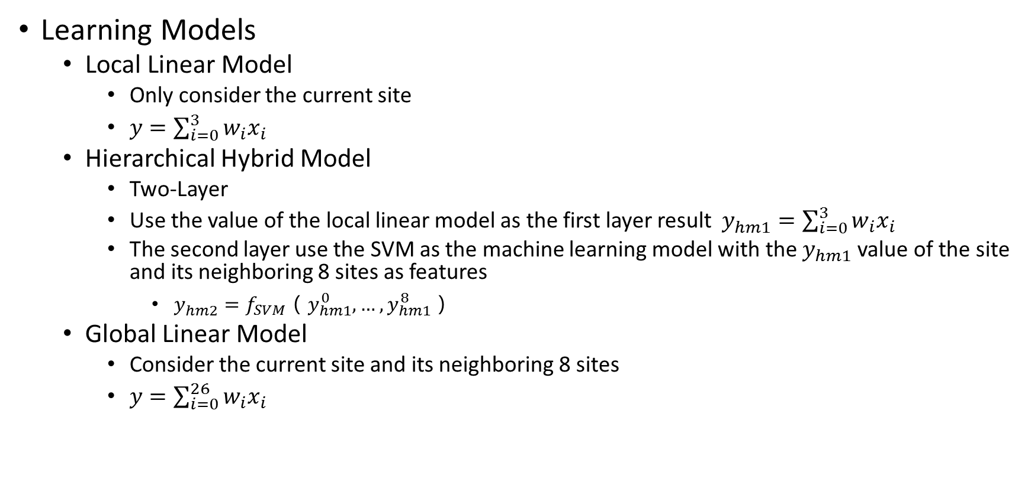
ML-Based Congestion Estimation
Learning Models
Local Linear Model
Only consider the current site
$y=\sum_{i=0}^{3}{w_{i}x_{i}}$
Hierarchical Hybrid Model
Two-Layer
Use the value of the local linear model as the first layer result $y_{hm1}^{}=\sum_{i=0}^{3}{w_{i}x_{i}}$
The second layer use the SVM as the machine learning model with the $y_{hm1}$ value of the site and its neighboring 8 sites as features
$y_{hm2}^{}=f_{SVM}（y_{hm1}^{0}, …,y_{hm1}^{8}）$
Global Linear Model
Consider the current site and its neighboring 8 sites
$y=\sum_{i=0}^{26}{w_{i}x_{i}}$

Slide 25

ML-Based Congestion Estimation
Training Methods
Unified model
One model for all design
Pros: generalize well
Independent model
Different model for different design
Pros: capture the unique characteristics of different design
Ensemble model
Different model for different known design
Ensemble all the known models to generate a model for new designs

Slide 26
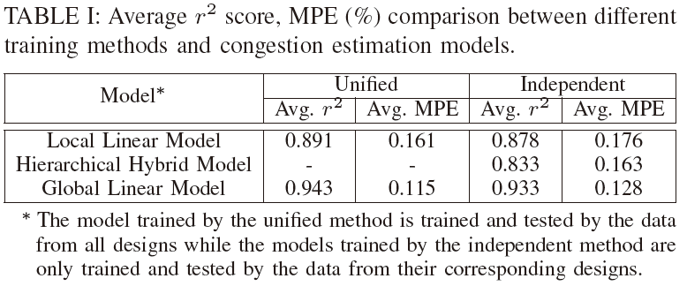
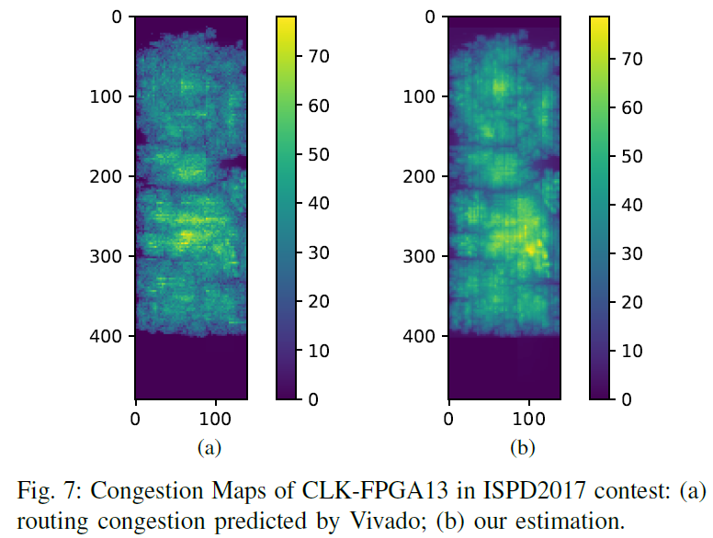
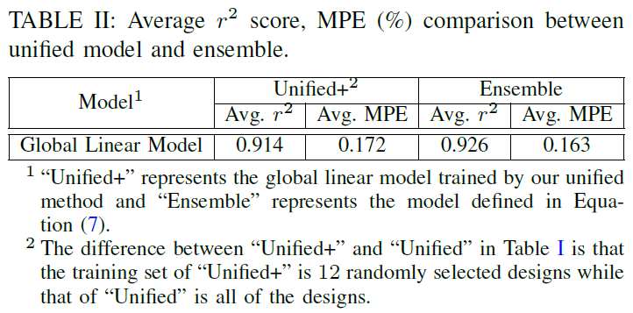
ML-Based Congestion Estimation
Result Analysis
Training Method
Unified is better than independent in our test
Model
Global models are better than local model
Global linear model is best, SVM perform worse
Both unified and ensemble model can generalize well to other designs
Comparison
Global routers for ASICs
Cons: hard to set the routing capacity
Probabilistic models
Cons: only good correlation with the relative congestion level
Machine Learning-Based
Good correlation with the congestion level
Give a better sense of congestion level
Less parameter tuning
Notes:
As you can see from table 1, the unified model actually works better than the independent model. We think this is because that the designs are quite similar to each other. Hence, compared with independent model, unified model won’t lose a lot accuracy due to the difference in design property but can get much more samples in training.
As excepted, the models that consider global information is better than the local linear model. But compared to global linear model, hierarchical hybrid model’s performance is not as good. We thinks the underlining reason is that the prediction generated by the tools is in a linear relationship with the feature we extract. From table 2, you can also see that both the unified and ensemble model can generalize well to other designs.
Compare to other congestion estimation method in FPGAs, our method has a few advantages. Compare to global router, our model don’t need to set the routing capacity. Compared to probabilistic model, our model not only have a good correlation with the relative congestion level but also the absolute congestion level. In practice, our model can give a more direct view to the user about how congest an area is and much less parameter tuning during implementation.

Slide 27
Experimental Result
Design | This Work |  |  |  | 1st Place |  |  |  | 2nd Place |  |  |  | 3rd Place
 | WL | ratio | Time | ratio | WL | ratio | Time | ratio | WL | ratio | Time | ratio | WL | ratio | Time | ratio
CLK-FPGA01 | 2011452 | 1 | 288 | 1 | 2208170 | 1.098 | 530 | 1.84 | 2209328 | 1.098 | 2686 | 9.326 | 2268532 | 1.128 | 2686 | 9.326
CLK-FPGA02 | 2167861 | 1 | 266 | 1 | 2279171 | 1.051 | 521 | 1.959 | 2273729 | 1.049 | 2788 | 10.481 | 2504444 | 1.155 | 2788 | 10.481
CLK-FPGA03 | 5265206 | 1 | 583 | 1 | 5353071 | 1.017 | 1038 | 1.78 | 6229292 | 1.183 | 3740 | 6.415 | 5803110 | 1.102 | 3740 | 6.415
CLK-FPGA04 | 3606567 | 1 | 380 | 1 | 3697950 | 1.025 | 725 | 1.908 | 3817377 | 1.058 | 2850 | 7.5 | 4085670 | 1.133 | 2850 | 7.5
CLK-FPGA05 | 4660136 | 1 | 569 | 1 | 4692356 | 1.007 | 943 | 1.657 | 4995177 | 1.072 | 3164 | 5.561 | 5180916 | 1.112 | 3164 | 5.561
CLK-FPGA06 | 5736998 | 1 | 591 | 1 | 5588507 | 0.974 | 1075 | 1.819 | 5605573 | 0.977 | 3570 | 6.041 | 6216898 | 1.084 | 3570 | 6.041
CLK-FPGA07 | 2325787 | 1 | 304 | 1 | 2444359 | 1.051 | 585 | 1.924 | 2504544 | 1.077 | 3698 | 12.164 | 2676088 | 1.151 | 3698 | 12.164
CLK-FPGA08 | 1778292 | 1 | 247 | 1 | 1885632 | 1.06 | 482 | 1.951 | 1989632 | 1.119 | 2504 | 10.138 | 2057117 | 1.157 | 2504 | 10.138
CLK-FPGA09 | 2530105 | 1 | 327 | 1 | 2601161 | 1.028 | 600 | 1.835 | 2583442 | 1.021 | 3158 | 9.657 | 2813538 | 1.112 | 3158 | 9.657
CLK-FPGA10 | 4495500 | 1 | 512 | 1 | 4464341 | 0.993 | 868 | 1.695 | 4770168 | 1.061 | 2971 | 5.803 | 4839765 | 1.077 | 2971 | 5.803
CLK-FPGA11 | 4189622 | 1 | 455 | 1 | 4182726 | 0.998 | 768 | 1.688 | 4207699 | 1.004 | 2535 | 5.571 | 4777177 | 1.14 | 2535 | 5.571
CLK-FPGA12 | 3387586 | 1 | 409 | 1 | 3368698 | 0.994 | 744 | 1.819 | 3376930 | 0.997 | 3007 | 7.352 | 3739517 | 1.104 | 3007 | 7.352
CLK-FPGA13 | 3833106 | 1 | 441 | 1 | 3815718 | 0.995 | 822 | 1.864 | 3920965 | 1.023 | 3155 | 7.154 | 4320345 | 1.127 | 3155 | 7.154
Average |  | 1 |  | 1 |  | 1.03 |  | 1.84 |  | 1.073 |  | 7.933 |  | 1.126 |  | 7.933
Routed wirelength and running time (s) comparison with the ISPD 2017 contest winners

Slide 28
Experimental Result
Design | w/ CCL |  |  |  | w/o CCL
 | HPWL | ratio | Time | ratio | HPWL | ratio | Time | ratio
CLK-FPGA01 | 1582915 | 1 | 288 | 1 | 1582917 | 1.000 | 276 | 0.958
CLK-FPGA02 | 1577051 | 1 | 266 | 1 | 1577175 | 1.000 | 254 | 0.955
CLK-FPGA03 | 4059162 | 1 | 583 | 1 | 4060708 | 1.000 | 558 | 0.957
CLK-FPGA04 | 2716961 | 1 | 380 | 1 | 2717722 | 1.000 | 367 | 0.966
CLK-FPGA05 | 3532759 | 1 | 569 | 1 | 3533407 | 1.000 | 534 | 0.938
CLK-FPGA06 | 4485498 | 1 | 591 | 1 | 4486401 | 1.000 | 572 | 0.968
CLK-FPGA07 | 1708920 | 1 | 304 | 1 | 1708954 | 1.000 | 293 | 0.964
CLK-FPGA08 | 1355308 | 1 | 247 | 1 | 1354247 | 0.999 | 244 | 0.988
CLK-FPGA09 | 1946225 | 1 | 327 | 1 | 1945948 | 1.000 | 313 | 0.957
CLK-FPGA10 | 3505733 | 1 | 512 | 1 | 3506732 | 1.000 | 499 | 0.975
CLK-FPGA11 | 3270338 | 1 | 455 | 1 | 3270689 | 1.000 | 440 | 0.967
CLK-FPGA12 | 2592324 | 1 | 409 | 1 | 2593721 | 1.001 | 395 | 0.966
CLK-FPGA13 | 2927103 | 1 | 441 | 1 | 2926786 | 1.000 | 420 | 0.952
Average |  | 1.000 |  | 1.000 |  | 1.000 |  | 0.962
Comparison of HPWL and running time (s) before and after applying the two-step clock constraint legalization (CCL)

Slide 29
Experimental Result
Design | RippleFPGA[1] |  | This work
 | WL | ratio | WL | ratio
FPGA01 | 350060 | 1 | 350802 | 1.002
FPGA02 | 635044 | 1 | 634700 | 0.999
FPGA03 | 3251264 | 1 | 3251721 | 1.000
FPGA04 | 5492214 | 1 | 5411107 | 0.985
FPGA05 | 9909270 | 1 | 9911182 | 1.000
FPGA06 | 6144522 | 1 | 6143973 | 1.000
FPGA07 | 9593240 | 1 | 9520252 | 0.992
FPGA08 | 8087931 | 1 | 8036647 | 0.994
FPGA09 | 12062928 | 1 | 12123865 | 1.005
FPGA10 | 6972278 | 1 | 7020054 | 1.007
FPGA11 | 10918250 | 1 | 10462601 | 0.958
FPGA12 | 7239553 | 1 | 7605996 | 1.051
Average |  | 1 |  | 0.999
Routed wirelength comparison between different routing congestion estimation models.
[1] RippleFPGA: A routability driven placement for large-scale heterogeneous FPGAs. ICCAD2016

Slide 30
Conclusion
A two-step displacement-driven legalization is introduced to remove all clock constraint violations with almost neglectable overhead in practice
Chain move is proposed to put a cell into a desired site efficiently
We study the performance of different routability prediction methods in FPGAs which save time in congestion-driven global placement and ease the burden of parameter tuning
All of the above techniques together can achieve 3% shorter wirelength and about 2X runtime compared to ISPD2017 contest winner

Slide 31
Thanks
Notes:
That’s all of my speech. Thank you.

