Slide 1

MARCH: MAze Routing
Under a Concurrent and Hierarchical Scheme
for Buses
Speaker:
Jingsong Chen
Authors:
Jingsong Chen, Ph.D. student, CSE, CUHK
Jinwei Liu, Ph.D. student, CSE, CUHK
Gengjie Chen, Ph.D. student, CSE, CUHK
Dan Zheng, Ph.D. student, CSE, CUHK
Evangeline F. Y. Young, Professor, CSE, CUHK

Slide 2
Outline
Problem Formulation
Our Methodology: MARCH
Experimental Results
Conclusion

Slide 3
Outline
Problem Formulation
Our Methodology: MARCH
Experimental Results
Conclusion

Slide 4
Problem Formulation
Input:
A set of routing layers
With preferred track direction for each layer
With min spacing constraint for each layer
With design boundary for each layer
With a set of obstacles for each layer
A set of routing tracks
With wire width constraint for each track
A set of buses
With a set of bits to be routed on tracks for each bus
With width constraint for each layer for each bus
With pin shapes for each bit in a bus
Pin 0
Pin 1
L₂
Obstacles
Track
L₁
A toy case*
*This case comes from the slides “ICCAD 2018 CAD Contest Problem B Summary” (link: http://iccad-contest.org/2018/)

Slide 5
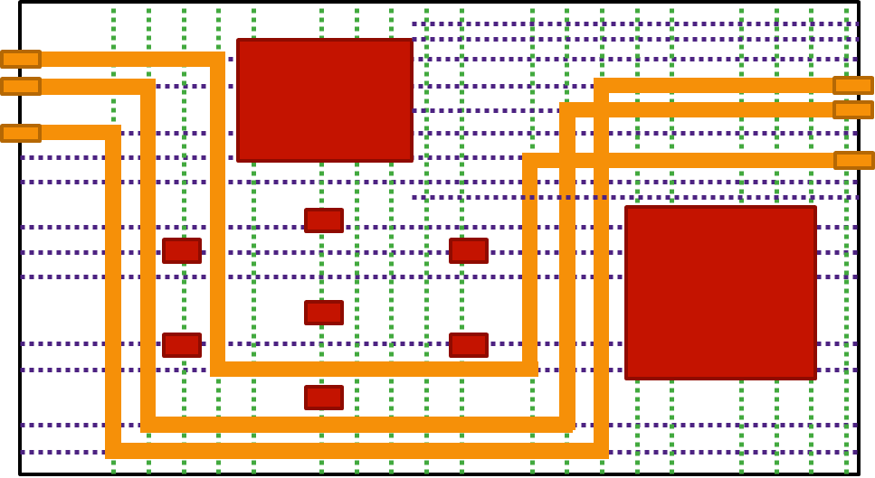
Problem Formulation
Output:
A set of on-track wires and vias that connect pins for all buses
The bits in the same bus must share the exactly same topology
Pin 0
Pin 1
L₂
Wire
Via
L₁
A toy case*
*This case comes from the slides “ICCAD 2018 CAD Contest Problem B Summary” (link: http://iccad-contest.org/2018/)

Slide 6
Problem Formulation
Evaluation rule:
Overall cost consists of routing cost and penalty cost
Routing cost is the summation of :
Wire length cost: shorter -> better
Segment cost: less -> better
Compactness cost: more compact -> better
Better
Worse
Wire length
Segment number
Compactness
Routing cases*
*These cases come from the slides “ICCAD 2018 CAD Contest Problem B Summary” (link: http://iccad-contest.org/2018/)

Slide 7

Problem Formulation
L₁
p₁
p₂
S₁
Evaluation rule:
Overall cost consists of routing cost and penalty cost
Penalty cost is the summation of:
Spacing violation penalty
Routing failure penalty
Wire off-track
Track width violation
Bit open
Topology inconsistency
Spacing constraint*
S₁
$$≥$$
O₁
S₁
S₁
M1
1
M2
1
M3
2
1
2
2
1
2
1
2
1
3
2
2
1
1
2
3
Four types of topology inconsistency
*This figure comes from the slides “ICCAD 2018 CAD Contest Problem B Summary” (link: http://iccad-contest.org/2018/)

Slide 8
Outline
Problem Formulation
Our Methodology: MARCH
Experimental Results
Conclusion

Slide 9
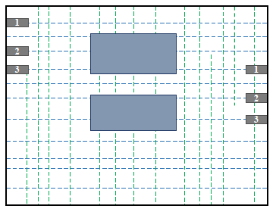
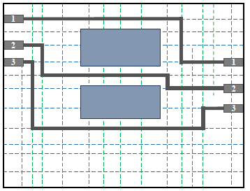
Our Methodology: MARCH
If routing bit by bit:
Advantage: traditional routing methods can be applied naturally.
Disadvantage: topology consistency can hardly be maintained in a relatively complex routing environment.
Pin
Obstacle
M1 Track
M2 Track
Wire

Slide 10
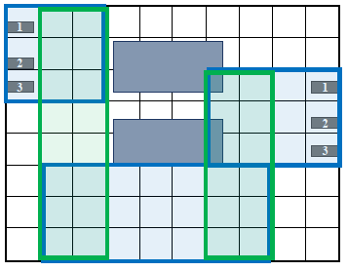
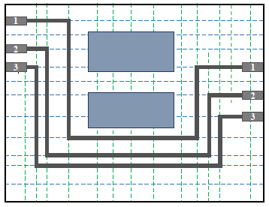
Our Methodology: MARCH
Two key features of MARCH:
Hierarchically: a topology-aware path planning (coarse-grained) and a track assignment for bits (fine-grained).
EFFICIENCY
Concurrently: route all the bits in a bus concurrently.
CORRECT-BY-CONSTRUCTION

Slide 11
Our Methodology: MARCH
Data Structures:
Bus-based Grid Graph (BGG):
A multilayer grid graph with uniform grid cells (G-cells)
A row of G-cells, named frontline, is the propagation unit in routing process.
Each edge stores edge capacity for the bus and history cost.
Track occupancy of each track:
Record the positions of the track segments which cannot be used since:
Occupied by obstacles
Occupied by the routed wires of the other buses
frontline
t5
Edge
e1
e2
e3
t4
Obstacle
t3
Track
spacing constraint
t2
Routed Wire
e5
e6
Occupied by Obstacle
e4
t1
Occupied by Routed Wire
Track occupancy of t1

Slide 12
Our Methodology: MARCH
Bus
Info
Track Info
Obstacle Info
The overall flow of MARCH:
Initialization
Construct a BGG with empty edge capacities
Inner loop for each bus b:
Update the BGG for b:
Edge capacities meeting width constraint
Pin locations
Generate a routing path consisting of a set of rectangular regions in topology-aware path planning (TAP)
Assign the track segments to the bits within each rectangular region in track assignment for bits (TAB)
Update the track occupancies of all the tracks by the routed b
Outer loop for rip-up and reroute (RR):
Add history cost to the edge of BGG
Enlarge the frontline size
Initialization
Bus-based Grid Graph (BGG) Update
Topology-aware Path Planning (TAP)
Track Assignment for Bits (TAB)
Track Occupancy Update
All Buses Routed?
N
Y
Evaluation & Best Solution Update
Need Rip-up and Reroute (RR)?
Y
N
Final Solution

Slide 13
Our Methodology: MARCH
Pin 0
Topology-aware Path Planning (TAP):
Same layer propagation
Layer switching
Build routing paths for multi-pin buses
frontline F1
Pin 2
Pin 1

Slide 14
Our Methodology: MARCH
frontline F2
Pin 0
Topology-aware Path Planning (TAP):
Same layer propagation:
Propagate the frontline along the track direction (F1 -> F2)
Generate a TAP region (T1)
Maintain running capacity which will only decrease when some tracks are broken midway
TAP region T1
frontline F1
Pin 2
Pin 1
F2
T1
F1
running capacity
F1 -> F2
(3, 2) -> (2, 1)

Slide 15
Our Methodology: MARCH
frontline F3
frontline F2
Pin 0
Topology-aware Path Planning (TAP):
Layer switching:
Go from one layer to its upper layer or lower layer (F2 on L₃ -> F3 on L₂) through a switching node
node N3
L₃
L₂
Pin 2
Pin 1
L₁

Slide 16
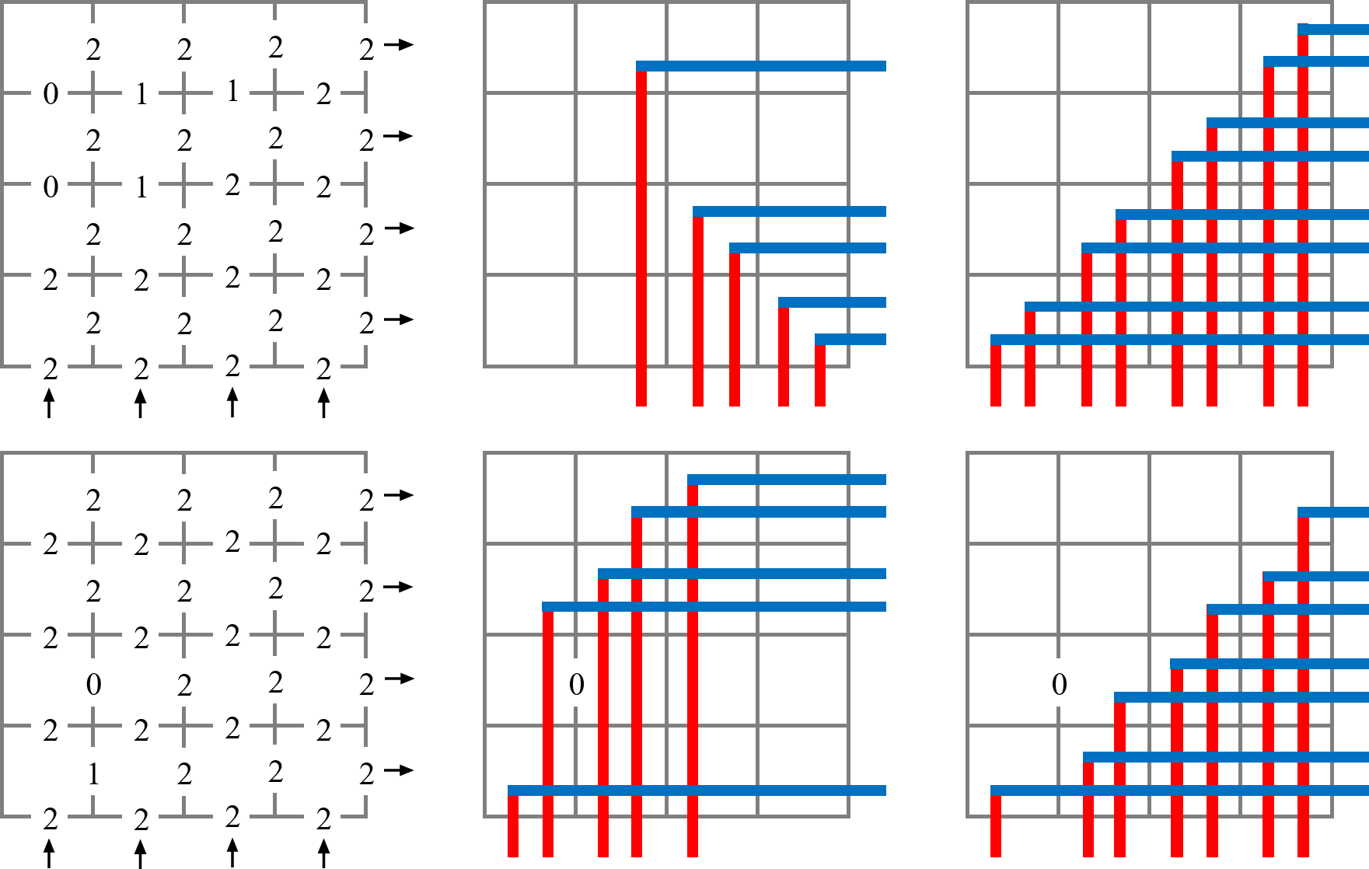
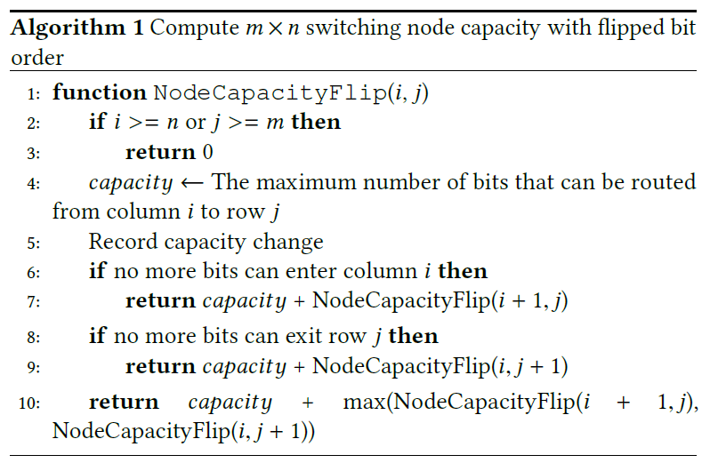
Our Methodology: MARCH
Topology-aware Path Planning (TAP):
Layer switching:
Go from one layer to its upper layer or lower layer (F2 on L₃ -> F3 on L₂)
Compute the max number of bits that can pass through the node
Without any bottleneck edge: trivial
With bottleneck edge(s):
With bit order unchanged:
Solved by a greedy method
With bit order changed:
Solved by the right recursive algorithm
The efficiency can be guaranteed by pruning

Slide 17
Our Methodology: MARCH
Pin 0
Topology-aware Path Planning (TAP):
Build routing paths for multi-pin buses:
Find the path between the source pin and one of the sink pins through the propagation from the source pin
Start the propagation from the current path to connect to the next pin
Repeat this process until all the pins are connected
TAP region T1
Pin 2
Pin 1
TAP region T2
TAP region T3
Pin 0
Pin 1

Slide 18
Our Methodology: MARCH
Track Assignment for Bits (TAB)
Track segment range estimation:
By determining the column/row of G-cells where the bit will be routed
Estimated Track Segment Range
TAP Region on L1
Actual Routed Wires Segment
TAP Region on L2
Obstacle on M2
Occupied by Obstacle
T3
bit4
bit3
T2
bit2
bit1
T1

Slide 19
Our Methodology: MARCH
Track Assignment for Bits (TAB)
Track segment range estimation:
By determining the column/row of G-cells where the bit will be routed
Exact track selection:
Three conditions:
Satisfy the width constraint
Have long enough track segment
With as less as possible spacing violations
Estimated Track Segment Range
TAP Region on L1
Actual Routed Wires Segment
TAP Region on L2
Obstacle on M2
Occupied by Obstacle
T3
t7
bit4
t6
bit3
t5
T2
t4
bit2
t3
t2
t1
bit1
T1

Slide 20
Our Methodology: MARCH
Track Assignment for Bits (TAB)
Track segment range estimation:
By determining the column/row of G-cells where the bit will be routed
Exact track selection:
Three conditions:
Satisfy the width constraint
Have long enough track segment
With less spacing violations
Exact track segment range assignment
See the actual routed wires
Estimated Track Segment Range
TAP Region on L1
Actual Routed Wires Segment
TAP Region on L2
Obstacle on M2
Occupied by Obstacle
T3
t7
bit4
t6
bit3
t5
T2
t4
bit2
t3
t2
t1
bit1
T1

Slide 21
Our Methodology: MARCH
Rip-up and Reroute Scheme (RR):
Add history cost to the edge of BGG:
To eliminate the congested regions on the BGG
hnew = α · nvio + β · hold where nvio is the number of spacing violations on the edge, and α and β are weights.
Enlarge the frontline size:
To handle the insufficiency of violation-free routing resources
Enlarge the frontline size of the bus by 1 on the layer where:
The number of spacing violations in a TAP region is larger than the bit number in 2 successive RR iterations.

Slide 22
Outline
Problem Formulation
Our Methodology: MARCH
Experimental Results
Conclusion

Slide 23
Experimental Results
 | Characteristics |  |  |  | Metric Weights
 | bus no. | net no. | layer no. | track no. | wwire | wseg | wcom | wspace | wfail
beta1 | 34 | 1260 | 3 | 49209 | 5 | 1 | 5 | 8 | 2000
beta2 | 26 | 1262 | 3 | 49209 | 5 | 1 | 5 | 8 | 2000
beta3 | 60 | 665 | 3 | 22732 | 12 | 1 | 4 | 8 | 2000
beta4 | 62 | 698 | 3 | 22732 | 12 | 1 | 4 | 8 | 2000
beta5 | 6 | 1964 | 4 | 54150 | 8 | 1 | 5 | 8 | 2000
final1 | 18 | 1032 | 3 | 81226 | 10 | 1 | 5 | 10 | 2000
final2 | 70 | 1285 | 3 | 14209 | 10 | 1 | 5 | 10 | 2000
final3 | 47 | 852 | 4 | 21379 | 10 | 1 | 5 | 10 | 2000

Slide 24
Experimental Results
 | First Place |  |  |  |  | Second Place |  |  |  |  | Third Place |  |  |  |  | MARCH
 | Croute | Cspace | Cfail | Ctotal | Time (s) | Croute | Cspace | Cfail | Ctotal | Time (s) | Croute | Cspace | Cfail | Ctotal | Time (s) | Croute | Cspace | Cfail | Ctotal | Time (s)
beta1 | 689 | 280 | 0 | 969 | 3600 | 701 | 5096 | 0 | 5797 | - | 641 | 8744 | 4000 | 13385 | - | 765 | 0 | 0 | 765 | 50
beta2 | 515 | 760 | 0 | 1275 | 3600 | 563 | 4904 | 0 | 5467 | - | 484 | 9472 | 2000 | 11956 | - | 578 | 0 | 0 | 578 | 9
beta3 | 1936 | 0 | 0 | 1936 | 71 | 2024 | 0 | 0 | 2024 | - | 1999 | 1928 | 0 | 3927 | - | 1942 | 0 | 0 | 1942 | 72
beta4 | 2192 | 0 | 0 | 2192 | 64 | 2271 | 0 | 0 | 2271 | - | 2250 | 1048 | 0 | 3298 | - | 2165 | 0 | 0 | 2165 | 39
beta5 | 119 | 1848 | 0 | 1967 | 3600 | 95 | 616 | 2000 | 2711 | - | 98 | 1216 | 2000 | 3314 | - | 118 | 1848 | 0 | 1966 | 12
final1 | 327 | 830 | 2000 | 3157 | 3317 | 367 | 2750 | 2000 | 5117 | - | 252 | 0 | 10000 | 10252 | - | 356 | 840 | 0 | 1196 | 352
final2 | 1824 | 4500 | 8000 | 14324 | 3600 | 1890 | 2990 | 8000 | 12880 | - | 1976 | 6910 | 0 | 8886 | - | 2071 | 1480 | 0 | 3551 | 199
final3 | 2966 | 490 | 10000 | 13456 | 3600 | 2678 | 300 | 2000 | 4978 | - | 4238 | 20 | 24000 | 28258 | - | 3313 | 150 | 0 | 3463 | 133
Avg. Ratio |  |  |  | 2.130 | 105.45 |  |  |  | 3.731 | - |  |  |  | 7.832 | - |  |  |  | 1.000 | 1.000
*The scores of top 3 teams of IC/CAD 2018 contest are provided by the contest organizer. A binary is also obtained from the first place to get its runtime information.

Slide 25
Outline
Problem Formulation
Our Methodology: MARCH
Experimental Results
Conclusion

Slide 26
Conclusion
We propose MARCH for bus routing:
Have a hierarchical framework (TAP & TAB) for efficiency
Route all the bits of a bus concurrently for topology consistency
Apply a RR scheme to reduce the routing congestion
Performance compared with the top contest teams
Reduce spacing violations greatly
Avoid any routing failure
Have competitive routing costs
Have a much shorter runtime

Slide 27
Thank you for attention!

Slide 28
Q & A

