Slide 1
A Dynamic Array of Sub-Array Architecture for Hybrid Beamforming in the Terahertz Band
Longfei Yan, Chong Han, and Jinhong Yuan
Terahertz Wireless Communications laboratory
Shanghai Jiao Tong University
Email: longfei.yan@sjtu.edu.cn
Website: http://umji.sjtu.edu.cn/~chan/

Slide 2
Outline
Beamforming in the THz band
Hybrid (digital + analog)
The Dynamic Array of Sub-Array (DAoSA) Hybrid Beamforming Architecture
Summary

Slide 3
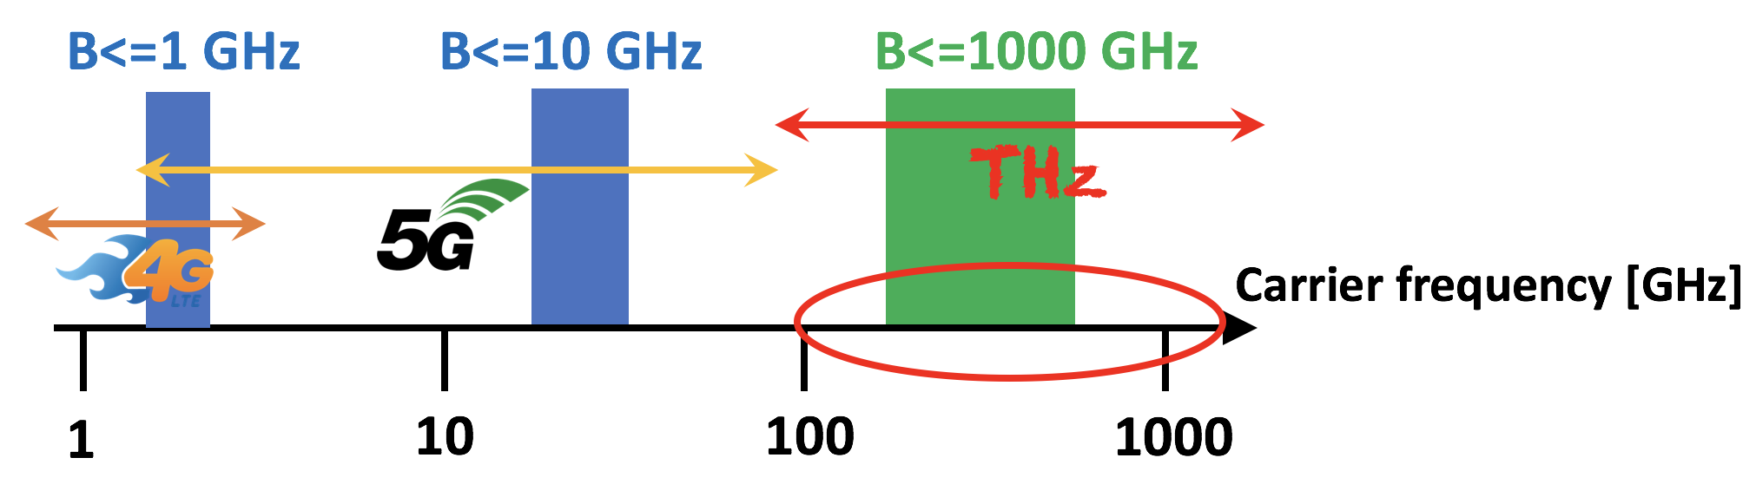
The Terahertz Band
Right after the mm-waves: from 0.1 to 10 THz
Provides huge bandwidth: multiple GHz and even THz
100 Gbps or even 1 Tbps is possible
Notes:
Instead, lets take a look at the THz band, which lies right after the mm-wave. THz band is from 0.1 to 10 THz. It can provide multiple GHz and even THz bandwidth. This huge bandwidth of terahertz spectrum makes Tbps wireless link possible.

Slide 4
Distance Challenge
I. F. Akyildiz, C. Han*, and S. Nie,
“Combating the Distance Problem in the Millimeter Wave and Terahertz Frequency Bands”,
IEEE Communications Magazine, 2018
Distance limitation: a major challenge at THz frequencies is posed by the very high propagation loss
Reasons:
Spreading loss
Molecular absorption loss
Reflection and scattering loss
Notes:
Spreading loss: increases quadratically with the frequency, as defined by Friis’ law
Molecular absorption loss: part of the wave energy is converted into internal kinetic energy of the medium molecules (e.g., water-vapor)
Reflection and scattering loss: rough surface scattering arises with tens of dB losses

Slide 5
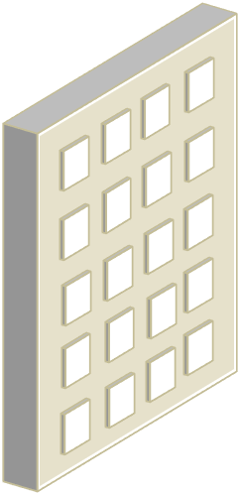
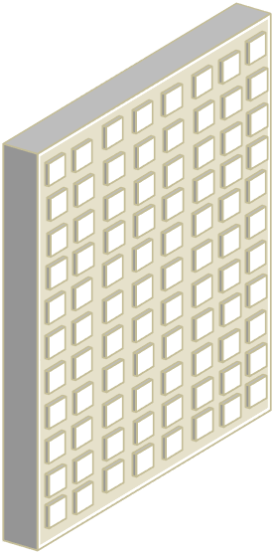
Ultra-Massive MIMO
Frequency: f ↑
Smaller wavelength
More antennas
Number of antennas: N ↑
THz: f=1 THz, λ=0.3mm → Ultra-Massive MIMO, e.g., 256, 512 or even 1024 antennas at transmitter and receiver
How can we use these ultra-massive antennas to get benefits?
One solution is beamforming!

Slide 6
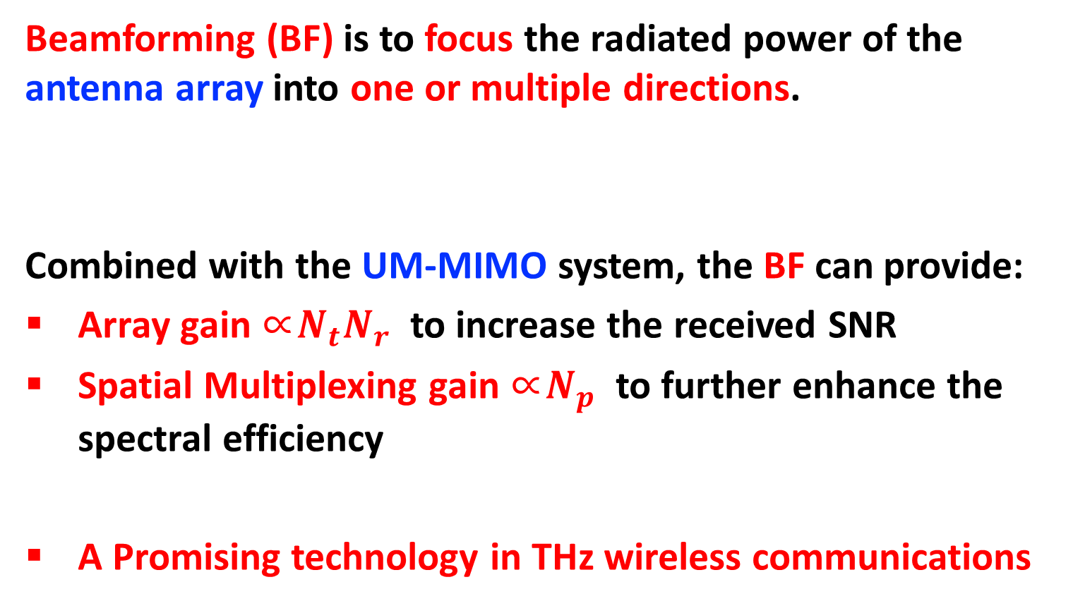
Beamforming
Beamforming (BF) is to focus the radiated power of the antenna array into one or multiple directions.
Combined with the UM-MIMO system, the BF can provide:
Array gain ∝${N_{t}N}_{r }$ to increase the received SNR
Spatial Multiplexing gain ∝$N_{p }$ to further enhance the spectral efficiency
A Promising technology in THz wireless communications

Slide 7






Why hybrid?
Digital beamforming: hardware & power consumption ✘
DAC
RF
Chain
RF
Chain
ADC
.
.
.
.
.
.
FPGA
+
DSP
Channel
Matrix
.
.
FPGA
+
DSP
.
.
.
.
.
.
.
.
.
.
$$N_{t}$$
$$N_{t}$$
$$N_{r}$$
$$N_{r}$$
$$N_{s}$$
$$N_{s}$$
DAC
RF
Chain
RF
Chain
ADC
digital precoder
digital combiner

Slide 8


Why hybrid?
Analog beamforming: performance & only single data stream ✘
.
.
.
.
.
Channel
Matrix
.
RF
Chain
$$N_{r}$$
Baseband
DAC
$$N_{t}$$
RF
Chain
ADC
Baseband
analog precoder
analog combiner

Slide 9
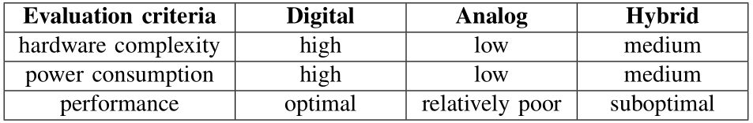








Why hybrid?
Hybrid analog and digital beamforming:
DAC
RF
Chain
RF
Chain
ADC
FPGA
+
DSP
.
Analog
signal
processing
Analog
signal
processing
.
FPGA
+
DSP
.
.
.
.
.
.
.
.
.
Channel
Matrix
.
.
.
.
$$L_{t}$$
.
.
$$L_{r}$$
.
$$N_{s}$$
$$N_{s}$$
RF
Chain
$$N_{t}$$
$$N_{r}$$
RF
Chain
DAC
ADC
digital precoder
analog precoder
analog combiner
digital combiner
$${1≤L}_{t}≪ N_{t}$$
$${1≤L}_{r}≪ N_{r}$$

Slide 10






Fully-Connected (FC)
DAC
RF
Chain
RF
Chain
ADC
FPGA
+
DSP
.
.
FPGA
+
DSP
.
.
.
Channel
Matrix
.
.
.
.
.
.
.
.
.
.
$$L_{t}$$
.
.
$$L_{r}$$
$$N_{s}$$
$$N_{s}$$
.
RF
Chain
$$N_{t}$$
$$N_{r}$$
RF
Chain
ADC
DAC
digital precoder
analog precoder
analog combiner
digital combiner
Each RF chain connects to all antennas through phase shifters.
The spectral efficiency can approach that of the digital beamforming.
O. E. Ayach, S. Rajagopal, S. Abu-Surra, Z. Pi, and R. W. Heath, “Spatially Sparse Precoding in Millimeter Wave MIMO Systems,” IEEE Trans. Wireless Commun, vol. 13, no. 3, pp. 1499–1513, March 2014.

Slide 11










Array of Sub-array (AoSA)
. . .
. . .
RF
Chain
$$N_{t}/L_{t}$$
$$N_{r}/L_{r}$$
RF
Chain
DAC
ADC
.
FPGA
+
DSP
.
.
.
.
FPGA
+
DSP
.
.
.
.
Channel
Matrix
.
.
.
.
.
.
.
.
.
$$N_{s}$$
$$L_{t}$$
$$N_{t}$$
$$N_{r}$$
. . .
$$L_{t}$$
$$N_{s}$$
. . .
$$N_{r}/L_{r}$$
RF
Chain
$$N_{t}/L_{t}$$
RF
Chain
DAC
ADC
digital precoder
analog precoder
analog combiner
digital combiner
Each RF chain only connects to a sub-array through phase shifters.
Poor performance on spectral efficiency.
R. W. Heath and N. G.-P. et al, “An Overview of Signal Processing Techniques for Millimeter Wave MIMO Systems,”
IEEE J. Sel. Topics Signal Process, vol. 10, no. 3, pp. 436–453, April 2016.

Slide 12
FC and AoSA architectures
FC and AoSA
 | Power consumption | Spectral efficiency
FC | Higher | Better
AoSA | Lower | poorer
Sacrifice either power consumption or spectral efficiency
Can we achieve a comparable spectral efficiency compared with FC while consuming much less energy?
Our solution: The dynamic array of sub-array (DAoSA) architecture

Slide 13
Outline
Beamforming in the THz band
Hybrid (digital + analog)
The Dynamic Array of Sub-Array (DAoSA) Hybrid Beamforming Architecture
Summary

Slide 14
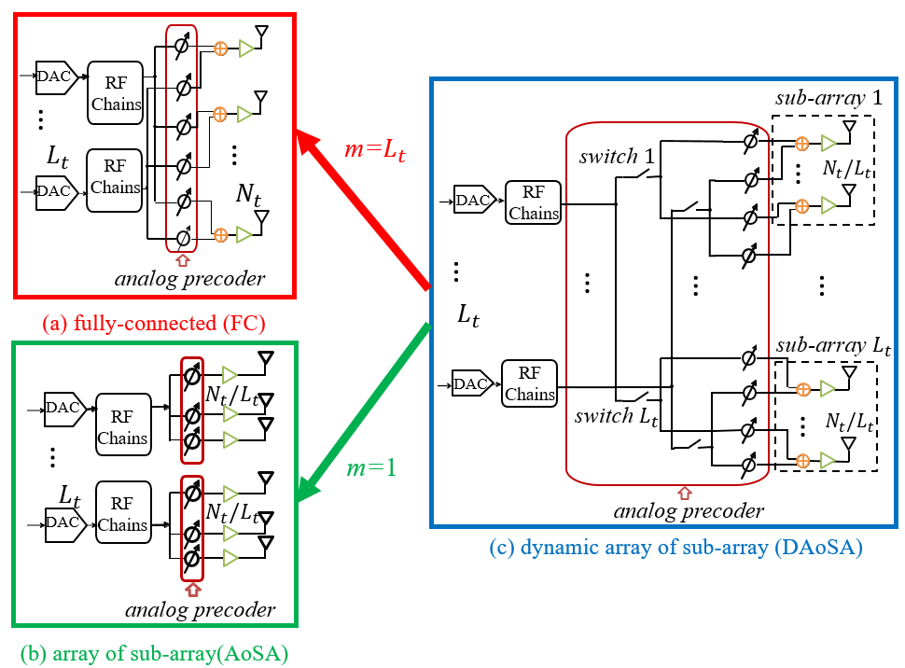
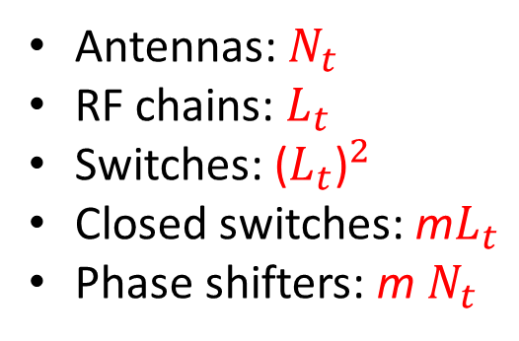
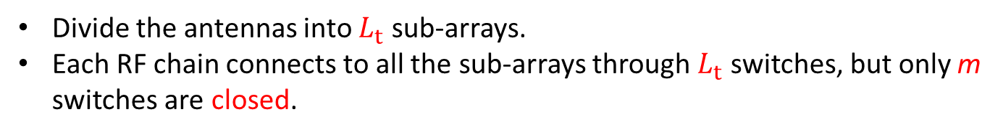
Dynamic Array of Sub-Array
Antennas: $N_{t}$
RF chains: $L_{t}$
Switches: ${\text{(}L_{t}\text{)}}^{2}$
Closed switches: m$L_{t}$
Phase shifters: m $N_{t}$
Divide the antennas into $L_{t}$ sub-arrays.
Each RF chain connects to all the sub-arrays through $L_{t}$ switches, but only m switches are closed.

Slide 15
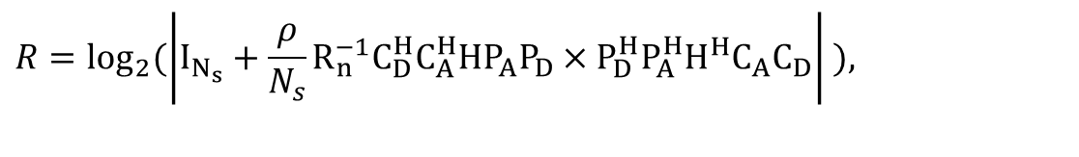
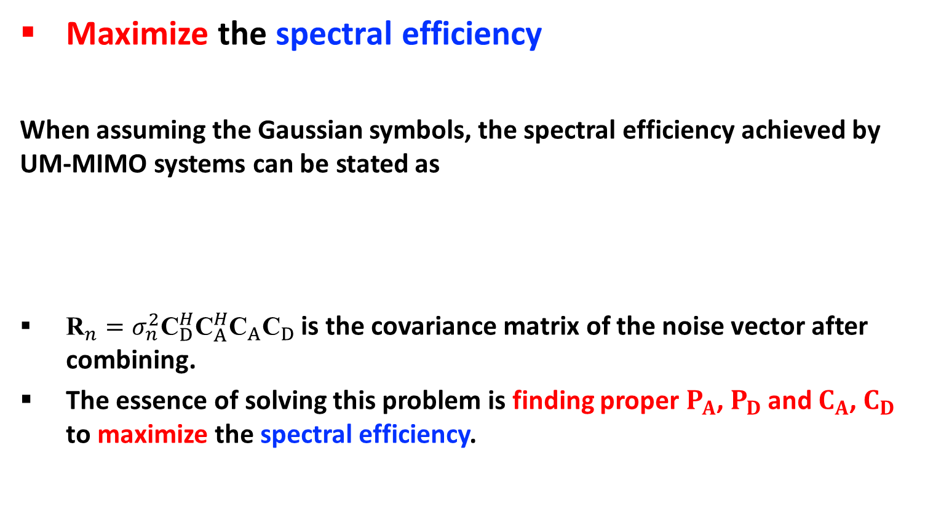
Problem Formulation
Maximize the spectral efficiency
When assuming the Gaussian symbols, the spectral efficiency achieved by UM-MIMO systems can be stated as
${\text{R}}_{n}=σ_{n}^{2}{\text{C}}_{D}^{H}{\text{C}}_{A}^{H}{\text{C}}_{A}{\text{C}}_{D}$ is the covariance matrix of the noise vector after combining.
The essence of solving this problem is finding proper $P_{A}$, $P_{D}$ and $C_{A}$, $C_{D}$ to maximize the spectral efficiency.
$$R=\text{lo}{\text{g}}_{2}(\left|\left.I_{N_{s}}+\frac{ρ}{N_{s}}R_{n}^{−1}C_{D}^{H}C_{A}^{H}HP_{A}P_{D}×P_{D}^{H}P_{A}^{H}H^{H}C_{A}C_{D}\right|\right. ),$$
Notes:
After introducing the J2SMB system and the architecture, we are interested about the problem formulation and the solution of J2SMB system.

Slide 16
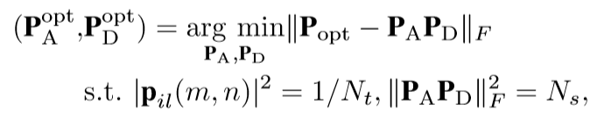
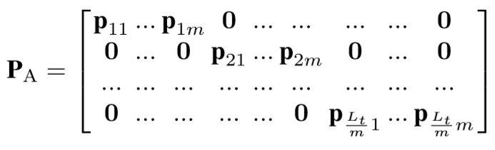

Optimization Solution
Put the receiver optimal then optimize the transmitter side.
After designing the transmitter side, the receiver side can be designed as the same method.
$P_{A}$ and $P_{D}$ can be solved by
Notes:
However, the joint optimization about transmitter and receiver is extremely difficult. To simplify the optimization process, first we make the assumption that the receiver is optimal so that we can focus on the design of transmitter. After determining the $P_{A}$ and $P_{D}$, we solve the $C_{A}$ and $C_{D}$. The optimization about transmitter and receiver is similar, so we give the optimization solution of $P_{A}$ and $P_{D}$ as an example and omit the optimization at receiver.

Slide 17
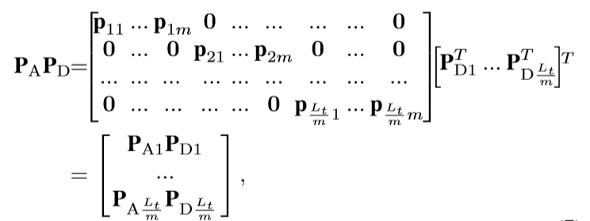

Optimization Solution
One intractable DAoSA problem has been decomposed into multiple tractable FC problems.
We just need to solve these FC problems one by one and then compose the ultimate solution.
Notes:
However, the joint optimization about transmitter and receiver is extremely difficult. To simplify the optimization process, first we make the assumption that the receiver is optimal so that we can focus on the design of transmitter. After determining the $P_{A}$ and $P_{D}$, we solve the $C_{A}$ and $C_{D}$. The optimization about transmitter and receiver is similar, so we give the optimization solution of $P_{A}$ and $P_{D}$ as an example and omit the optimization at receiver.

Slide 18

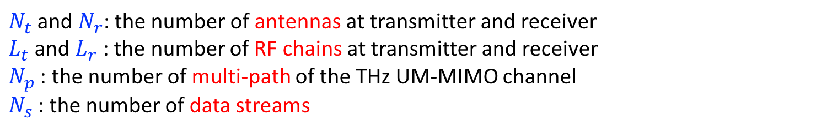
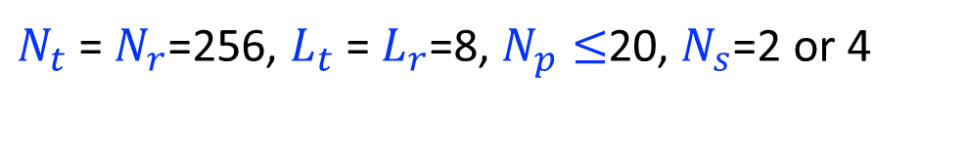
Performance Evaluation
Simulation parameters
$N_{t}$ = $N_{r}$=256, $L_{t}$ = $L_{r}$=8, $N_{p}≤$20, $N_{s}$=2 or 4
$N_{t}$ and $N_{r}$: the number of antennas at transmitter and receiver
$L_{t}$ and $L_{r}$ : the number of RF chains at transmitter and receiver
$N_{p}$ : the number of multi-path of the THz UM-MIMO channel
$N_{s}$ : the number of data streams
Notes:
Nt and Nr are the number of transmit antennas and receive antennas respectively. Lt and Lr are the number of RF chains at transmitter and receiver. Nray is the number of paths which make up the channel matrix H. m and n are the dynamic parameters of the DAoSA architecture.

Slide 19
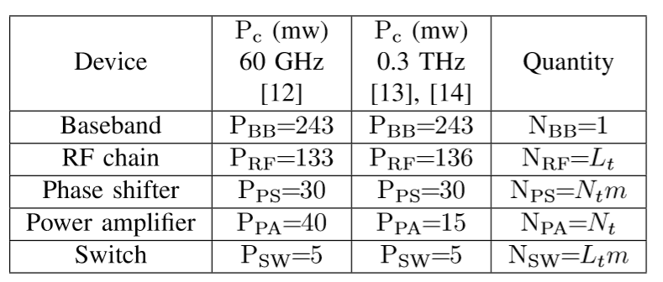
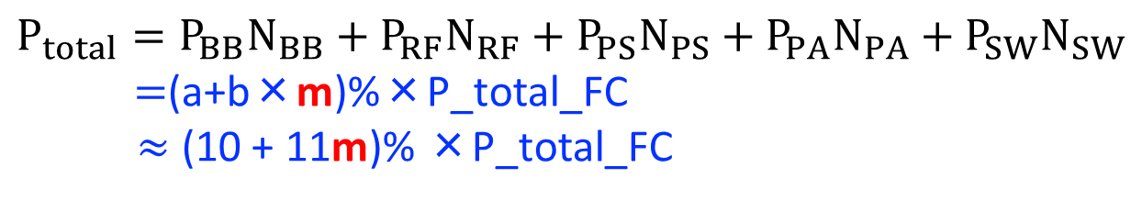
Power Consumption
$$P_{total}=P_{BB}N_{BB}+P_{RF}N_{RF}+P_{PS}N_{PS}+P_{PA}N_{PA}+P_{SW}N_{SW}$$
$=$(a+b×m)%×P_total_FC
$≈$ (10 + 11m)% ×P_total_FC

Slide 20
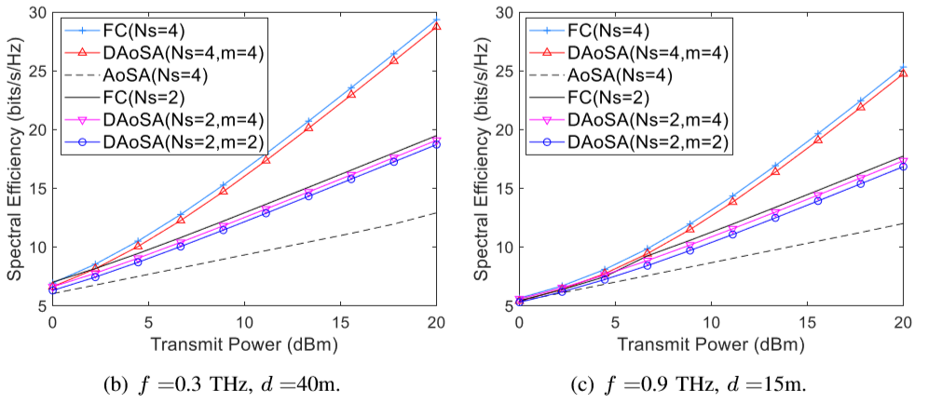
Spectral efficiency
DAoSA(Ns=4,m=4): similar SE, consume only 54% power
DAoSA(Ns=2, m=2):similar SE, consume only 32% power
(10 + 11m)% ×P_total_FC
The spectral efficiency of DAoSA is fairly closed to that of the FC and much higher than the AoSA.

Slide 21
Outline
Beamforming in the THz band
Hybrid (digital + analog)
The Dynamic Array of Sub-Array (DAoSA) Hybrid Beamforming Architecture
Summary

Slide 22
Summary
Through selecting m intelligently, the spectral efficiency of DAoSA architecture is fairly closed to that of the FC, while consuming less power.
Compared with the AoSA architecture, the substantially higher spectral efficiency makes DAoSA more appealing.

Slide 23
Mr. Longfei Yan
University of Michigan-Shanghai Jiao Tong University Joint Institute
Shanghai Jiao Tong University
Shanghai, 200240, China
Email: longfei.yan@sjtu.edu.cn
Website: http://umji.sjtu.edu.cn/~chan/

Slide 24

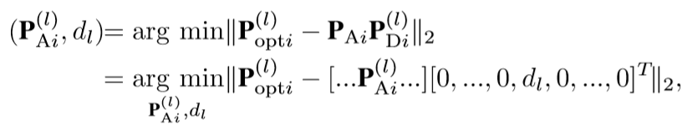
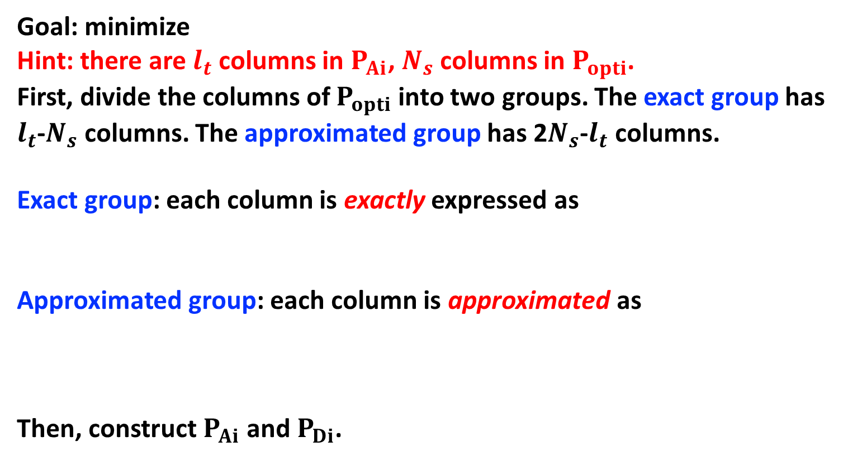
CBC algorithm
Goal: minimize
Hint: there are $l_{t}$ columns in $P_{Ai}$, $N_{s}$ columns in $P_{opti}$.
First, divide the columns of $P_{opti}$ into two groups. The exact group has $l_{t}$-$N_{s}$ columns. The approximated group has 2$N_{s}$-$l_{t}$ columns.
Exact group: each column is exactly expressed as
Approximated group: each column is approximated as
Then, construct $P_{Ai}$ and $P_{Di}$.

