Slide 1
S3-07
Spatial-temporal Programmable Metasurface for Single Channel Radiation
C. Li¹, Z. Yu¹, Y. Shen², R. Cai¹, and X. Lu¹
¹UM-SJTU Joint Institute, Shanghai Jiao Tong University, Shanghai, China
²School of Electronics and Information Technology, Sun Yat-sen University, Guangzhou, China
1

Slide 2
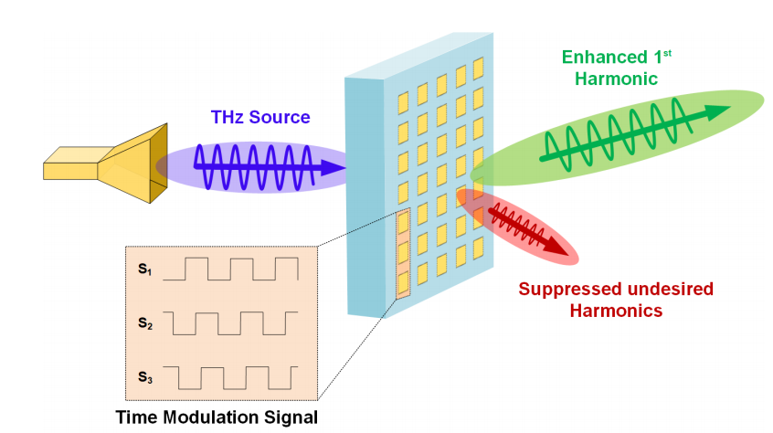
Introduction
Unit Cell Design
Harmonic Suppression Theory
Simulation Result
Conclusion and Discussion
Outline
2

Slide 3
Introduction
2

Slide 4
Unit Cell Design
2

Slide 5
Harmonic Suppression Theory
2

Slide 6
Simulation Result
2

Slide 7
Conclusion
2

Slide 8
Discussion
2

Slide 9
Reference
2

Slide 10
Q & A
2

Slide 11
Thank You
2

Slide 12
Spatial-temporal Programmable Metasurface for Single Channel Radiation

Slide 13
Background
Unit Cell Design
Harmonic Suppression Theory, （耦合，固定一者周边不是复制，观察变化，仿真， spacing的变化导致系数的变化， 开关瞬间、噪声的影响，时间抖动影响）
Simulation Result
Conclusion and Discussion

Slide 14
Background，参照bilibili

Slide 15
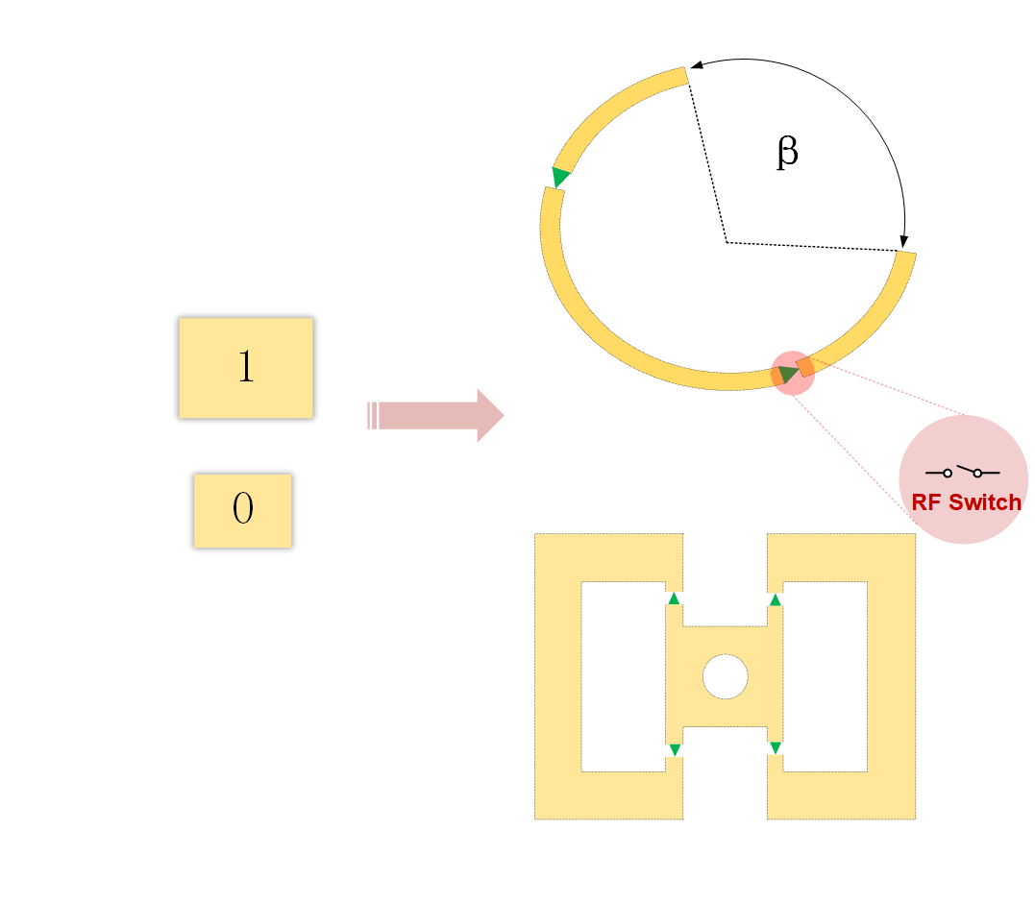
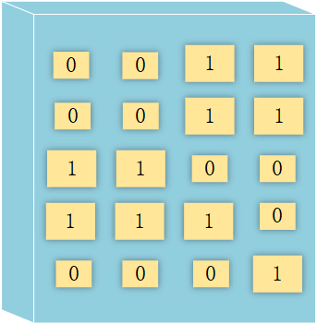
Coding metasurface
Programmable metasurface
Coding sequence设计容易，原理成熟，排布模式的推导容易。制造便捷，便宜，无源无控制系统
散射模式固定，或许可以拼装，但大多低频。好处是，设计起来容易，尺寸太大
设计开关以获得需要的状态（phase,amplitude, polarization）。用FPGA编码超表面。
灵活，任意控制
设计与制造困难。Hard to achieve continously tunable phase，面临Phase granularity and radiation efficiency
的trade off，multilayer？

Slide 16
Spatial-temporal Programmable Metasurface
引入第四个变量，解决连续编码的限制
实现相位的控制的同时，减小损耗
单层材料的调相理论极限
可调节的相位比特数越多，损耗越大，波束赋形效果越好，但是传输距离变短了。
时间上的调控引入了更多的谐波，所以需要采取手段消除谐波

Slide 17
应用
谐波消除 高效通信 波束赋形 space- and frequency-division multiplexing
可移植，多用途，灵活高效the flexibility for installation, and low cost

Slide 18
Unit Cell Design

Slide 19
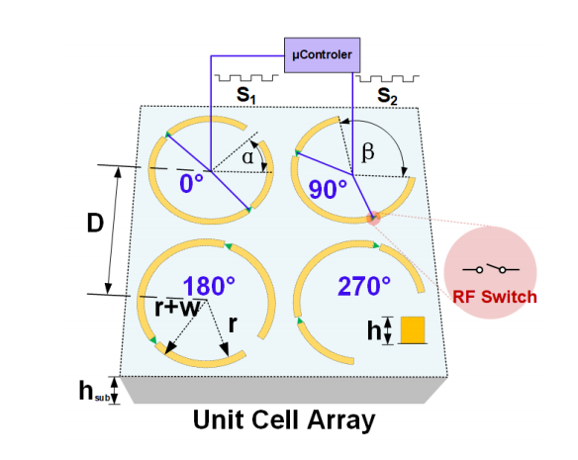
Four 1-bit elements Five States one off state 低透过率 four on states 高透过率并提供四种相位变化来替代phase shifters 8 pin diodes，由高速FPGA控制

Slide 20
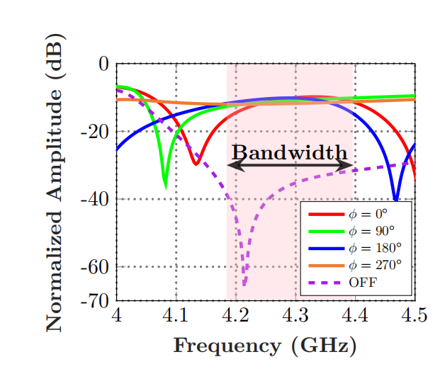
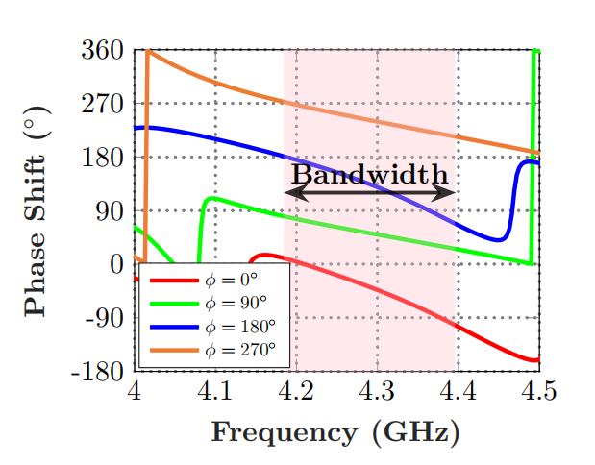
Phase and Amplitude modulation
S21 parameter
4.3GHz, 200MHz bandwidth D=lambda/8
On-off ratio > 20dB, average 27.6dB
Transmittance > -12dB, off state < -30dB
Relative phase error less than 10 \deg

Slide 21
Harmonic Suppression Theory

Slide 22

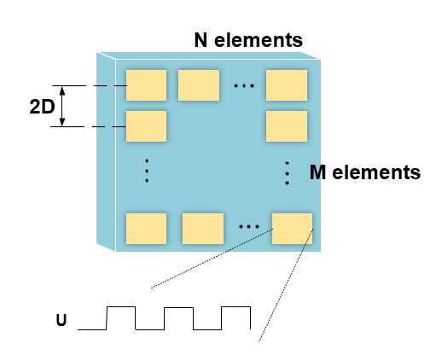
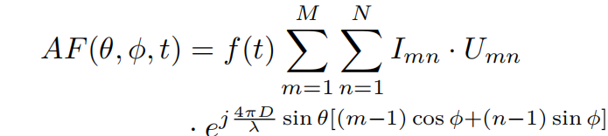
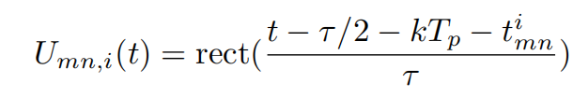
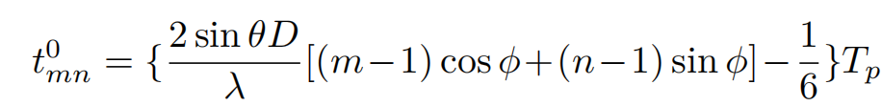
Phased Array

Slide 23
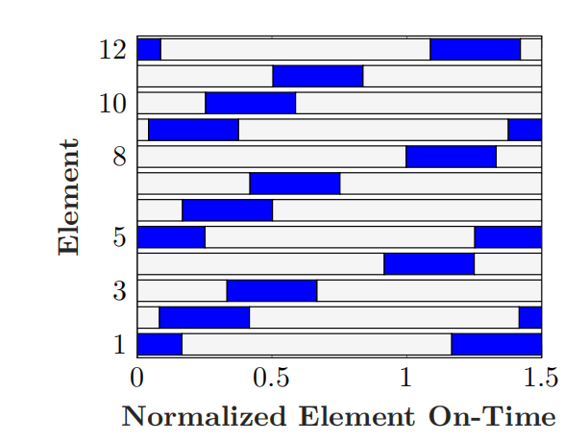



STPM

Slide 24
Simulation Result

Slide 25
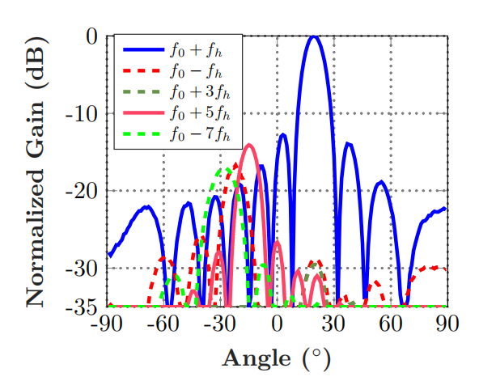
Harmonic suppression ratio of more than 15dB
Adjacent channel power ratio of -14,38dB
Target angle 20 \deg

Slide 26
Conclusion and Discussion

