Slide 1
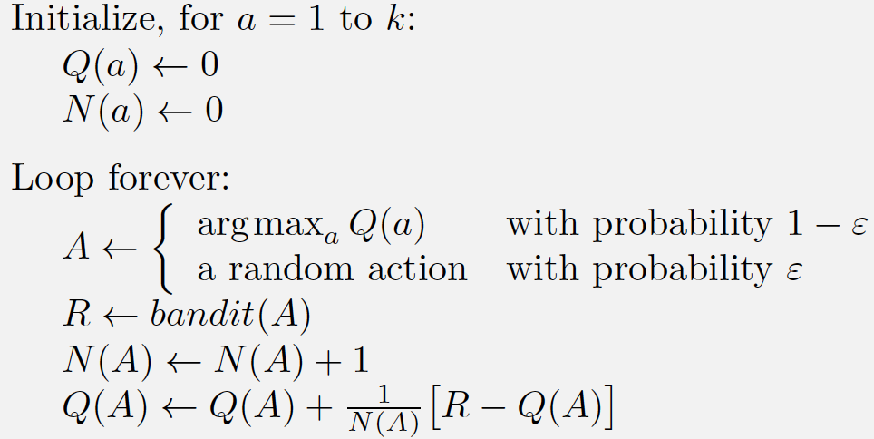
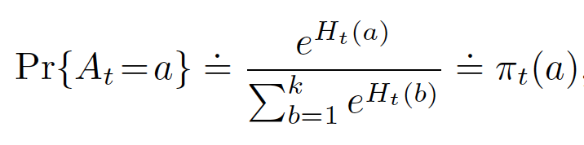
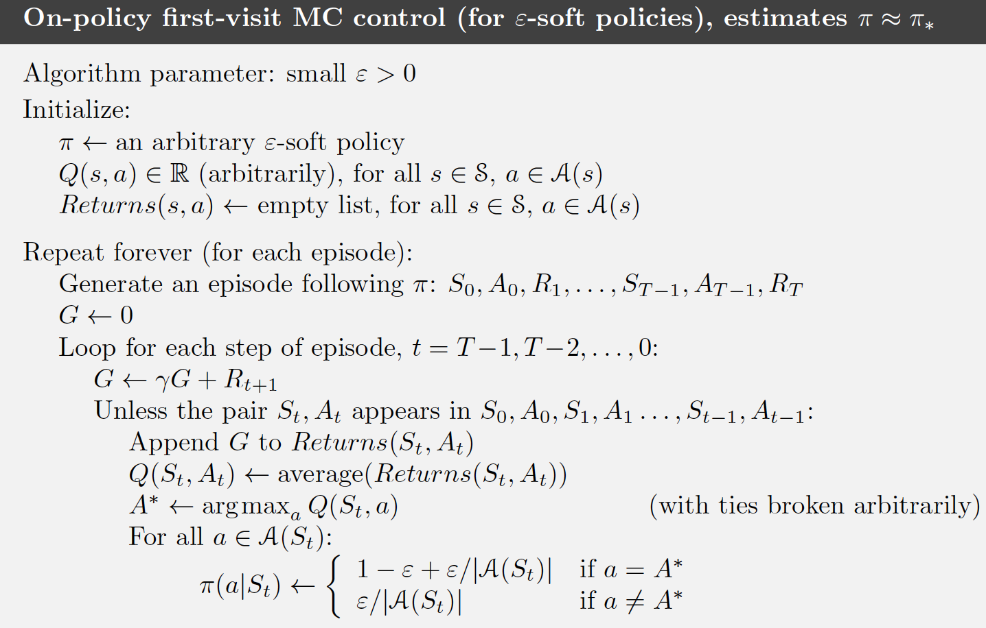
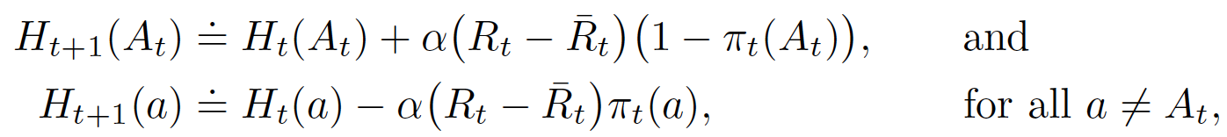
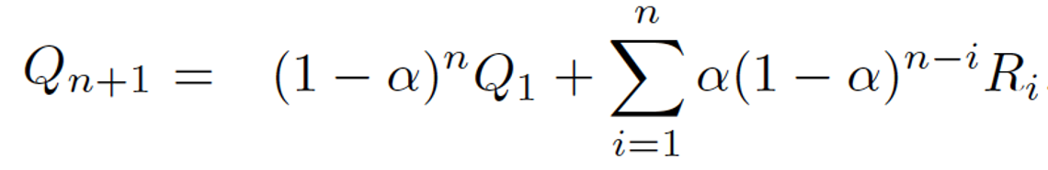
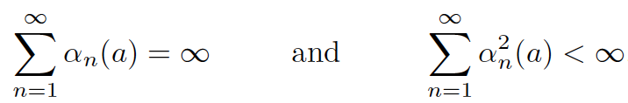
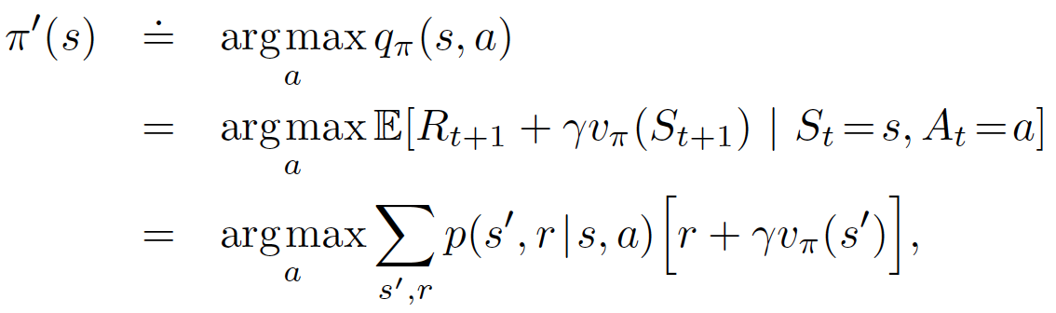
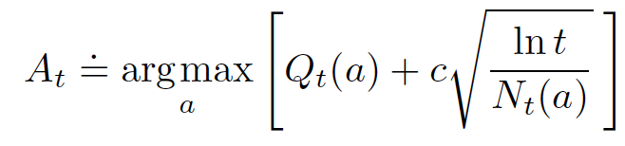
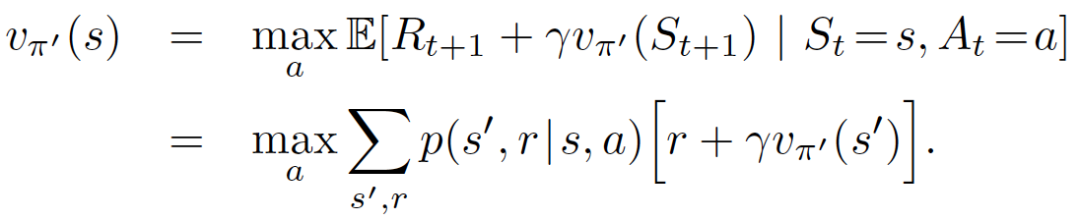

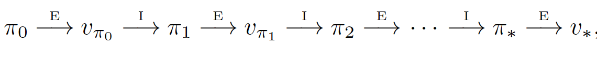
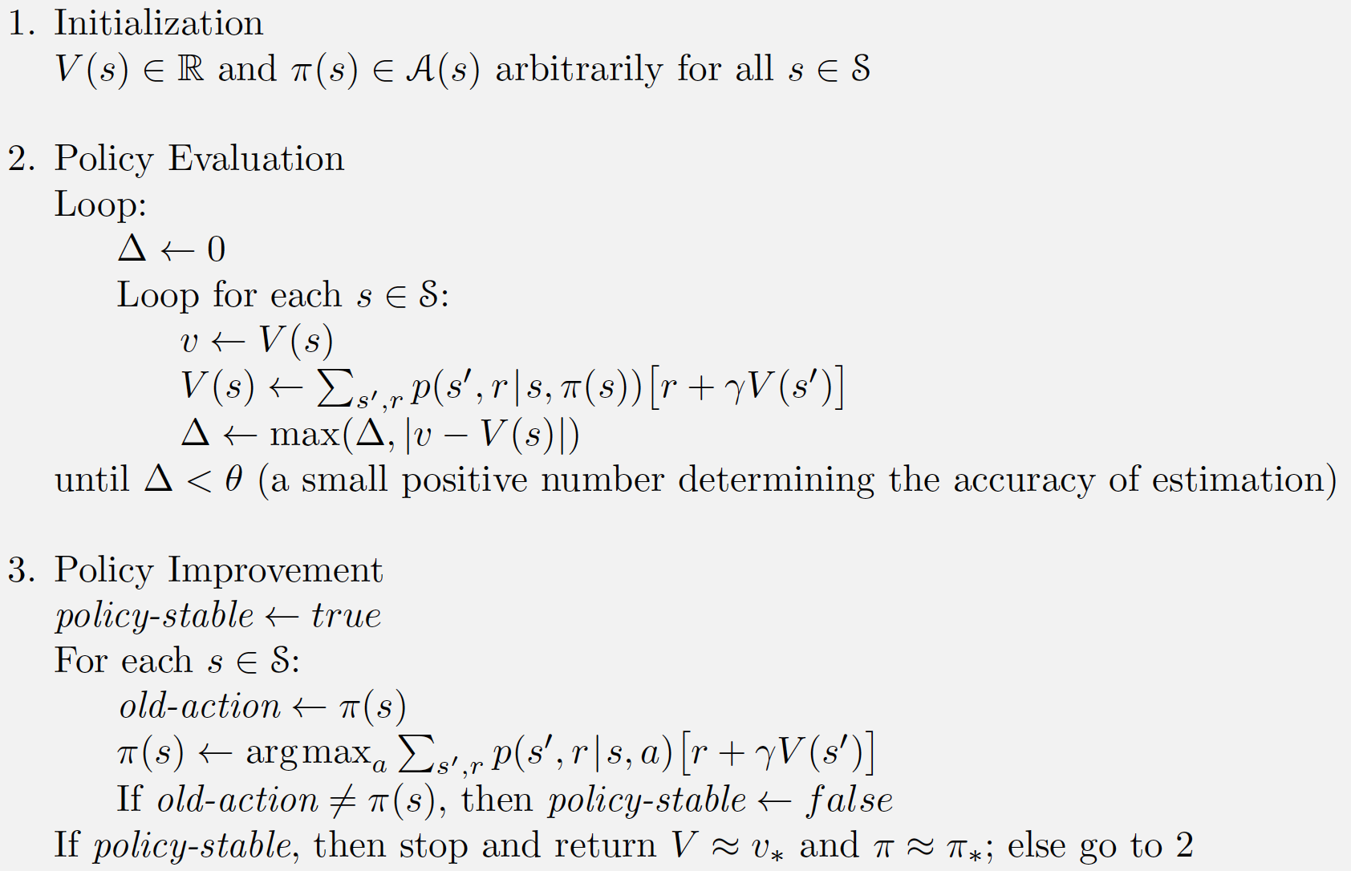
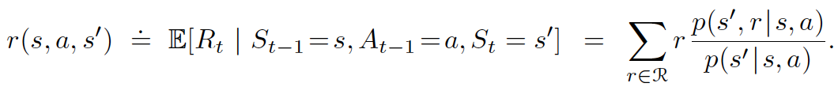
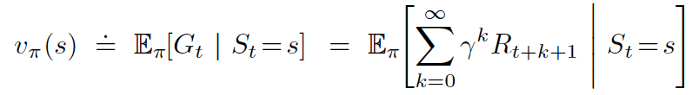
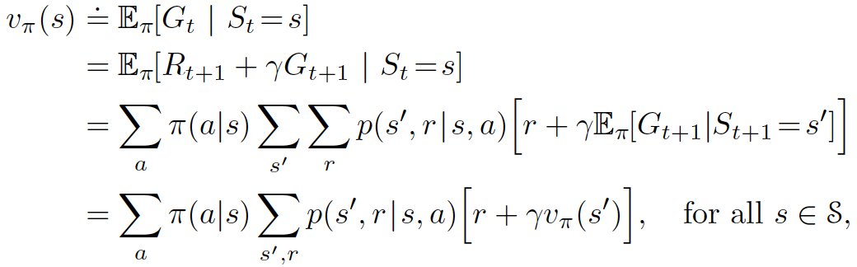
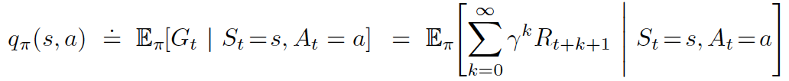
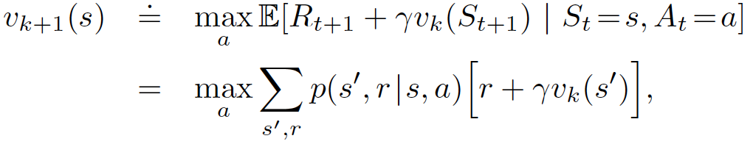
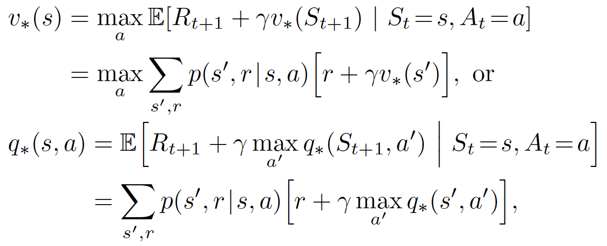
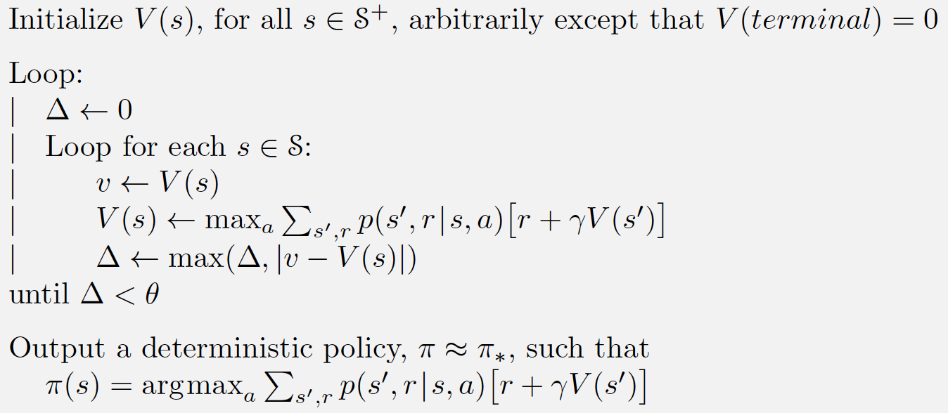

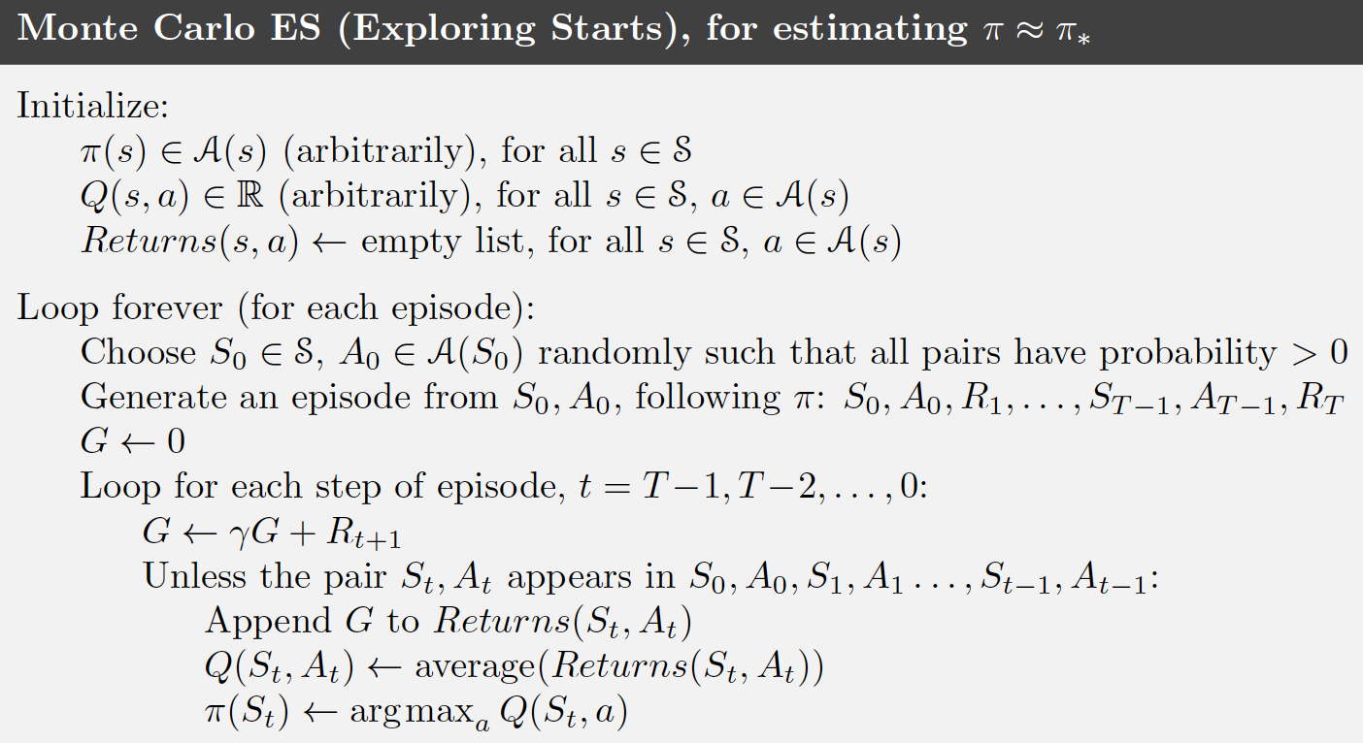

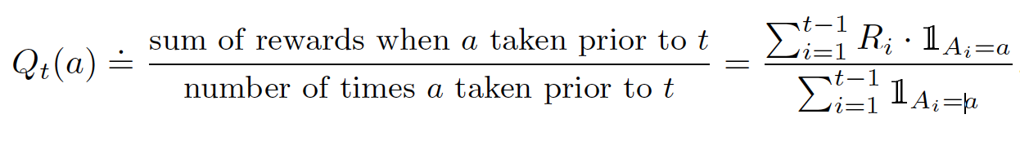
Soft-max distribution
Action preferences
Policy Evaluation: Sequence {vk} can be shown in general to converge to vpi as k-> ∞ under the same conditions that guarantee the existence of vpi. This algorithm is called iterative policy evaluation.
Policy Improvement
New greedy policy, pi0
Dynamics of the MDP
State-transition probabilities
Probability of nongreedy actions
Expected rewards state-action
Expected rewards state-action-state
State-value function for policy pi
Action-value function for policy pi
Value Iteration
Bellman optimality equation
Some equations related to Bellman

Slide 2
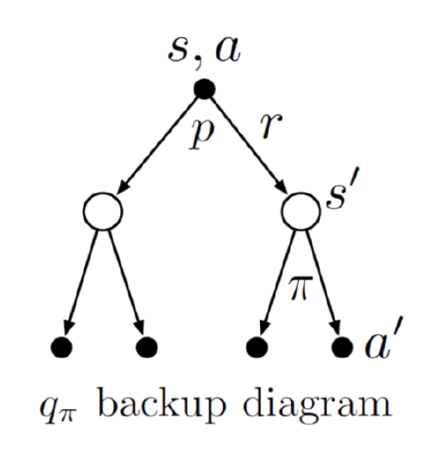

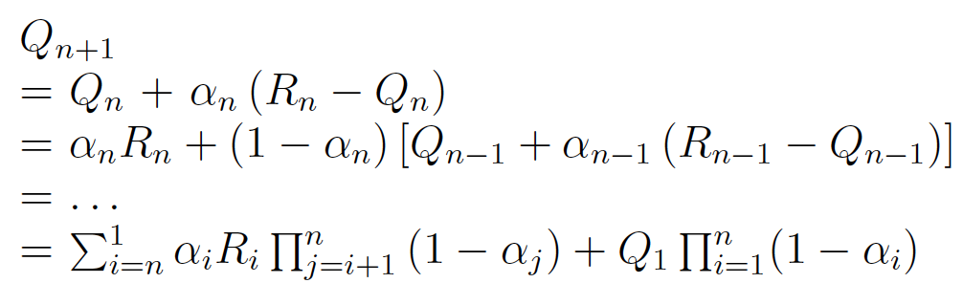
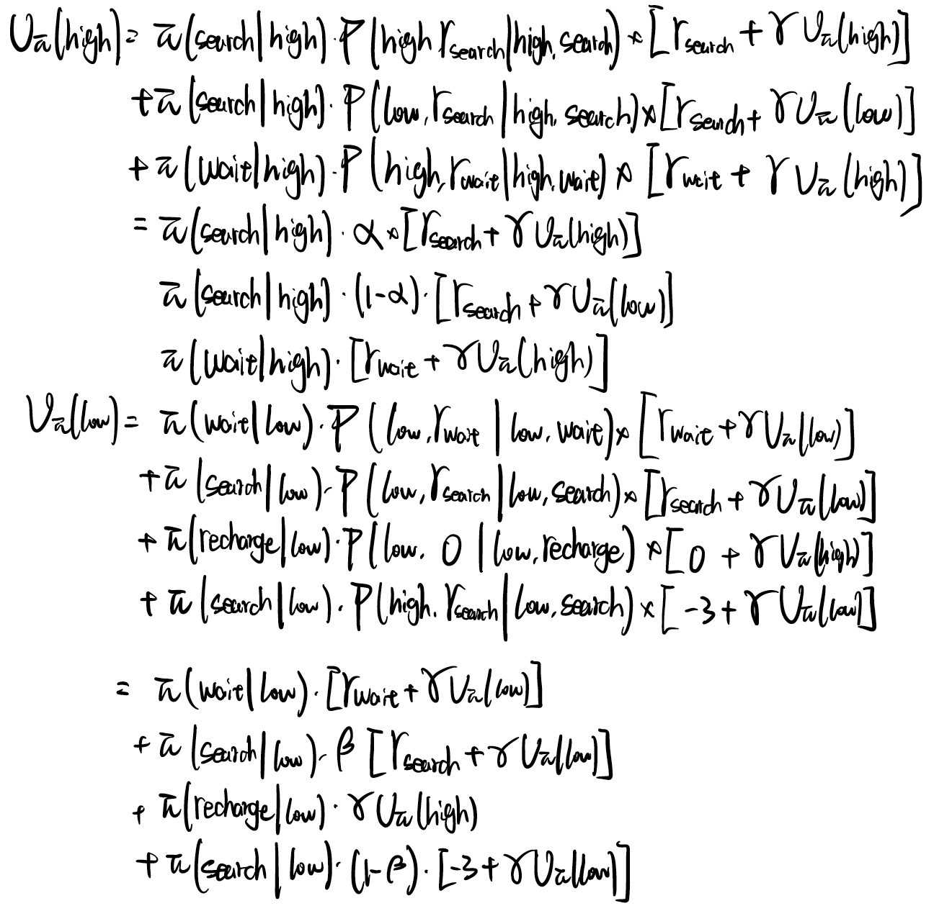
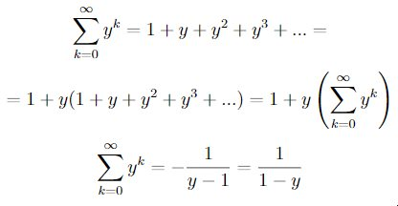
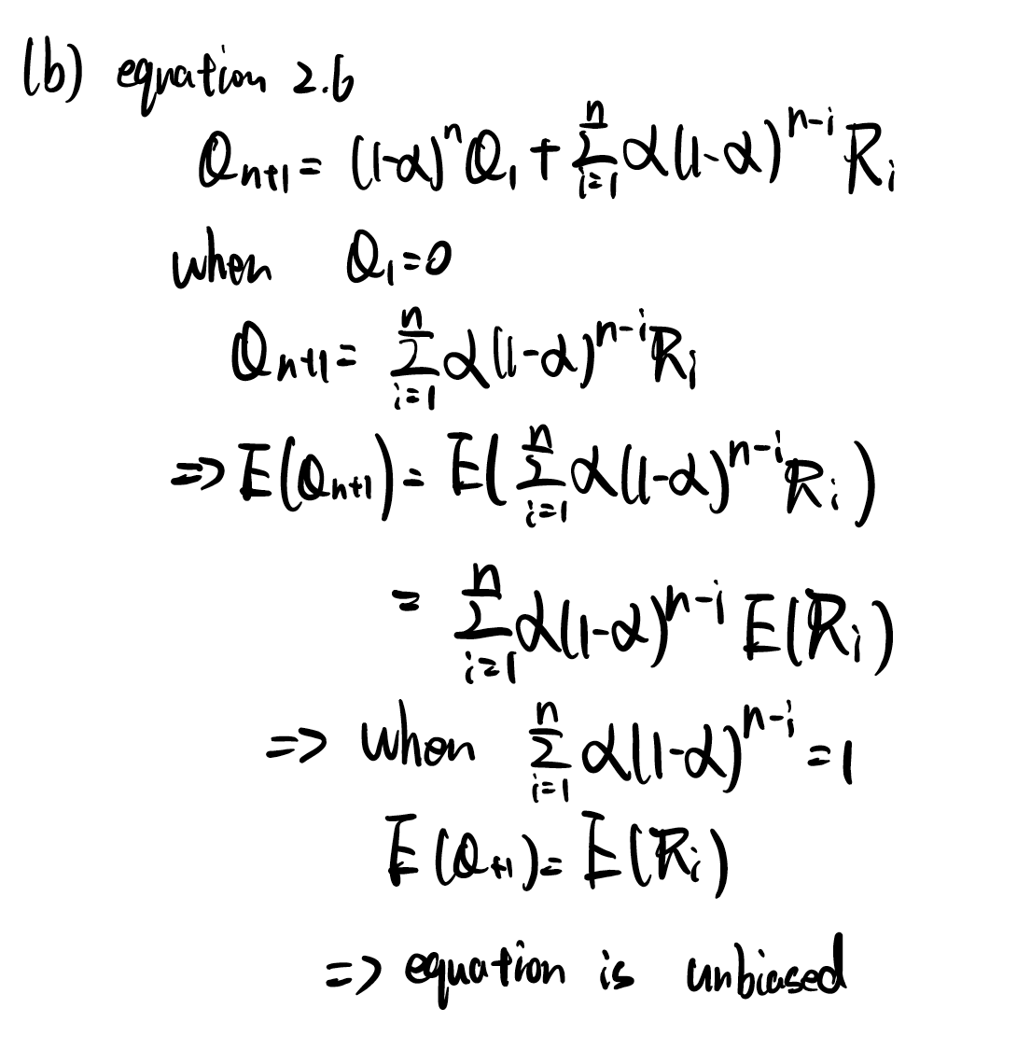
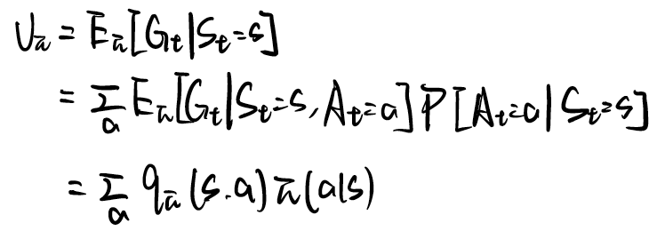
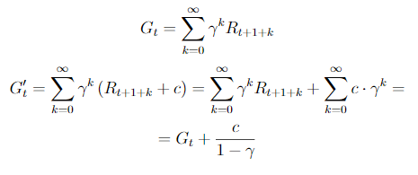
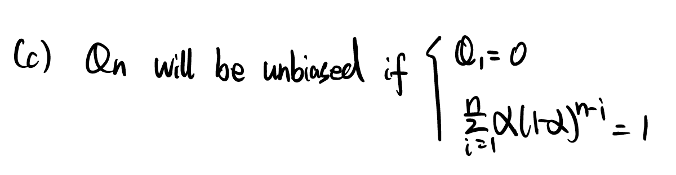
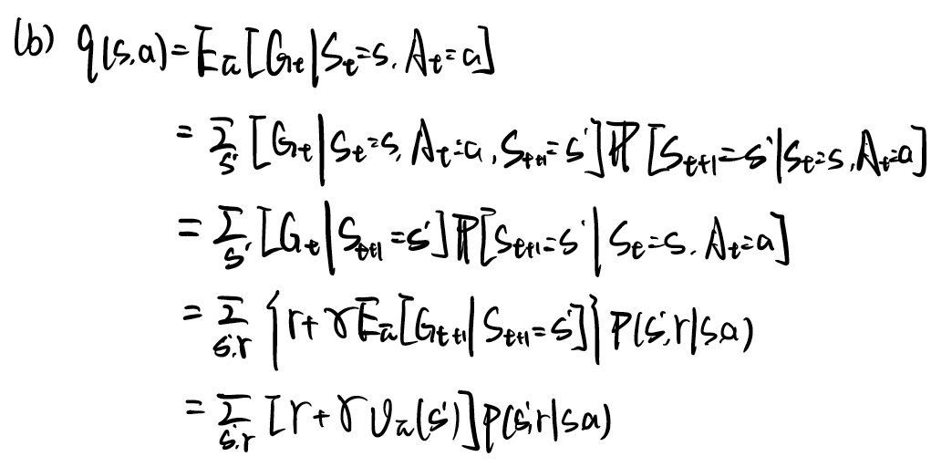
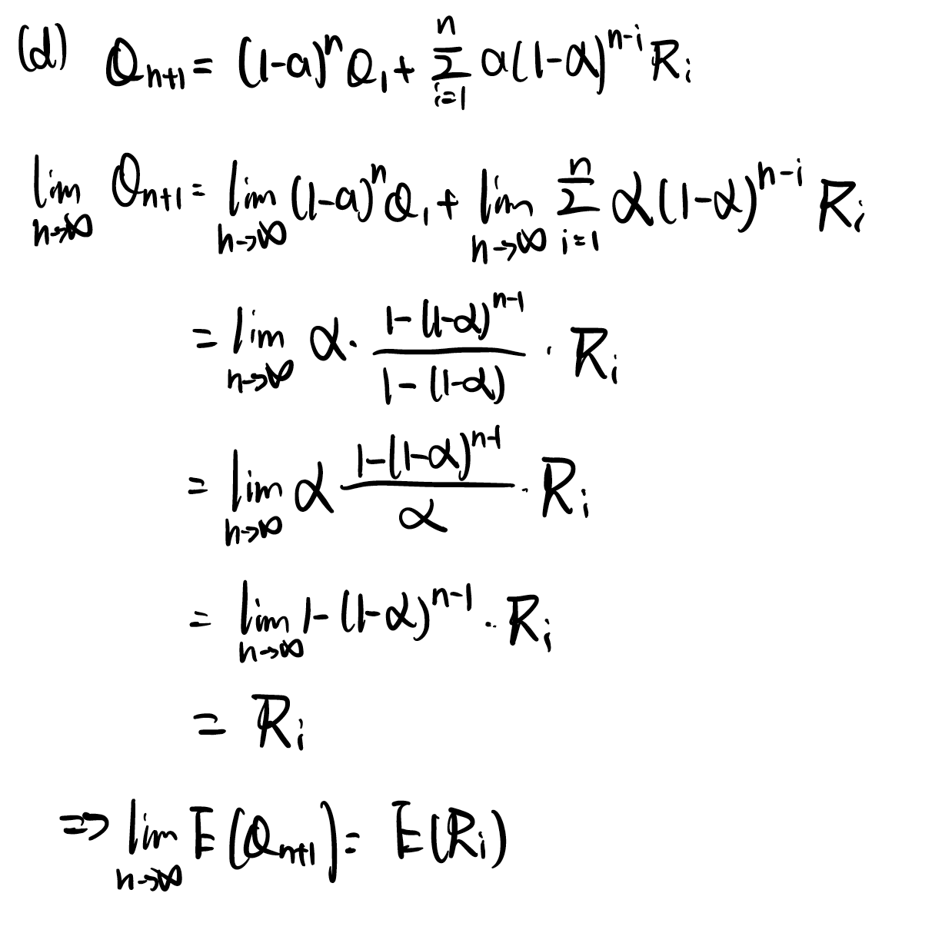
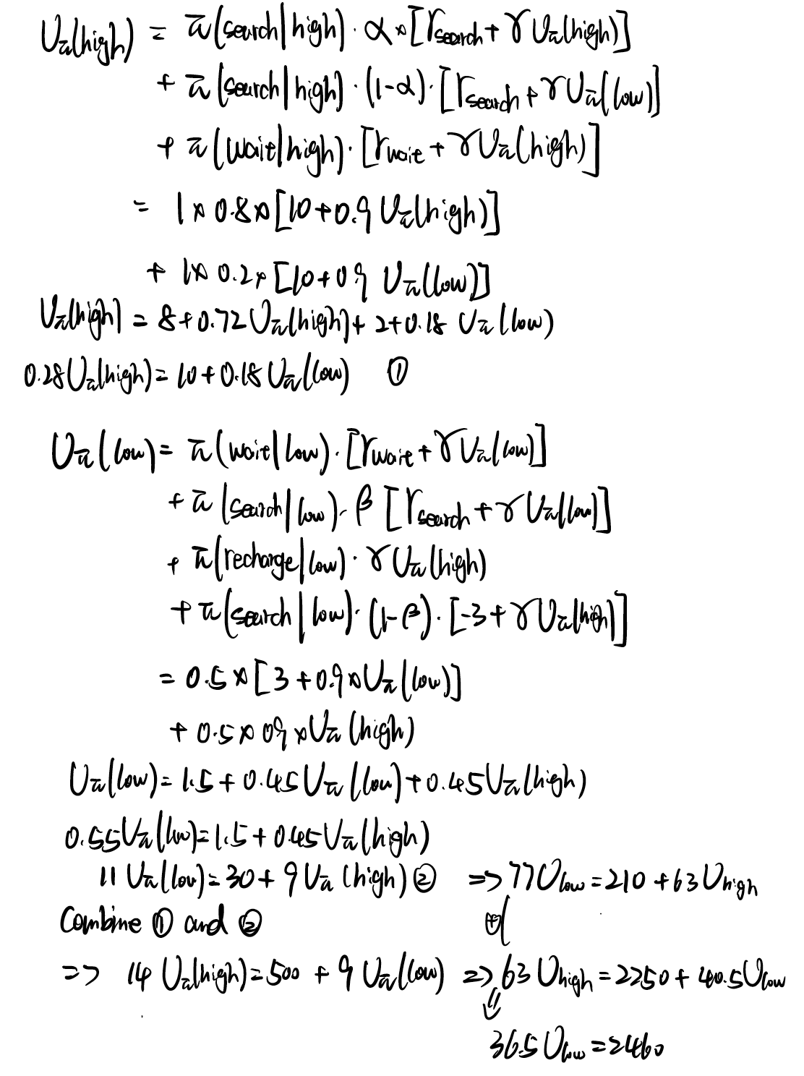
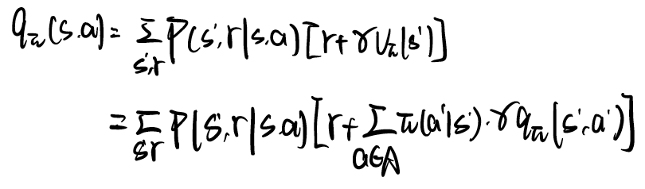
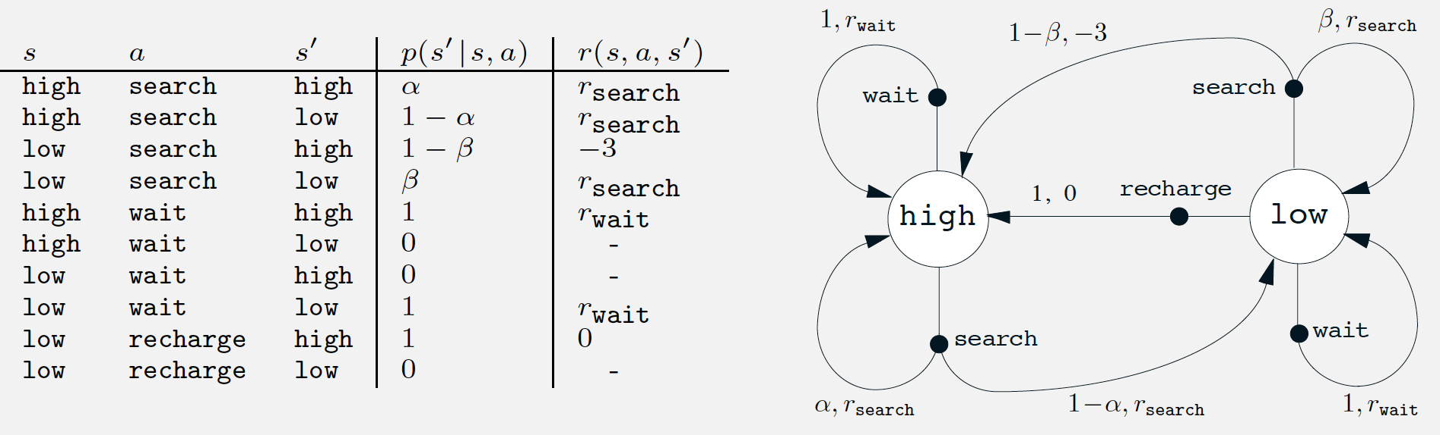
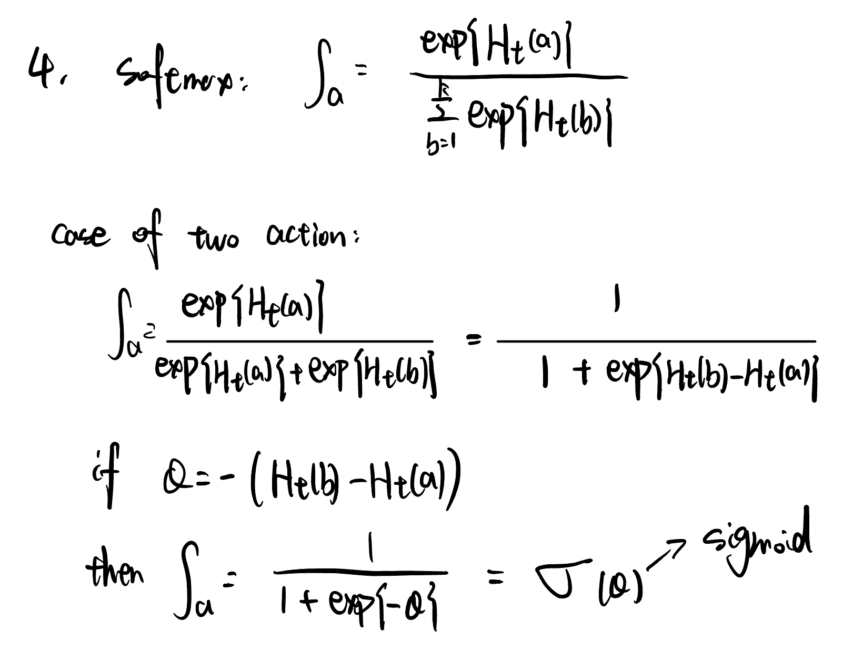
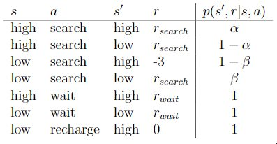
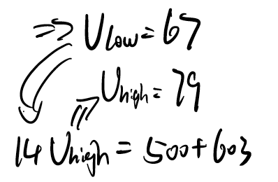
- If the step-size parameters, an, are not constant, then the estimate Qn is a weighted average
of previously received rewards with a weighting different from that given by Equation 2.6. What is the
weighting on each prior reward for the general case, analogous to Equation 2.6, in terms of the sequence
of step-size parameters?
* Expand the Bellman equation for the 2 states in the recycling robot, for an arbitrary policy π (a|s), discount factor γ, and domain parameters α, β, rsearch, rwait as described in the example.
- If Q1 = 0, is Qn (for n > 1) biased? Justify your answer with brief words and equations\
* Give an equation for vπ in terms of qπ and π.
* Give an equation for qπ in terms of vπ and the four-argument p.
- Derive condition(s) for Q1 for when Qn will be unbiased.
* You should now have two linear equations involving two unknowns, v(high) and v(low), as well as involving the policy π(a|s), γ, and the domain parameters. Let α = 0.8, β = 0.6, γ = 0.9, rsearch = 10, rwait = 3. Consider the policy π(search | high) = 1, π(wait | low) = 0.5, and π(recharge | low) = 0.5.
- Show that Qn is an unbiased estimator as n. (which is often referred to as asymptotically unbiased).
* What is the Bellman equation for action values, that is, for qπ? It must give the action value qπ(s, a) in terms of the action values, qπ(s′, a′), of possible successors to the state–action pair (s, a).
- Why should we expect that the exponential recency-weighted average will be biased in practice?
For a, we are able to control the learning rate by modify a, the learning process could be speed up by increasing a and vice versa. For Q1, the agent could start explore more in the beginning rather then always choosing the best choice by increase Q1.
- Show that in the case of two actions, the soft-max distribution is the same as that given by the logistic, or sigmoid, function often used in statistics and artificial neural networks
- UCB also produce spikes in the very beginning in both the two reproduced figures. Explain in your own words why the spikes appear (both the sharp increase and sharp decrease)
- In the optimistic initialization, the first few steps are not really random. Instead, we loop through all
the actions multiple times, picking our large optimistic value at random. In the first round, all actions have equal optimization percentages (10%).The next action will have a spike, because on average the best action will have the largest value. This will be repeated with decreasing values until the effect of the optimal initial value fades away.

