Slide 1
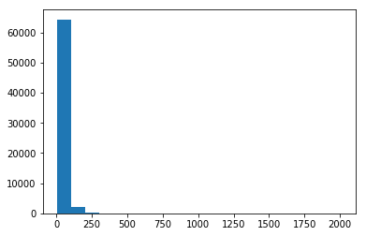
Linear Model – how to capture the price tail?
Top 6 most frequent countries
US, Italy, Spain, France, Chile, Portugal
Top 6 most frequent varieties
Pinot Noir, Chardonnay, Red Blend, Cabernet Sauvignon, Riesling, Syrah
Quality (Points)
Score Range 80-100
99% of prices < $164
Max Price = $2013

Slide 2
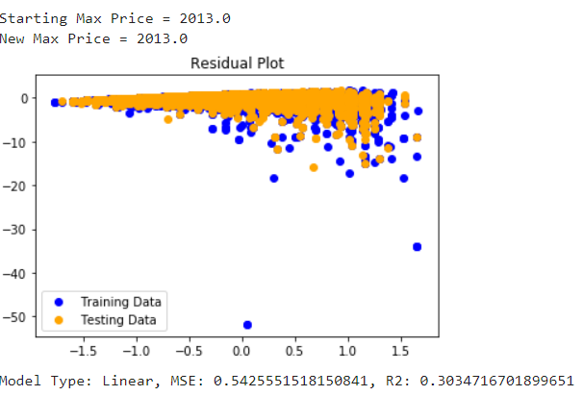
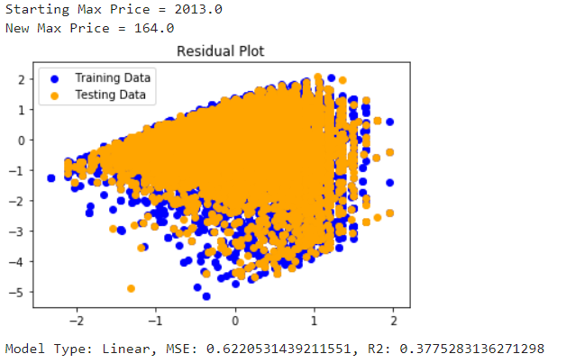
Linear Model – struggles with price tail
100% of prices included
99% of prices included

Slide 3
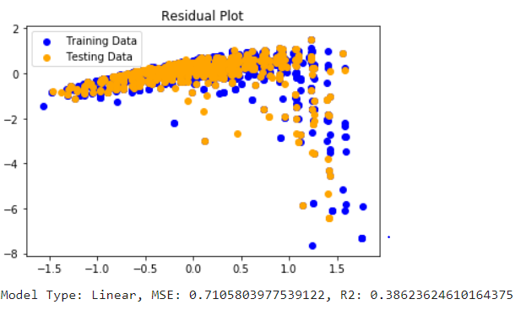
Linear Model – wineries in place of countries
Top 3 most frequent wineries in each country
99% of prices
Not much accuracy improvement

Slide 4


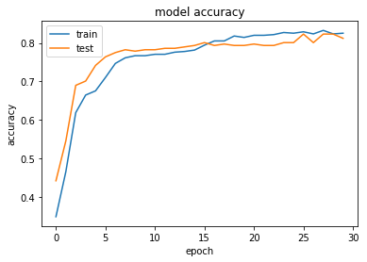
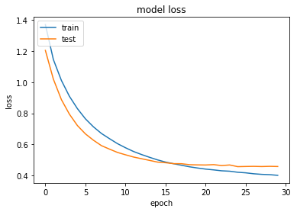
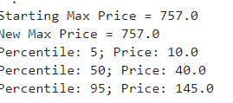


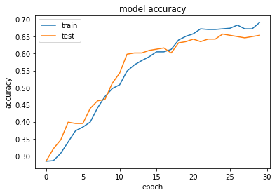
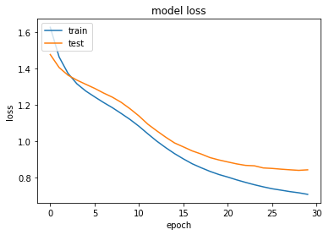
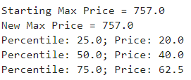

Deep Learning Model Better at predicting extreme price ranges with same inputs

