Slide 1
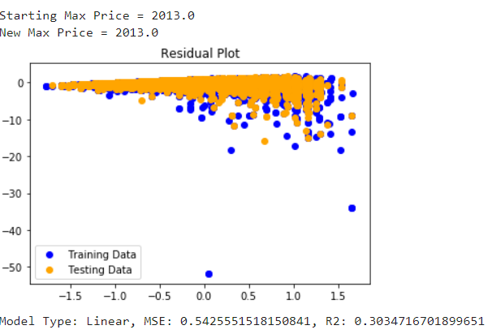
Linear Model – struggles with price tail
100% of prices included
Top 6 most frequent countries
US, Italy, Spain, France, Chile, Portugal
Top 6 most frequent varieties
Pinot Noir, Chardonnay, Red Blend, Cabernet Sauvignon, Riesling, Syrah
Quality (Points)
Score Range 80-100

Slide 2
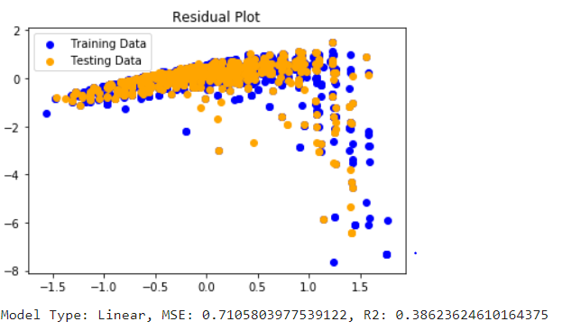
Linear Model – wineries in place of countries
Top 3 most frequent wineries in each country
100% of prices
Small improvement in standard error

Slide 3


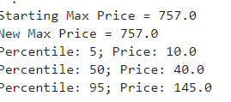
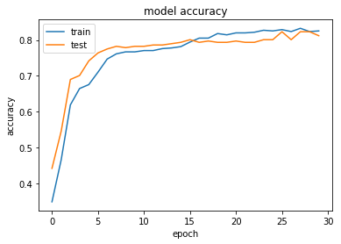
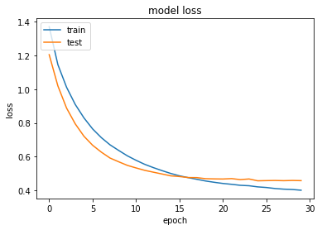


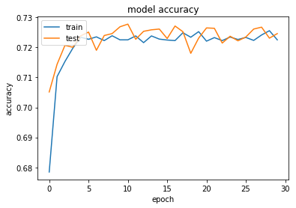
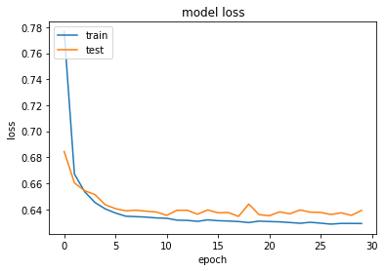

Deep Learning Model Better at predicting extreme price ranges with same inputs
Model = f(winery, wine variety, points)
Model = f(country, wine variety, points)

Slide 4

Random Forest
Splitting the data to 2 bins
Quality ratings from 2 – 6.5 are bad wines “0”
Quality ratings from 6.5 – 10 are good wines “1”

Slide 5
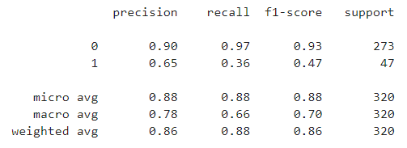
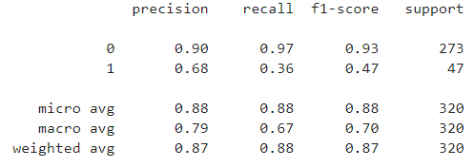
RandomForestClassifier
Red Wine
Precision, the ability of a classifier not to label an instance red that is actually white and vise versa. Weighted avg of 86% (red), 87% (white)
Recall is the ability of a classifier to find all red or white instances, respectively. Weighted avg of 88% for both.
F1 score is a weighted harmonic mean of precision and recall such that the best score is 1.0 and the worst is 0.0. The weighted average of F1 should be used to compare classifier models, not global accuracy.
Support is the number of actual occurrences of the class in the specified dataset.
White Wine

Slide 6
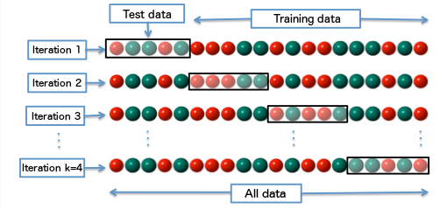
Cross Validation
Using 1 subset of the data as the validation data. It got through each subset as the validation data and averages the results.
Testing multiple number of subsets, found that 10 gave the best results
The cross validation score for red wine was 91.55% and white wine 91.24%

Slide 7
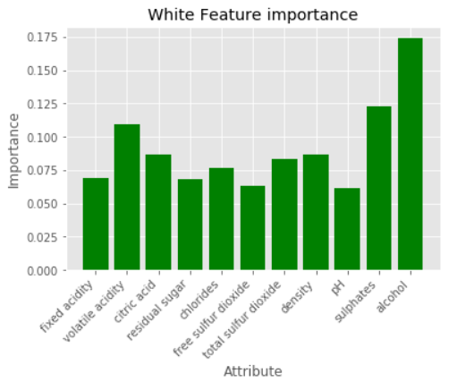
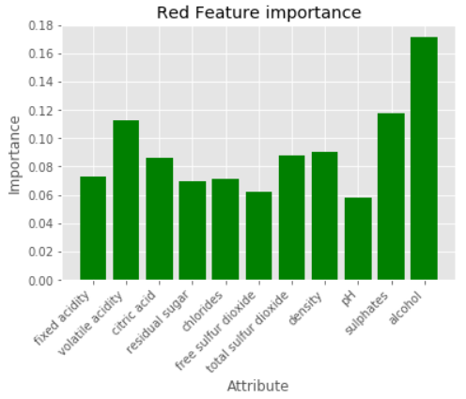
Feature Importance with Random Forest

Slide 8
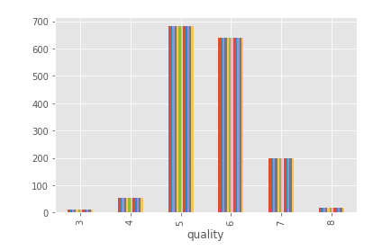
Deep Learning Categorical Neural Network
Divided our physio-chemical wine observations into buckets based on quality
Good >= 7
Bad <= 6

Slide 9
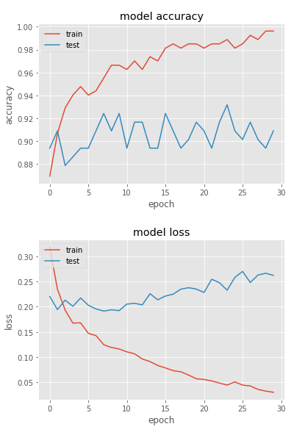
Implications of the Deep Learning model
Prediction accuracy of ~90% on the test data
Feature impact of our 11 inputs?
Chlorides, volatile acidity, and sulphates seem to drive our model the most

Slide 10
Conclusions
Chlorides and acidity are big drivers of quality, and generally less of both means improved quality.
Quality matters for price, but winery (brand) matters more than location.
Deep learning better than simple linear models for predicting price tails

