Slide 1
Presentation On Paddy Leaf Disease Detection Using SVM Classifier
Presented by
Moshiur Rahman, Student ID: 1402042
Faisal Kabir, Student ID: 1302054
B.Sc C.S.E.
Level: 4 Semester: I
HSTU, Dinajpur
Notes:
Good noon everyone. Assalamualaikum. Our presentation on ……..presented by muself mosiur rahaman and here is my project partner faisal kabir.

Slide 2
Outlines
Objectives
Introduction
Leaf in image
Detection and Recognition
Why Leaf Disease detection?
Background Study
Available techniques
Related works
Proposed System
Motivation
Block diagram and Flow chart
Simulation Result
Tools for Implementation
Detection
Recognition
Conclusion and Future Plan
Notes:
Outlines of the presentation is here. 1st one is objectives 2nd is introduction then background study proposed system simulation result and finally future plan of our system.

Slide 3
Objective
To detect paddy leaf disease portion from image
To extract features of detected portion of leaf
To recognize detected portion of leaf through SVM
Notes:
Objectives.
Main objective is .
.
.
.

Slide 4
Introduction
Leaf in Image
Two types of leaf (Healthy and Unhealthy)
Detection
Find out the disease portion of leaf
Recognition
Classifying the disease portion of leaf and obtaining the properties
Why Leaf Disease Detection and Recognition?
Agricultural research
Image retrieval
Digitalize the farmers
Increase production of crops
Notes:
Now introduction
We chose two type of leaf one is healthy and another is unhealthy. Then we find out the disease portion of the taking sample leaf. Finding disease portion we classify and obtain the properties.
why leaf disease detection and recognition? For agriculture research digitalize the farmers and increase production of crops.

Slide 5
Background Study
Available techniques for leaf detection
CIELAB Color Space
Greyscale Matching
Color Based
Gradient Matching
Histogram Analysis etc.
Notes:
In background study we find out the available techniques for leaf detection such as …………..

Slide 6
Background Study (Cont’d)
Related Work:
Authors | Title of Paper | Methodology
K. Jagan Mohan M. Balasubramanian S. Palanivel | Detection and Recognition of Diseases from Paddy Plant Leaf Images | Scale-Invariant Feature Transform (SIFT) is used to get features These features are taken to recognize the image using SVM and KNN.
Nonik Noviana kurniawati Salwani Abdullah | Texture Analysis for Diagnosing Paddy Disease | Image acquisition Converting the RGB to gray scale images. Converting the gray scale to binary images with noise. Used morphological algorithm to remove the noise.
Notes:
Here are some related work on this field,
Mr. Jagan and Palanviel used

Slide 7
Background Study (Cont’d)
Authors | Title of Paper | Methodology
Shenweizheng wcyachun | Grading method of Leaf Spot Disease based on Image Processing | Sobal operator is used to extract the disease spot edges. The system is proposed that the plant diseases are identified by calculating the ratio of two quantities to be divided of the disease spot and leaf area.
Manoj Mukherjee Titan Pal in | Damaged Paddy Leaf Detection using Image Processing | A conventional color digital image is a method used to identify the symptoms of the paddy leaf. This method was proposed by automatically and removing the possibility of the mistakes created by human.

Slide 8
Proposed System
Motivation
For decrease the sufferings of people in agricultural field as like paddy culture by leaf disease detection and recognition process.
The proposal
Preprocessing the input image
Detection and feature extraction of individual leaf
Recognition of the disease portion of paddy leaf
Notes:
Checking the sufferings of people in agricultural fields as like leaf diseases detection and recognition we submit a proposed system.the proposal is,,,,

Slide 9
Proposed System (Cont’d)
Proposed system block diagram
Image acquisition
Image preprocessing
Image segmentation
Feature extraction
Image classification
Recognition Block Diagram
Notes:
Block diagram of our proposed system is here. In our system 1st we taking a image then processing that image.then we divide the image in some segment. then we evaluate the features of the image and classify it.

Slide 10
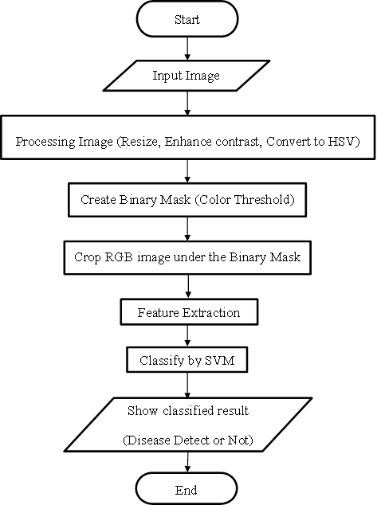
Proposed System (Cont’d)
Flowchart of the proposed system
Notes:
Flowchart of our proposed system shows the overall. Start, input image, processing image. In processing we resize, enhance contrast, and converting to hsv. Then we create a binary mask like colour threshold feature extractionand classify by SVM. Finaly shows the disease detect or not.

Slide 11
Simulation Result
Tools for Implementation
Platform: MATLAB R2017a
Language: MATLAB
Operating System: Windows 8

Slide 12
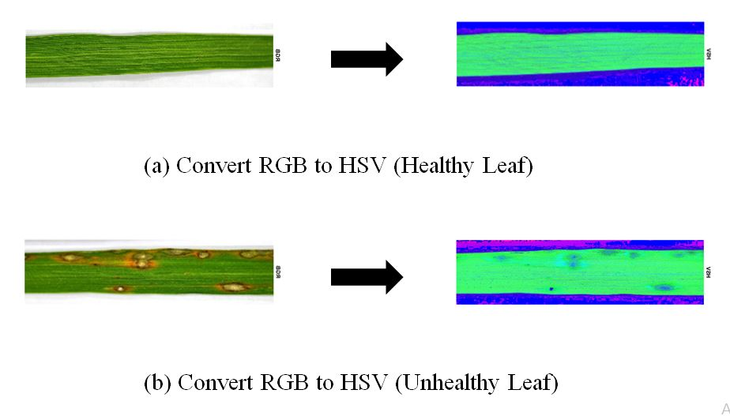
Simulation Result (Cont’d)
Example of convert RGB to HSV
Notes:
RGB defines color in terms of a combination of primary colors, where as, HSV describes color using more familiar comparisons such as
Color, vibrancy and brightness.

Slide 13
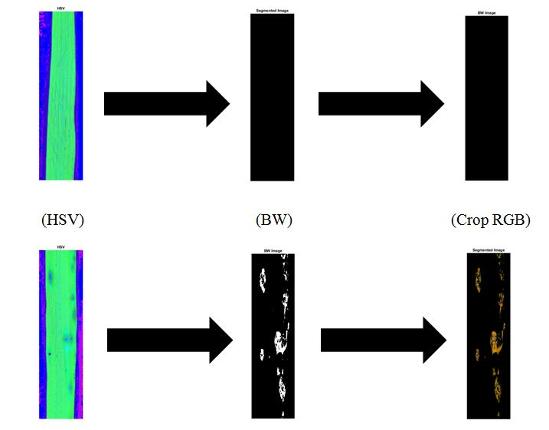
Simulation Result (Cont’d)
Example of convert segmented image
Notes:
From HSV we create a binary mask (by color thresholding).
Under the binary mask we crop the main RGB image.

Slide 14
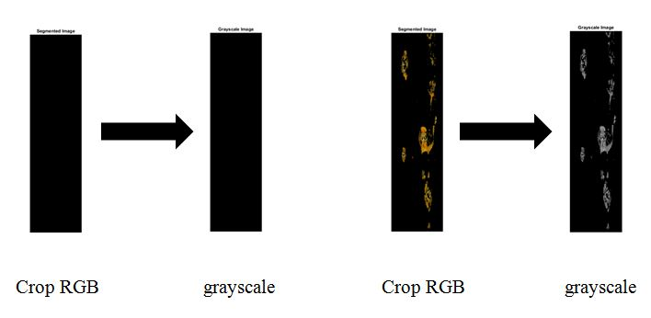
Simulation Result (Cont’d)
Conversion of grayscale image
Notes:
GLCM = Gray level concurrence matrics

Slide 15
Simulation Result (Cont’d)
Extracted feature of paddy leaf
Contrast
Energy
Homogeneity
Mean
Standard Deviation
Entropy
Root-Mean-Square (RMS)
Variance
Smoothness
Inverse Difference Movement (IDM)

Slide 16
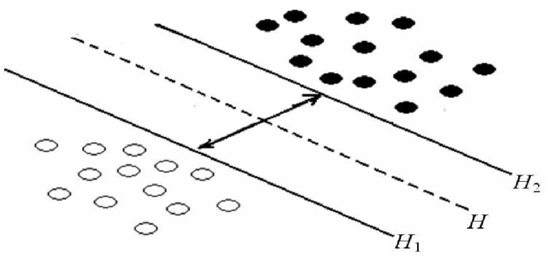
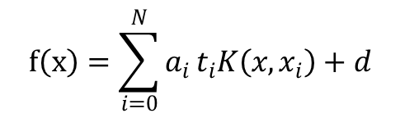
Simulation Result (Cont’d)
Table of SVM Learning database
Leaf Type | Number of Images | Resolution | Pixel value | Image Type
Healthy | 10 | 1000x260x3 | uint8 | JPG
Disease | 10 | 1000x260x3 | uint8 | JPG
$$f\left(x\right)=\sum_{i=0}^{N}{a_{i }t_{i}K\left(x,x_{i}\right)}+d$$
The optimal plane of SVM in linearly separable condition

Slide 17
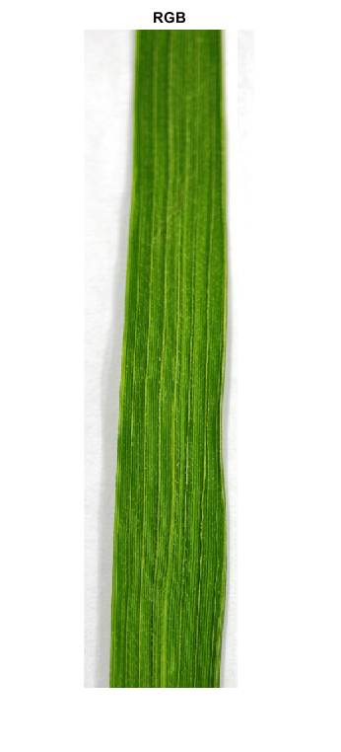
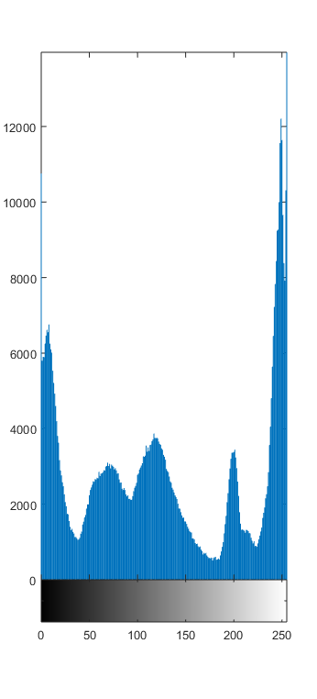
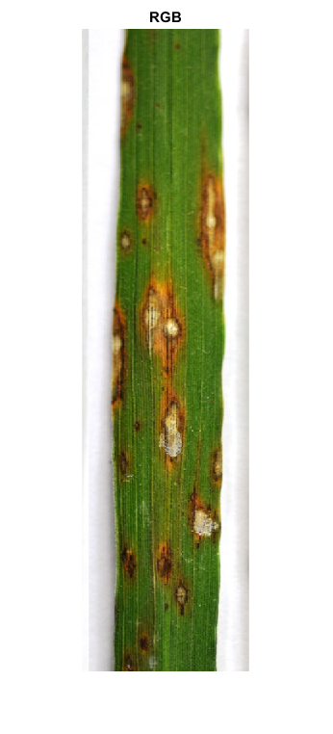
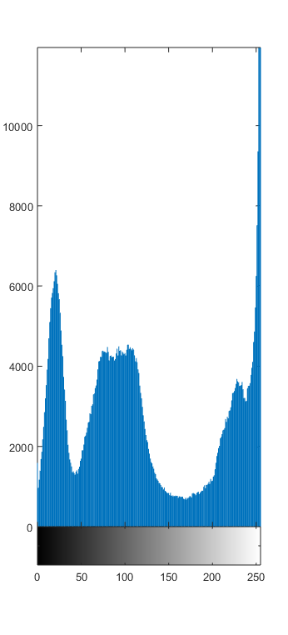
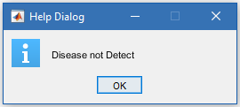
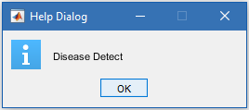
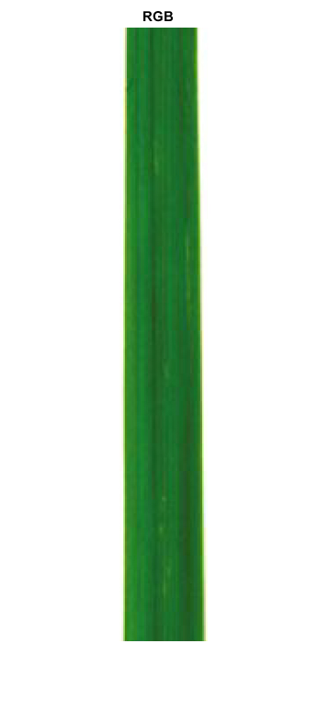
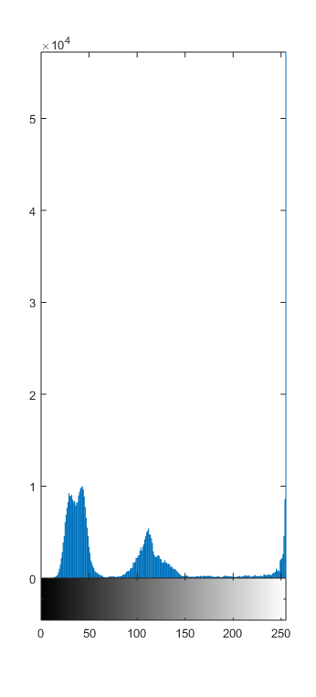
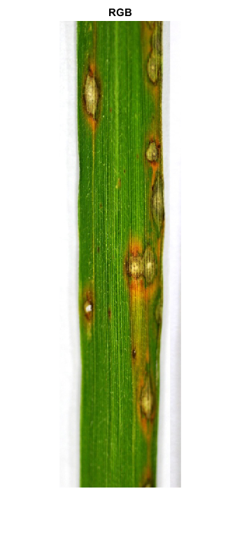
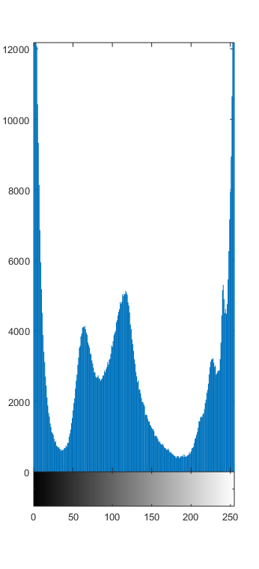
Simulation Result (Cont’d)
Experimental Results (with image)
Healthy image | Histogram Plots | Results
Unhealthy image | Histogram Plots | Results

Slide 18
Simulation Result (Cont’d)
Experimental Results (with table)
 | Healthy | Disease
Healthy | 10 | 0
Disease | 1 | 9

Slide 19
Conclusion and Future Plan
Overall idea behind this project is to detect and recognize paddy leaf
Will be detect specific paddy leaf disease and improve the complexity and accuracy so that in the field of agriculture the leaf detection and classification can be a useful application
Will be applied on real images

Slide 20
Thanks to All

