Slide 1
ENTERPRISE .NET I
Group 4
Koo Sheng Kiat
Gong ShengLiang
CHENG Hao

Slide 2
Table of contents
Architecture design
Features
Technologies
Database design, domain model design
Sequence diagram to show the end to end flow
Application demonstration
Code walkthrough

Slide 3
Architecture design
Presentation Layer
Business Layer
Unit of Work
Data Access Layer
Repository
Repository
Entity Framework
MVC
Façade Pattern
DbContext
DB

Slide 4
Features
Administrator can manage instructors, students and courses
Instructor
Upload/Download files
View quiz statistics
Student
Download files
Play Video
Answer quiz questions
Enter chat

Slide 5
Technologies
Web Vulnerability
Authentication and Password Hashing
File Upload Vulnerabilities
Anti-Forgery Tokens
Quiz
jQuery AJAX and SignalR
Reponsive, better user experience
Implemented using web api
Notes:
Rename file
Store files in App_Data folder

Slide 6
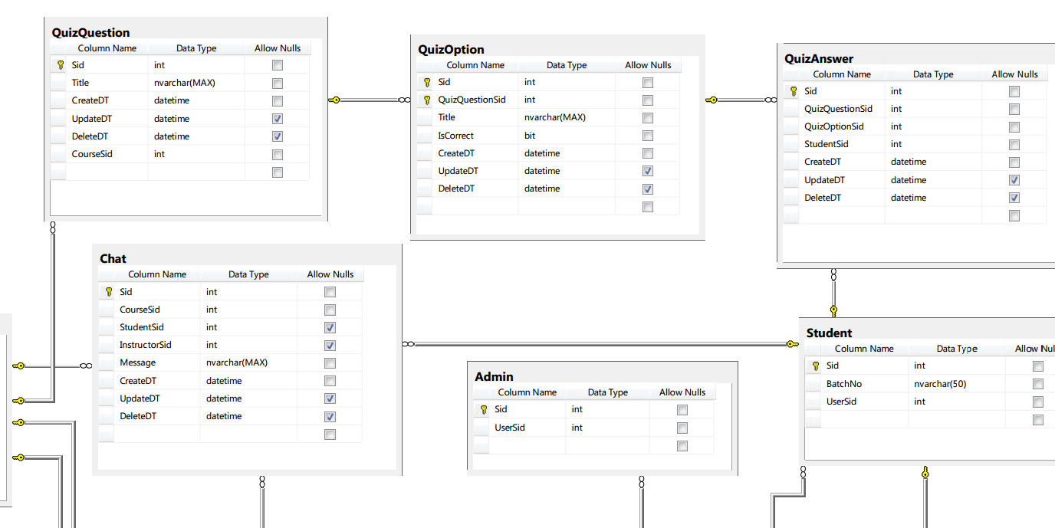
Database design

Slide 7
Sequence diagram

Slide 8
Application Demonstration
http://chh1983web.cloudapp.net/
Username: admin1, instructor1, student1
Password: 1234

