Slide 1
Movie Success Predictor
Machine Learning (Decision Tree)

Slide 2

HELLO!
Team #7:
Aung Myo
Cheng Hao
Lim, Hean Soon
Lin, Wei
Liu, Yakun
Nyi Nyi Zin

Slide 3
Introduction

Slide 4
What makes a movie a success?
What if, we can predict beforehand whether a movie going to be a hit or not, will this be.. helpful?

Slide 5
Movie Success Predictor
Build a model to help predict whether a movie (with the specific features) will be a success or failure

Slide 6
Data Collection
IMDB (main source)
Rotten Tomatoes
Facebook
Wikipedia (for missing linkage)
Kaggle (main data reference point)

Slide 7
Data Collection (Cont.)
Different sources provide different mechanism (eg: API)
Parse the data translate them into excel spreadsheet
Cross reference with formula (Movie Title as key feature)
Concatenate the columns needed to form a dataset

Slide 8
Datasets Collected

Slide 9
5,044
Movie titles (before cleansing)

Slide 10
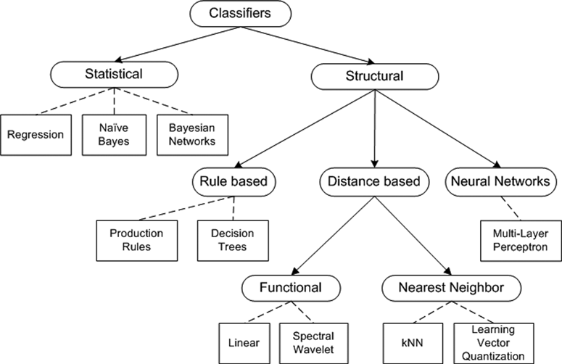
Machine Learning Techniques
Classification? Many choices such as..
Bayesian
Support Vector Machine
Decision tree
Regression
Neural Networks
and goes on..

Slide 11
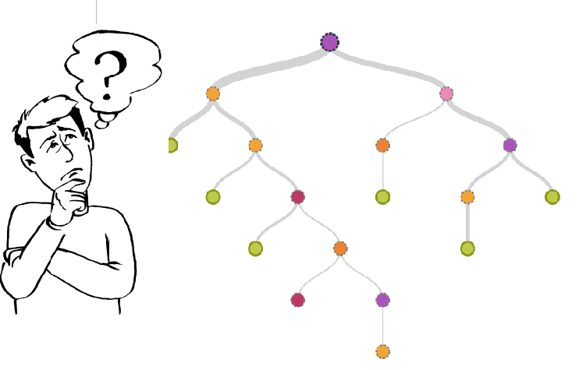
Decision Tree
Fairly transparent and easy to understand
Training data has rule and label (success or failure)
Able to achieve the desired level of accuracy
Best suit for business case we’re trying to address..

Slide 12
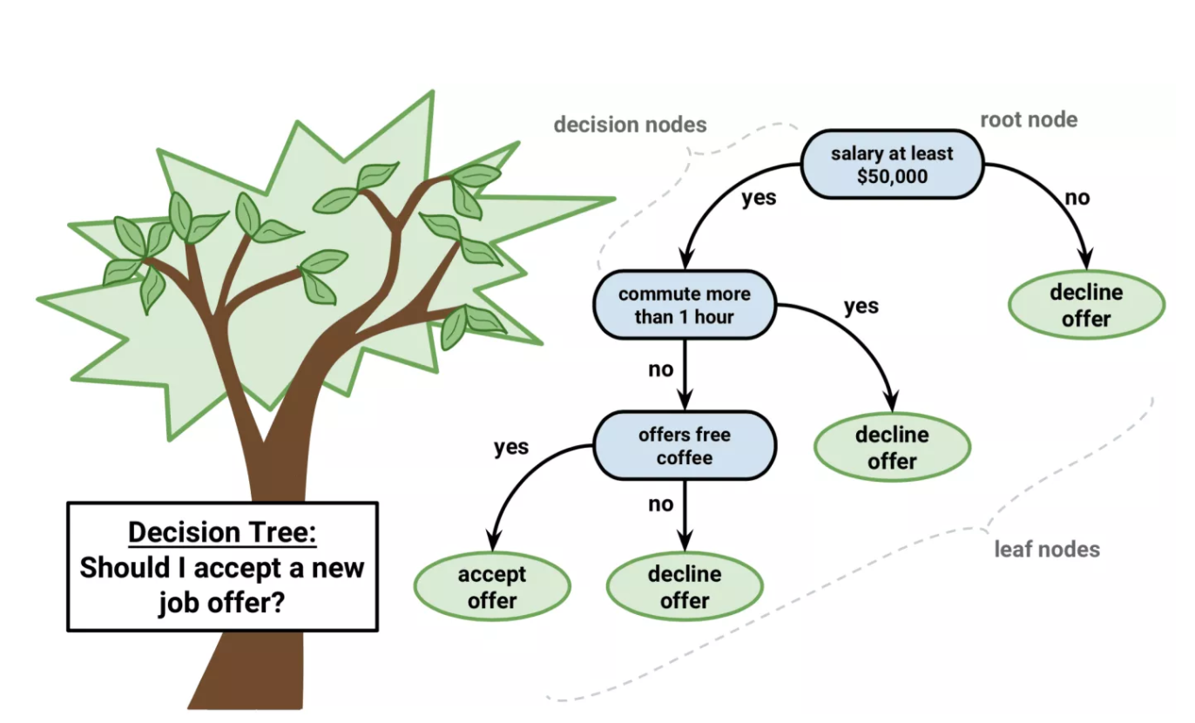
How does Decision Tree algorithm work?
Place the best attribute of the dataset at the root of the tree.
Split the training set into subsets. Subsets should be made in such a way that each subset contains data with the same value for an attribute.
Repeat step 1 and step 2 on each subset until you find leaf nodes in all the branches of the tree.

Slide 13
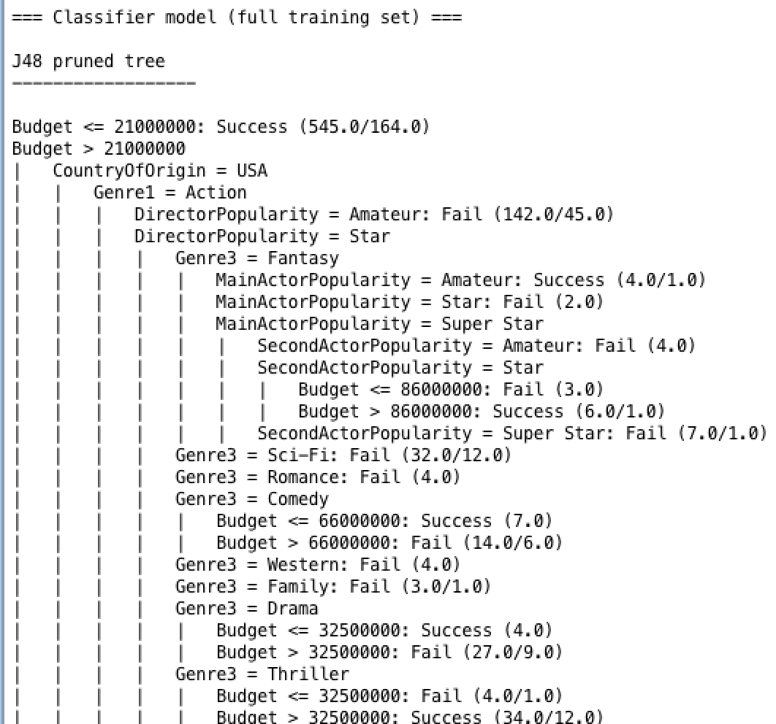
How Decision Tree is used?
Use training data to build prediction model (algorithm mapped it to tree structure)
Evaluate model with test/cross validation data
Use it to classify new data (movie)..

Slide 14
Data Cleansing and Improvement
Remove the movie data that has <3 Genres
Remove movie that does not have Gross Profit (Documentary)
Remove movie where the Main/Secondary actors information not available
Remove Actors/Directors that we are not able to find their Facebook information (Facebook Likes)

Slide 15
Features used
Main Actor (Name and Popularity)
Secondary Actor (Name and Popularity)
Director (Name and Popularity)
Genres (3 categories)
Country of Origin
Budget

Slide 16
Success/Fail?
Success: Gross Profit more than 20% of Budget of the movie
Fail: Anything below 20% of Budget

Slide 17
1,559
Rows of data (cleansed)

Slide 18
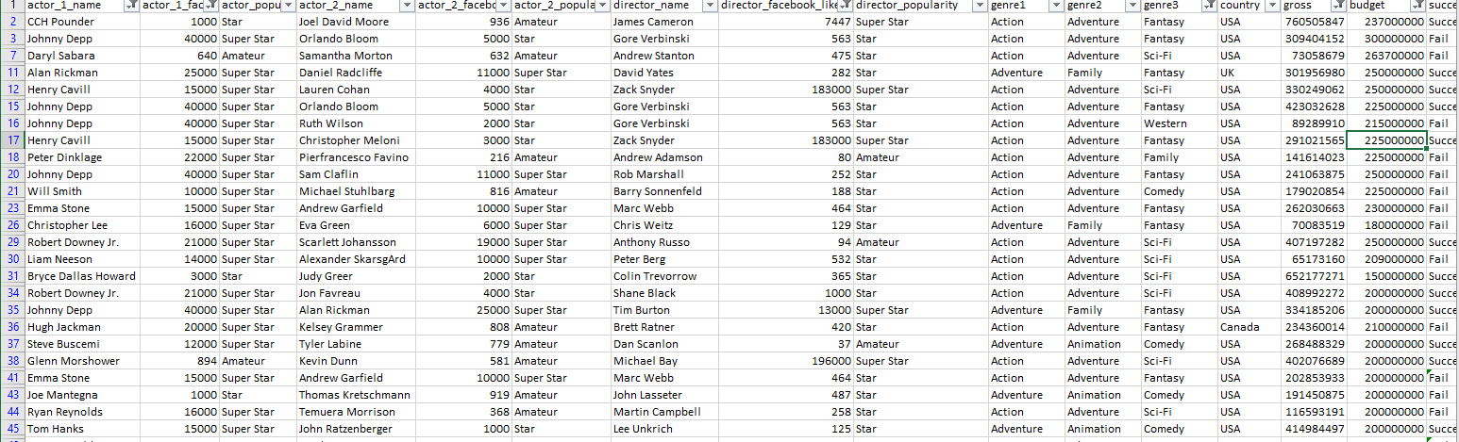

Slide 19

WEKA TOOL Example

Slide 20
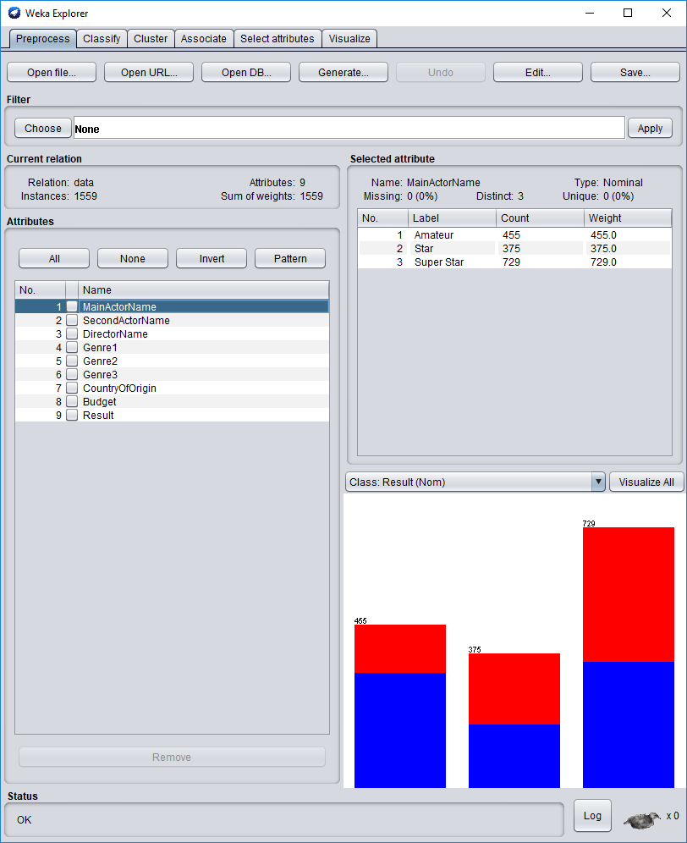

Slide 21
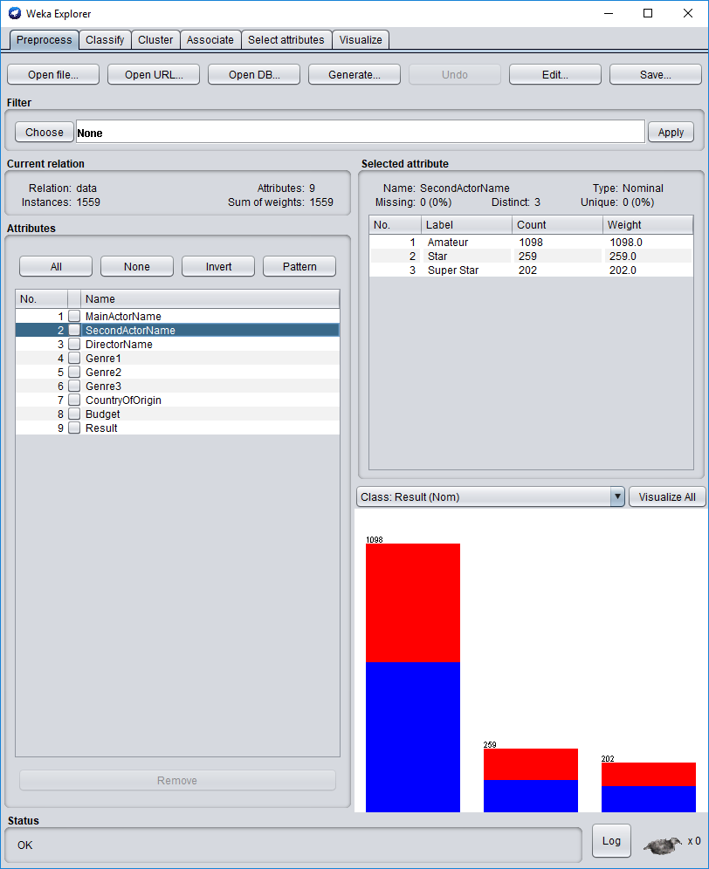

Slide 22
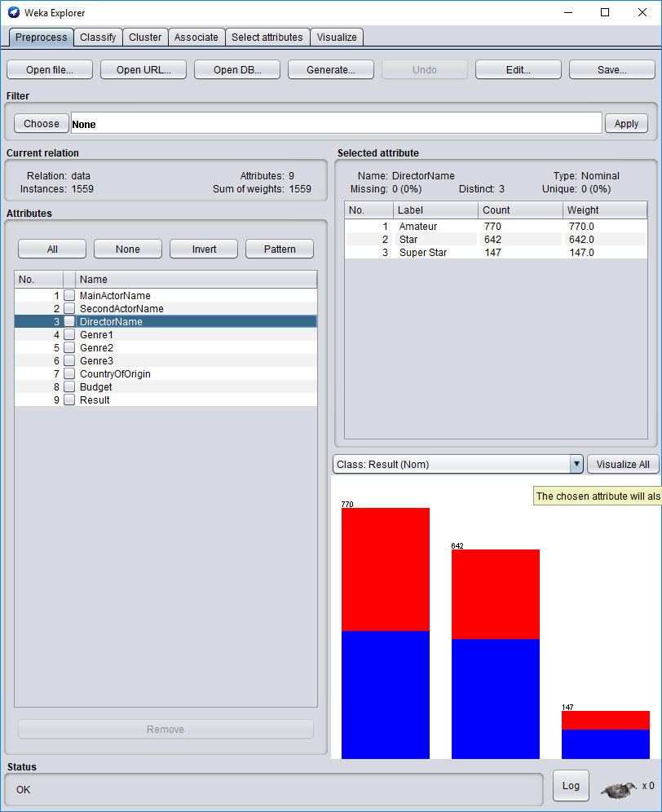

Slide 23
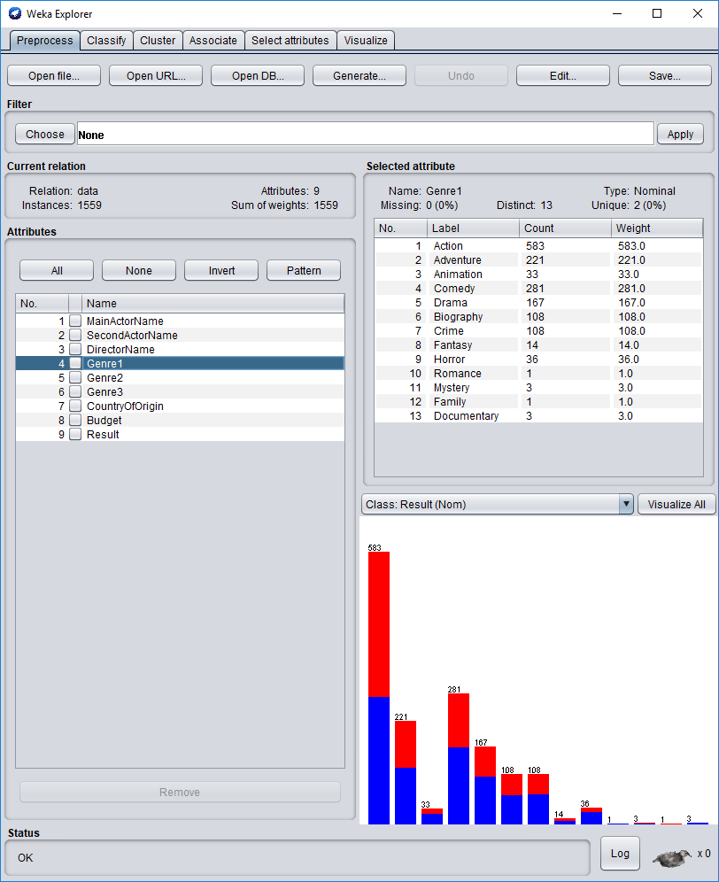
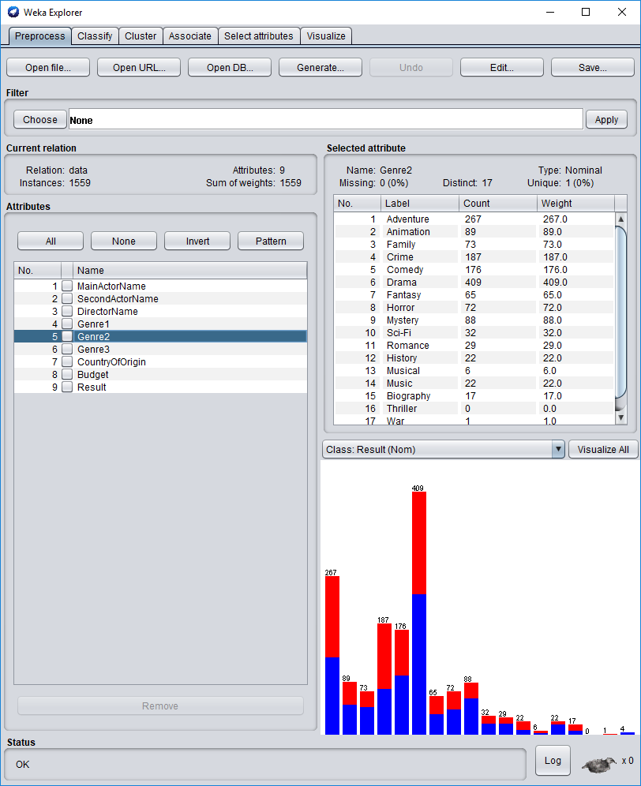
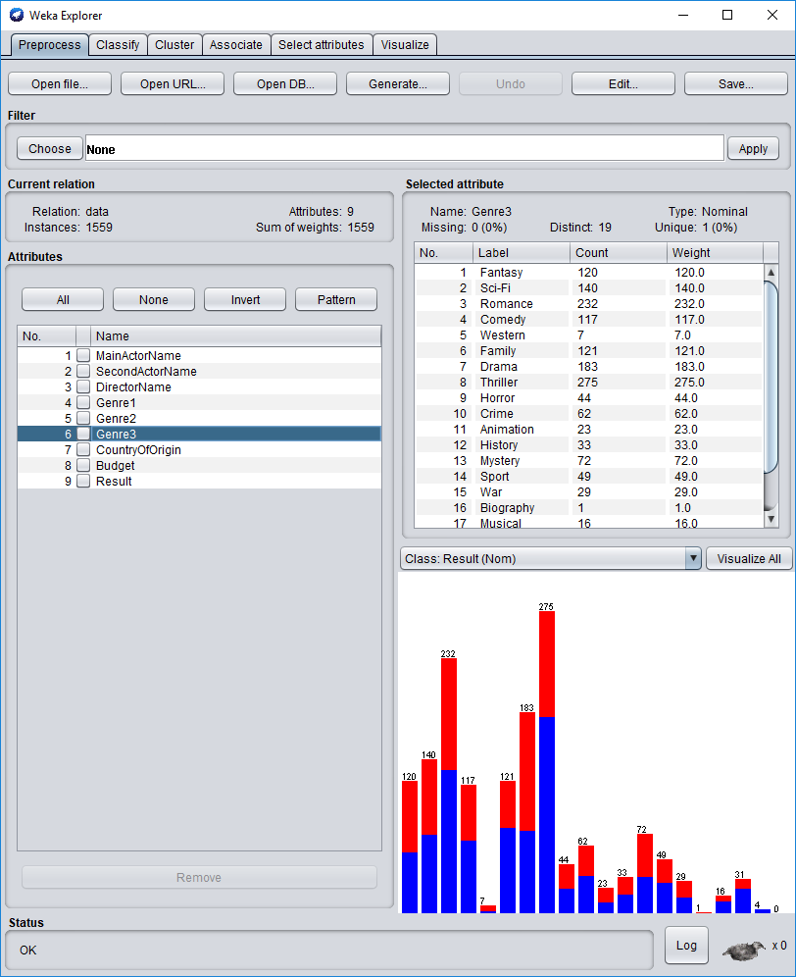

Slide 24
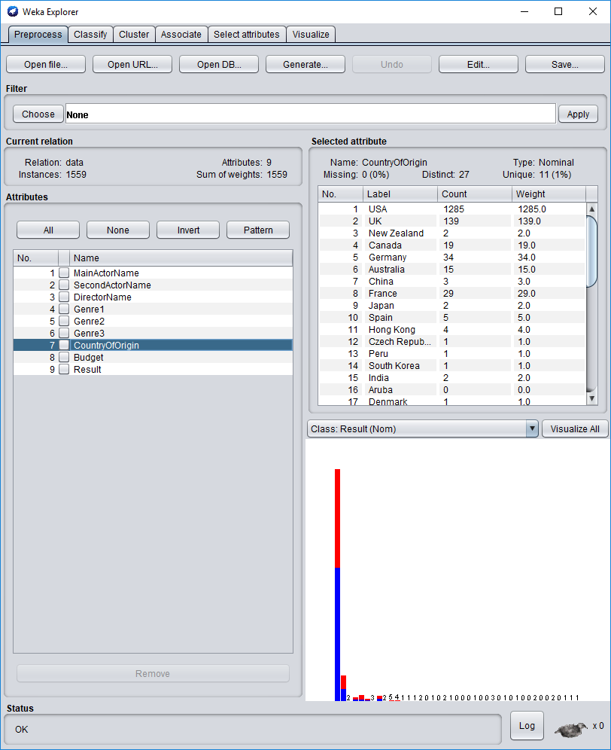

Slide 25
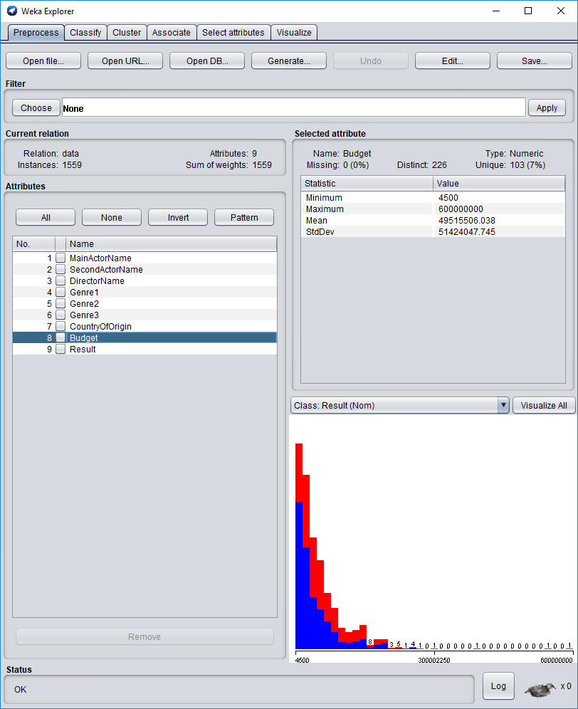

Slide 26
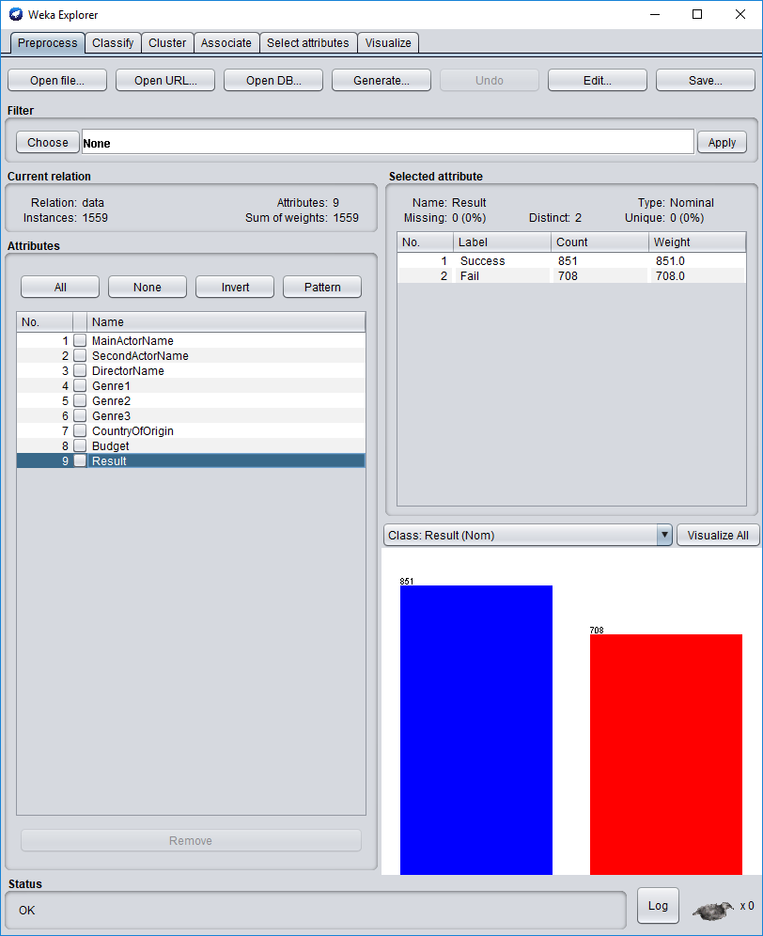

Slide 27
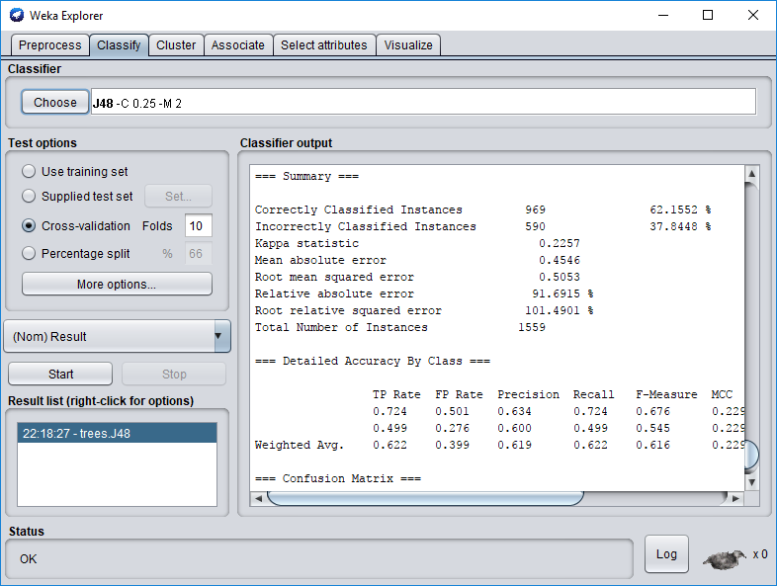
To validate the accuracy, we used Weka Explorer (with 10 Cross-validation)
Accuracy: 62%

Slide 28
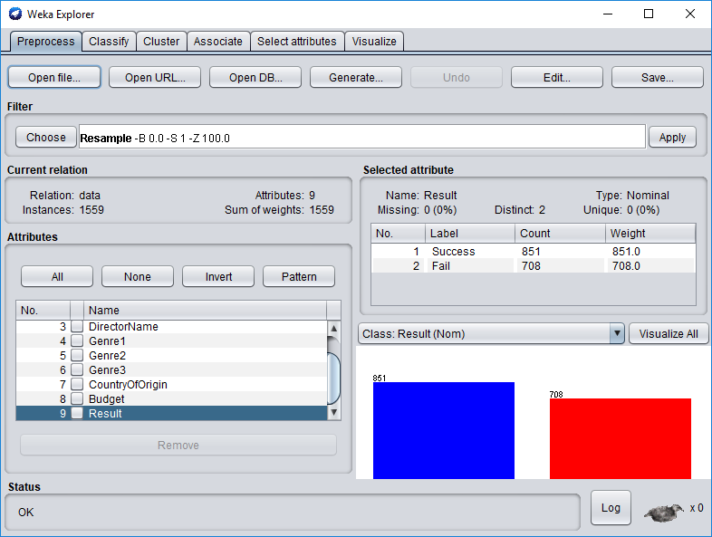

Slide 29
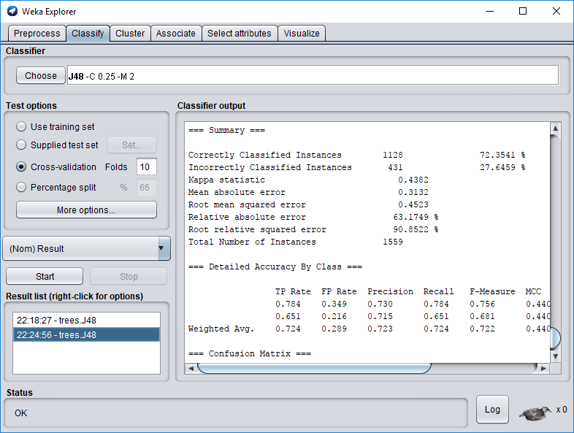
Resample the data
Accuracy: 72%

Slide 30
DEMO~

Slide 31
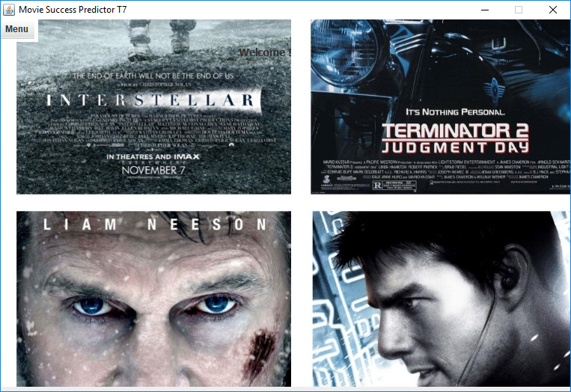
About the Application

Slide 32
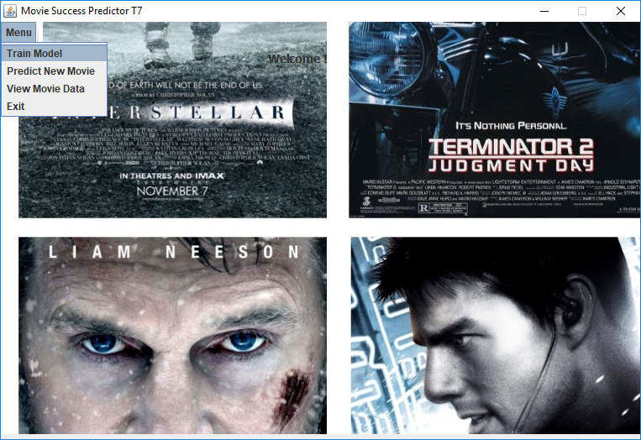
Train Model
It trains the model based on the latest dataset and create a model file

Slide 33
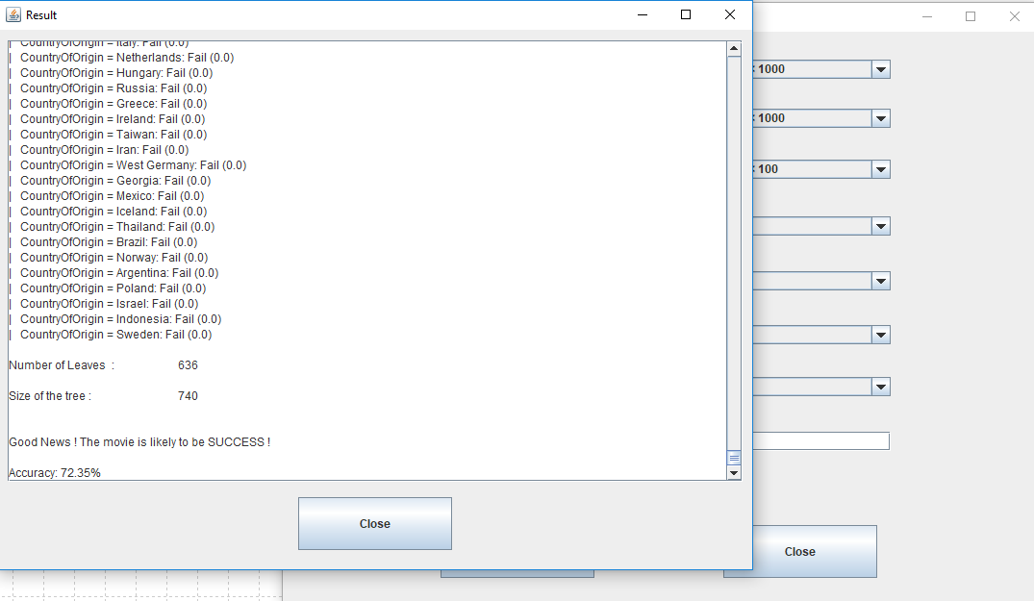
Predict Success/Fail of New Movie
It predict whether the new movie is a SUCCESS or will FAIL using the previously trained model

Slide 34
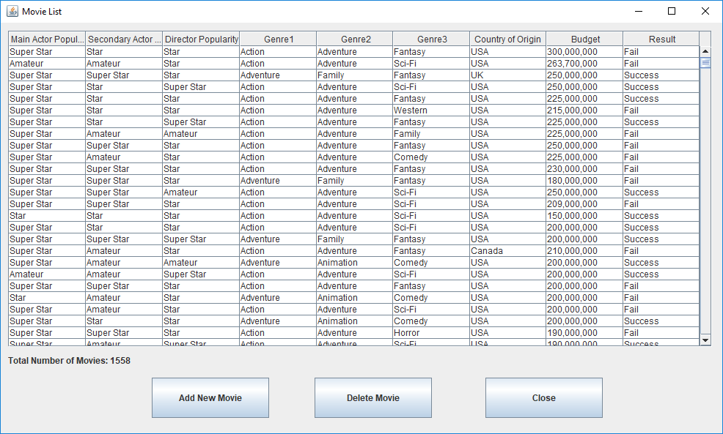
View Data
It lists down all the rows in the dataset

Slide 35
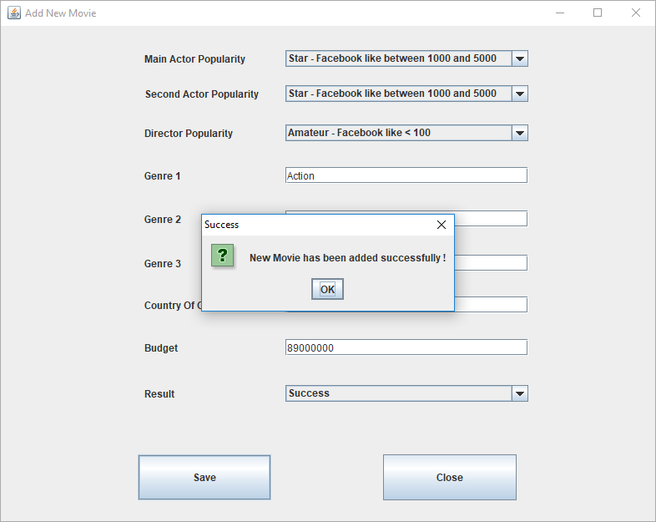
Add Data
It adds new movie data to the dataset

Slide 36
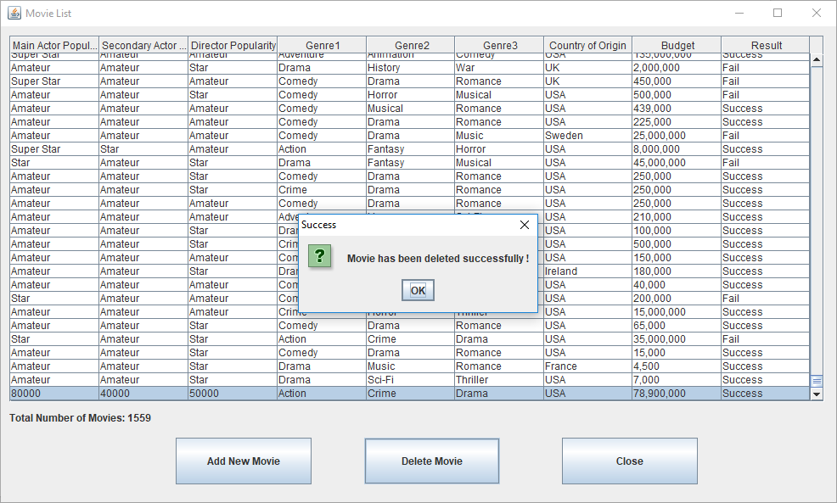
Delete Data
It deletes a movie data from the dataset

Slide 37
THANKS!

