Slide 1



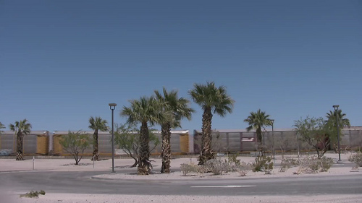
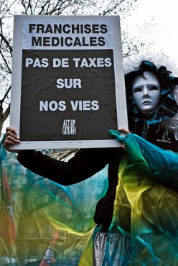

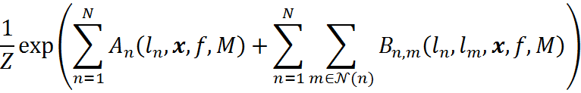

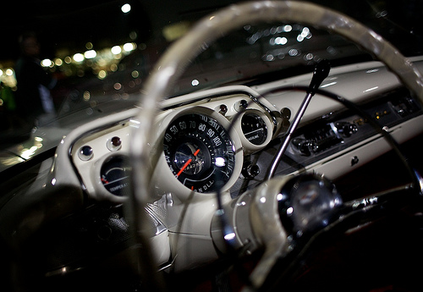





Image Labeling Using Social Network Metadata
Motivation
Baseline Model
Multimedia data such as video and pictures are being produced and shared at an unprecedented and accelerating rate. YouTube, for example, reports that 300 hours of video are uploaded to its servers every minute. There is a strong need for automated tools to help users understand, organize, and retrieve images and videos from very large collections.
A Conditional Random Field (CRF) will be used as a probability model due to its natural ability to model dependencies between pairs of labels while being conditioned on the input image. We will also compare against McAuley’s max-margin optimization solution.
Metadata: shared groups and words from text features
Number of ground truth labels (24)
Label
Normalization constant
Clique neighborhood
Image features: raw (x), object detector (f)
Unitary potential
Pairwise potential
Tags: [empty]
Labels: plant_life, sky, structures, tree
Tags: Paris, Ile-de-France, France, Act Up-Paris
Labels: female, people, plant_life, sky, structures, tree
Testing and Evaluation Plan
Data will be partitioned into training and (sequestered) test data based on EXIF timestamp data. Data with no EXIF timestamp will be used for training.
Round 1 (presented July 2015, evaluated January 2016):
Images which do not contain the tag “structure”: 5216 images for training, 2252 for testing
Round 2 (presented January 2016, evaluated July 2016):
Round 1 data plus 5421 images tagged “structure”: total 9182 training, 3707 for testing
Metrics:
Following [McAuley 2012], performance on test data will be measured using both Mean Average Precision (mAP) and Balanced Error Rate:
…where and are the set of images with positive and negative predicted labels, respectively, and
and are the sets of correct positive and negative images, respectively.
Tags: Tuscon, flower, Om
Labels: people, plant_life
Tags: Dashboard, steering, wheel
Labels: car, night, structures, transport
Sample images, first four associated user-supplied tags, and ground-truth labels, from [Huiskes2008]
Problem Specification
The challenge problem is to infer label(s) for images based on the metadata extracted from the Flickr social network in which the image is embedded. Image features may optionally also be used.
The source images and label set are drawn from the MIRFLICKR dataset [Huiskes 2008], which contains ground-truth labels for 25,000 Creative Commons-licensed images. The labels are a set of 24 high-level concepts.
The social network metadata is due to [McAuley 2012], who used the Flickr API to collect intrinsic and relational information about 12,889 of the MIRFLICKR images. These 12,889 images form the challenge problem corpus. The information includes:
The photo’s EXIF time / date, whether flash was used
Flickr-determined locality information
Flickr ID of the photo’s owner
Social text (free-form tags and comments from the owner and other Flickr users)
Social linking information (what Flickr groups this image belongs to)
Data Formats
Intrinsic, image feature, and relational data provided as flat files
Images available, but no performer image processing is required
References
[Huiskes2008] M. Huiskes, M. Lew, “The MIR Flickr retrieval evaluation,” CIVR, 2008
[McAuley2012] Julian McAuley and Jure Leskovec, Image Labeling on a Network: Using Social-Network Metadata for Image Classification, in ECCV 2012

