Slide 1
Functional-coefficient regression model of resource curse
Chengjun
20130816

Slide 2
1st step
library(locpol)
city =read.csv("d:/github/Research/visualization/city3.csv")
c1 = locpol(urbangroth~mining, city, xeval= city$mining)
dim(c1$lpFit)

Slide 3
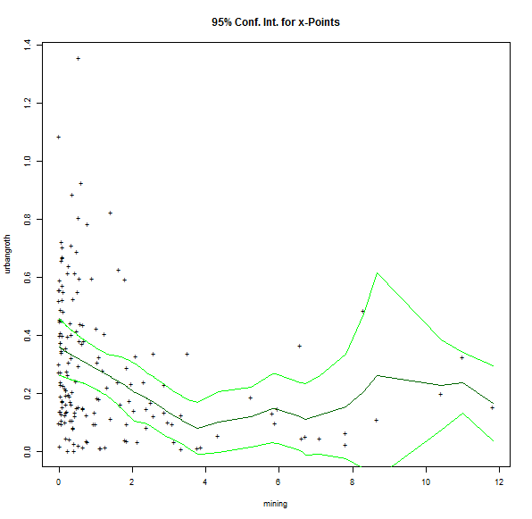
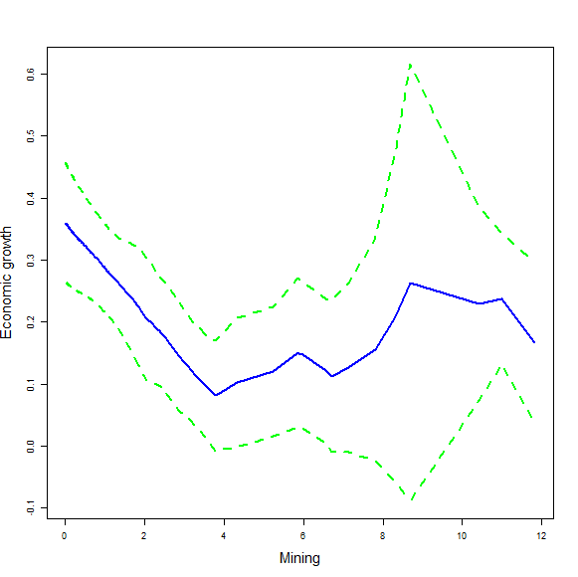
plot(c1), OR reproduce it by hand:
d = data.frame(city$mining, city$urbangroth)
dev <- sqrt(c1$CIwidth * c1$lpFit$var/c1$lpFit$xDen)
maxY = max( c1$lpFit[,c1$Y]+ 2*dev )
minY = min( c1$lpFit[,c1$Y]- 2*dev )
plot(d, type = "n", xlab = "Mining", ylab = "Economic growth", cex.lab=1.5, ylim = c(minY, maxY))
points(c1$lpFit[,c1$X],c1$lpFit[,c1$Y],type="l",lwd = 2, col="blue")
lines(c1$lpFit[,c1$X],c1$lpFit[,c1$Y]+ 2*dev,type="l",lty = 2,lwd = 2, col="green")
lines(c1$lpFit[,c1$X],c1$lpFit[,c1$Y]- 2*dev,type="l",lty = 2,lwd = 2, col="green")

Slide 4
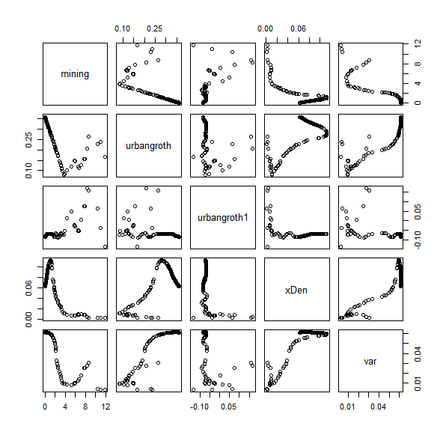
Summary(c1)
> summary(c1)
Kernel = ifelse(abs(x) <= 1, 3/4 * (1 - x^2), 0)
n deg bw ase
167 1 1.499942 0.04984723
Get the 1st derivative as the Coefficient

Slide 5
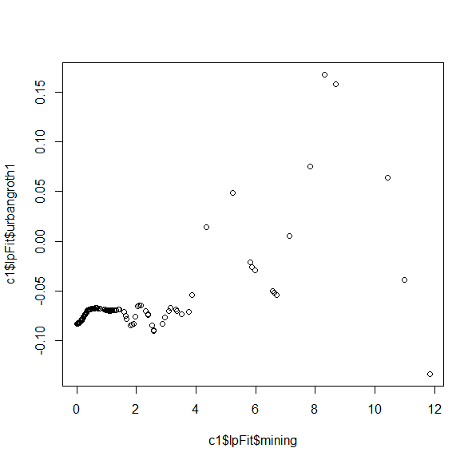
The 1st derivative of Y: Urban_growth

Slide 6


Slide 7
2nd Step
orderId = order(city$mining)
city2 = city[with(city, orderId), ]
city2 = data.frame(city2, c1$lpFit)
city2$LOGmanufactural = log(city2$manufactural)
c21 = locpol(urbangroth1~LOGmanufactural, city2)
c22 = locpol(urbangroth1~RD, city2)
c23 = locpol(urbangroth1~eduction, city2)
c24 = locpol(urbangroth1~openness, city2)

Slide 8
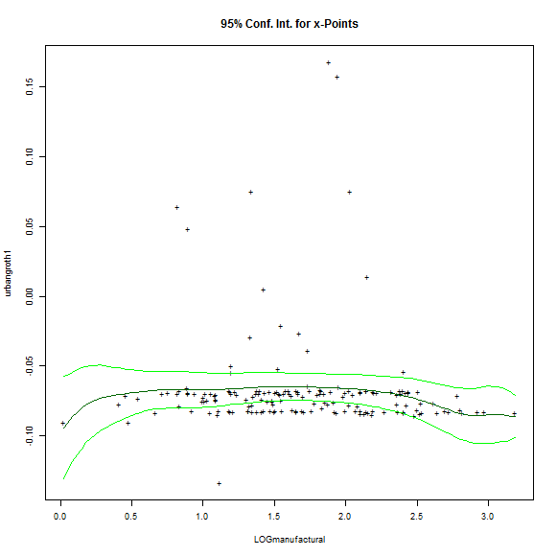
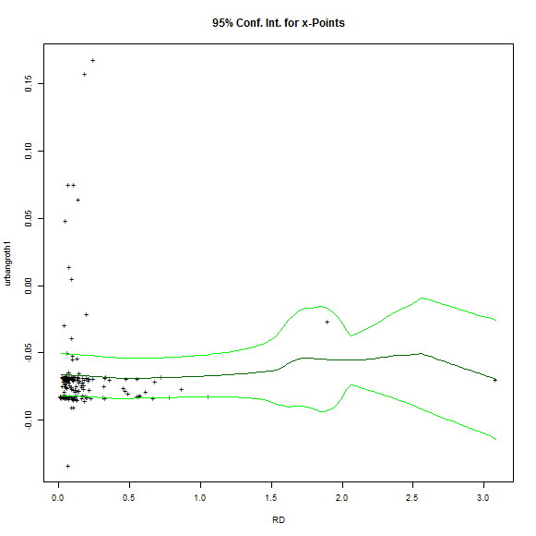
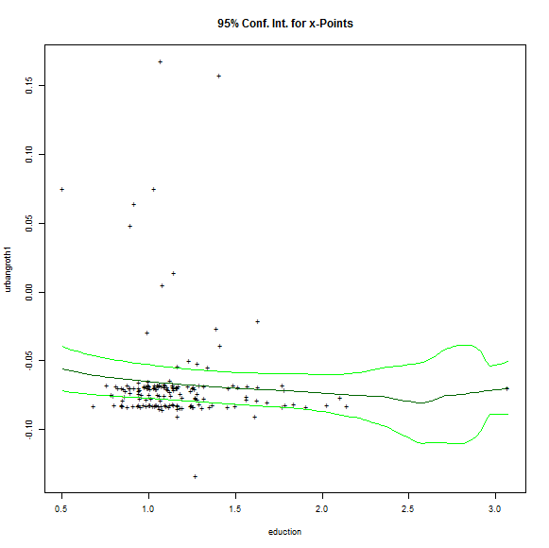
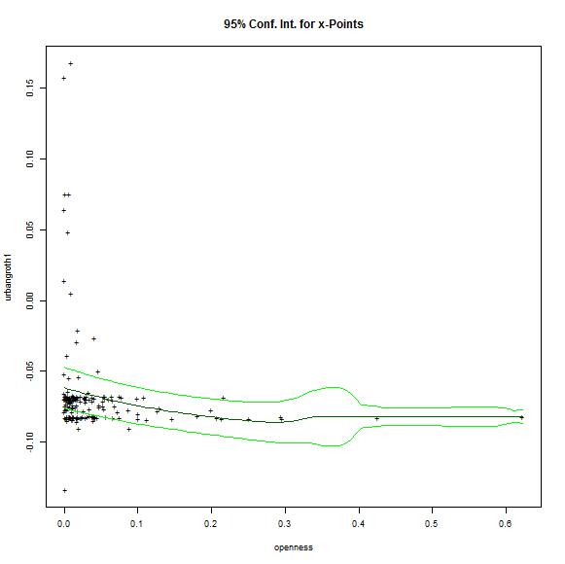

Slide 9
New Plot 1
# plot 22
c21 = c22
c1 = c22
maxY = max( c21$lpFit[,c21$Y]+ sqrt(c21$lpFit$var) )
minY = min( c21$lpFit[,c21$Y]- sqrt(c21$lpFit$var) )
plot(city2$urbangroth1~city2$RD, # Change here
type = "n", xlab = "R&D", # Change here
ylab = "Coefficient", main = "Economic growth", cex.lab=1.5, cex.main = 2, cex.axis = 1.5,
ylim = c(minY, maxY ) )
points(c1$lpFit[,c1$X],c1$lpFit[,c1$Y],type="l",lwd = 2, col="blue")
lines(c1$lpFit[,c1$X],c1$lpFit[,c1$Y]+ sqrt(c1$lpFit$var),type="l",lty = 2,lwd = 2, col="green")
lines(c1$lpFit[,c1$X],c1$lpFit[,c1$Y]- sqrt(c1$lpFit$var),type="l",lty = 2,lwd = 2, col="green")

Slide 10
New Plot 2
# plot 21
maxY = max( c21$lpFit[,c21$Y]+ sqrt(c21$lpFit$var) )
minY = min( c21$lpFit[,c21$Y]- sqrt(c21$lpFit$var) )
plot(city2$urbangroth1~city2$LOGmanufactural, # Change here
type = "n", xlab = "Manufactural(Log)", # Change here
ylab = "Coefficient", main = "Economic growth", cex.lab=1.5, cex.main = 2, cex.axis = 1.5,
ylim = c(minY, maxY ) )
c1 = c21 # change here
points(c1$lpFit[,c1$X],c1$lpFit[,c1$Y],type="l",lwd = 2, col="blue")
lines(c1$lpFit[,c1$X],c1$lpFit[,c1$Y]+ sqrt(c1$lpFit$var),type="l",lty = 2,lwd = 2, col="green")
lines(c1$lpFit[,c1$X],c1$lpFit[,c1$Y]- sqrt(c1$lpFit$var),type="l",lty = 2,lwd = 2, col="green")

Slide 11
New Plot 3
# plot 24
c21 = c24
c1 = c24
maxY = max( c21$lpFit[,c21$Y]+ sqrt(c21$lpFit$var) )
minY = min( c21$lpFit[,c21$Y]- sqrt(c21$lpFit$var) )
plot(city2$urbangroth1~city2$openness, # Change here
type = "n", xlab = "Openness", # Change here
ylab = "Coefficient", main = "Economic growth", cex.lab=1.5, cex.main = 2, cex.axis = 1.5,
ylim = c(minY, maxY ) )
points(c1$lpFit[,c1$X],c1$lpFit[,c1$Y],type="l",lwd = 2, col="blue")
lines(c1$lpFit[,c1$X],c1$lpFit[,c1$Y]+ sqrt(c1$lpFit$var),type="l",lty = 2,lwd = 2, col="green")
lines(c1$lpFit[,c1$X],c1$lpFit[,c1$Y]- sqrt(c1$lpFit$var),type="l",lty = 2,lwd = 2, col="green")

Slide 12
New Plot 4
# plot 23
c21 = c23
c1 = c23
maxY = max( c21$lpFit[,c21$Y]+ sqrt(c21$lpFit$var) )
minY = min( c21$lpFit[,c21$Y]- sqrt(c21$lpFit$var) )
plot(city2$urbangroth1~city2$eduction, # Change here
type = "n", xlab = "Education", # Change here
ylab = "Coefficient", main = "Economic growth", cex.lab=1.5, cex.main = 2, cex.axis = 1.5,
ylim = c(minY, maxY ) )
points(c1$lpFit[,c1$X],c1$lpFit[,c1$Y],type="l",lwd = 2, col="blue")
lines(c1$lpFit[,c1$X],c1$lpFit[,c1$Y]+ sqrt(c1$lpFit$var),type="l",lty = 2,lwd = 2, col="green")
lines(c1$lpFit[,c1$X],c1$lpFit[,c1$Y]- sqrt(c1$lpFit$var),type="l",lty = 2,lwd = 2, col="green")

Slide 13
