Slide 1
ECE 569A
Programmer Salary Prediction web application with Explainable AI
Archana Radhakrishnan Sreevidhya
Charina Regis
Chaoran Zhou
Chengkai Yang
MADS - UVic

Slide 2
Problem description and motivation[2 mins]
Kai
Notes:
In January 2025, DeepSeek released the DeepSeek-R1 model, whose performance can be comparable to the official version of OpenAI o1. This model has extensively employed reinforcement learning techniques during the post-training phase. Even with only a minimal amount of annotated data, it has significantly enhanced the model's reasoning ability. What's more striking is that the development cost of DeepSeek-R1 is only about 6 million US dollars, which is far lower than the development expenses of other similar models.

Slide 3
show Demo [1-2 mins]
Kai
- Input
- Output
- Explainable Ai

Slide 4
Steps to build the website[1-2mins]
kai

Slide 5
Data Sources and Selected Features
Main Dataset
File: survey_results_public.csv
Source: Stack Overflow Developer Survey 2024
Features Selected:
YearsCodePro (float64)
Age (float64)
WorkExp (float64)
ConvertedCompYearly (float64)
DevType, Country, RemoteWork, EdLevel, Employment, OrgSize, LanguageHaveWorkedWith (object)
Secondary Dataset 1: World Bank – GDP per Capita
Source: The World Bank, accessed via the wbgapi Python package.
Country
GDP_per_capita
Secondary Dataset 2: Global Cost of Living Index
Source: Kaggle – Global Cost of Living
https://www.kaggle.com/datasets/mvieira101/global-cost-of-living
country → Country
x2 → Cost_Index

Slide 6
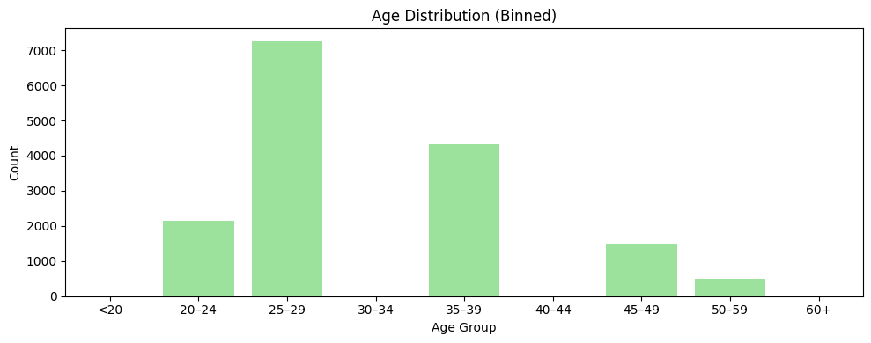
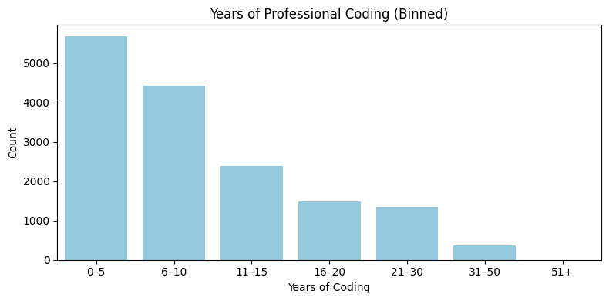
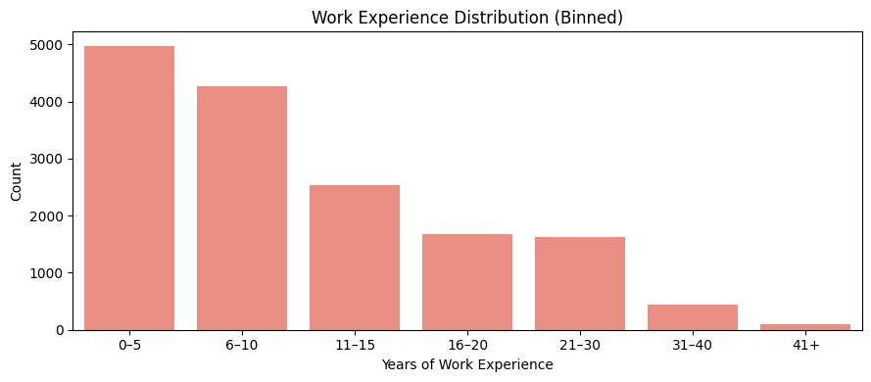
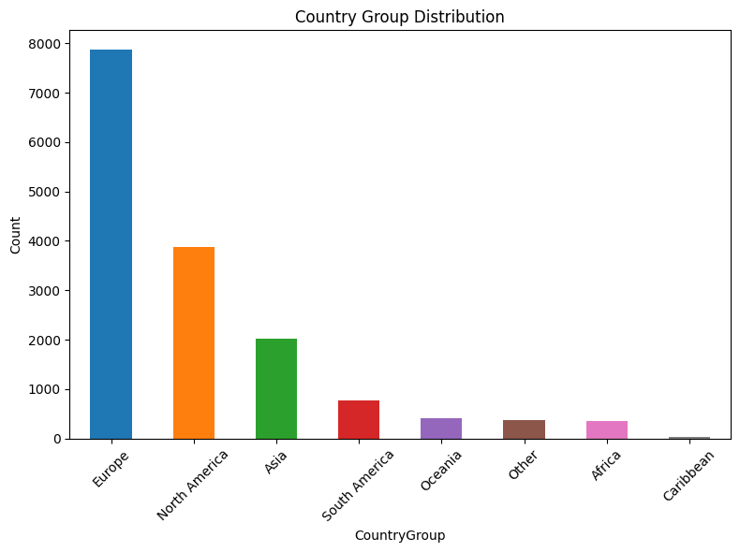
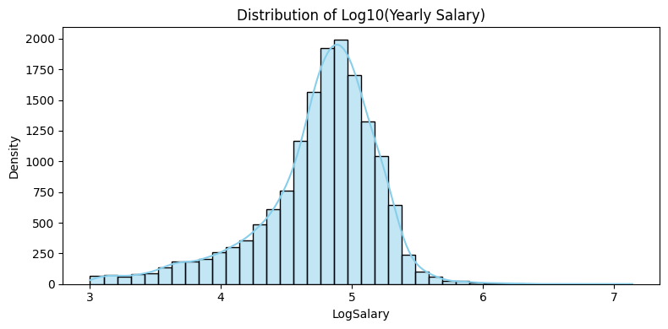
EDA Overview

Slide 7
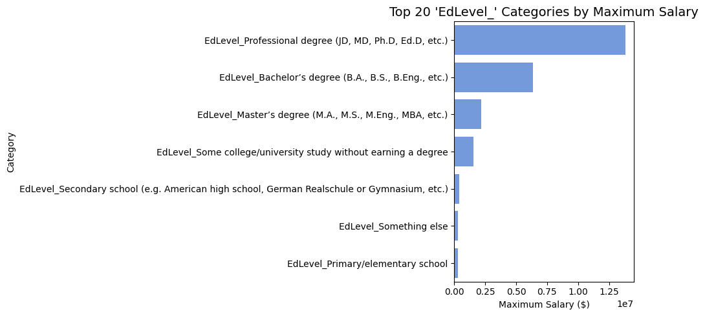
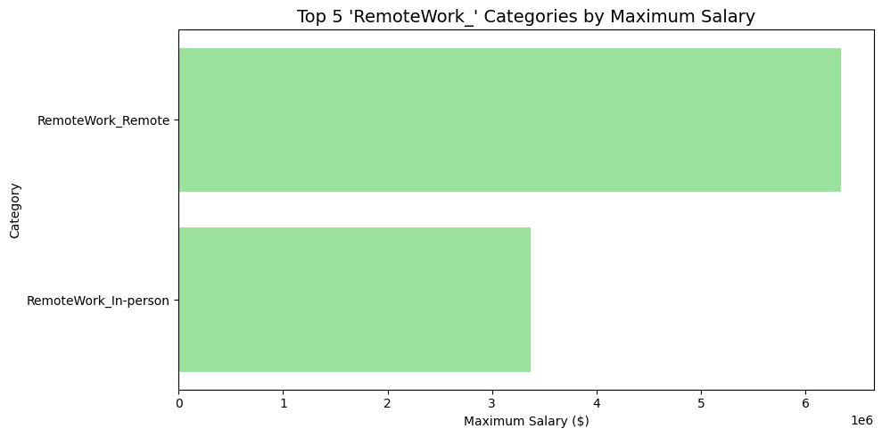
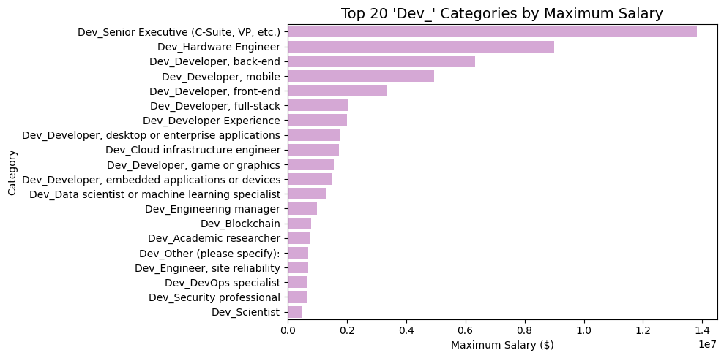
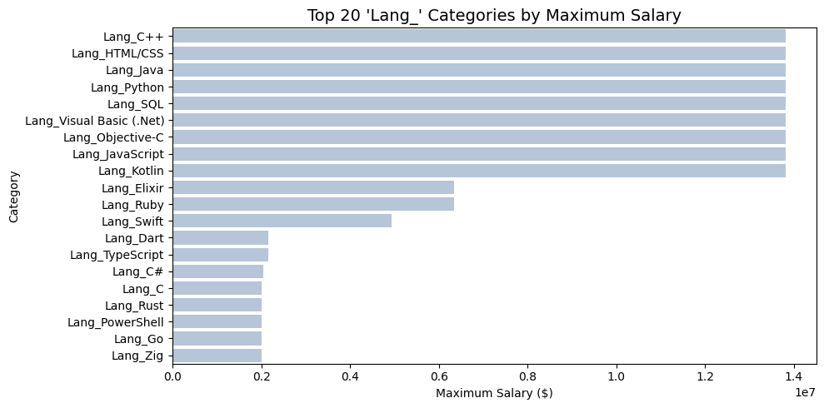
Max Salary Insights

Slide 8
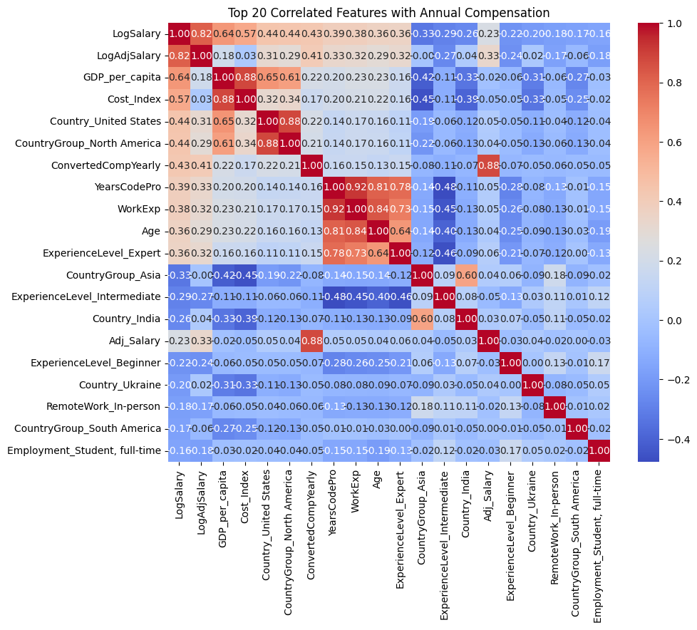
Correlation Matrix

Slide 9
Feature Engineering and Transformation
New Features Created:
CountryGroup (derived from Country: North America, South America, Europe, Asia, Africa, Oceania, Caribbean, Other)
ExperienceLevel (derived from YearsCodePro: Beginner, Intermediate, Advanced, Expert)
LogSalary (log of ConvertedCompYearly)
GDP_per_capita (derived from the WB dataset)
Cost_Index (derived from Cost of Living dataset)
Adj_Salary (ConvertedCompYearly/Cost_Index)
LogAdjSalary (log of Adj_Salary)
Numeric Feature Handling:
Age (convert to midpoint of the age ranges)
YearsCodePro
WorkExp
ConvertedCompYearly (drop non-numeric values)
Drop non-numeric values
One-Hot Encoded Categorical Variables:
EdLevel
RemoteWork
OrgSize
ExperienceLevel
Country
CountryGroup
DevType
Employment
LanguageHaveWorkedWith (also group Low-Frequency Languages into “Other”)

Slide 10
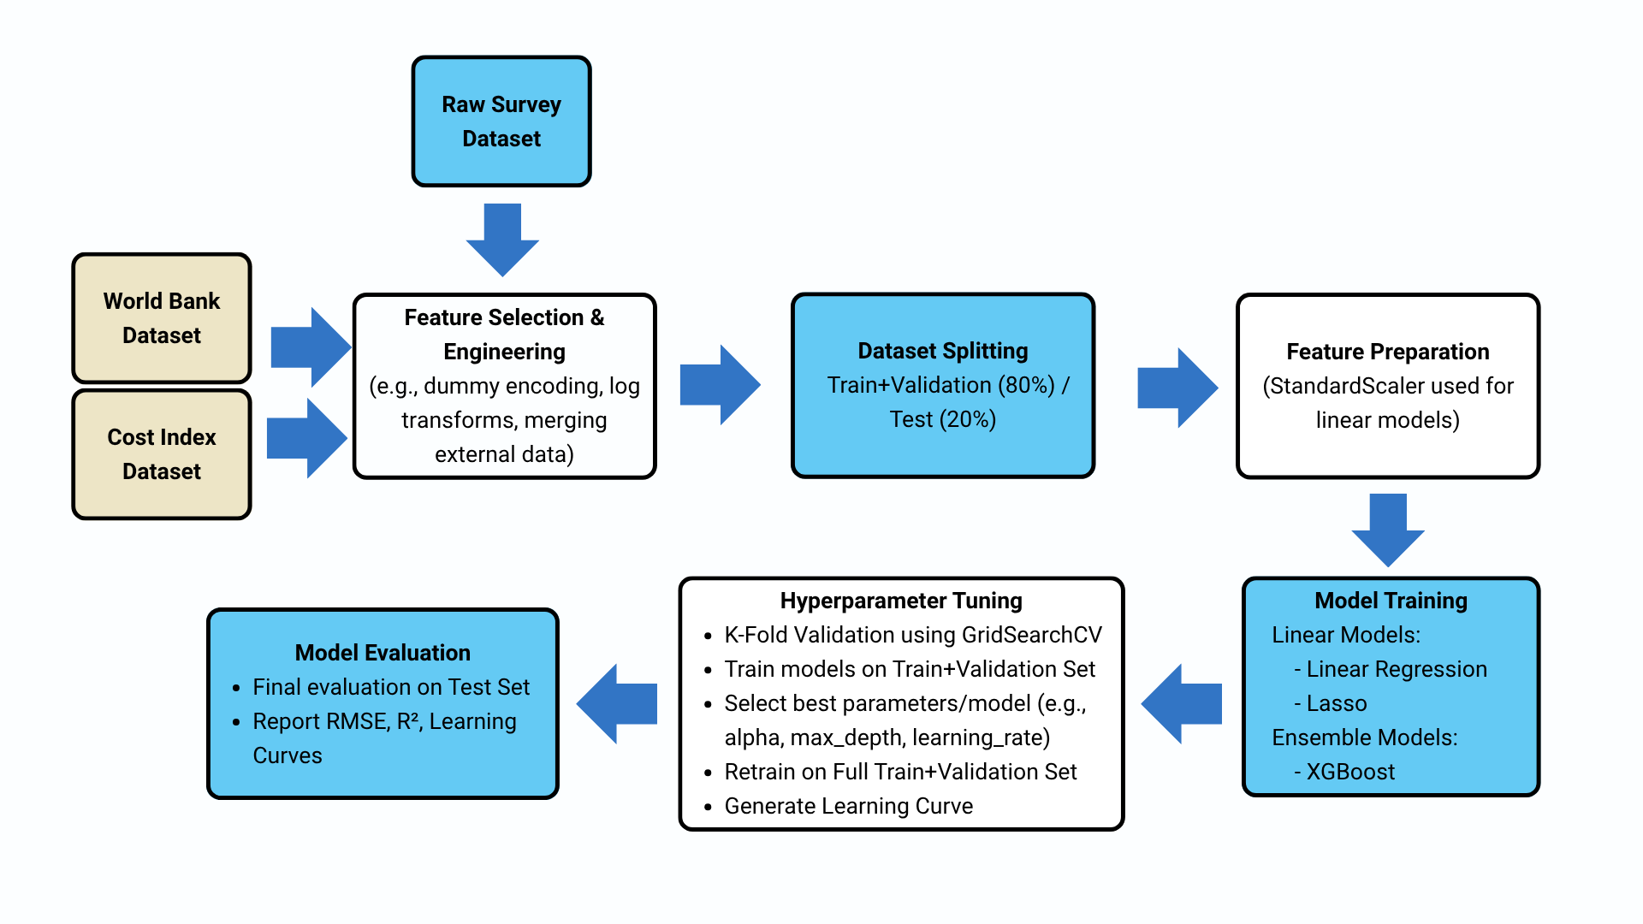
End-to-End Modeling Workflow

Slide 11
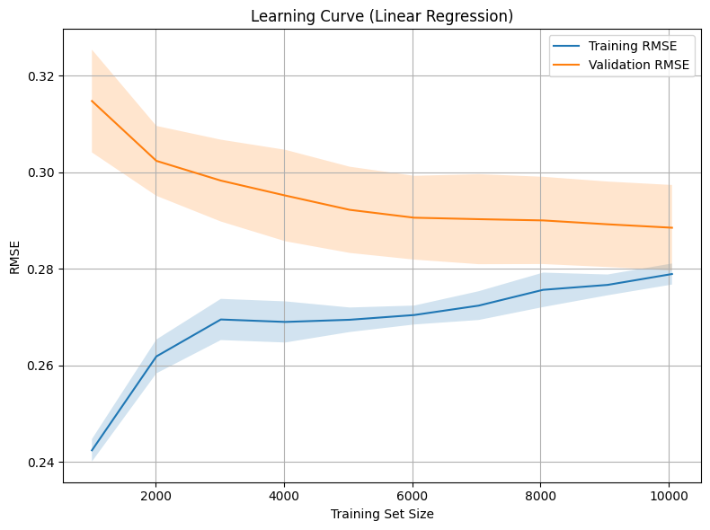

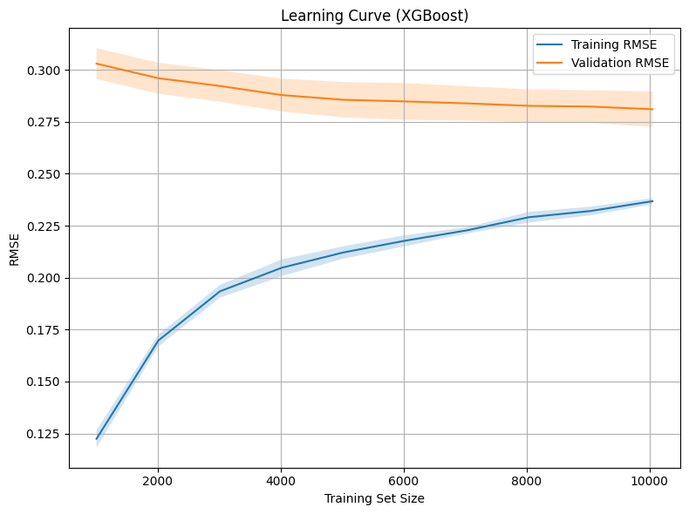
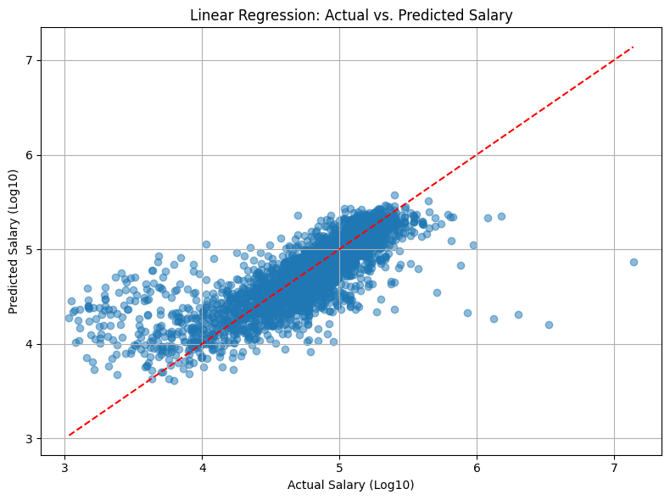
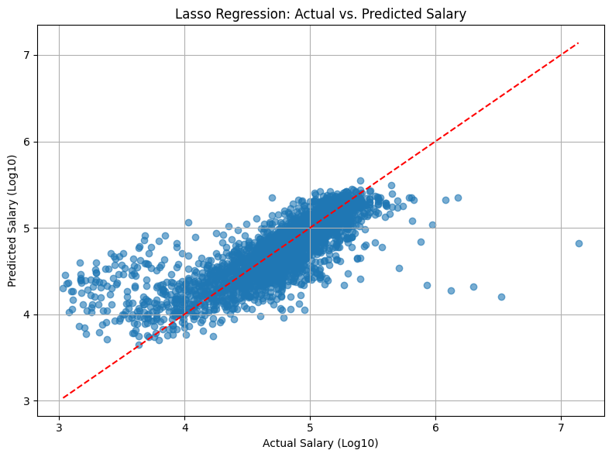

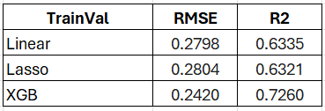
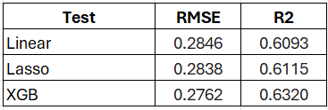
Model Training and Evaluation
Linear Regression
Lasso Regression
XGBoost
XGBoost achieved the best test accuracy with lowest RMSE and highest R², though its learning curve showed overfitting. Linear models were more stable, reflecting a trade-off between accuracy and generalization.

Slide 12
QA

