Slide 1
ECE 569A
Programmer Salary Prediction web application with Explainable AI
Archana Radhakrishnan Sreevidhya
Charina Regis
Chaoran Zhou
Chengkai Yang
MADS - UVic

Slide 2
Problem description and motivation
Many UVic Computer Science students are looking for internships or their first job
But sometimes they don’t know what salary to expect, especially international students.
They might have questions like:
- How much can I earn with my current skills?
- If I want to be a full-stack developer or data analyst, how does salary change in different cities or with different skills?

Slide 3
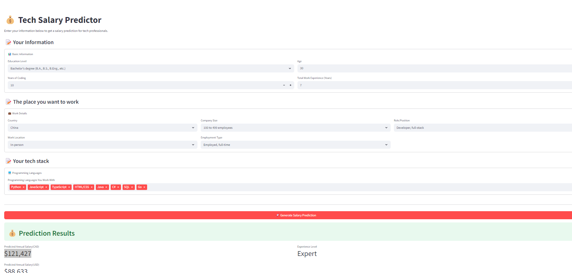
Online Demo
We developed an online webpage that allows users to predict their salary based on their personal information, such as education level, years of experience, and work location.
- http://47.121.130.34:8089/

Slide 4
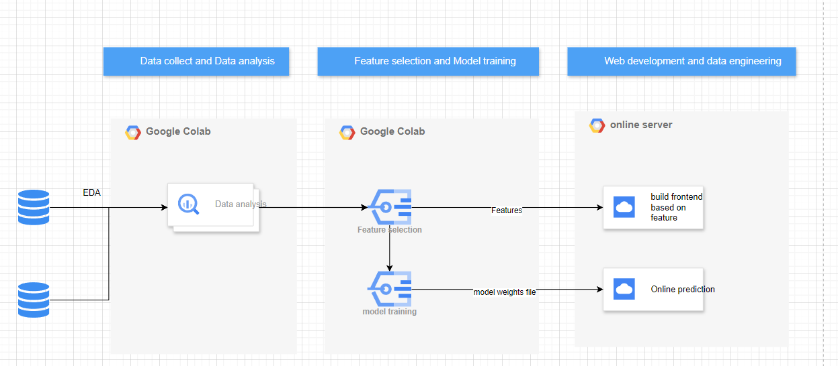
Workflow

Slide 5
Data Sources and Selected Features
Main Dataset
File: survey_results_public.csv
Source: Stack Overflow Developer Survey 2024
Features Selected:
YearsCodePro (float64)
Age (float64)
WorkExp (float64)
ConvertedCompYearly (float64)
DevType, Country, RemoteWork, EdLevel, Employment, OrgSize, LanguageHaveWorkedWith (object)
Secondary Dataset 1: World Bank – GDP per Capita
Source: The World Bank, accessed via the wbgapi Python package.
Country
GDP_per_capita
Secondary Dataset 2: Global Cost of Living Index
Source: Kaggle – Global Cost of Living
https://www.kaggle.com/datasets/mvieira101/global-cost-of-living
country → Country
x2 → Cost_Index

Slide 6
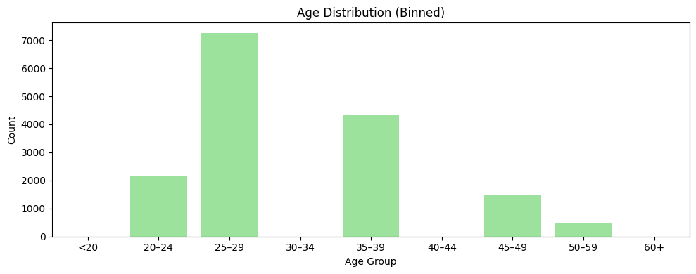
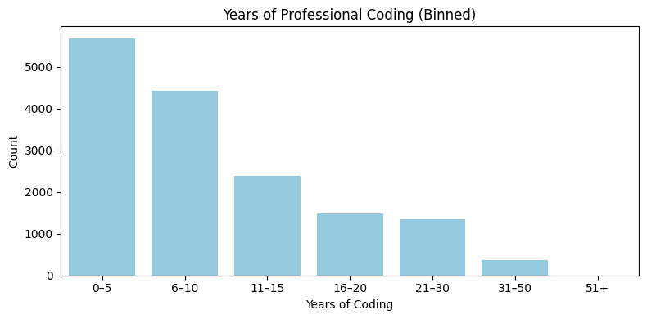
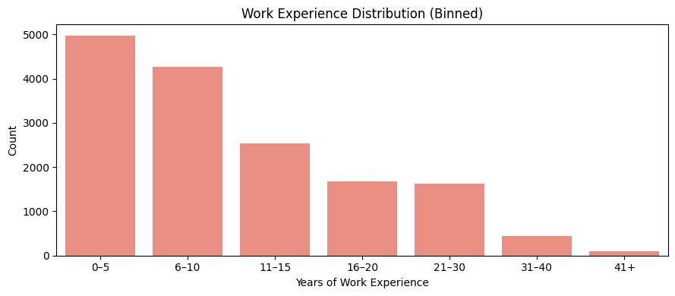
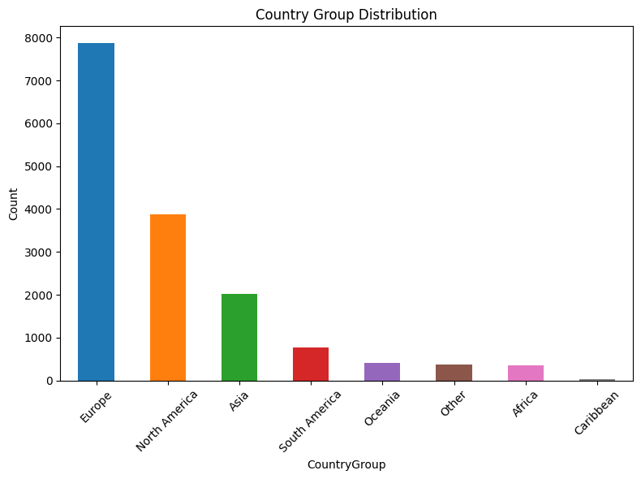
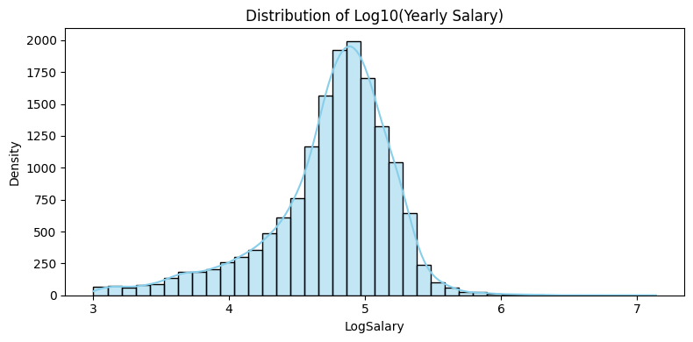
EDA Overview

Slide 7
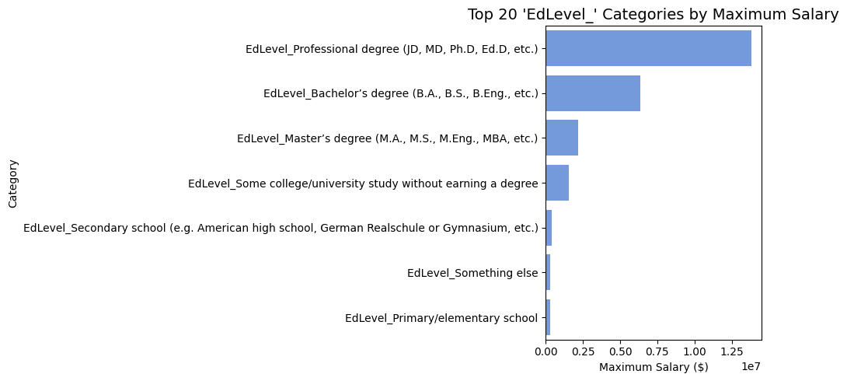
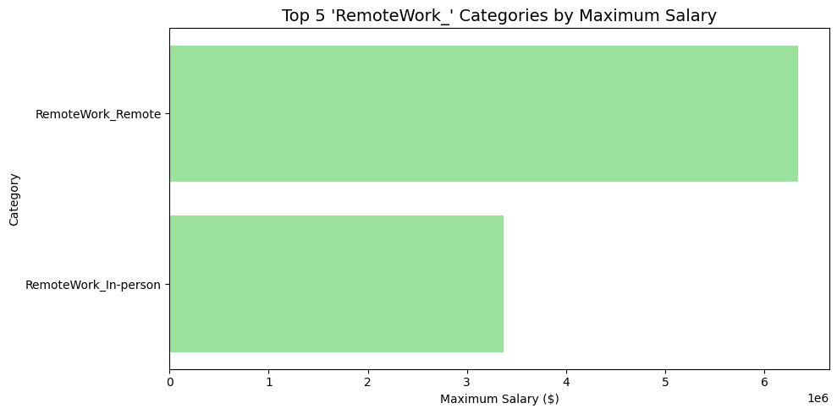
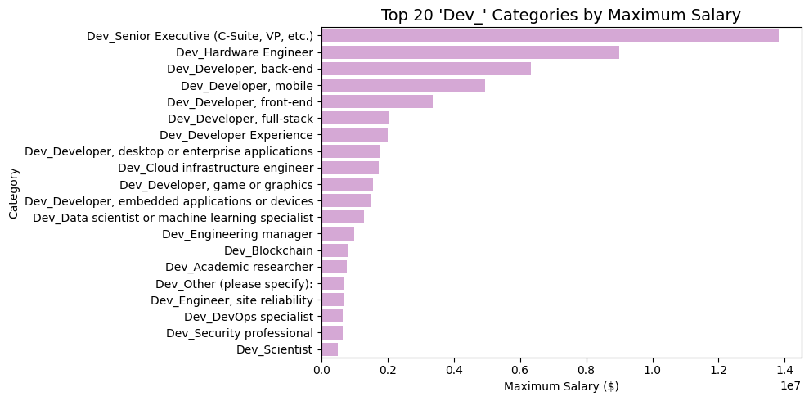
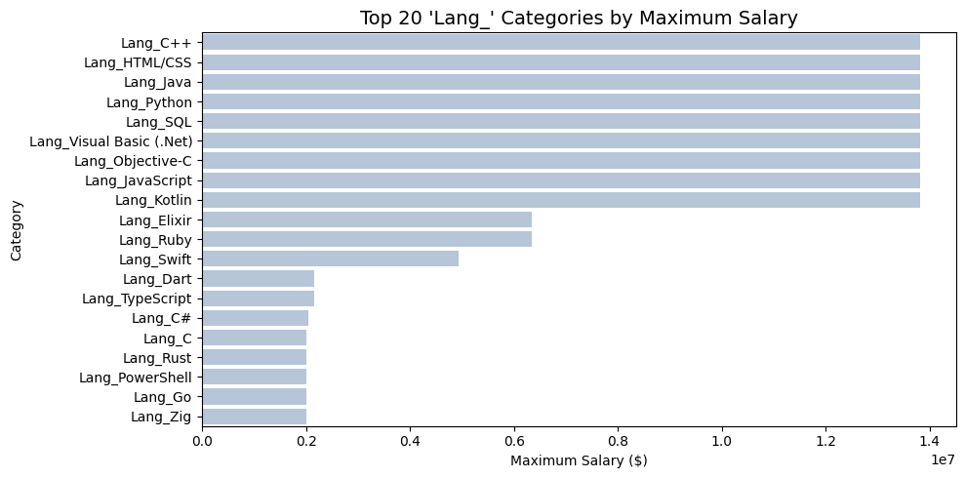
Max Salary Insights

Slide 8
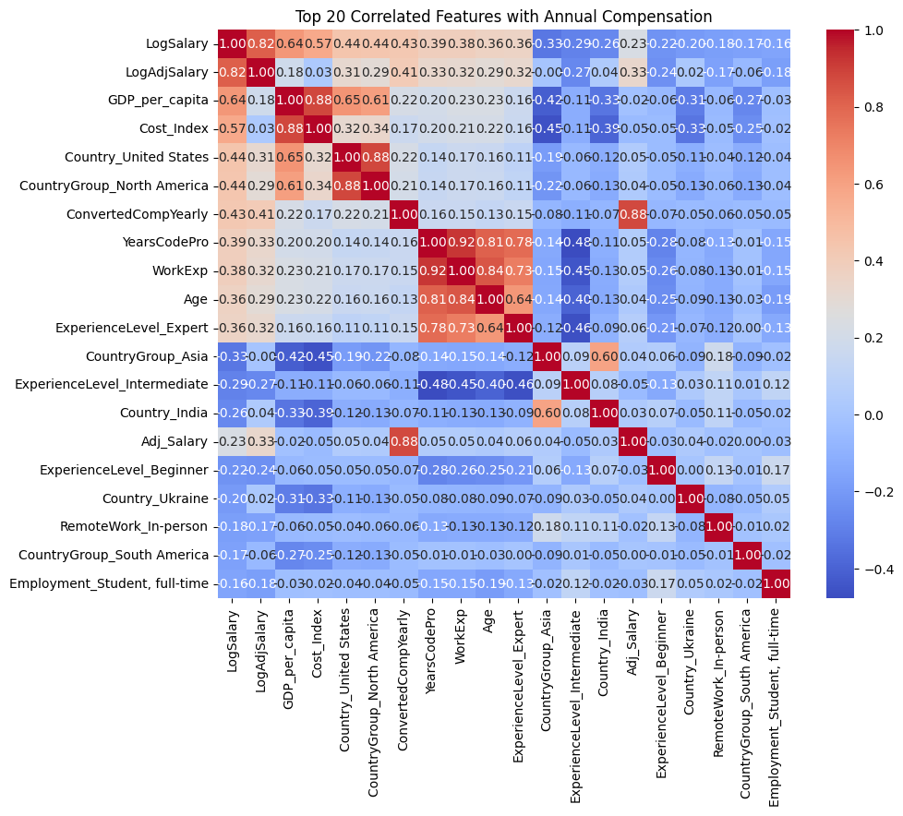
Correlation Matrix

Slide 9
Feature Engineering and Transformation
New Features Created:
CountryGroup (derived from Country: North America, South America, Europe, Asia, Africa, Oceania, Caribbean, Other)
ExperienceLevel (derived from YearsCodePro: Beginner, Intermediate, Advanced, Expert)
LogSalary (log of ConvertedCompYearly)
GDP_per_capita (derived from the WB dataset)
Cost_Index (derived from Cost of Living dataset)
Adj_Salary (ConvertedCompYearly/Cost_Index)
LogAdjSalary (log of Adj_Salary)
Numeric Feature Handling:
Age (convert to midpoint of the age ranges)
YearsCodePro
WorkExp
ConvertedCompYearly (drop non-numeric values)
Drop non-numeric values
One-Hot Encoded Categorical Variables:
EdLevel
RemoteWork
OrgSize
ExperienceLevel
Country
CountryGroup
DevType
Employment
LanguageHaveWorkedWith (also group Low-Frequency Languages into “Other”)

Slide 10
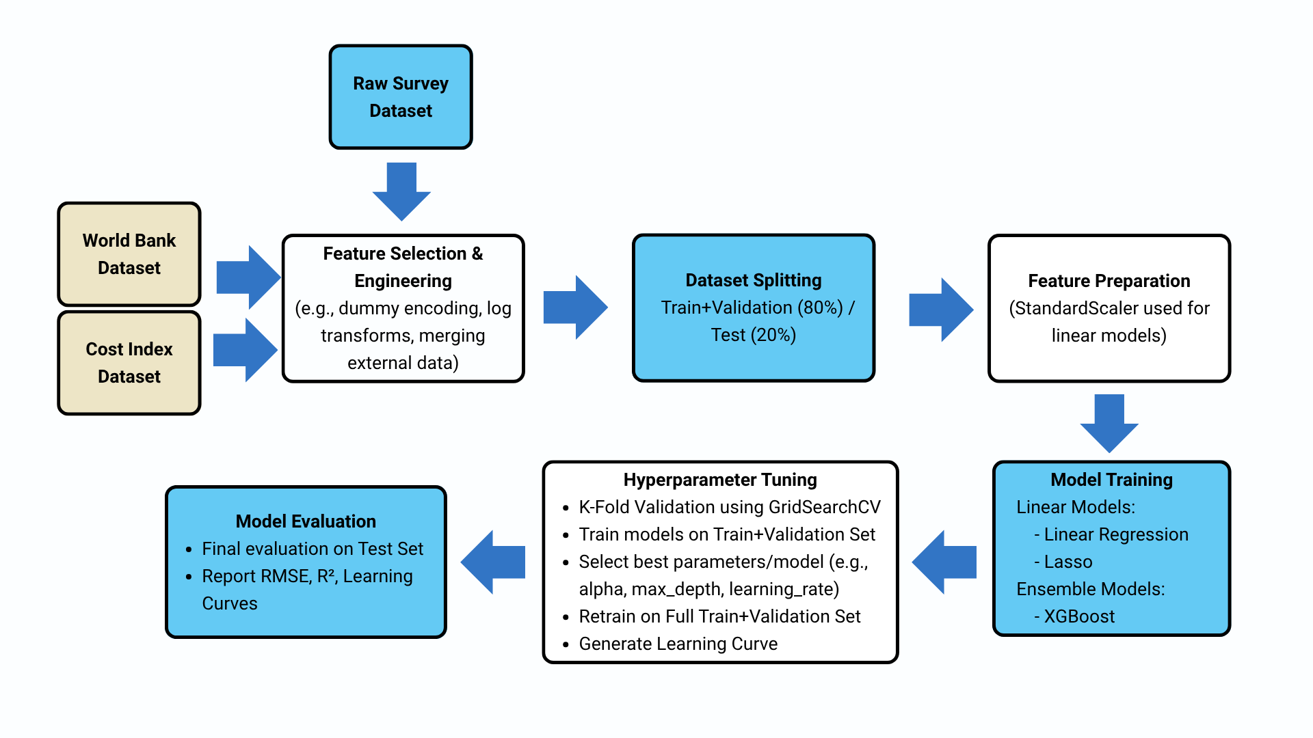
End-to-End Modeling Workflow

Slide 11
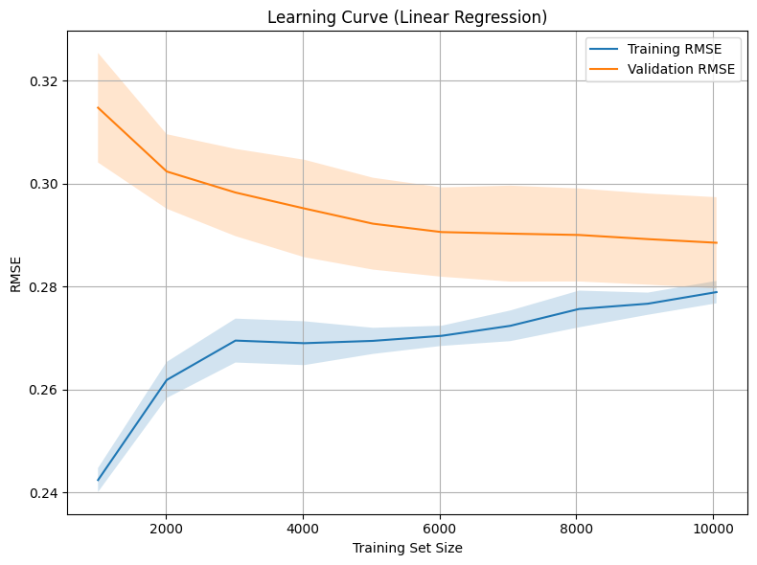

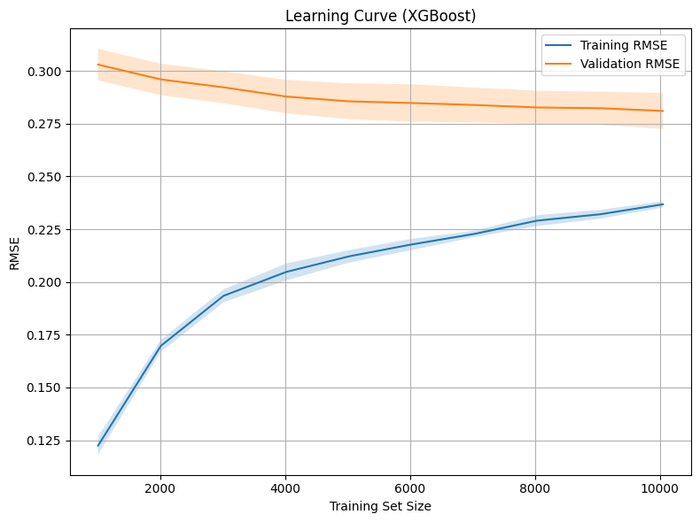
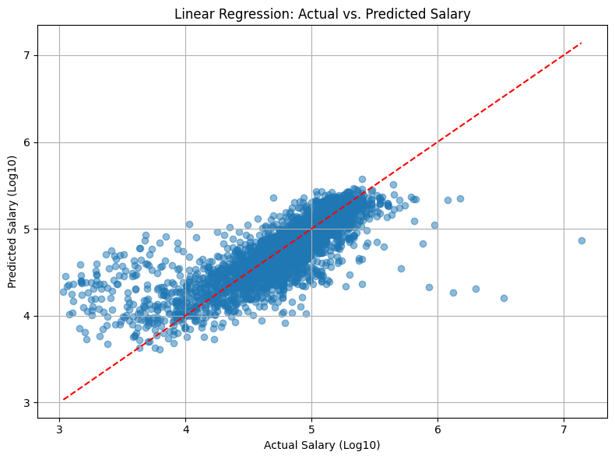
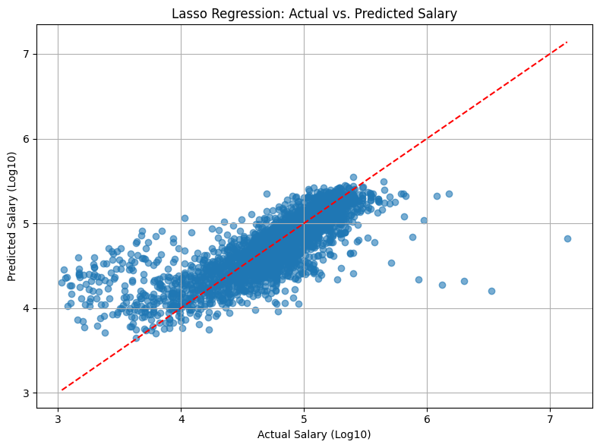

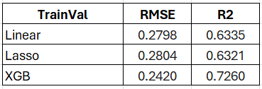
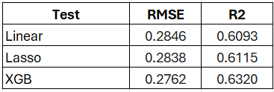
Model Training and Evaluation
Linear Regression
Lasso Regression
XGBoost
XGBoost achieved the best test accuracy with lowest RMSE and highest R², though its learning curve showed overfitting. Linear models were more stable, reflecting a trade-off between accuracy and generalization.

Slide 12
QA

