Slide 2
Summary on
Hope you all read this paper...

Slide 3
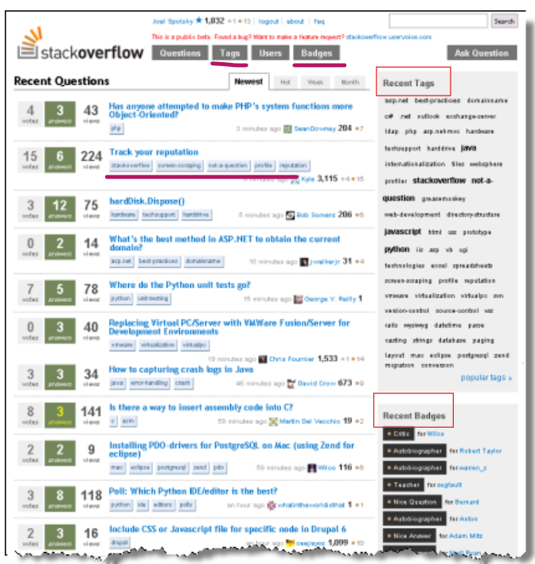
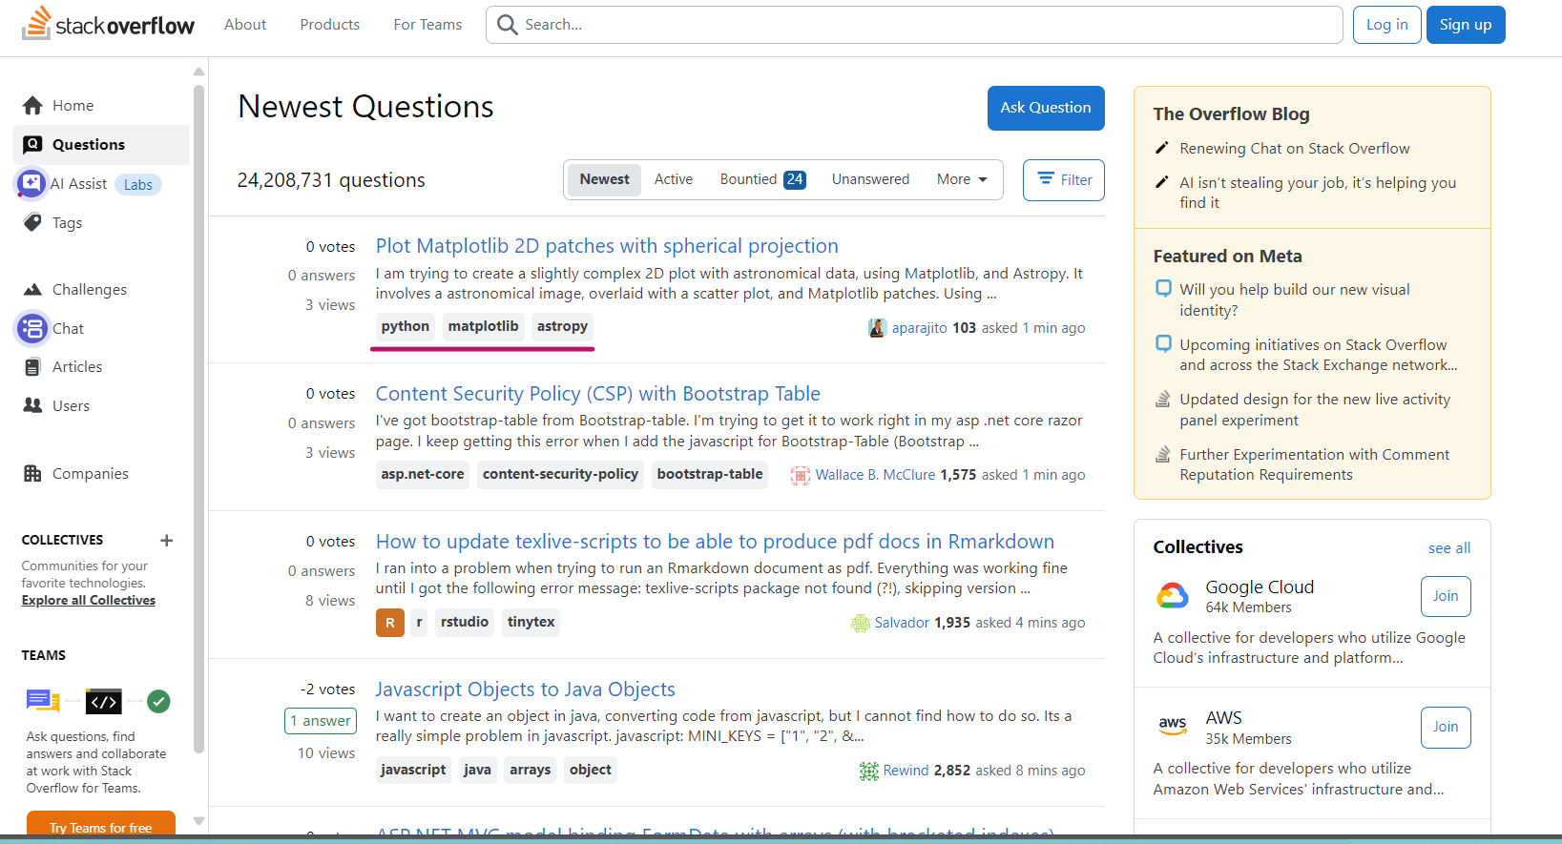
Summary(What is Stack Overflow)
Stack Overflow is a question-and-answer community for programmers, founded in 2008, where users can ask or answer programming-related questions. Each question can be tagged (e.g., *python*, *java*, *machine-learning*) .

Slide 4
Summary
The authors analyzed Stack Overflow data from 2008 july to 2010 Sep, using an LDA topic model to investigate the 4 research questions.
RQ1. What are the main discussion topics in Stack Overflow?
RQ2. Does a question in one topic trigger answers in another?
RQ3. How does developer interest change over time?
RQ4. How do the interests in specific technologies change over time?

Slide 5
Reseach Data and Reseach Methodology

Slide 6
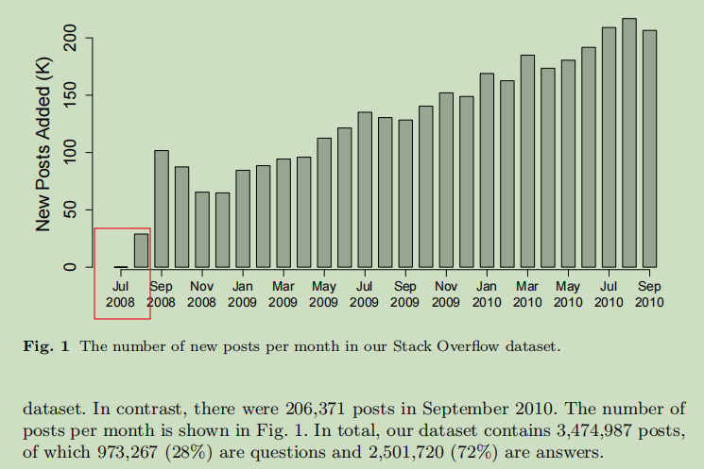
Research Data
Authors mentioned that their Stack Overflow dataset spans 27 months, from July 2008 to September 2010.

Slide 7
Discussion 1🤔 :Should the research data start on July 31 or September 15? What do you think?
However, Stack Overflow was only opened to the public starting on September 15, and between July 31, 2008 and September 15, 2008 it was in private beta[1][2][3]. This point was not mentioned in the paper.
That is, if you were doing this research, would you drop the data before September 15?
- [1]https://en.wikipedia.org/wiki/Stack_Overflow
- [2]https://stackoverflow.blog/2013/09/16/five-years-ago-stack-overflow-launched-then-a-miracle-occurred/
- [3]https://www.joelonsoftware.com/2008/09/15/stack-overflow-launches/
Notes:
有多少人认为：我们应该使用9月15日后的数据？Or，how many people think this is it actual problem?

Slide 8
Discussion 1🤔 :Should the research data start on July 31 or September 15? What do you think?
Both approaches could be valid
We can drop the data before Sep 15(when Stack Overflow opened to the public), because there is plenty of data after September. We can first focus on analyzing Stack Overflow’s public data after its launch, starting with a simpler dataset problem.
Or
We keep this part of the data but perform EDA (Exploratory Data Analysis) on it to check for noise or obvious outliers. For example, posts from early August may be limited to a few topics, as during the private beta stage, Stack Overflow’s founders might have only sent invitations to a few friends, whose tech stacks could be limited to a certain range.

Slide 9
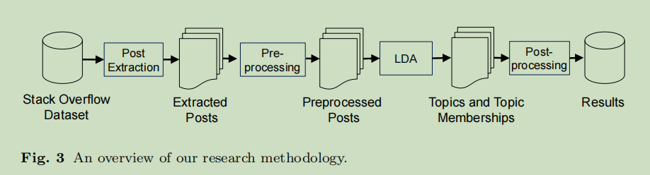
Research Methodology
The authors analyzed Stack Overflow data from 2008 to 2010, using an LDA topic model to investigate the 4 research questions.
Post extraction and Pre-processing output: Remove HTML tags, stop words, maintain metadata: post type,timestamp..
LDA output: topic membership vectors for each post.(K=40 number of topics)
Post-processing:Metrics including Topic share (RQ1),Topic relationships (RQ2). Topic trends over time (RQ3),Technology trends over time (RQ4).

Slide 10
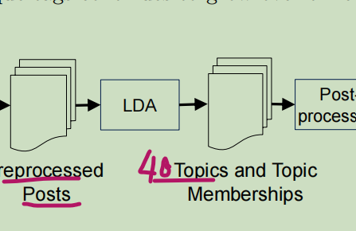
Discussion 2🤔 :If the authors had directly used Stack Overflow’s user-generated tags as the topics for analysis, instead of applying LDA(which generated 40 topics), what problems could that cause?
VS
Directly used Stack Overflow’s user-generated tags

Slide 11
Discussion 2🤔 :If the authors had directly used Stack Overflow’s user-generated tags as the topics for analysis, instead of applying LDA(which generated 40 topics), what problems could that cause?
Only questions have user tags. Only 28% are questions.
Too many user tags. User tags are freely entered,and their expressions are not always same(for example, C++, cpp, and C Plus Plus refer to the same topic). This leads to thousands of topics, making it difficult to aggregate them into representative results.
User Tags might be subjective and noisy. Spelling mistakes,vague meanings,even unrelated to the question
The tagging system is unstable.When new technologies appear, users may create new tags(Mysql/Apache Hive) while old tags(Oracle) are phased out, causing inconsistencies across time periods.

Slide 12
After reading this paper, what do we now know that we did not know before?

Slide 13
The authors drew conclusions based on four research questions.
RQ1. What are the main discussion topics in Stack Overflow?
RQ2. Does a question in one topic trigger answers in another?
RQ3. How does developer interest change over time?
RQ4. How do the interests in specific technologies change over time?

Slide 14
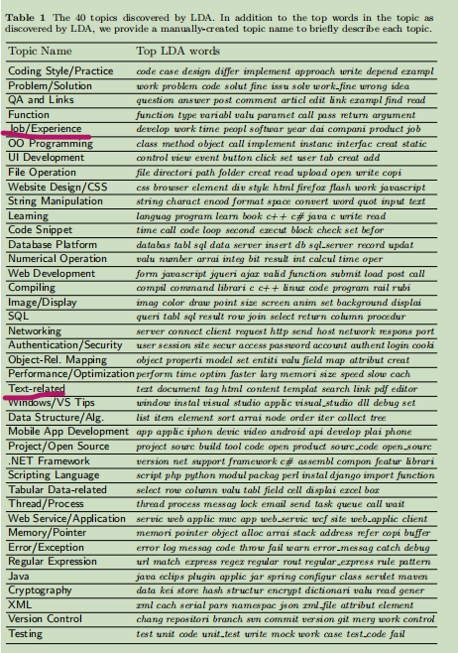
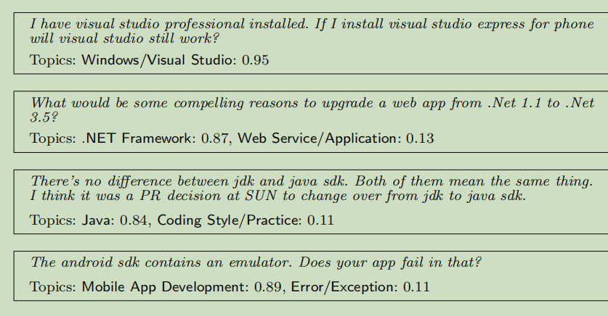
RQ1: What are the main discussion topics in Stack Overflow?
Mostly about technology,web/mobile development,database.
A few other topics like job experience.

Slide 15
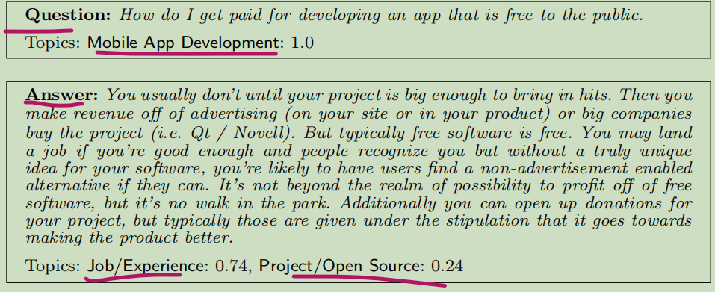
RQ2:Does a question in one topic trigger answers in another?
Literally,the topic of the question is mobile development. But what the user is really seeking might be others’ experiences on making money from software development.
Literally, LDA identifies the topic as related to job experience, and the answer is advice based on the respondent’s own work experience.

Slide 16
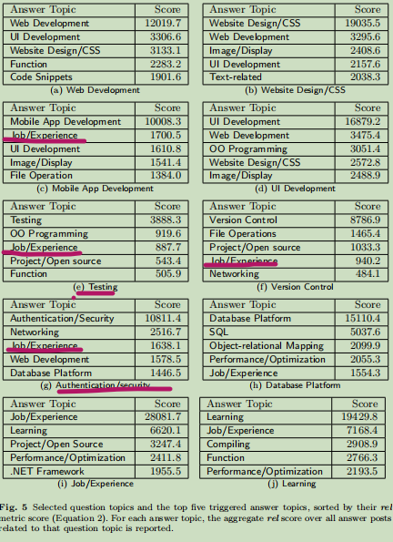
RQ2:Does a question in one topic trigger answers in another?
The authors selected 10 different question topics, such as web development, and then analyzed the topics of the answers for each question topic.
Interestingly, for some questions topic including mobile development, testing, security/authentication, and version control, some of the answers were on the topic of jobs/experience.
Intuitively, this may be because security and testing are not limited to a specific tech stack (frontend, backend, mobile, or web), and therefore answers often need to draw on personal experience.
Meanwhile, from 2008 to 2011, mobile development and version control (especially with Git starting to surpass SVN) grew rapidly, so respondents might have been more willing to share these new technologies based on their own experience.

Slide 17
Discussion 3🤔 , what if K changed?
If the number of LDA topics (K) were decreased or increased significantly, how might that affect the discovery and interpretation of RQ2?
If the K value is too small, the topics of answer posts may become more closer to the question topic, making the phenomenon of “a question in one topic triggering answers in another” less frequent and harder to observe.
If the K value is too large, the topics of the answers may become overly fine-grained, making this phenomenon more noticeable, but potentially introducing more noise.

Slide 18
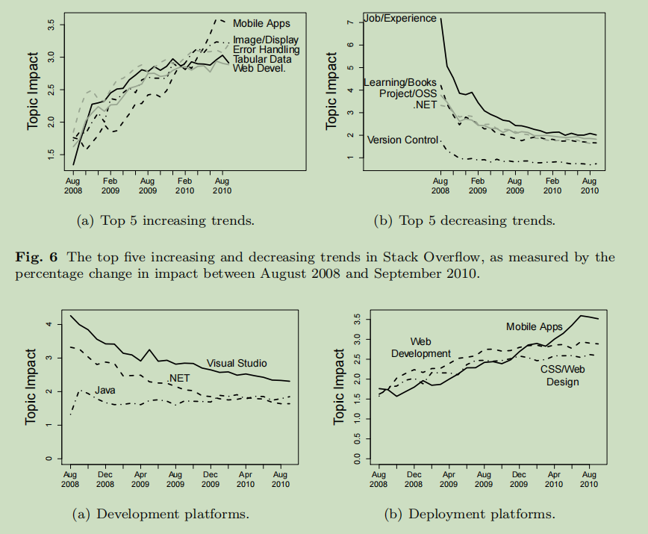
RQ3. How does developer interest change over time?

Slide 19
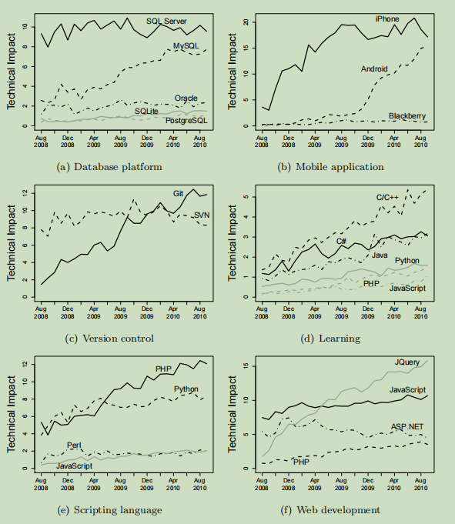
RQ4. How do the interests in specific technologies change over time?

Slide 20
What is the most questionable issue of the paper?
In the paper, K is an LDA hyperparameter.
The authors only briefly mention that K = 40 is the optimal value,and mention tat choosing the hyperparameter K is very challenging, and they are not certain whether the chosen K value is optimal.
However, they are still able to compare the effects of having K too large or too small on the 4 research questions.

Slide 21
Are the reported conclusions generalizable?
This study is primarily based on Stack Overflow, and if another Q&A site were used or a different K value were chosen, the conclusions might not be the same.
The dataset mainly covers the period from 2008 to 2010, and in a few years, using different data, the conclusions could change.

Slide 22
Ethical implications
The paper notes that certain technology stack trends, such as .NET, are decreasing. If this information were provided to Stack Overflow, the platform might reduce .NET-related recommendations to users, potentially resulting in unanswered questions.
If the findings of this paper were misused, for example, in the job market, recruiters might reduce the number of .NET-related job openings and instead favor candidates skilled in Java, which could negatively impact job seekers specializing in .NET.

Slide 23
Open Science & Reproducibility
The study uses publicly available Stack Overflow data, but the authors don’t share their full preprocessing steps, code, or detailed LDA settings. Without these, it’s hard for others to get the exact same results. Releasing scripts, parameter details, and intermediate outputs would make the work much easier to reproduce.

