Slide 1
RPi 1
Redis
GPIO Module
Detection Algo Module
MQTT Module
RPi 2
MQTT Server

Slide 2
Algo
Redis
GPIO
MQTT
Redis Publish: tester.vid<ID>.result
tester.vid<ID>.result: {‘cat’: <str>, ‘val’: <str/int>
GPIO output such as LED, Servo or bipper
tester.vid<ID>.response: {‘status’: success/failed, ‘cat’: <str>, ‘val’: <str/int>}
Message flow:
Algo send detection result with category and value
Redis received message and capture by GPIO adaptor
GPIO plugin module extract info and output to LED, Servo or bipper depending on message content
GPIO send response message to Redis contain hardware update status, category and value
Message capture by MQTT module and deliver to MQTT server
Every minutes, Algo need to deliver tester.vid<ID>.status message indicate usage condition and utilization rate
tester.vid<ID>.response: {‘status’: success/failed, ‘cat’: <str>, ‘val’: <str/int>}
Deliver to MQTT server

Slide 3
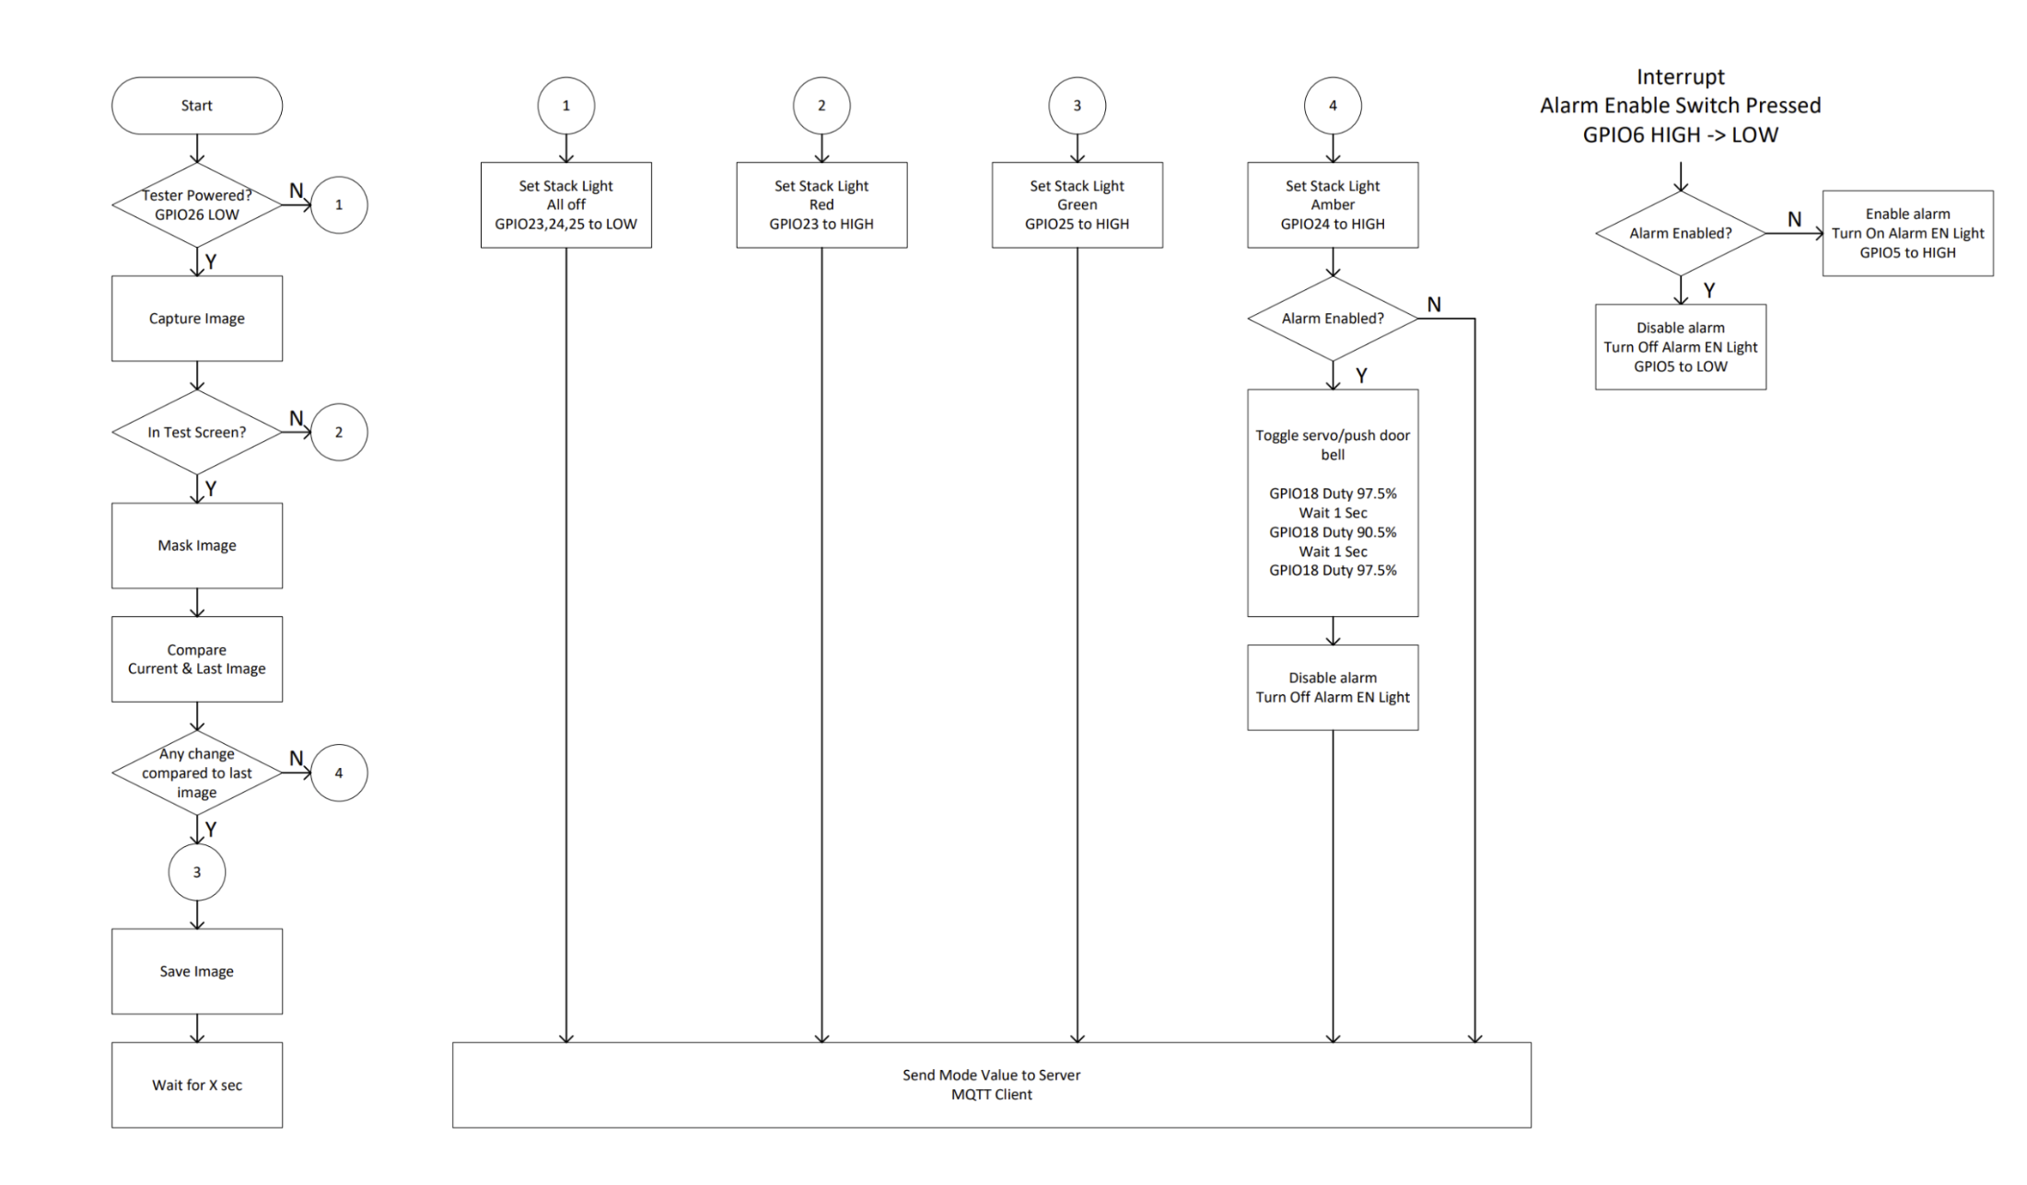
Defined Flow by Partner

Slide 4
Algo
Redis
GPIO
MQTT
GPIO 26 set to Low, GPIO23, 24, 25 to High
tester.vid<ID>.response: {‘stage’: ‘init’, ‘status’: ‘success|failed’}
Log error & stop script if failed to set GPIO26 to Low
tester.vid<ID>.response: {‘stage’: ‘init’, ‘status’: ‘success|failed}
tester.vid<ID>.response: {‘stage’: ‘init’, ‘status’: ‘success|failed}
Log error & stop script init stage is failed
tester.vid<ID>.result: {‘stage’: ‘beginCapture’, ‘status’: ‘success’>
Extract:
ID: id
stage: ‘init’
status: ‘success|failed’
tester.vid<ID>.result: {‘stage’: ‘beginCapture’, ‘status’: ‘success’>
GPIO23, 24, 25 to Low
tester.vid<ID>.response: {‘stage’: ‘beginCapture’, ‘status’: ‘success|failed’}
Log error if failed to set GPIO
tester.vid<ID>.response: {‘stage’: ‘beginCapture’, ‘status’: ‘success|failed}
tester.vid<ID>.respone: {‘stage’: ‘beginCapture’, ‘status’: ‘success|failed}
Log error if beginCapture failed to initialize
Extract:
ID: id
stage: ‘beginCapture’
status: ‘success|failed’
Message flow for Initialization & Output 1

Slide 5
Algo
Redis
GPIO
MQTT
tester.vid<ID>.result: {‘stage’: ‘testScreen’, ‘status’: ‘success’>
tester.vid<ID>.result: {‘stage’: ‘testScreen’, ‘status’: ‘success’>
tester.vid<ID>.response: {‘stage’: ‘testScreen’, ‘status’: ‘success|failed’}
GPIO 23 set to High
tester.vid<ID>.result: {‘stage’: ‘testScreen’, ‘status’: ‘success|failed}
Log Error if failed to set GPIO
tester.vid<ID>.response: {‘stage’: ‘testScreen’, ‘status’: ‘success|failed}
Log error if testScreen failed initialize
Mask Image
Extract:
ID: id
stage: ‘testScreen’
status: ‘success|failed’
Compare Image
tester.vid<ID>.result: {‘stage’: ‘popUp’, ‘status’: ‘success’>
tester.vid<ID>.result: {‘stage’: ‘popUp’, ‘status’: ‘success’>
tester.vid<ID>.response: {‘stage’: ‘popUp’, ‘status’: ‘success|failed’}
GPIO 25 set to High
Log Error if failed to set GPIO
tester.vid<ID>.response: {‘stage’: ‘popUp’, ‘status’: ‘success|failed}
Extract:
ID: id
stage: ‘popUp’
status: ‘success|failed’
Message flow for Output 2 & Output 3

Slide 6
Algo
Redis
GPIO
MQTT
Wait 5s if no interaction to pop up
Reset switch pressed but Alarm not enabled
tester.vid<ID>.alert: {‘stage’: ‘alert’, ‘status’: ‘activated’>
tester.vid<ID>.alert: {‘stage’: ‘alert’, ‘status’: ‘activated’>
GPIO 24 set to High
Servo/push door bell
GPIO18 duty 97.5%
1s delay
GPIO18 duty 90.5%
1s delay
GPIO18 duty 97.5%
tester.vid<ID>.alert-response: {‘stage’: ‘alert-msg|alert-switch’, ‘status’: ‘success|failed}
tester.vid<ID>.alert-response: {‘stage’: ‘alert-msg|alert-switch’, ‘status’: ‘success|failed’}
Log Error if failed to set GPIO
Log error if testScreen failed initialize
tester.vid<ID>.alert-response: {‘stage’: ‘alert-msg|alert-switch’, ‘status’: ‘success|failed}
Extract:
ID: id
stage: ‘alert’
ActivateBy: ‘msg|switch’
status: ‘success|failed’
Message flow for Output 4 or switch pressed when alarm not enabled

Slide 7
Algo
Redis
GPIO
MQTT
Reset switch pressed when alarm enabled
GPIO 24 set to low
tester.vid<ID>.alert-response: {‘stage’: ‘alert-reset’, ‘status’: ‘success|failed’}
tester.vid<ID>.alert-response: {‘stage’: ‘alert’, ‘status’: ‘success|failed}
Log Error if failed to set GPIO
tester.vid<ID>.alert-response: {‘stage’: ‘alert-reset’, ‘status’: ‘success|failed}
Log error if alarm failed initialize
Extract:
ID: id
stage: ‘alert-reset’
status: ‘success|failed’
Message flow for Alert Reset

