Slide 1
React 应用实践
Coding · WebIDE

Slide 2

刘辉 (@hulufei)

Slide 3
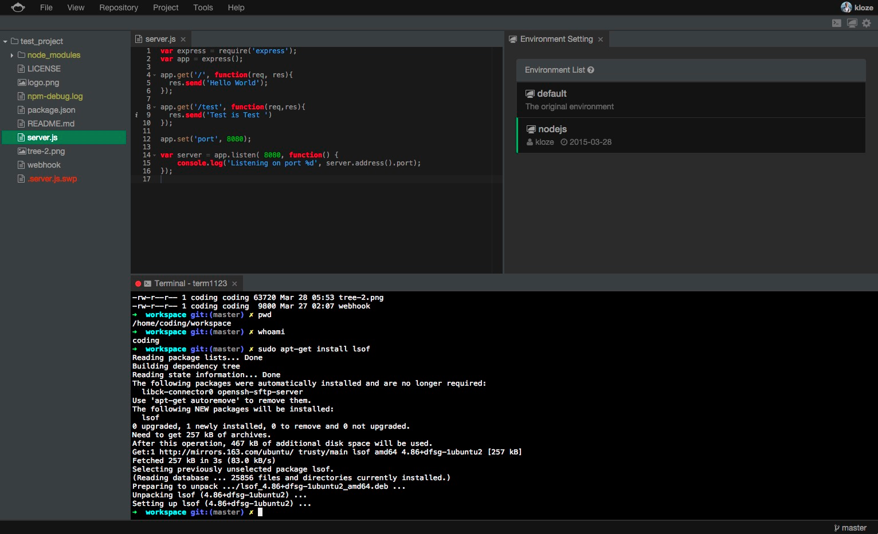


Slide 4



React
Flux
Karma

Slide 5
Components

Slide 6
<Menu />
<Tree />
<Tab />
<Editor />
<EnvSettings />
<Terminal />
<StatusBar />

Slide 7

<WebIDE />
var Menu = React.createClass(...)
var Tree = React.createClass(...)
// ...
var App = React.createClass({
render: function() {
return (
<div>
<Menu />
<Tree />
...
</div>
)
}
})
JSX

Slide 8
+
React
Flux

Slide 9

Flux
emitChange
call
Store
View
Action
Dispatcher

Slide 10
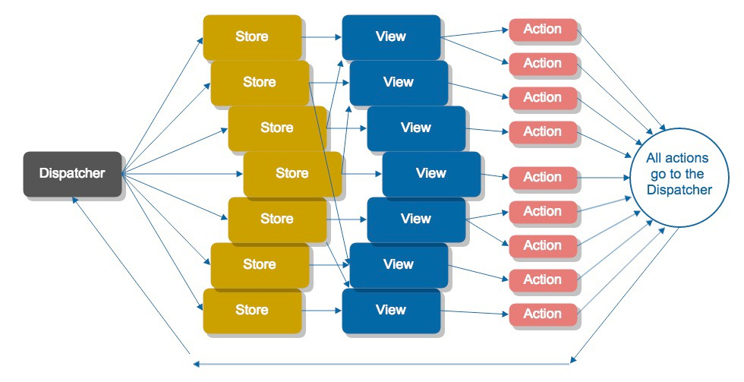

Slide 11
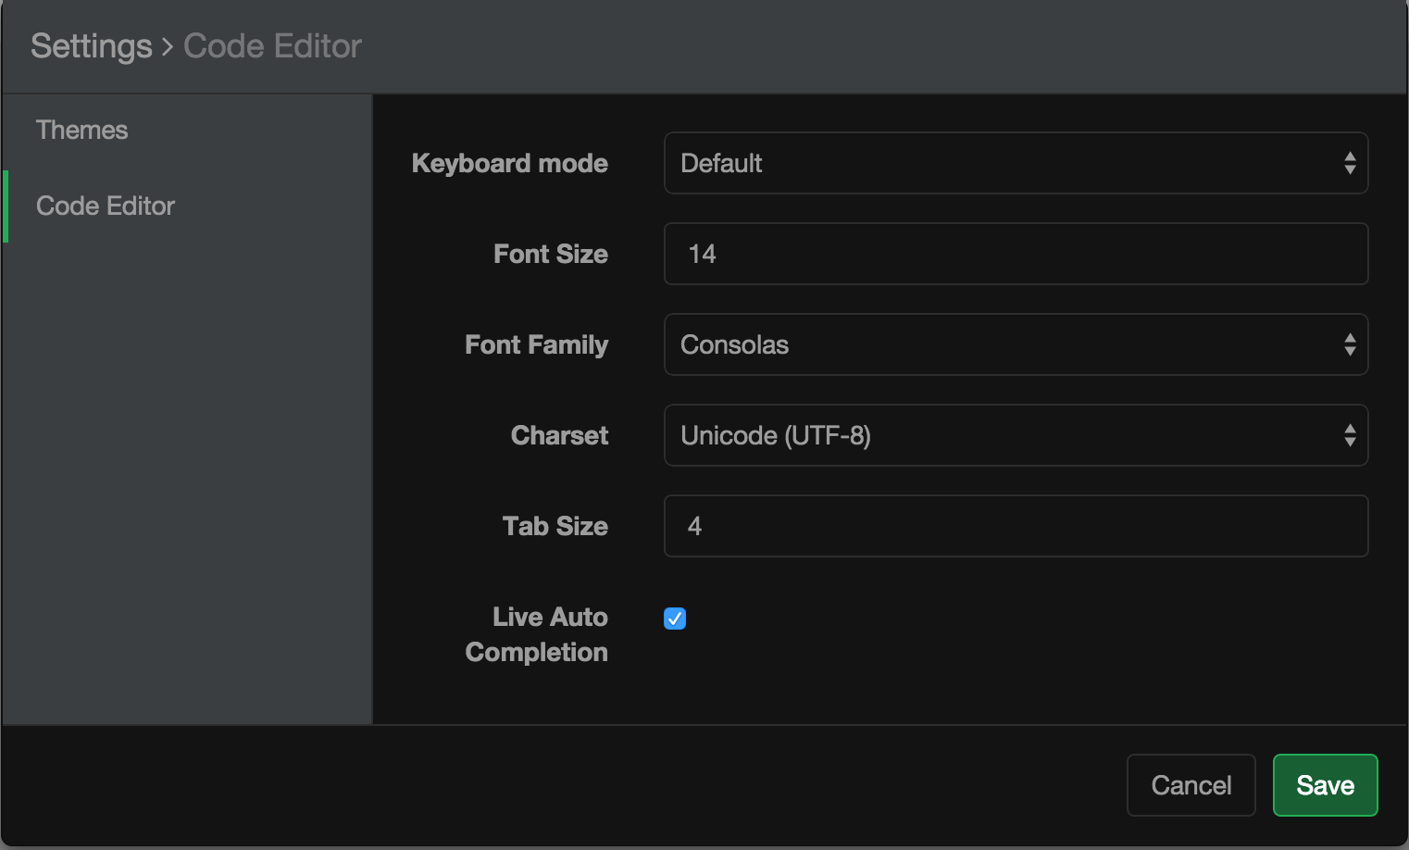

<SettingModal />

Slide 12
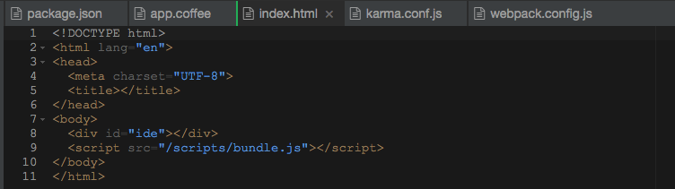
<Editor />

Slide 13
Editor Settings
<SettingModal />
save
SettingActions
SettingStore
emitChange
<Editor />

Slide 14

Addons
Core
(Flux)
Actions
Addons
Bridge
window.cide =
require: (action) ->
require '../actions/' + action

Slide 15
Async Requests
Reads
Writes

Slide 16
Reads
Server
get
API Layer
Store
Promise
Components
request.get(url)
Store.getData()
.catch(errorAction)

Slide 17
Writes
Server
post/put
API Layer
Action
Components
request.post(url).catch(errorAction)
Action.update()

Slide 18
Writing Testable JavaScript
is hard
, once

Slide 19
Writing Testable JavaScript
Loose Coupling

Slide 20
Testing Flux Application
Testing Stores
Testing Components

Slide 21



Tools
Karma as test runner
Mocha as test framework
Sinon as test mocks
Chai as assertion library
Rewire as dependency injection
+
👉https://github.com/hulufei/karma-react-boilerplate

Slide 22
Testing Stores
Data persistency
Dispatch actions

Slide 23
rewire = require 'rewire'
beforeEach ->
sinon.spy AppDispatcher, 'register'
@callback = AppDispatcher.register.args[0][0]
# Reset data
@store = rewire '../stores/SomeStore'
@store.__set__ '_data', 'fake store data'
# Test cases
fakeAction = { actionType: 'ACTION_TYPE' }
@callback fakeAction
expect(@store.getData()).to.be.equal 'something'

Slide 24
Testing Async Requests
“Aggressively limit the number of truly asynchronous tests you write and maintain.”
–http://martinfowler.com/articles/asyncJS.html

Slide 25
Testing Async Requests
Stub API Layer
Use Promise
API Layer
Store
API Layer
Actions

Slide 26
Stub API
API = require './utils/api'
stub = sinon.stub API, 'fetch'
data = Store.getData()
stub.returns(Promise.resolve fakedResponse)
expect(stub).to.be.calledOnce
expect(data).to.eql fakedResponse
stub.returns(Promise.reject 'fake error')
expect(data).to.be.rejected

Slide 27
Testing Components
DOM verify
DOM events simulate

Slide 28
React = require 'react/addons'
ContextMenu = require '../index'
TestUtils = React.addons.TestUtils
describe 'ContextMenu', ->
beforeEach ->
ContextMenuElement = React.createElement ContextMenu
@contextMenuComponent = TestUtils.renderIntoDocument ContextMenuElement
@el = React.findDOMNode @contextMenuComponent
it 'should render empty context menu', ->
expect(@el.className).to.contain 'context-menu'
expect(@el.className).to.contain 'hide'
it 'should invoke callback on menu close', ->
closeSpy = sinon.spy()
ContextMenuElement = React.createElement ContextMenu,
onMenuClose: closeSpy
component = TestUtils.renderIntoDocument ContextMenuElement
el = React.findDOMNode component
TestUtils.Simulate.blur el
expect(closeSpy).to.called.once
React = require 'react/addons'
TestUtils = React.addons.TestUtils
beforeEach ->
ContextMenuElement = React.createElement ContextMenu
@contextMenuComponent = TestUtils.renderIntoDocument ContextMenuElement
expect(@el.className).to.contain 'context-menu'
expect(@el.className).to.contain 'hide'
TestUtils.Simulate.blur el
expect(closeSpy).to.called.once

Slide 29
Awesome React
Immutable.js
Server side rendering
React styling
Relay and GraphQL
…

Slide 30

Q&A
关注我们

