Slide 1
Distributed Computing Seminar
Parallelization
Christophe Bisciglia, Aaron Kimball, & Sierra Michels-Slettvet
Summer 2007
Except as otherwise noted, the content of this presentation is (c) 2007 Google Inc. and licensed under the Creative Commons Attribution 3.0 License.

Slide 2
Outline
Scope of Parallelizable Problems
Parallel vs. Distributed Computing
Flynn's Taxonomy
Algorithm Parallelization

Slide 3
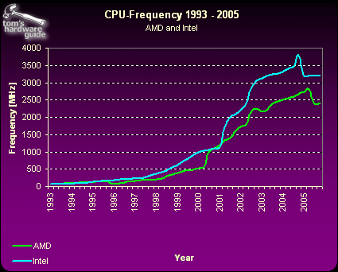
Computer Speedup
Moore’s Law: “The density of transistors on a chip doubles every 18 months, for the same cost” (1965)
Image: Tom’s Hardware

Slide 4
Scope of problems
What can you do with 1 computer?
What can you do with 100 computers?
What can you do with an entire data center?

Slide 5

Distributed problems
Rendering multiple frames of high-quality animation
Image: DreamWorks Animation

Slide 6
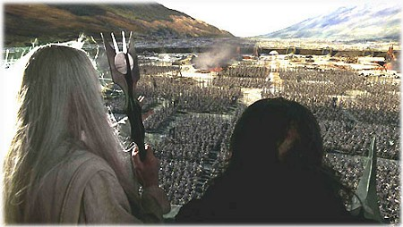

Distributed problems
Simulating several hundred or thousand characters
Happy Feet © Kingdom Feature Productions; Lord of the Rings © New Line Cinema

Slide 7
Distributed problems
Indexing the web (Google)
Simulating an Internet-sized network for networking experiments (PlanetLab)
Speeding up content delivery (Akamai)
What is the key attribute that all these examples have in common?

Slide 8
Parallel vs. Distributed
Parallel computing can mean:
  Vector processing of data
  Multiple CPUs in a single computer
Distributed computing is multiple CPUs across many computers

Slide 9
Flynn's Taxonomy of Computers
Instructions applied
single
multiple
Data manipulated
single
SISD – single-threaded process
MISD – pipeline architecture
(uncommon)
multiple
SIMD – vector processing
MIMD – multi-threaded programming

Slide 10
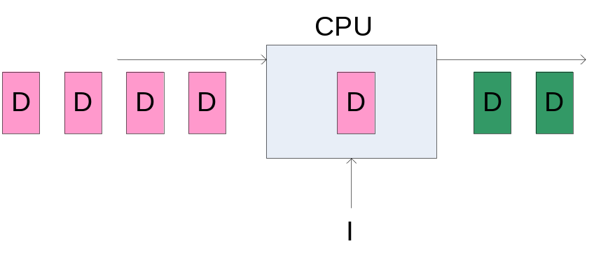
Diagram: SISD

Slide 11
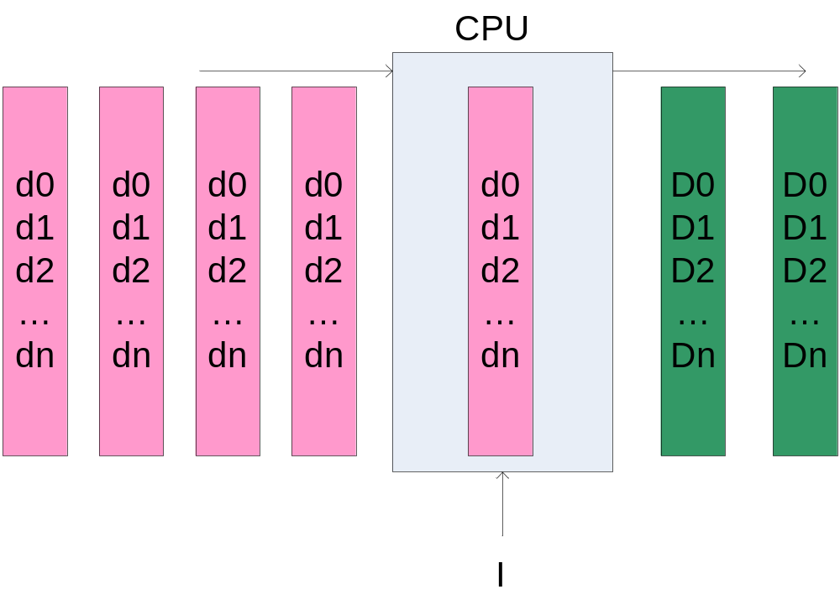
Diagram: SIMD

Slide 12
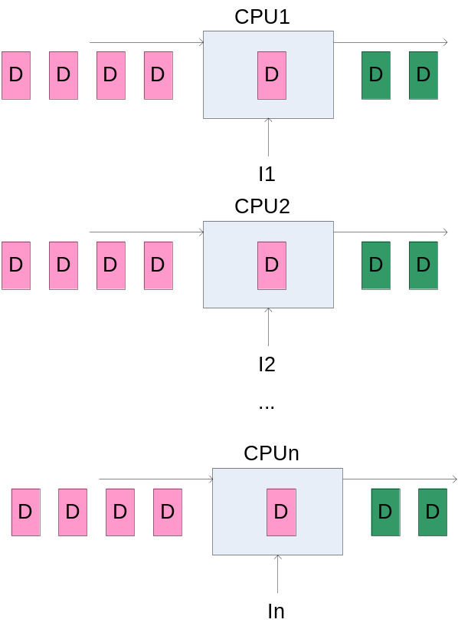
Diagram: MIMD

Slide 13
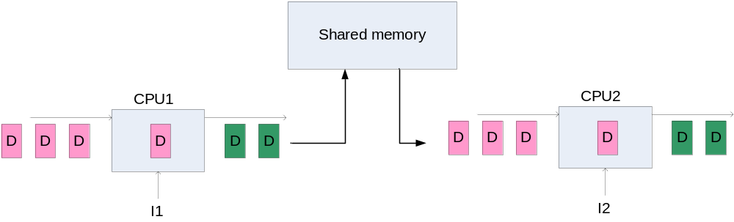
Parallel vs. Distributed Computation
Parallel processing refers to multiple CPUs within the same shared-memory machine performing computation

Slide 14
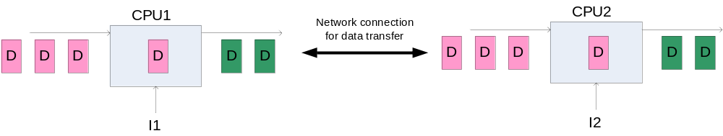
Parallel vs. Distributed Computation
Distributed computation involves multiple computers with their own memory communicating over a network

Slide 15
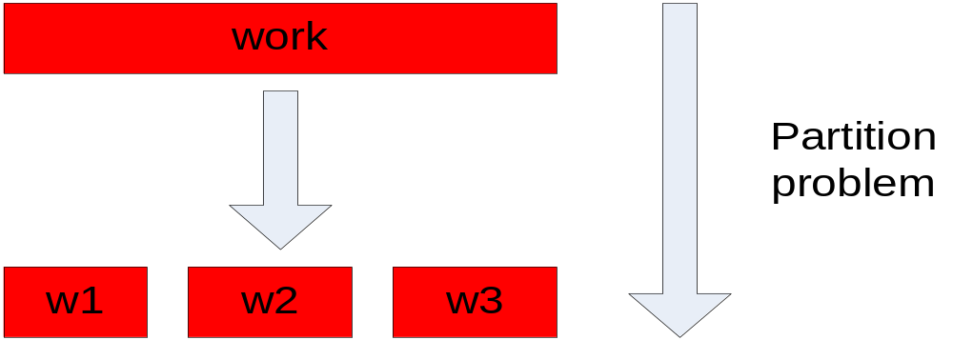
Parallelization Idea
Parallelization is “easy” if processing can be cleanly split into n units:

Slide 16
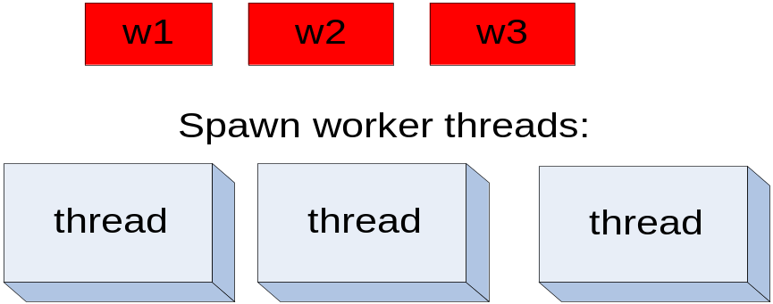
Parallelization Idea (2)
In a parallel computation, we would like to have as many threads as we have processors. e.g., a four-processor computer would be able to run four threads at the same time.

Slide 17
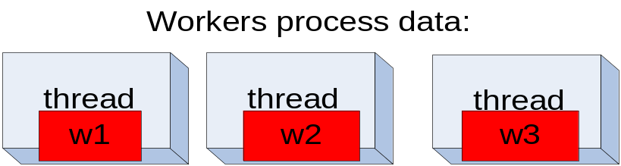
Parallelization Idea (3)

Slide 18
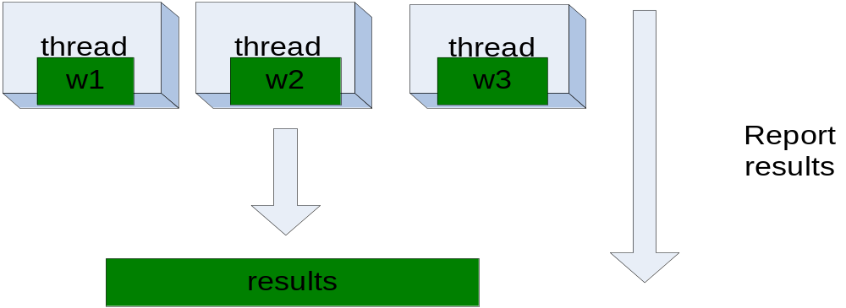
Parallelization Idea (4)

Slide 19
Parallelization Pitfalls
But this model is too simple!
How do we assign work units to worker threads?
What if we have more work units than threads?
How do we aggregate the results at the end?
How do we know all the workers have finished?
What if the work cannot be divided into completely separate tasks?
What is the common theme of all of these problems?

Slide 20
Parallelization Pitfalls (2)
Each of these problems represents a point at which multiple threads must communicate with one another, or access a shared resource.
Golden rule: Any memory that can be used by multiple threads must have an associated synchronization system!

Slide 21
The Moral: Be Careful!
Synchronization is hard
  Need to consider all possible shared state
  Must keep locks organized and use them consistently and correctly
Knowing there are bugs may be tricky; fixing them can be even worse!
Keeping shared state to a minimum reduces total system complexity

Slide 22
Data Parallelism
x := (a * b) + (y * z);
computation A
computation B
At the micro level, independent algebraic operations can commute – be processed in any order.
If commutative operations are applied to different memory addresses, then they can also occur at the same time
Compilers, CPUs often do so automatically

Slide 23
Higher-level Parallelism
x := foo(a) + bar(b)
computation A
computation B
Commutativity can apply to larger operations. If foo() and bar() do not manipulate the same memory, then there is no reason why these cannot occur at the same time

Slide 24
Parallelism: Dependency Graphs
x := foo(a) + bar(b)
foo(a)
bar(b)
write x
Arrows indicate dependent operations
If foo and bar do not access the same memory, there is not a dependency between them
These operations can occur in parallel in different threads
write x operation waits for predecessors to complete

Slide 25
Dependency Graphs: Full Parallelism?
Creating dependency graphs requires sometimes-difficult reasoning about isolated processes
I/O and other shared resources besides memory introduce dependencies
More threads => more communication; this adds overhead and complexity

Slide 26
Task-Level Parallelism
Task A
Task B
synchronization points
unexploited
parallelism
Dividing work into larger “tasks” identifies logical units for parallelization as threads

Slide 27
Task-Level Parallelism
Intelligent task design eliminates as many synchronization points as possible, but some will be inevitable
Independent tasks can operate on different physical machines in distributed fashion
Good task design requires identifying common data and functionality to move as a unit

Slide 28
Patterns for Parallelism
Several programming methodologies exist to build parallelism into programs
The following slides demonstrate a few of them

Slide 29
Master/Workers
One object called the master initially owns all data.
Creates several workers to process individual elements
Waits for workers to report results back
worker threads
master

Slide 30
Producer/Consumer Flow
P
C
P
C
P
C
Producer threads create work items
Consumer threads process them
Can be daisy-chained

Slide 31
Work Queues
All ready consumers should be available to process data from any producer
Work queues divorce 1:1 relationship from producers to consumers
P
C
P
C
shared queue
P
C

Slide 32
Next time...
Parallelization constructs that work over the network
  Distributed shared memory
  Remote Procedure Calls

