Slide 1
Distributed Computing Seminar
MapReduce Theory and Implementation
Christophe Bisciglia, Aaron Kimball, & Sierra Michels-Slettvet
Summer 2007
Except as otherwise noted, the content of this presentation is (c) 2007 Google Inc. and licensed under the Creative Commons Attribution 3.0 License.

Slide 2
Outline
Lisp/ML review
  functional programming
  map, fold
MapReduce overview

Slide 3
Functional Programming Review
Functional operations do not modify data structures: They always create new ones
Original data still exists in unmodified form
Data flows are implicit in program design
Order of operations does not matter

Slide 4
Functional Programming Review
fun foo(l: int list) =
sum(l) + mul(l) + length(l)
Order of sum() and mul(), etc does not matter – they do not modify l

Slide 5
Functional Updates Do Not Modify Structures
fun append(x, lst) =
let lst' = reverse lst in
reverse ( x :: lst' )
The append() function above reverses a list, adds a new element to the front, and returns all of that, reversed, which appends an item.
But it never modifies lst!

Slide 6
Functions Can Be Used As Arguments
fun DoDouble(f, x) = f (f x)
It does not matter what f does to its argument; DoDouble() will do it twice.
What is the type of this function?

Slide 7
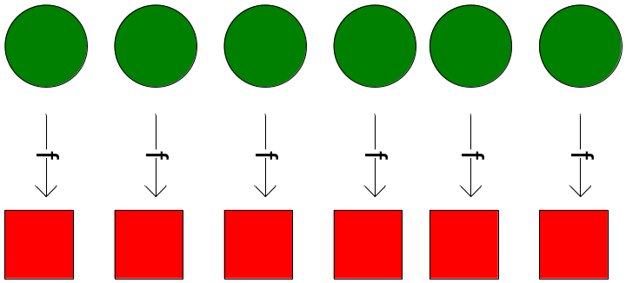
Map
map f lst: (’a->’b) -> (’a list) -> (’b list)
Creates a new list by applying f to each element of the input list; returns output in order.

Slide 8
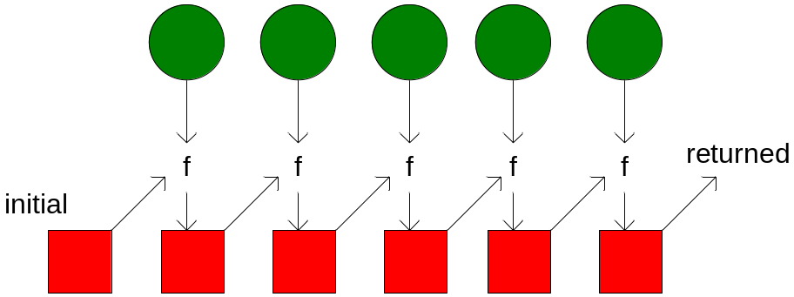
Fold
fold f x₀ lst: ('a*'b->'b)->'b->('a list)->'b
Moves across a list, applying f to each element plus an accumulator. f returns the next accumulator value, which is combined with the next element of the list

Slide 9
fold left vs. fold right
Order of list elements can be significant
Fold left moves left-to-right across the list
Fold right moves from right-to-left
SML Implementation:
fun foldl f a [] = a
| foldl f a (x::xs) = foldl f (f(x, a)) xs
fun foldr f a [] = a
| foldr f a (x::xs) = f(x, (foldr f a xs))

Slide 10
Example
fun foo(l: int list) =
sum(l) + mul(l) + length(l)
How can we implement this?

Slide 11
Example (Solved)
fun foo(l: int list) =
sum(l) + mul(l) + length(l)
fun sum(lst) = foldl (fn (x,a)=>x+a) 0 lst
fun mul(lst) = foldl (fn (x,a)=>x*a) 1 lst
fun length(lst) = foldl (fn (x,a)=>1+a) 0 lst

Slide 12
A More Complicated Fold Problem
Given a list of numbers, how can we generate a list of partial sums?
e.g.: [1, 4, 8, 3, 7, 9] →
[0, 1, 5, 13, 16, 23, 32]

Slide 13
A More Complicated Map Problem
Given a list of words, can we: reverse the letters in each word, and reverse the whole list, so it all comes out backwards?
[“my”, “happy”, “cat”] -> [“tac”, “yppah”, “ym”]

Slide 14
map Implementation
fun map f [] = []
| map f (x::xs) = (f x) :: (map f xs)
This implementation moves left-to-right across the list, mapping elements one at a time
… But does it need to?

Slide 15
Implicit Parallelism In map
In a purely functional setting, elements of a list being computed by map cannot see the effects of the computations on other elements
If order of application of f to elements in list is commutative, we can reorder or parallelize execution
This is the “secret” that MapReduce exploits

Slide 16
MapReduce

Slide 17
Motivation: Large Scale Data Processing
Want to process lots of data ( > 1 TB)
Want to parallelize across hundreds/thousands of CPUs
… Want to make this easy

Slide 18
MapReduce
Automatic parallelization & distribution
Fault-tolerant
Provides status and monitoring tools
Clean abstraction for programmers

Slide 19
Programming Model
Borrows from functional programming
Users implement interface of two functions:
  map (in_key, in_value) ->
  (out_key, intermediate_value) list
  reduce (out_key, intermediate_value list) ->
  out_value list

Slide 20
map
Records from the data source (lines out of files, rows of a database, etc) are fed into the map function as key*value pairs: e.g., (filename, line).
map() produces one or more intermediate values along with an output key from the input.

Slide 21
reduce
After the map phase is over, all the intermediate values for a given output key are combined together into a list
reduce() combines those intermediate values into one or more final values for that same output key
(in practice, usually only one final value per key)

Slide 22
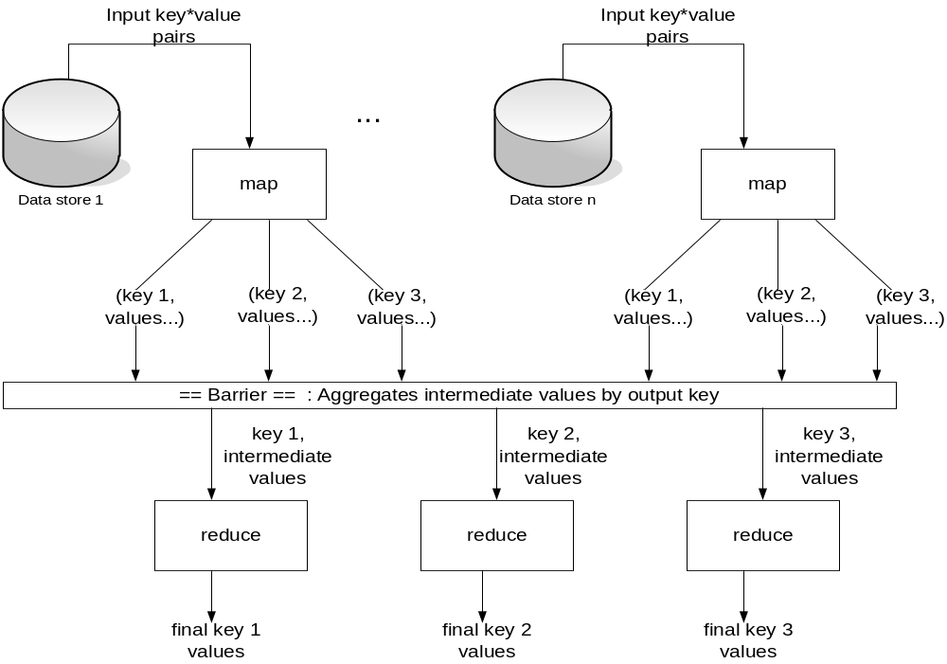

Slide 23
Parallelism
map() functions run in parallel, creating different intermediate values from different input data sets
reduce() functions also run in parallel, each working on a different output key
All values are processed independently
Bottleneck: reduce phase can’t start until map phase is completely finished.

Slide 24
Example: Count word occurrences
map(String input_key, String input_value):
// input_key: document name
// input_value: document contents
for each word w in input_value:
EmitIntermediate(w, "1");
reduce(String output_key, Iterator intermediate_values):
// output_key: a word
// output_values: a list of counts
int result = 0;
for each v in intermediate_values:
result += ParseInt(v);
Emit(AsString(result));

Slide 25
Example vs. Actual Source Code
Example is written in pseudo-code
Actual implementation is in C++, using a MapReduce library
Bindings for Python and Java exist via interfaces
True code is somewhat more involved (defines how the input key/values are divided up and accessed, etc.)

Slide 26
Locality
Master program divvies up tasks based on location of data: tries to have map() tasks on same machine as physical file data, or at least same rack
map() task inputs are divided into 64 MB blocks: same size as Google File System chunks

Slide 27
Fault Tolerance
Master detects worker failures
  Re-executes completed & in-progress map() tasks
  Re-executes in-progress reduce() tasks
Master notices particular input key/values cause crashes in map(), and skips those values on re-execution.
  Effect: Can work around bugs in third-party libraries!

Slide 28
Optimizations
No reduce can start until map is complete:
  A single slow disk controller can rate-limit the whole process
Master redundantly executes “slow-moving” map tasks; uses results of first copy to finish
Why is it safe to redundantly execute map tasks? Wouldn’t this mess up the total computation?

Slide 29
Optimizations
“Combiner” functions can run on same machine as a mapper
Causes a mini-reduce phase to occur before the real reduce phase, to save bandwidth
Under what conditions is it sound to use a combiner?

Slide 30
MapReduce Conclusions
MapReduce has proven to be a useful abstraction
Greatly simplifies large-scale computations at Google
Functional programming paradigm can be applied to large-scale applications
Fun to use: focus on problem, let library deal w/ messy details

