Slide 1
操作系统课程实验可视化
Keyboard——键盘中断可视化
报告人：尹小龙

Slide 2
涉及的 linux 系统文件： 键盘中断：tty_io.c , keyboard.s 屏幕显示：console.c

Slide 3
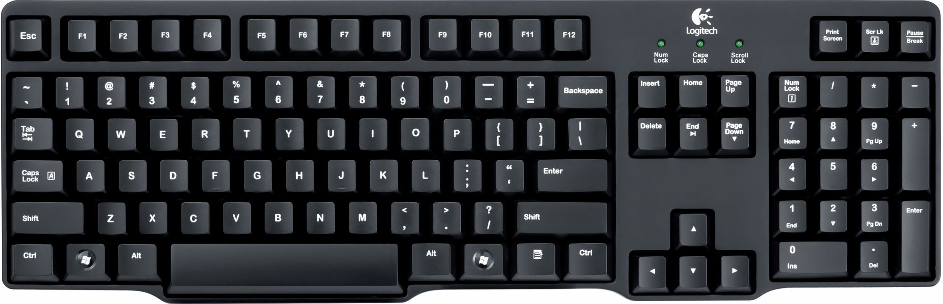
Memory
Con_write
Write_q
Secondary
Read_q
mode(0号位)置1
2A

Slide 4
Memory
Con_write
T
Write_q
Secondary
Read_q
mode(0号位)置1
{
"module":"interrupt",
"provider":"zl",
"event":"keyboard",
"data":{
"chInReadq":“T",
"current_time":1514015119
}
}

Slide 5
Memory
Con_write
T
Write_q
Secondary
Read_q
mode(0号位)复0
AA

Slide 6
Memory
Con_write
Tw
Write_q
Secondary
Read_q
{
"module":"interrupt",
"provider":"zl",
"event":"keyboard",
"data":{
"chInReadq":“w",
"current_time":15140152000
}
}

Slide 7
Memory
Con_write
Twi
Write_q
Secondary
Read_q
{
"module":"interrupt",
"provider":"zl",
"event":"keyboard",
"data":{
"chInReadq":“i",
"current_time":15140152050
}
}

Slide 8
Memory
Con_write
Twin
Write_q
Secondary
Read_q
{
"module":"interrupt",
"provider":"zl",
"event":"keyboard",
"data":{
"chInReadq":“n",
"current_time":15140152050
}
}

Slide 9
Memory
Con_write
Twink
Write_q
Secondary
Read_q
{
"module":"interrupt",
"provider":"zl",
"event":"keyboard",
"data":{
"chInReadq":“k",
"current_time":15140152050
}
}

Slide 10
Memory
Con_write
Twinkl
Write_q
Secondary
Read_q
{
"module":"interrupt",
"provider":"zl",
"event":"keyboard",
"data":{
"chInReadq":“l",
"current_time":15140152050
}
}

Slide 11
Memory
Con_write
Twinkle
Write_q
Secondary
Read_q
{
"module":"interrupt",
"provider":"zl",
"event":"keyboard",
"data":{
"chInReadq":“e",
"current_time":15140152050
}
}

Slide 12
Memory
Con_write
Twinkle
Write_q
Secondary
Read_q
{
"module":"interrupt",
"provider":"zl",
"event":"insert_char",
"data":{
"insert_ch_Origin":%d,
"insert_ch_Pos":%d,
"insert_ch_Scr_end":%d
}
}

Slide 13
Memory
Con_write
Twinkle t
Write_q
Secondary
Read_q
{
"module":"interrupt",
"provider":"zl",
"event":"keyboard",
"data":{
"chInReadq":“t",
"current_time":15140152050
}
}

Slide 14
Memory
Con_write
Twinkle twinkle little star
Write_q
Secondary
Read_q
{
"module":"interrupt",
"provider":"zl",
"event":"lf",
"data":{
"lf_Origin":~~~,
"lf_Pos":~~~,
"lf_Scr_end":~~~
}
}

Slide 15
Memory
Con_write
Twinkle twinkle little star
How I wonder what you are!
Write_q
Secondary
Read_q

Slide 16
Memory
Con_write
Twinkle twinkle little star
How I wonder what you are!
Write_q
Secondary
Read_q
{
"module":"interrupt",
"provider":"zl",
"event":"gotoxy",
"data":{
"pos":%d,
"new_x":%d,
"new_y":%d
}
}

Slide 17
Thanks~

