Slide 1
Gridstone: Comments and Resource Guide
Richard Birge, Team Lead
Rahul Jain, Operations Manager (Mumbai)
Sam Kasserman, Project Manager
Chris Mendoza, Equity Data Analyst
Notes:
Opening/Introduction: Richard

Slide 2
Agenda
Business Questions: Product & Process
  Does Gridstone actually work as advertised?
  What is the potential value to customers of the deep data collected by Gridstone?
  What is the extent and quality of the semantic data embedded in Gridstone? How was it generated? How will it need to be maintained?
  How much does it cost to collect data in Gridstone? What is the split between IS/BS/CF and deep data?
  Is the deep data collected by Gridstone a sustainable competitive advantage? How many data points does Gridstone capture? How much does the competition capture? How difficult would it be to replicate the deep data?
Data Questions: Technical Operations
  Can fundamental and deep data be captured separately?
  How long does it take to collect the same data as MEDS in Gridstone? How long does it take to initialize a company, if only Morningstar current is required?
Notes:
Opening/Introduction: Richard

Slide 3
Business Questions:
Product & Process
Notes:
Opening/Introduction: Richard

Slide 4
Does Gridstone actually work as advertised? (cont.)
Financials (cont.)
 | Number of Industries
Sector Classification (Gridstone) | Gridstone | Morningstar
Communications Services | 3 | 2
Consumer Durables | 15 | 13
Consumer Services and Nondurables | 36 | 28
Energy | 8 | 6
Financial Services | 21 | 29
Health Care | 8 | 10
Industrials | 18 | 23
Materials | 11 | 13
Technology | 17 | 19
Utilities | 4 | 5
Total | 141 | 148
Parameter Groups:
Insurance
Industrial & Commercial
Banking & Financial Services
Notes:
Financials: Sam
-Question was is Gridstone a system of deep relevant data points about companies & industries
- I will guide you through an initial look at each of these three attributes
-With respect to system(ization), Gridstone is well-organized into a number of sectors & industries; highly comparable with its counterpart in M*; influences deep data & notion of competitors
-3 parameter groups for display (versus 6 templates for M*)

Slide 5
Does Gridstone actually work as advertised?
Financials
The table below is an analysis of the data points captured in the main financial statements for Prudential Financial Inc. (PRU) and Southwest Airlines, Co. (LUV).
This table highlights the percentage of Gridstone data point that align directly with a MEDS counterpart.
It is important to note that there are instances where a direct alignment did not exist though the data point could be calculated by combining existing Gridstone data points (E.g. Net Loans)
Financial Statement | MEDS Data Points | GSR Data Points | GSR Data Points (%)
Balance Sheet | 105 | 99 | 94%
Income Statement | 67 | 53 | 79%
Cash Flow Statement | 94 | 79 | 84%
Earnings Report | 24 | 24 | 100%
Total | 290 | 255 | 88%
Notes:
Financials: Sam
-Move onto the actual product & data points, which will give us an indication of relevance & depth
-On the most fundamental level, we let’s take a look at financials from the main tables & notes; core equity data offering
-Looking at final products reveals a significant level of comparability with Morningstar; this slide provides a sample of comparison I conducted between XOI & Gridstone DAP products
-As you can se there is a significant amount of direct correspondence between M* & Gridstone—an overall 88% rate. Furthermore datapoints outside of the 88% are able to be calculated
-Rahul was able to further corroborate this finding via constructing the M* dataset from the Gridstone MPs
-As will be discussed in further detail later, Gridstone has 5000+ different parameter data points that can be potentially used/spread across its financials collection universe

Slide 6
Does Gridstone actually work as advertised? (cont.)
Breakout Data
Category | NNFS Values | Gridstone Coverage | Gridstone Coverage (%)
Auditor | 13 | 0 | 0%
Inventory | 7 | 0 | 0%
TSO | 17 | 5 | 29%
Float | 7 | 0 | 0%
Segment | 24 | 21 | 88%
Capital Adequacy | 6 | 0 | 0%
Other | 5 | 3 | 60%
Grand Total | 79 | 29 | 37%
Gridstone uses breakout data for segment data or data or data contained within footnotes
In MEDS we refer to breakout data as non-financial data and this data is collected manually in MEDS
Notes:
Breakout Data: Sam
-Moving outside of the fundamentals to “Breakouts” or M*’s non-financial data, there is somewhat less convergence
-Should note that the NNFS is an independent system with a focused process

Slide 7
Does Gridstone actually work as advertised? (cont.)
Operating Metrics (OMs)
Gridstone uses OMs that gouge the efficiency or profitability of a company relative to industry benchmarks.
OMs are also referred to as Key Performance Indicators (KPIs) because both are considered measures of performance.
OMs collected in the Gridstone platform include items such as:
  Room Occupancy Rate
  Number of Hotel Rooms
  Number of Properties
  Revenue per Available Room
Notes:
Primary speaker: Sam
Secondary speaker: Chris
-Looking at the most detailed level we have the OMs, or operating metrics collected from tables (outside the notes) & text, the so-called “Deep Data” or “KPIs”
-Extremely detailed data classified at the industry & sector level

Slide 8
Does Gridstone actually work as advertised? (cont.)
Operating Metrics (OMs) (cont.)
Sector | Total | Unique | Shared | Shared (%)
Communications Services | 1,813 | 589 | 1,224 | 68%
Consumer Durables | 1,090 | 493 | 597 | 55%
Consumer Services and Nondurables | 5,252 | 2,303 | 2,949 | 56%
Energy | 7,155 | 1,202 | 5,953 | 83%
Financial Services | 10,535 | 1,703 | 8,832 | 84%
Health Care | 499 | 263 | 236 | 47%
Industrials | 2,133 | 834 | 1,299 | 61%
Materials | 1,304 | 504 | 800 | 61%
Technology | 2,367 | 921 | 1,446 | 61%
Utilities | 1,415 | 335 | 1,080 | 76%
Grand Total | 33,563 | 9,147 | 24,416 | 73%
Notes:
Primary speaker: Sam
Secondary speaker: Chris
-High level stats on the OM data offering
-As one can imagine, a big concern with such detailed data would be one’s ability to create a standardized product with relevant & comparable data points in various classifications

Slide 9
Does Gridstone actually work as advertised? (cont.)
Operating Metrics (OMs) (cont.)
Sector | Total | Unique | Shared | Shared (%)
Communications Services | 20 | 7 | 13 | 65%
Consumer Durables | 15 | 7 | 8 | 53%
Consumer Services and Nondurables | 14 | 6 | 8 | 57%
Energy | 29 | 5 | 24 | 83%
Financial Services | 46 | 7 | 39 | 85%
Health Care | 3 | 2 | 1 | 33%
Industrials | 8 | 3 | 5 | 63%
Materials | 16 | 6 | 10 | 63%
Technology | 9 | 3 | 6 | 67%
Utilities | 13 | 3 | 10 | 77%
Grand Total | 174 | 50 | 124 | 71%
Notes:
Primary speaker: Sam
Secondary speaker: Chris
-Same data from a per company perspective; note the number of real OM data points collected per company in a given instance

Slide 10
What is the potential value to customers of the deep data collected by Gridstone?
Approximately 73% of captured OMs data is comparable across peer companies or industry classifications
  Thus, 27% of captured OMs data is unique to a given company
Competitor research is currently ongoing.
  Bloomberg
  S&P/Compustat
  Thomson Reuters
Notes:
Sam and Chris
-Indicates a measure of comparability value exists amongst deep Gridstone datapoints

Slide 11
What is the extent/quality of the semantic data in Gridstone? How was it generated? How will it need to be maintained?
Industry & component companies defined by US-based PM team
Mumbai sector analyst begins identification & creation of MP List
Company in industry selected for analysis; general review of SEC filings & other information materials
Repeat as necessary per coverage requirements
Search relevant filings (annual & quarterly) from previous two fiscal years manually searched for potential new data points (MPs); Operational metrics typically located in tables & text outside of financial notes
Potential MP added to potential “target list” (in ARP for data-points match) based on repeatability across individual company’s filing history
Sector analyst coordinates with MPT analyst team to review “target lists” of all companies in industry
“Maintenance” efforts occur during periodic coverage expansions
Data points repeated across two or more companies added by default to MP coverage list
Data points unique to a given company (one-offs) added to MP coverage list based on applicability to construction of earnings models & client requests
Selected data points added as collectable “nodes” in system MP list
Collection team briefed on node list & new industry definition
Collection of new OM data points begins; merged with normal Gridstone collection process
Notes:
Flow Chart: Sam
Lastly we get a picture of the process & logic used to create the product I have described to you

Slide 12
How much does it cost to collect data in Gridstone? What is the split between IS/BS/CF and deep data?
Parameter Group | Insurance | Industrial and Commercial | Banking and Financial | Total
Income Statement | 389 | 1,266 | 469 | 2,124
Balance Sheet | 368 | 868 | 514 | 1,750
Cash Flow Statement | 565 | 522 | 400 | 1,487
Operational Metrics | 208 | 4,704 | 580 | 5,492
Supplemental Data | 13 | 588 | 83 | 684
Financial and Operating Ratios | 0 | 50 | 7 | 57
Corporate | 0 | 50 | 0 | 50
Total | 1,543 | 8,078 | 2,053 | 11,674
Notes:
Rahul

Slide 13
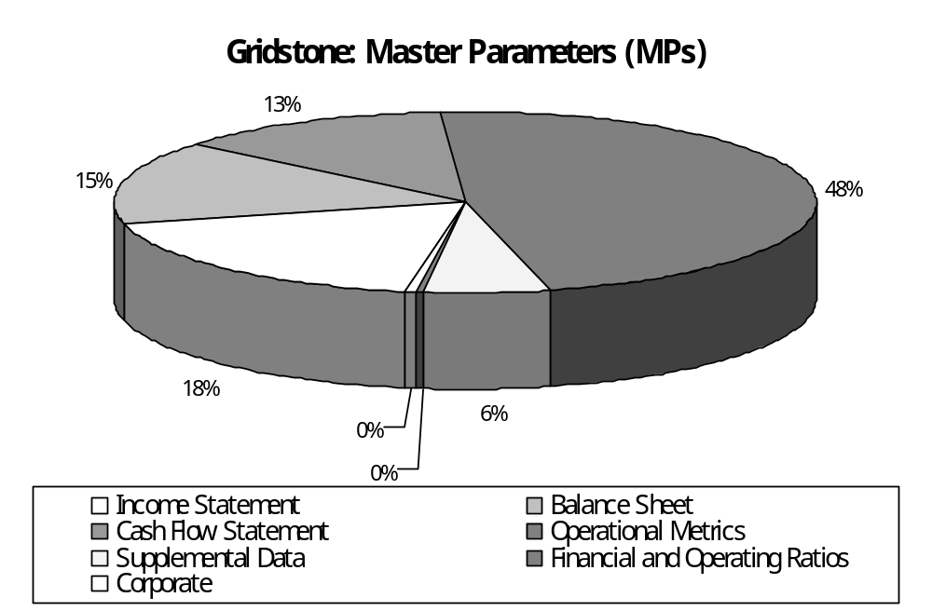
How much does it cost to collect data in Gridstone? What is the split between IS/BS/CF and deep data? (cont.)
Notes:
Rahul

Slide 14
How much does it cost to collect data in Gridstone? What is the split between IS/BS/CF and deep data? (cont.)
 | Initialization |  |  | Subsequent Documents
 | Processing Time | Data Points | Time (%) | Processing Time | Data Points | Time (%)
Income Statement | 0:03 | 49 | 2% | 0:03 | 41 | 5%
Balance Sheet | 0:05 | 65 | 3% | 0:02 | 38 | 3%
Cash Flow | 0:03 | 104 | 2% | 0:07 | 84 | 12%
Total Financial Statements | 0:11 | 218 | 7% | 0:12 | 163 | 20%
Notes | 0:14 | 56 | 9% | 0:16 | 71 | 27%
Operating Metrics | 0:15 | 33 | 9% | 0:15 | 33 | 25%
Template and ARP Creation | 1:49 |  | 68% | 0:00 |  | 0%
Search Time | 0:11 |  | 7% | 0:17 |  | 28%
Total | 2:40 | 307 | 100% | 1:00 | 267 | 100%
Notes:
Rahul

Slide 15
Is the deep data collected by Gridstone a sustainable competitive advantage? How many data points does Gridstone capture? How much does the competition capture? How difficult would it be to replicate the deep data?
As mentioned previously, 73% of captured OMs data is comparable across peer companies or industry classifications
  Thus, 27% of captured OMs data is unique to a given company
The following represents the total number of MPs collected across Gridstone’s product templates:
      Insurance 1,543
      Industrial and Commercial 8,078
      Banking and Financial Services + 2,053
      Total 11,674
Notes:
Primary speaker: Sam
Secondary speaker: Rahul

Slide 16
Data Questions:
Technical Operations
Notes:
Sam or Rahul

Slide 17
Can fundamental and deep data be captured separately?
Yes, the fundamental and deep data can be captured separately in Gridstone.
The following table outlines the average processing time and average number of OMs captured separately from the fundamental data collection process:
 | Operating Metrics
Document Type | Processing Time | Data Points
Annual Document (10-K, 20-F) | 0:18 | 32
Quarterly Document (10-Q) | 0:13 | 33
Total (Average) | 0:15 | 33
Notes:
Primary speaker: Rahul
Secondary speaker: Sam

Slide 18
How long does it take to collect the same data as MEDS in Gridstone? How long does it take to initialize a company, if only Morningstar current is required?
 | Initialization |  |  |  | Subsequent Documents
 | Processing Time | Data Points | Time (%) | MEDS | Processing Time | Data Points | Time (%)
Income Statement | 0:05 | 44 | 7% |  | 0:04 | 43 | 20%
Balance Sheet | 0:05 | 52 | 7% |  | 0:04 | 37 | 20%
Cash Flow | 0:06 | 32 | 8% |  | 0:06 | 57 | 30%
Total Financial Statements | 0:16 | 128 | 22% |  | 0:14 | 137 | 70%
Notes | 0:01 | 9 | 1% |  | 0:01 | 7 | 5%
Template and ARP Creation | 0:50 |  | 67% |  | 0:01 |  | 5%
Search Time | 0:08 |  | 10% |  | 0:04 |  | 20%
Total | 1:15 | 137 | 100% | 0:23 | 0:20 | 144 | 100%
Notes:
Richard and Chris

Slide 19
How long does it take to collect the same data as MEDS in Gridstone? How long does it take to initialize a company, if only Morningstar current is required? (cont.)
 | Initialization |  |  |  | Subsequent Documents
 | Processing Time | Data Points | Time (%) | MEDS | Processing Time | Data Points | Time (%)
Income Statement | 0:06 | 50 | 3% |  | 0:02 | 31 | 12%
Balance Sheet | 0:07 | 54 | 3% |  | 0:03 | 37 | 19%
Cash Flow | 0:12 | 97 | 6% |  | 0:04 | 56 | 25%
Total Financial Statements | 0:25 | 201 | 12% |  | 0:09 | 124 | 56%
Notes | 0:06 | 28 | 3% |  | 0:03 | 10 | 19%
Template and ARP Creation | 2:46 |  | 78% |  | 0:00 |  | 0%
Search Time | 0:16 |  | 7% |  | 0:04 |  | 25%
Total | 3:33 | 229 | 100% | 0:23 | 0:16 | 134 | 100%
Notes:
Richard and Chris

Slide 20
Questions and Discussion

Slide 21


