Slide 1
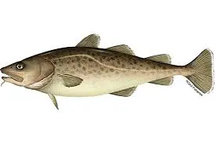
Pacific Cod Assessments in Alaska
Matt Cheng
04/02/24 (Written Exam) &
04/24/24 (Oral Exam)

Slide 2
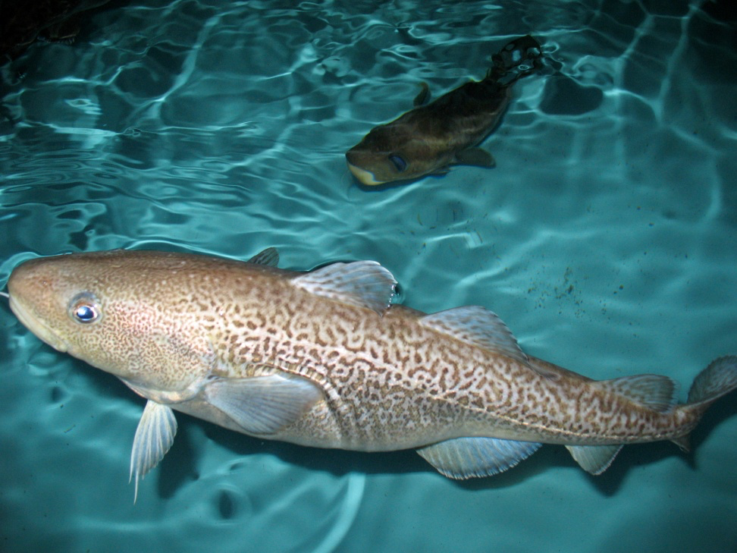
Pacific cod biology
Generalist predator (consumes a variety of prey)
Occur at depths from shoreline to 500m
Highly sensitive to temperature conditions
High mortality events during marine heatwaves
Hatching success and egg survival are influenced by prevailing temperature conditions
Exhibit seasonal migrations
Return to place of birth to spawn (natal homing; Winter)
Migrations away from place of birth to feed (Spring – Summer)

Slide 3
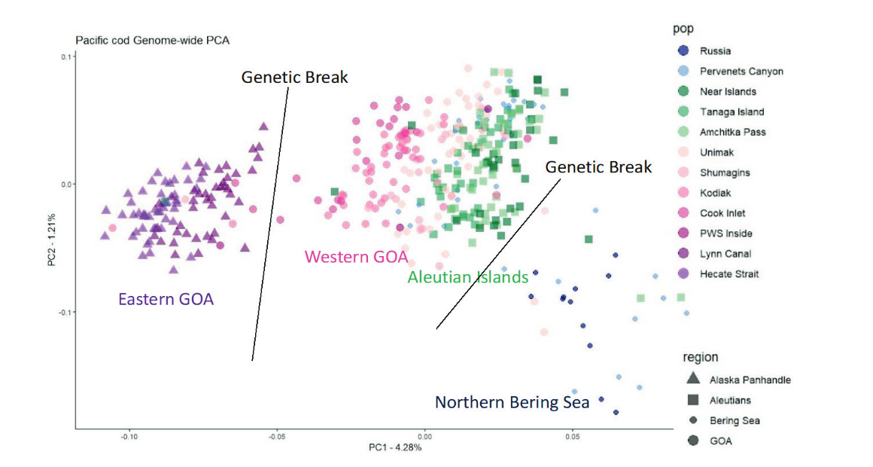
Pacific cod population structure
Across Alaska, there are multiple populations of Pacific cod that are genetically distinct
Population = group of individuals breeding in the same space and time
These populations are managed as separate units, each with separate stock assessments
Eastern Bering Sea (EBS)
Aleutian Islands (AI)
Gulf of Alaska (GOA)
Western and eastern GOA are separate populations but managed as one unit
Spies et al. 2022

Slide 4
How do we assess the health of these stocks?
Utilize stock assessment models to estimate the amount of biomass left in the ocean
Population estimates of these models can then be utilized to derive recommended harvest levels
The goal here is to derive harvest levels that meet both fishery and conservation objectives
Maximizing catch
Ensure sufficient biomass remains for reproduction
Models vary in complexity, which are generally based on the amount of data available

Slide 5
Which models are currently used for each stock?
Eastern Bering Sea | Gulf of Alaska | Aleutian Islands
Age-structured model (Complex) | Age-structured model (Complex) | Biomass Index (Simple)
Recent accumulation of data has allowed for the development of a complex age-structured model for the AI Pacific cod stock

Slide 6
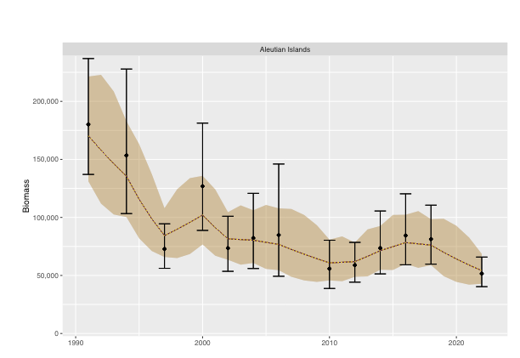
Simple models used for Pacific cod assessments
The simplest models used for Pacific cod utilize abundance indices from summer surveys to estimate population biomass
These methods are simpler to employ and do not have large data requirements
However….
They do not explicitly account for growth, natural and fishery removals, and ignore the different ages in the population

Slide 7
Simple models: Common data sources
Abundance indices
Informs scale and trend of the population (i.e., how big the population is, and if it’s decreasing or increasing)

Slide 8
Complex models used for Pacific cod assessments
Integrated age-structured models
Combines a variety of data sources to estimate abundance
More accurate depiction of population dynamics
Estimates abundance for each age
Growth and mortality are directly accounted for
But high data requirements
Lots of decisions with how to model different population and fishery dynamics
Natural Mortality (Death)
Births (Recruitment)
Growth (Size and Weight)
Fishery Processes (Selectivity, different gear types used, removals)

Slide 9
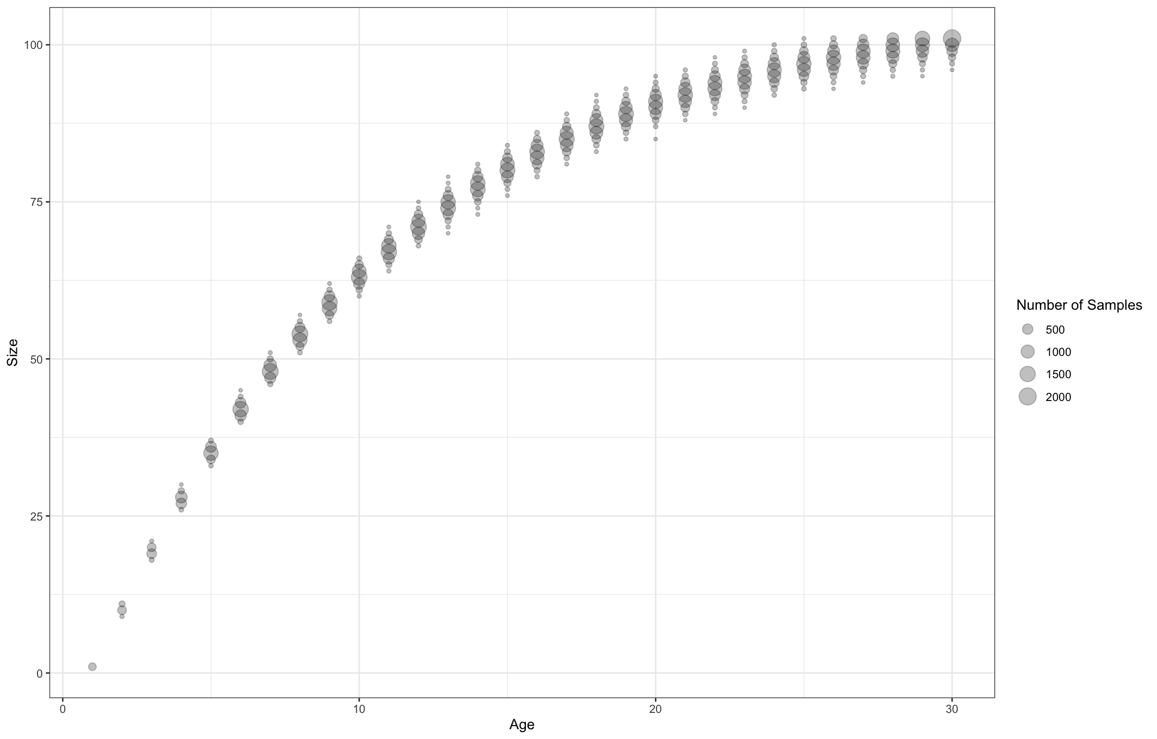
Complex models: Common data sources
Abundance indices
Informs scale and trend of the population (i.e., how big the population is, and if it’s decreasing or increasing)
Age and size-composition
Informs deaths and births
Informs age and size-structure of population
Informs which ages are removed from the population
Paired Size-Age Data
Informs growth
Catch
Informs scale and removals from the population

Slide 10
Management advice: Simple vs. Complex
Simple methods:
Advice is generally conservative to account for increased uncertainties
Does not allow a determination of whether the stock is overfished
Does not account for how the fishery interacts with the population (i.e., selection of older vs younger fish)
Ignores if sufficient biomass remains for reproduction
Complex methods:
Allows for determination of whether a stock is overfished
Accounts for how the fishery interacts with the population (i.e., utilizes knowledge of how fishery selects specific ages/sizes)
Recognizes the potential for reducing the stock to sizes where it can no longer replace itself (i.e., not reproductivity viable)

Slide 11
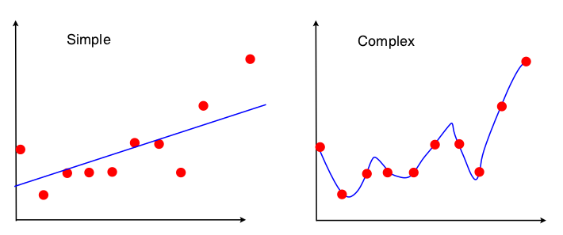
Summary: How do complex and simple models differ for Pacific cod?
Simple models
Only utilize abundance indices from surveys
Less realistic representation of reality
Management advice is generally more conservative given uncertainties
Less modelling decisions required
Complex models
Utilizes more data sources
Management advice considers the potential of depleting the reproductive potential of the stock
More accurate description of reality
But many key decisions to be made
Notes:
After this slide, transition to talk primarily about complex models and how they differ

Slide 12
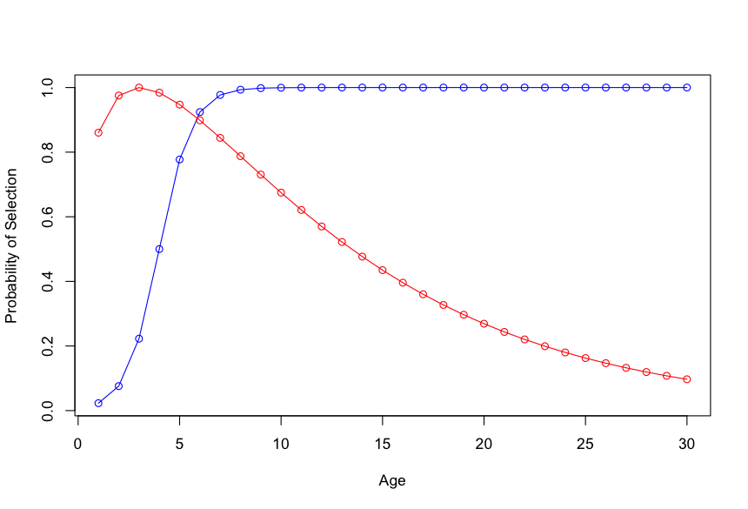
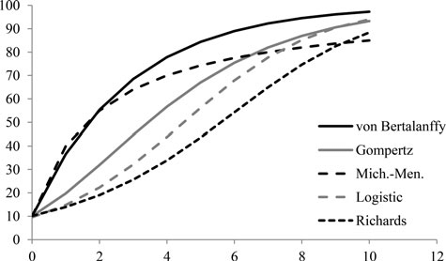
Key decisions to be made in complex models?
What data sources should we use?
Number of fishery gears to represent?
i.e., should catches and composition data be combined for a specific gear type or separated?
How should fishery or survey selectivity be described?
Selectivity = probability of capturing a fish when encountered
Does it vary over time?
What does the shape look like?
How should growth be modelled?
Does it vary over time? What does the growth pattern look like?
S-shaped
Dome shaped

Slide 13
Why care about these decision points?
Failing to adequately represent selectivity can result in incorrect fishery removals at age
Getting the growth pattern incorrect or ignoring changes in growth can similarly be problematic
If the two decision points are incorrect…
Impacts on recommended harvest levels
Incorrect estimated biomass

Slide 14
How do these data inputs differ among complex Pacific cod assessments (Fishery)?
Assessment Region | Fishery Catches | Fishery Size Composition | Fishery Paired Age-Length Data
Eastern Bering Sea | Combined | Combined | Not used
Gulf of Alaska | Separate Gears (Longline, Pot, Trawl) | Separate Gears (Longline, Pot, Trawl) | Separate Gears (Longline, Pot, Trawl)
Aleutian Islands (in development) | Combined | Combined | Not used
Notes:
For the following tables, would probably present them slowly with each column coming up one by one as animations. If I had more time, I would make figures and animations depicting a catch time series, size comps, CAAL data, and age comps, etc structured in a table format like this

Slide 15
How do these model decisions differ among complex Pacific cod assessments (Fishery)?
 | Fishery Gears | Fishery Selectivity Shape (Removal Patterns) | Fishery Selectivity Time-Variation
Eastern Bering Sea | Single combined gear | S-shaped describing removals for all combined gears | Varies discretely in 2 periods to account for abrupt changes in fishery removal patterns.
Gulf of Alaska | Multiple gear types (Longline, Pot, Trawl) | Longline: S-shaped Pot: Dome-shaped (reduced capture of old fish) Trawl: S-shaped | Longline: Initially varies annually, and then switches to discrete variation Pot: Varies discretely in 2 periods Trawl: Initially varies annually, and then switches to discrete variation for 4 periods
Aleutian Islands (in development) | Combined | S-shaped describing removals for all combined gears | Assumes that no changes in fishery removal patterns occurred

Slide 16
How do these data inputs differ among complex Pacific cod assessments (Survey)?
 | Bottom Trawl Survey Index | Bottom Trawl Survey Sizes | Bottom Trawl Survey Paired Age-Length Data | Bottom Trawl Survey Age Data | Longline Survey Index | Longline Survey Sizes | Environmental Index
Eastern Bering Sea | Used | Used | Not used | Used | Not used | Not used | Not used
Gulf of Alaska | Used | Used | Used | Supplemented by paired Age-Length Data | Used | Used | Used
Aleutian Islands (in development) | Used | Used | Used | Supplemented by paired Age-Length Data | Not used | Not used | Not used

Slide 17
How do these model decisions differ among complex Pacific cod assessments (Survey)?
 | Bottom Trawl Survey Selectivity | Bottom Trawl Survey Selectivity Time-Variation | Bottom Trawl Survey Gear Efficiency (catchability) | Longline Survey Selectivity | Longline Survey Selectivity Time-Variation | Longline Survey Gear Efficiency (catchability)
Eastern Bering Sea | S-shaped | Changes continuously | Freely estimated | Longline survey is not used | None | Longline survey is not used
Gulf of Alaska | S-shaped | Changes discretely | Freely estimated | Dome-shaped | None | Estimation assumes that survey gear efficiency changes with bottom temperatures. Survey catches more fish when it is warmer.
Aleutian Islands (in development) | S-shaped | Does not change | Estimation is heavily constrained to assume that the survey gear is highly efficient in capturing all fish encountered (can underestimate our uncertainty in model estimates!) | Longline survey is not used | None | Longline survey is not used

Slide 18
How do these model decisions differ among complex Pacific cod assessments (Biology)?
 | Growth Curve | Time-variation in Growth Curve | Natural Mortality | Time-variation in Natural Mortality
Eastern Bering Sea | More complex (Richards) | Changes continuously | Assumed known (can underestimate our uncertainty in model estimates!) | Does not change
Gulf of Alaska | Less complex (von Bertalanffy) | Does not change | Estimation is informed by external knowledge | Changes in 2 distinct periods (marine heatwave)
Aleutian Islands (in development) | Less complex (von Bertalanffy) | Changes in 2 distinct periods | Freely estimated | Changes in 2 distinct periods (marine heatwave)

Slide 19
Data inputs in complex models (EBS)
Longline
Pot
Trawl
Combined gear catches and size composition data
Bottom trawl survey index, age-and size composition data

Slide 20
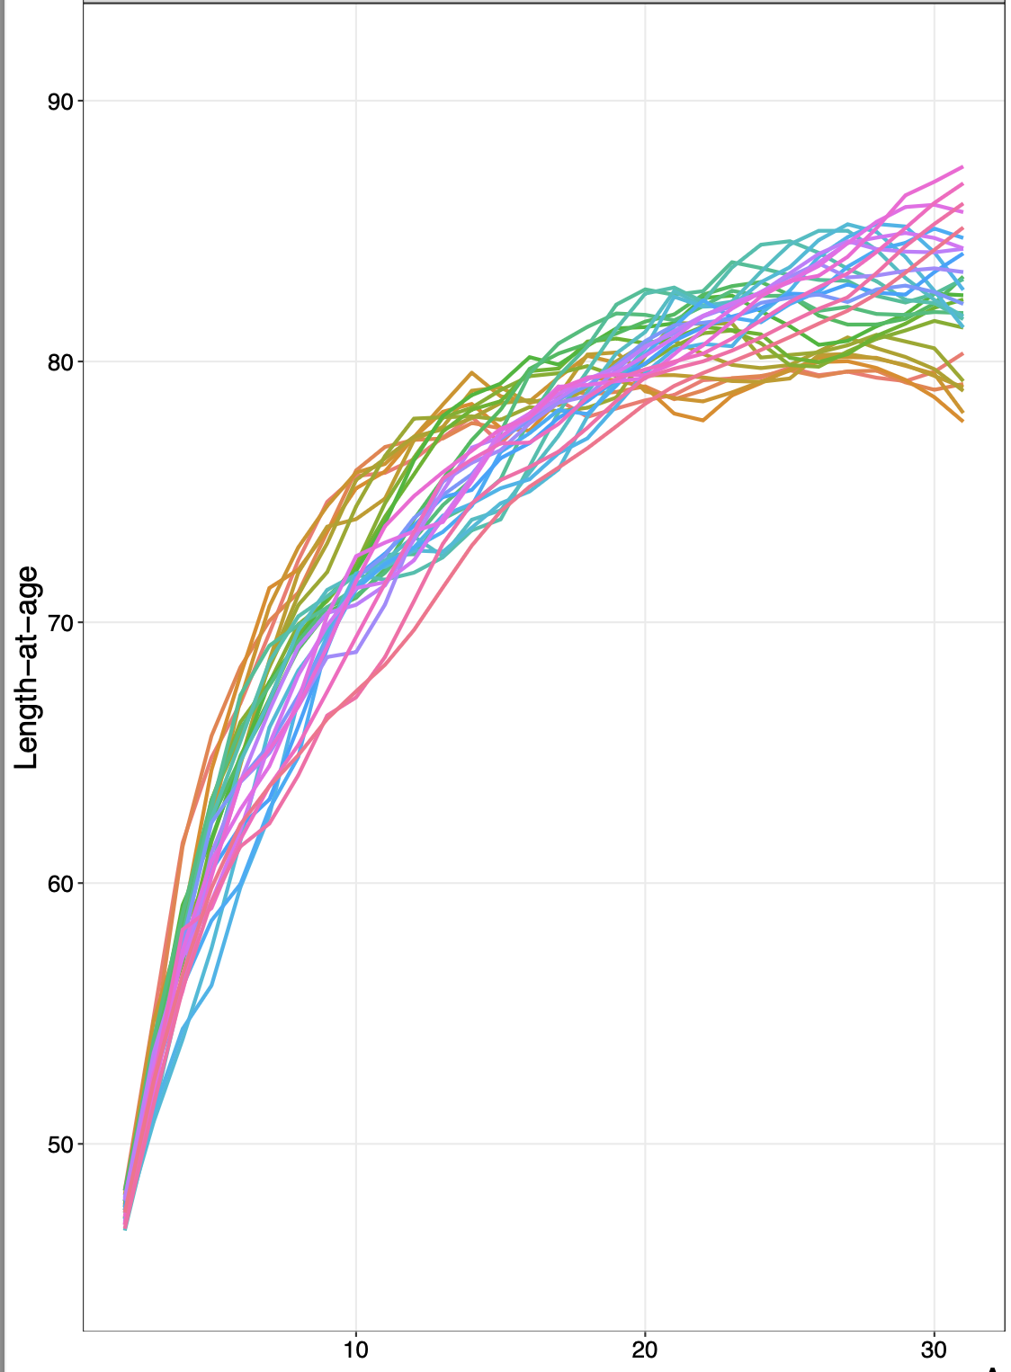
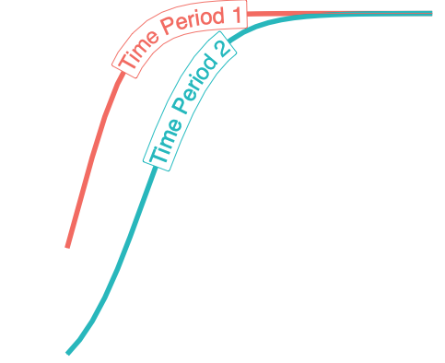
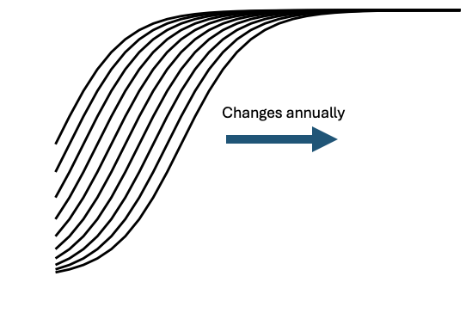
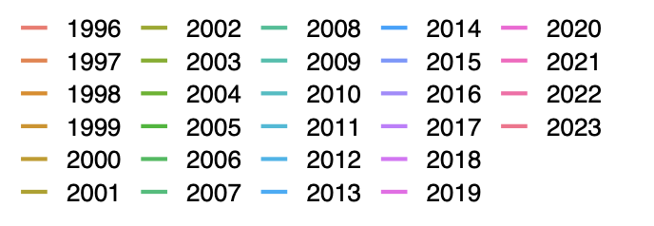
Model decisions in complex models (EBS)
Fishery gears are modelled as combined
Fishery selectivity from combined gears are S-shaped and changes discretely
Bottom trawl survey selectivity are S-shaped (Selectivity changes annually)
Growth pattern is more complicated (Richards Curve)
Changes annually
Natural mortality is known (does not change)
Treating unknowns as knowns will mischaracterize our uncertainty in model estimates!
Age
Notes:
Richards = non-symmetric growth at young ages (differences in growth rates at young and old ages)

Slide 21
Data inputs in complex models (GOA)
Separate gear catches, size composition, and paired size-age data (longline, pot, and trawl)
Bottom trawl survey index, size composition data, and paired size-age data
Longline survey index, size composition data
Longline
Pot
Trawl

Slide 22
Model decisions in complex models (GOA)
Separate gears modelled
Fishery selectivity is:
S-shaped (trawl and longline)
Dome-shaped (pot)
mix of annual and discrete changes in selectivity,
Bottom trawl survey selectivity is S-shaped (discrete changes)
Longline survey selectivity is S-shaped (no change)
Utilizes temperature data to inform survey abundance estimates
Growth pattern is less complicated (Von Bertalanffy)
Growth does not change over time,
Natural mortality is estimated by the model, while being informed by external knowledge (discrete changes)
S-shaped
Dome shaped
Notes:
Changes in temp because of difference in cod distribution when warmer encountered by LLS

Slide 23
Data inputs in complex models (AI)
Combined gear catches and size composition data
Bottom trawl survey index, size composition data, and paired size-age data
Longline
Pot
Trawl

Slide 24
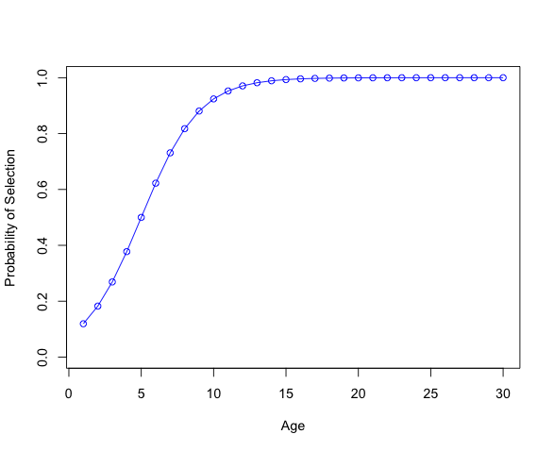
Model decisions in complex models (AI)
Gears are modelled in a combined fashion
Fishery removal patterns from combined gears are S-shaped (no time-variation)
Bottom trawl survey removal patterns are S-shaped (no time-variation)
Growth pattern is less complicated (Von Bertalanffy)
Growth changes discretely
Natural mortality is estimated by the model (varies discretely)
S-shaped

Slide 25
Harmonious modelling approaches?
Clearly, there are multiple decision points for more complex models
Consensus is needed, particularly for how to model the biology (growth) of this species
Growth patterns are modelled with either a complicated (EBS; Richards) or simple form (GOA and AI; Von Bertalanffy)
Growth patterns likely do not differ across regions that much to warrant a completely different growth pattern
Growth patterns likely changes over time, given the sensitivity of Pacific cod to their environment.
The consistent use of paired size-age data across assessment frameworks will likely aid in such representations

Slide 26
Harmonious modelling approaches?
The treatment of how gears are represented are inconsistent across assessments
The GOA assessment separates gears
The BS and AI assessments combine gears
Combining gears increases information content and helps simplify an already complicated model
But a key consideration to note: if catches and selectivity within a gear type changes over time, an analyst must consider the presence of variation in fishery processes
For the AI assessment, likely insufficient data to support a separate gear approach

Slide 27
Current consensus to harmonize models
Utilize paired size-age data to inform growth processes
Explore different ways to represent growth and ensure consistent use of growth patterns across assessments and the presence of variable growth over time.
Failing to acknowledge variable growth when present will bias recommended harvest levels and biomass estimates!
When utilizing a combined gear approach (e.g., EBS and AI), always consider the presence of time-variation in removal patterns

