Slide 1
Spatial Sablefish Model Building

Slide 2
Base Parameterization
5 Areas
Start at 1960
Multinomial for all composition data (weighted by bootstrapped ISS)
Using tag data from 1978 – 2020
Poisson tag likelihood
Constant tag reporting rate
Tag dynamics are release-conditioned
Recruitment + Release, 2) Mortality + Ageing, 3) Movement (recruits don’t move), 4) Shedding

Slide 3
Model Building (01 – Tag likelihoods)
Three Models
01-Poisson
01-NegBin
01-Multinomial
Reporting rate fixed at 0.276 using values from Heiftez and Fujioka
Compare models based on fits to indices here
Eliminate models based on convergence (01-Multinomial)
I think I will spend more time on the Multinomial here, as some of the fits look kind of promising… not sure why it’s not converging

Slide 4
Model Building (01 – Tag likelihoods)

Slide 5
Model Building (01 – Tag likelihoods)

Slide 6
Model Building (01 – Tag likelihoods)

Slide 7
Model Building (01 – Tag likelihoods)

Slide 8
Model Building (01 – Tag likelihoods)

Slide 9
Model Building (01 – Tag likelihoods)
NegBin fits index better, at the cost of fitting tag recaptures (which makes sense given that NegBin allows for overdispersion)
Tag recaptures are likely? to exhibit overdispersion so my inclination is to go with this parameterization.
Also, following the idea of Francis (2011) that we should prioritize fits to index data
Fits to all comp data are pretty similar so not showing here.

Slide 10
Model Building (02 – Reporting Rate)
Five Models
01-NegBin
Constant Reporting
02-Recent
Two blocks (1978 – 2016, 2017 – 2021)
02-FishBlock
Three blocks (1978 – 1994, 1995 – 2016, 2017 – 2021)
02-Decadal
Four blocks (1978 – 1989, 1990 – 2000, 2001 – 2010, 2011 – 2021)
02-Spatial
Tag reporting rates estimated for each region
I have no clue… what information is estimating this reporting rate…
Is it using the catch in each region and comparing to number of recaptures?

Slide 11
Model Building (02 – Reporting Rate)

Slide 12
Model Building (02 – Reporting Rate)

Slide 13
Model Building (02 – Reporting Rate)

Slide 14
Model Building (02 – Reporting Rate)

Slide 15
Model Building (02 – Reporting Rate)

Slide 16
Model Building (02 – Reporting Rate)
Any time-varying reporting rates results in better fits to tag recaptures
Some work from Heiftez and Fujioka showing that they might vary spatially and through time
Looking at these, spatial reporting rates don’t seem to lead to overly large improvements relative to a constant rate
My inclination is to go forward with 02-FishBlock because changes in fishery practices will likely lead to changes in reporting rates
Also compared to decadal model – better fits, but less parameters and more well justified

Slide 17
Model Building (03 – Movement)
Four Models
02-FishBlock
Three blocks (1978 – 1994, 1995 – 2016, 2017 – 2021)
03-Time_4_Move
4 time blocks: 1960 – 1990, 1991 – 2000, 2001 – 2010, 2011 – 2021
03-Time_3_Move
3 time blocks: 1960 – 1995, 1996 – 2010, 2011 – 2021
03-Time_2_Move
2 time blocks: 1960 – 1990, 1991 – 2021
Tried Age X Time blocks...model blows up with scale estimated at an insane number
Tried Age blocks too, and model also blows up

Slide 18
Model Building (03 – Movement)

Slide 19
Model Building (03 – Movement)

Slide 20
Model Building (03 – Movement)

Slide 21
Model Building (03 – Movement)

Slide 22
Model Building (03 – Movement)

Slide 23
Model Building (03 – Movement)
4 time blocks converges, but very high uncertainty for movement estimates
3 time blocks fail to converge
2 time blocks converge, with movement relatively well estimated
Fits to recapture dataa re pretty similar, except for 3 time block models
Slightly improved fits with time-varying movement to index and recapture data
Movement estimates all seem to indicate WGOA is the transition zone, with high residency in CGOA and EGOA
Preference is to go with some time-varying movement, given uncertain estimates and convergence in 3 and 5 movement blocks, should go with 2 time blocks, since fits are similar among time-varying parameterizations

Slide 24
Model Building (04 – Spatial Q)
Two Models
03-Time_2_Move
2 time blocks: 1960 – 1990, 1991 – 2021
04-SptQ
Spatially varying catchability for surveys
Reasoning?
Maybe differences in habitat use and how they overlap with surveys (i.e., depth)
Begs the question of the alternating survey design in a single area assessment… is there then actually time-varying Q that alternates every other year, assuming that it is time-invariant?

Slide 25
Model Building (04 – Spatial Q)

Slide 26
Model Building (04 – Spatial Q)

Slide 27
Model Building (04 – Spatial Q)

Slide 28
Model Building (04 – Spatial Q)

Slide 29
Model Building (04 – Spatial Q)

Slide 30
Model Building (04 – Spatial Q)
Spatial Q definitely fits way better to index
Very different trends in biomass and movement estimates
Spatial constant Q = allow areas with higher survey CPUE to scale accordingly
Spatially varying Q = model can’t anchor to higher or lower CPUE to attribute population scale… but catch data combined with rate of decline in survey indices can help inform that?

Slide 31
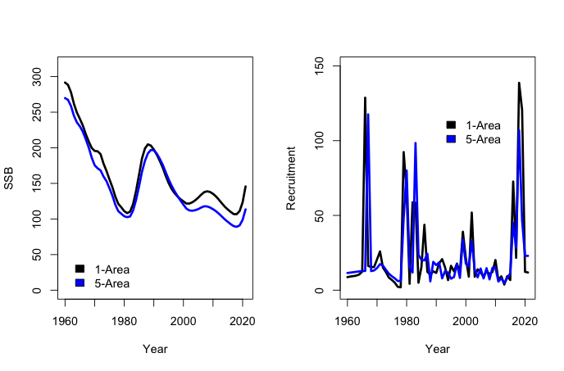
Comparison with 1-Area model

Slide 32
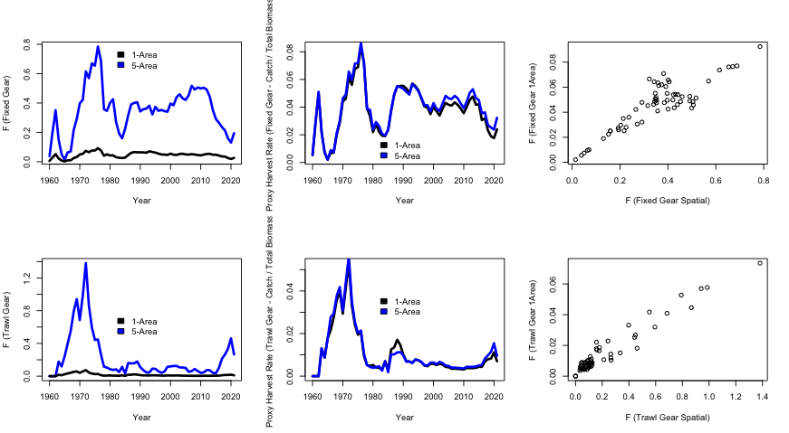
Comparison with 1-Area model

