Slide 1
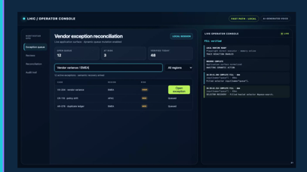
LHIC / PROJECT HIGHLIGHTS
BUILT WITH OPENAI CODEX
Local execution.
Verifiable outcomes.
Built with OpenAI Codex: Local Human Intent Controller turns intent into typed actions, local automation, explicit proof, and redacted traces.
CODEX-BUILT FAST PATH
VERIFIER-FIRST
HUMAN AUTHORITY
OPENAI BUILD WEEK • 20 July 2026
01
Notes:
0:00–0:10 — Hi, I’m presenting LHIC: Local Human Intent Controller. It turns intent into typed local actions, explicit proof, and redacted traces.

Slide 2
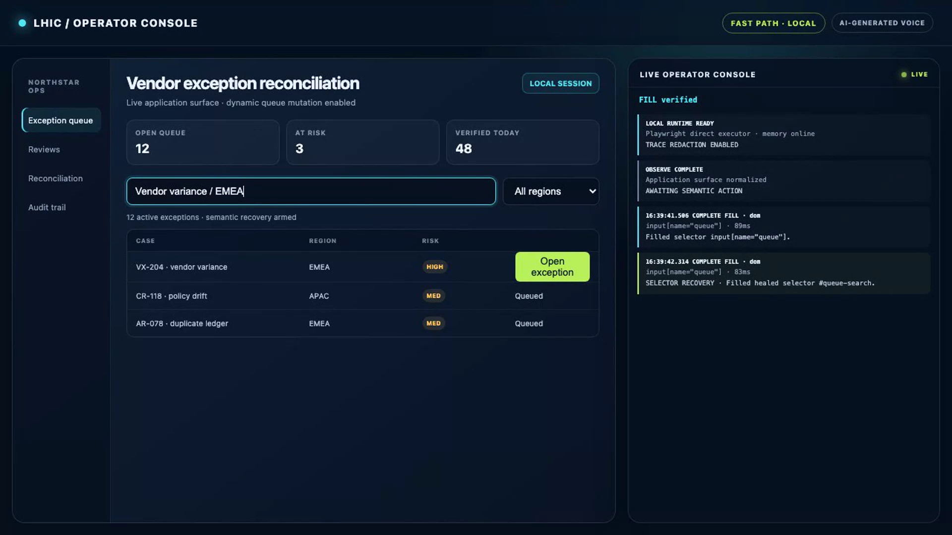
01
Notes:
0:10–0:17 — This is controlled local evidence, not a market or SOTA claim. I’ll show what the current checkout can prove repeatably.

Slide 3
CORE THESIS
Intelligence can propose. LHIC decides what happened.
The execution boundary is the product.
Fast Path
LOCAL / DETERMINISTIC
Playwright + DOM + accessibility. No LLM. No MCP. No browser coordinates.
Routine work stays local and deterministic. Ambiguous work may use a model, but every proposal is revalidated. High-risk or global work returns authority to the human.
Slow Path
OPTIONAL / BOUNDED
Strict structured plan, redacted request, 30-second timeout, full schema and policy checks.
Human authority
SUCCESS ≠ “THE CLICK RAN”
EXACT-ACTION APPROVAL
Success is a declared postcondition with verifier evidence and a redacted trace.
Required for high/unknown risk and every native desktop action; pre/post window and process proof.
Source: repository architecture, routing profiles, OpenAI planner, and global-control implementation.
02
Notes:
0:17–0:32 — Core thesis: intelligence can propose, but LHIC decides what happened. Success is not a click; it is a declared postcondition backed by verifier evidence.

Slide 4
FAST PATH WORKFLOW
Fast Path: deterministic browser workflow
Fast Path
LOCAL / DETERMINISTIC
Playwright + DOM/AX + keyboard. No LLM. No MCP. No browser coordinates.
FULL WORKFLOW / NO MODEL OR MCP IN THE LOOP
01
›
02
›
03
›
04
›
05
›
06
INTENT
OBSERVE
RESOLVE
ACT
VERIFY
TRACE
Natural-language goal
DOM + accessibility
Exactly one target
Playwright / keyboard
Postcondition evidence
Redacted + memory-ready
Fast Path invariant: 0 model calls • 0 MCP calls • no raw browser coordinates
Semantic browser work stays local, deterministic, and evidence-backed.
04
Notes:
0:32–0:47 — Fast Path handles routine browser work deterministically through Playwright, DOM, accessibility, and keyboard. No model, no MCP, and no raw browser coordinates.

Slide 5
SLOW PATH WORKFLOW
Slow Path: bounded model-assisted workflow
Slow Path
MODEL-ASSISTED / BOUNDED
Optional strict-JSON plan. Redacted request. Local schema, policy, approval, and verifier checks.
FULL WORKFLOW / PROPOSAL IS NOT AUTHORITY
01
›
02
›
03
›
04
›
05
›
06
OBSERVE
ROUTE
REDACT
PLAN
RECHECK
EXECUTE
Normalize UI state
Confidence / risk budget
Sensitive fields removed
Strict JSON proposal
Schema + policy + approval
Local act → verify → recover
Slow Path invariant: the provider may propose actions, never expand authority or redefine success
Models can propose; LHIC remains the authority on scope, policy, and success.
05
Notes:
0:47–1:02 — Slow Path is bounded model help. Requests are redacted, proposals must be strict JSON, and local checks decide policy, approval, execution, and success.

Slide 6
HUMAN AUTHORITY WORKFLOW
Human authority: approved desktop workflow
Human Authority
APPROVAL-GATED / NATIVE DESKTOP
Exact approval, active-window/process checks, native OS action, and postcondition evidence.
FULL WORKFLOW / APPROVAL + ACTIVE-CONTEXT PREFLIGHT
01
›
02
›
03
›
04
›
05
›
06
DETECT
SHOW
APPROVE
PREFLIGHT
ACT
PROVE
High / unknown risk
Exact action payload
Hash + signature + TTL
Window + process match
Native OS bridge
Post-verify + consume
Human authority invariant: no approval, no action • no exact match, no execution • replay is rejected
High-risk work is explicit, time-bounded, identity-bound, and replay-resistant.
06
Notes:
1:02–1:16 — High-risk and native desktop actions require exact human approval. The approval is hashed, signed, time-limited, context-checked, and consumed once.

Slide 7
ARCHITECTURE
A deterministic control loop with proof at the end
Every transition is typed, budgeted, and inspectable.
INTENT
›
SENSE
›
PLAN
›
ACT
›
PROVE
›
TRACE
Goal
DOM + AX
Typed
Local SDK
Verifier
Redacted
01
Exactly one target
02
One local recovery
03
Evidence before learning
Ambiguity rejects the action; selector memory is earned only after proof.
Then an optional slow planner—only if the routing profile still has budget.
Verified task IDs and unseen-UI holdout gate skill promotion.
Source: browser-plan-v1 schema, target resolver, multipath controller, verifier, trace, and learning code.
03
Notes:
1:16–1:29 — The architecture is a typed loop: sense, plan, act, prove, trace. Ambiguity fails closed, and learning only starts after proof.

Slide 8
PROJECT HIGHLIGHTS
Four engineering choices define LHIC
The project is differentiated by constraints that survive changes in planner or interface.
01
Verifier-first
02
Exact human authority
Every step states its postcondition before execution. Missing evidence fails closed.
Approval hashes the entire action, expires quickly, and cannot be replayed.
03
Semantic resilience
04
Evidence-gated learning
DOM and accessibility targets must resolve uniquely; verified history can heal selectors.
Three independent verified task IDs plus an unseen-UI holdout are required.
PLUS: HARDENED TRACES
MULTIPLE OPERATOR SURFACES
LOCAL-FIRST SKILL MEMORY
Source: security, trace, memory, selector resolver, and schema implementation.
04
Notes:
1:29–1:42 — Four engineering choices define LHIC: verifier-first execution, exact human authority, semantic resilience, and evidence-gated learning, all supported by hardened traces.

Slide 9
CONTROLLED PROOF
The current checkout passed its full local evidence suite
Internal regression evidence—not an external market or state-of-the-art claim.
CONTROLLED LOCAL
341/341
100%
774 ms
0
TESTS PASSED
TASK SUCCESS
P95 LATENCY
MODEL + MCP CALLS
93 test files
300 executions
60 fixtures × 5
per Fast Path task
100%
0
100%
0
0
structured actions
raw coordinates
verifier pass
false-positive success
human intervention
Source: npm run bench:internal, executed 20 Jul 2026 • local fixture regression • all configured gates passed.
05
Notes:
1:42–1:56 — The local evidence suite passed: 341 tests, 300 executions, 774 millisecond P95 latency, and zero model or MCP calls on Fast Path tasks.

Slide 10
RESILIENCE SIGNAL
Semantic targeting survived the controlled selector ablation
A deliberately limited static selector baseline is useful for regression contrast—not market comparison.
+80 pp
CONTROLLED DELTA
100% semantic route vs 20% intentionally limited static selector route.
What this does prove
Semantic resolution is wired into execution.
Healing preserves verifier evidence.
NO EXTERNAL-SUBMISSION ELIGIBILITY
Source: npm run bench:simulate, seed 20260715 • controlled ablation • externalSubmissionEligible=false.
06
Notes:
1:56–2:08 — The selector ablation is a regression signal: semantic targeting survived at 100%, while the intentionally limited static route reached 20%.

Slide 11
SAFETY MODEL
Trust is enforced in the execution layer
Network, authority, evidence, and provider controls reinforce each other.
NETWORK
AUTHORITY
EVIDENCE
Reject private targets, credentialed URLs, unsafe redirects, and invalid protocols.
Bind approval to the exact action. Expire it quickly. Reject every replay.
Do not report success without the declared postcondition and a redacted trace.
DNS + redirect checks
Ed25519 in production
Verifier is mandatory
Origin / protocol policy
≤ 5 minute lifetime
PII + action values redacted
No browser coordinates
Atomic one-time marker
Secure trace creation
Optional models can suggest actions. They cannot expand budget, bypass policy, approve themselves, or redefine success.
Source: security/approval/replay, production browser guards, trace redaction, verifier, and OpenAI planner code.
07
Notes:
2:08–2:22 — Safety lives in the execution layer. Network guards, exact authority, mandatory verifiers, and redacted traces keep optional models from expanding power.

Slide 12
SKILL MEMORY
Learning is earned through independent proof
LHIC does not promote a successful trace directly into the Fast Path.
RUN
GATE
GATE
FAST PATH ELIGIBLE
01
02
03
04
Verified run
Independent repetition
Unseen-UI holdout
Promoted skill
Task succeeds with declared postcondition evidence.
Three distinct verified task IDs are required.
Offline test must use a new UI fingerprint.
Only redacted/hash provenance enters memory.
Promotion stays blocked until every evidence gate passes—and network synchronization is completed before runtime, never during the Fast Path.
Source: learning gate, skill store, shared-skill eligibility, and selector-memory implementation.
08
Notes:
2:22–2:34 — Skill memory is earned. LHIC requires verified runs, three independent task IDs, an unseen-UI holdout, and redacted provenance before promotion.

Slide 13
PRODUCT SURFACES
One runtime. Four operator surfaces.
DESKTOP OPERATOR CONSOLE
A Codex-built control plane, not a demo script.
01
Desktop
Electron/React operator console, approvals, dashboard, release UX.
02
CLI
Task execution, inspection, benchmarks, packaging, and operator workflows.
03
MCP server
Slow-path and external-agent adapter—explicitly outside Fast Path.
04
Shared skills
Appwrite-backed control plane with local cache before runtime.
12 PACKAGES
4 APPS
286 FILES
Built with OpenAI Codex • Source: apps/desktop, apps/cli, apps/mcp-server, shared-skills package, and Appwrite service.
09
Notes:
2:34–2:45 — The runtime has four operator surfaces: desktop, CLI, MCP server, and shared skills. It is broader than a single scripted demo.

Slide 14
MATURITY
The core path is ahead of external proof and distribution
A useful release conversation distinguishes implemented behavior from integration-ready and gated work.
Capability | Assessment | Evidence / remaining work
Fast Path browser execution | IMPLEMENTED | Direct SDK, policy, verifier, trace, tests
Security + approvals | IMPLEMENTED | Exact-action signing, replay checks, redaction
Desktop control center | EVOLVING | Build passes; distribution evidence still gated
BrowserPool / workflows | INTEGRATION-READY | Caller owns lifecycle, workers, secrets
External benchmark publication | GATED | No eligible public submission result
Screenshot/custom verifiers | KNOWN GAP | Not available in verifier v0
Release truth is split: npm latest 0.1.1; local docs describe 0.1.2 CLI RC and desktop 0.1.4 development build.
Source: local source/tests, release-status and production-readiness docs; npm registry metadata observed 20 Jul 2026.
10
Notes:
2:45–2:55 — Maturity is transparent: Fast Path and approvals are implemented; distribution evidence, external benchmarks, and screenshot/custom verifiers are still gated.

Slide 15
THE POSITION TO OWN
NEXT 90 DAYS
Local execution
with proof.
01
External evaluation pack
Pinned BrowserGym/WorkArena harness, traces, and failure taxonomy.
02
Verifier challenge set
LHIC is strongest as a Codex-built execution substrate—where policy, human authority, deterministic automation, verification, and audit evidence decide what actually happened.
False-positive and false-negative tests by postcondition family.
03
Harmonized release
One version matrix plus signed/notarized desktop evidence.
OPENAI CODEX BUILD
STRONG INTERNAL INVARIANTS
OpenAI Build Week artifact • current working tree • 20 July 2026
11
Notes:
2:55–3:00 — The position to own is local execution with proof. Next: external evaluation, verifier challenge sets, and a harmonized signed release.

