Slide 1
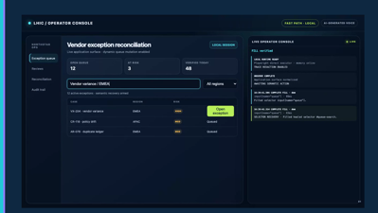
LHIC / PROJECT HIGHLIGHTS
CONTROLLED LOCAL DEMO
Local execution.
Verifiable outcomes.
Local Human Intent Controller turns intent into typed actions, local automation, explicit proof, and redacted traces.
MODEL-FREE FAST PATH
VERIFIER-FIRST
HUMAN AUTHORITY
Technical & product briefing • 20 July 2026
01

Slide 2
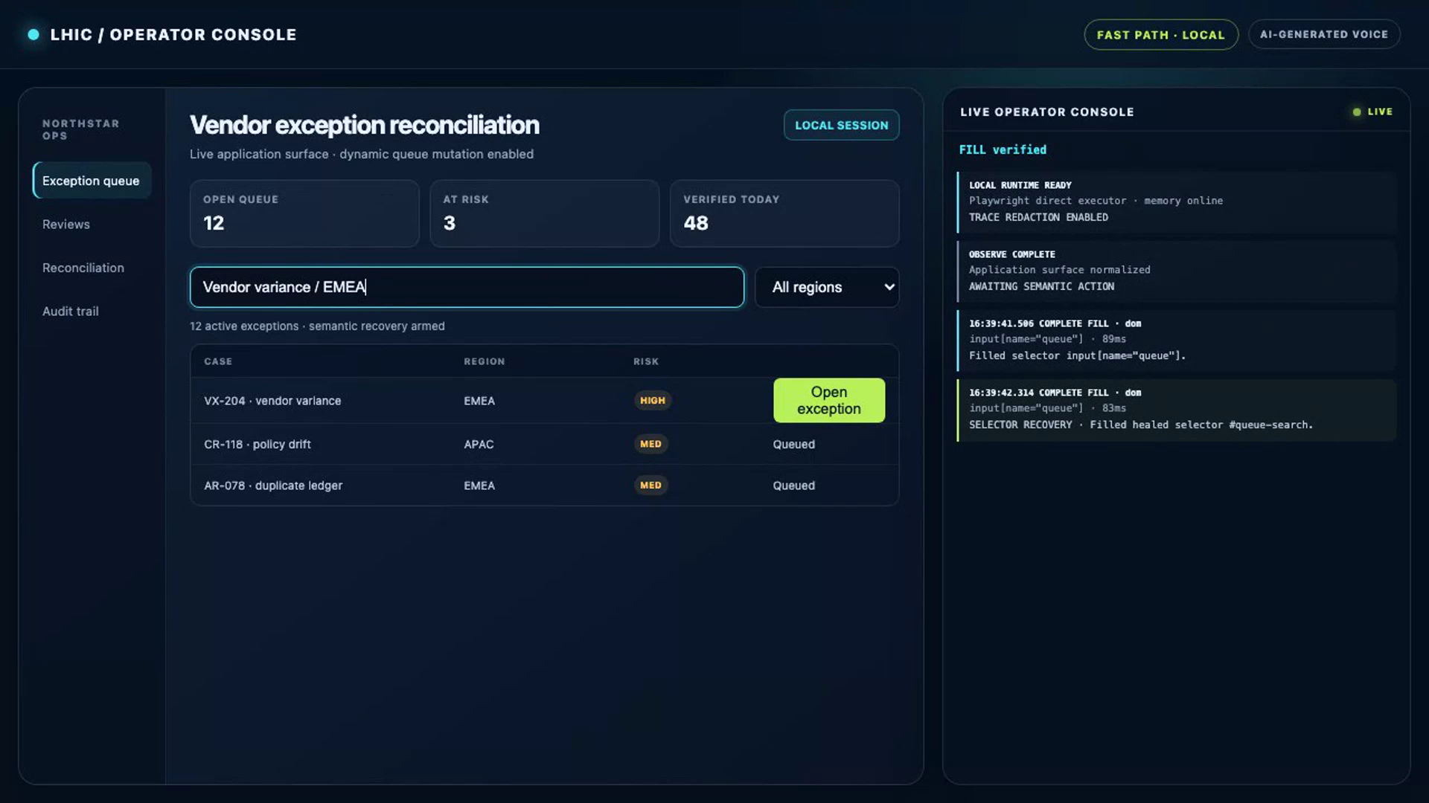
01

Slide 3
CORE THESIS
Intelligence can propose. LHIC decides what happened.
The execution boundary is the product.
Fast Path
LOCAL / DETERMINISTIC
Playwright + DOM + accessibility. No LLM. No MCP. No browser coordinates.
Routine work stays local and deterministic. Ambiguous work may use a model, but every proposal is revalidated. High-risk or global work returns authority to the human.
Slow Path
OPTIONAL / BOUNDED
Strict structured plan, redacted request, 30-second timeout, full schema and policy checks.
Human authority
SUCCESS ≠ “THE CLICK RAN”
EXACT-ACTION APPROVAL
Success is a declared postcondition with verifier evidence and a redacted trace.
Required for high/unknown risk and every native desktop action; pre/post window and process proof.
Source: repository architecture, routing profiles, OpenAI planner, and global-control implementation.
02

Slide 4
CORE THESIS
Intelligence can propose. LHIC decides what happened.
Fast Path
LOCAL / DETERMINISTIC
Playwright + DOM + accessibility. No LLM. No MCP. No browser coordinates.
Success is a declared postcondition with verifier evidence and a redacted trace.
Source: repository architecture, routing profiles, OpenAI planner, and global-control implementation.
02

Slide 5
CORE THESIS
Intelligence can propose. LHIC decides what happened.
Slow Path
OPTIONAL / BOUNDED
Strict structured plan, redacted request, 30-second timeout, full schema and policy checks.
Success is a declared postcondition with verifier evidence and a redacted trace.
Source: repository architecture, routing profiles, OpenAI planner, and global-control implementation.
02

Slide 6
CORE THESIS
Intelligence can propose. LHIC decides what happened.
Human authority
EXACT-ACTION APPROVAL
Required for high/unknown risk and every native desktop action; pre/post window and process proof.
Success is a declared postcondition with verifier evidence and a redacted trace.
Source: repository architecture, routing profiles, OpenAI planner, and global-control implementation.
02

Slide 7
ARCHITECTURE
A deterministic control loop with proof at the end
Every transition is typed, budgeted, and inspectable.
INTENT
›
SENSE
›
PLAN
›
ACT
›
PROVE
›
TRACE
Goal
DOM + AX
Typed
Local SDK
Verifier
Redacted
01
Exactly one target
02
One local recovery
03
Evidence before learning
Ambiguity rejects the action; selector memory is earned only after proof.
Then an optional slow planner—only if the routing profile still has budget.
Verified task IDs and unseen-UI holdout gate skill promotion.
Source: browser-plan-v1 schema, target resolver, multipath controller, verifier, trace, and learning code.
03

Slide 8
PROJECT HIGHLIGHTS
Four engineering choices define LHIC
The project is differentiated by constraints that survive changes in planner or interface.
01
Verifier-first
02
Exact human authority
Every step states its postcondition before execution. Missing evidence fails closed.
Approval hashes the entire action, expires quickly, and cannot be replayed.
03
Semantic resilience
04
Evidence-gated learning
DOM and accessibility targets must resolve uniquely; verified history can heal selectors.
Three independent verified task IDs plus an unseen-UI holdout are required.
PLUS: HARDENED TRACES
MULTIPLE OPERATOR SURFACES
LOCAL-FIRST SKILL MEMORY
Source: security, trace, memory, selector resolver, and schema implementation.
04

Slide 9
CONTROLLED PROOF
The current checkout passed its full local evidence suite
Internal regression evidence—not an external market or state-of-the-art claim.
CONTROLLED LOCAL
341/341
100%
774 ms
0
TESTS PASSED
TASK SUCCESS
P95 LATENCY
MODEL + MCP CALLS
93 test files
300 executions
60 fixtures × 5
per Fast Path task
100%
0
100%
0
0
structured actions
raw coordinates
verifier pass
false-positive success
human intervention
Source: npm run bench:internal, executed 20 Jul 2026 • local fixture regression • all configured gates passed.
05

Slide 10
RESILIENCE SIGNAL
Semantic targeting survived the controlled selector ablation
A deliberately limited static selector baseline is useful for regression contrast—not market comparison.
+80 pp
CONTROLLED DELTA
100% semantic route vs 20% intentionally limited static selector route.
What this does prove
Semantic resolution is wired into execution.
Healing preserves verifier evidence.
NO EXTERNAL-SUBMISSION ELIGIBILITY
Source: npm run bench:simulate, seed 20260715 • controlled ablation • externalSubmissionEligible=false.
06

Slide 11
SAFETY MODEL
Trust is enforced in the execution layer
Network, authority, evidence, and provider controls reinforce each other.
NETWORK
AUTHORITY
EVIDENCE
Reject private targets, credentialed URLs, unsafe redirects, and invalid protocols.
Bind approval to the exact action. Expire it quickly. Reject every replay.
Do not report success without the declared postcondition and a redacted trace.
DNS + redirect checks
Ed25519 in production
Verifier is mandatory
Origin / protocol policy
≤ 5 minute lifetime
PII + action values redacted
No browser coordinates
Atomic one-time marker
Secure trace creation
Optional models can suggest actions. They cannot expand budget, bypass policy, approve themselves, or redefine success.
Source: security/approval/replay, production browser guards, trace redaction, verifier, and OpenAI planner code.
07

Slide 12
SKILL MEMORY
Learning is earned through independent proof
LHIC does not promote a successful trace directly into the Fast Path.
RUN
GATE
GATE
FAST PATH ELIGIBLE
01
02
03
04
Verified run
Independent repetition
Unseen-UI holdout
Promoted skill
Task succeeds with declared postcondition evidence.
Three distinct verified task IDs are required.
Offline test must use a new UI fingerprint.
Only redacted/hash provenance enters memory.
Promotion stays blocked until every evidence gate passes—and network synchronization is completed before runtime, never during the Fast Path.
Source: learning gate, skill store, shared-skill eligibility, and selector-memory implementation.
08

Slide 13
PRODUCT SURFACES
One runtime. Four operator surfaces.
DESKTOP OPERATOR CONSOLE
The repository is broader than a demo script.
01
Desktop
Electron/React operator console, approvals, dashboard, release UX.
02
CLI
Task execution, inspection, benchmarks, packaging, and operator workflows.
03
MCP server
Slow-path and external-agent adapter—explicitly outside Fast Path.
04
Shared skills
Appwrite-backed control plane with local cache before runtime.
12 PACKAGES
4 APPS
286 FILES
Source: apps/desktop, apps/cli, apps/mcp-server, shared-skills package, and Appwrite service.
09

Slide 14
MATURITY
The core path is ahead of external proof and distribution
A useful release conversation distinguishes implemented behavior from integration-ready and gated work.
Capability | Assessment | Evidence / remaining work
Fast Path browser execution | IMPLEMENTED | Direct SDK, policy, verifier, trace, tests
Security + approvals | IMPLEMENTED | Exact-action signing, replay checks, redaction
Desktop control center | EVOLVING | Build passes; distribution evidence still gated
BrowserPool / workflows | INTEGRATION-READY | Caller owns lifecycle, workers, secrets
External benchmark publication | GATED | No eligible public submission result
Screenshot/custom verifiers | KNOWN GAP | Not available in verifier v0
Release truth is split: npm latest 0.1.1; local docs describe 0.1.2 CLI RC and desktop 0.1.4 development build.
Source: local source/tests, release-status and production-readiness docs; npm registry metadata observed 20 Jul 2026.
10

Slide 15
THE POSITION TO OWN
NEXT 90 DAYS
Local execution
with proof.
01
External evaluation pack
Pinned BrowserGym/WorkArena harness, traces, and failure taxonomy.
02
Verifier challenge set
LHIC is strongest as a secure execution substrate—where policy, human authority, deterministic automation, verification, and audit evidence decide what actually happened.
False-positive and false-negative tests by postcondition family.
03
Harmonized release
One version matrix plus signed/notarized desktop evidence.
NO SOTA CLAIM
STRONG INTERNAL INVARIANTS
Deep research based on the current working tree • 20 July 2026
11

