Slide 1
A Data-Driven Optimization Framework to Improve Search Advertising Efficiency
Discussant: Cheng Nie
Iowa State University
chengnie.com/files/2024big12.pptx

Slide 2
Great things about this paper
Very clearly written with easy-to-understand examples
Combing empirical (“data-driven”) with analytical (“optimization problem”)

Slide 3
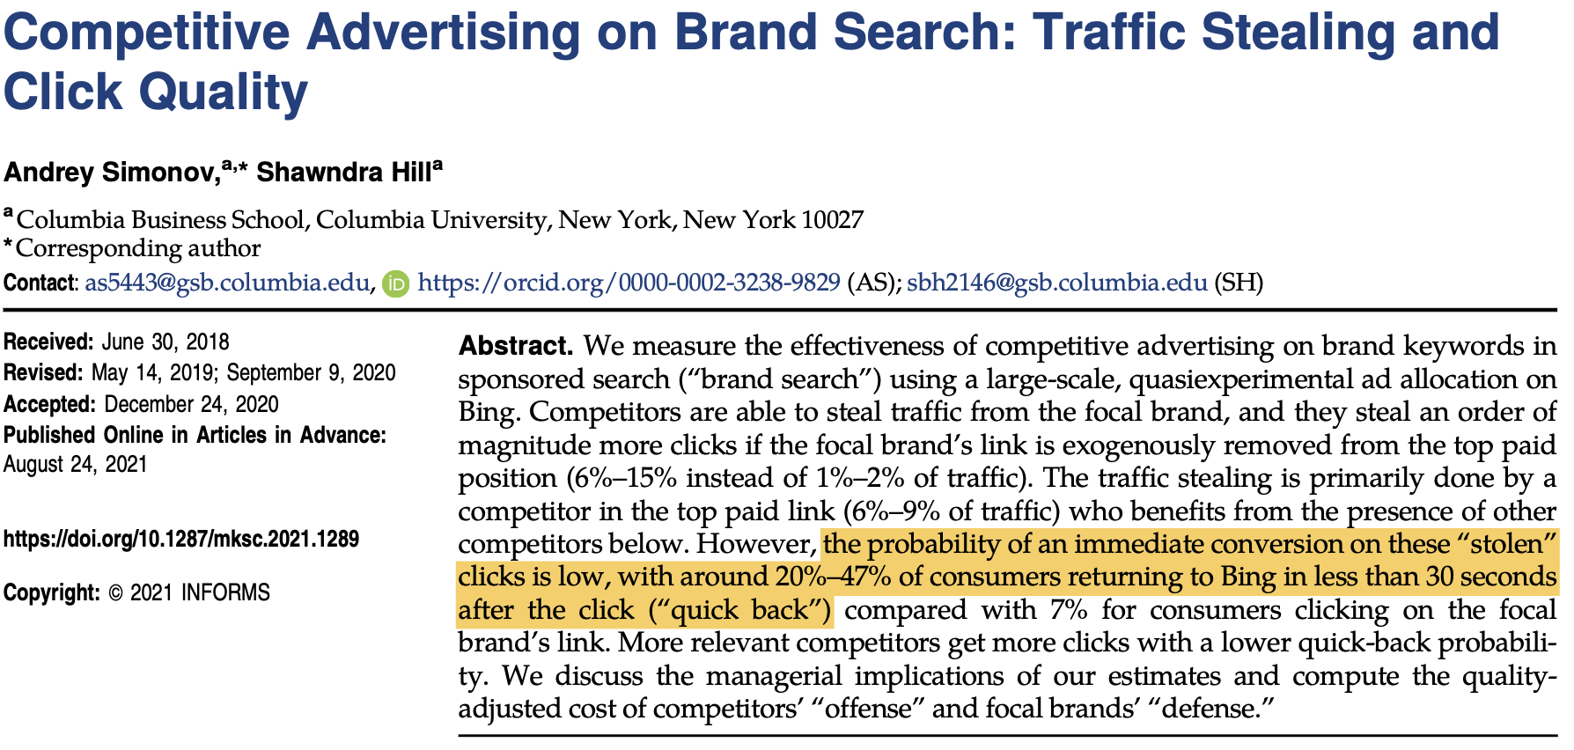
Finding # 1. Never optimal to do competitive advertising

Slide 4
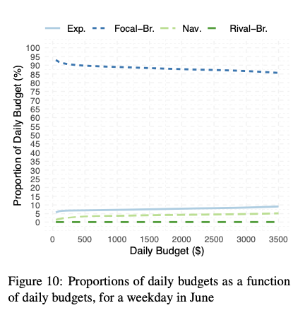
Finding # 2 The share of the budget to focal-branded keywords decreases in budget amount?
What is the intuition behind Finding #2?
Is Finding #2 the driving force of Finding #3 (yearly budget can yield 2.9% more efficiency than daily budget?)
The explanation in the paper: click-through-rates and conversion-rates change depending on the weekday or month of a year.

Slide 5
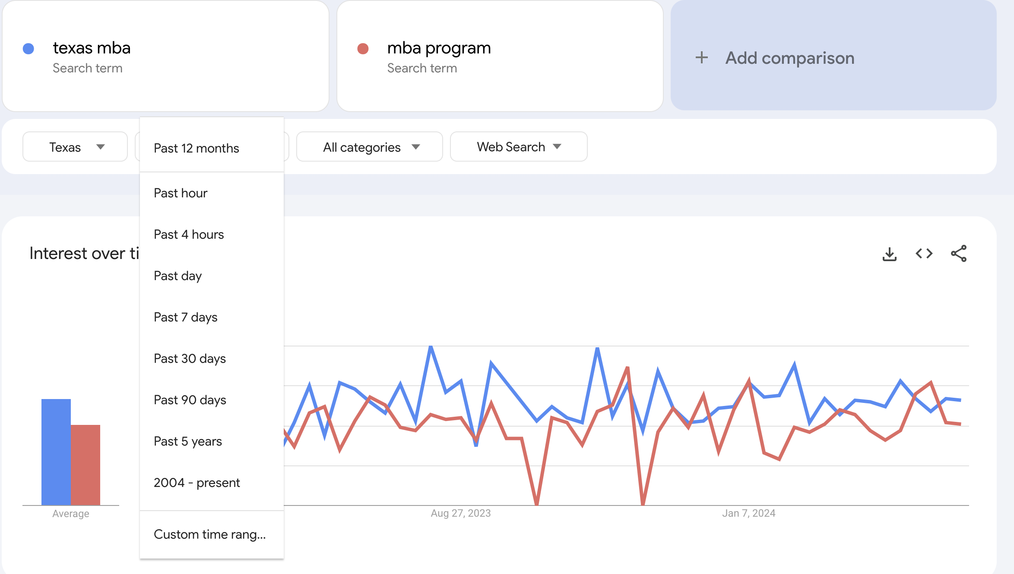
Limitation #2: search engine search volumes

Slide 6
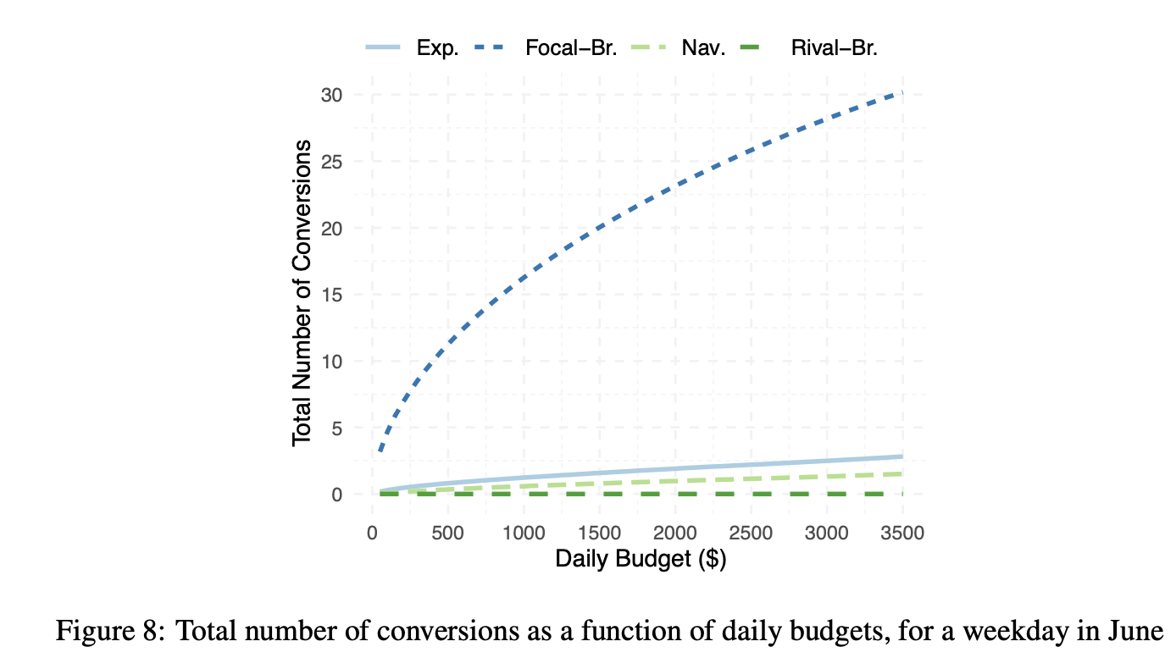
Non-focal branded looks linear might be due to the scale of picture.

Slide 7
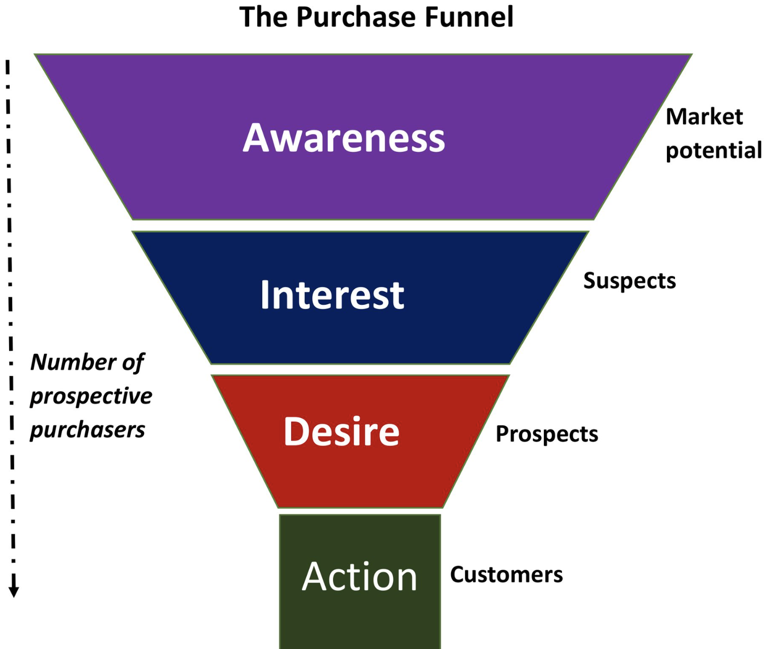
The Purchase Funnel
Similar to the concepts used in the paper (e.g., consideration set)
The estimated click-through-rates and conversion-rates are assumed to be the static (depending on the weekday or month). But they might change due to ads from previous periods.

Slide 8
Possible Extensions
Control for the rank of the focal-brand ads
Control for the presence and rank of rival-brand ads
Organic search results: SEO + SEM combination
Generalizable to contexts other than higher education
Field experiment with the help of the advertising agency
The journey of individual customers at different search stages
clickstream data
What if the objective function is maximizing clicks, not conversions? Or alternative definitions of conversions?

