Slide 1
ML4MI Bootcamp: Core Principles
Updated:
July 24th, 2018
Contributors:
Kevin M. Johnson ( kmjohnson3@wisc.edu)

Slide 2

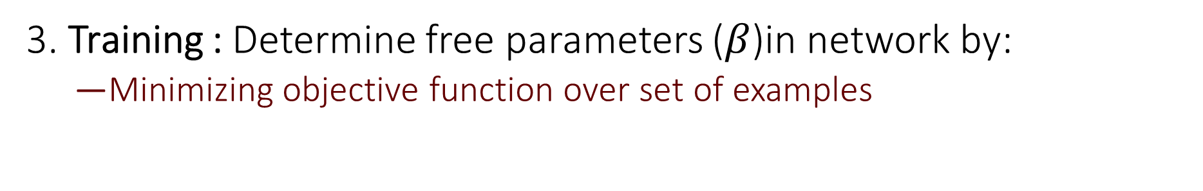
Core Architecture (Supervised Learning)
$$f\left(x | β\right)=y$$
1. Design Network
2. Loss: Set an objective function to minimize
Some metric that is a measure of goodness (0=best)
3. Training : Determine free parameters ($β$)in network by:
Minimizing objective function over set of examples

Slide 3

$$f\left(x | β\right)=y$$
1. Design Network
A network is built from relatively simple functions
$$f\left(x | β\right)=f_{4} ({ f}_{3}( f_{2}( f_{1}(x))))$$

Slide 4
Functions of a network
Connections
Fully connected layers
Convolution layers
Neurons
Activation functions
Biases
Resampling
Max/Average pool

Slide 5
A two neuron network graph ( Feed forward )
Inputs
Hidden Layer
X₁
H₁
Output (s)
Y
X₂
H₂
Connections

Slide 6
A two neuron network graph ( Feed forward )
Inputs
Hidden Layer
X₁
w₁₁
H₁
Output (s)
w_{1o}
w₁₂
O
w₂₁
w_{2o}
X₂
w₂₂
H₂
Connections
(with weights)

Slide 7


A two neuron network graph ( Feed forward )
Inputs
Hidden Layer
X₁
w₁₁
H₁
$$H_{1}=X_{1}w_{11}+X_{2}w_{21}$$
w₁₂
w₂₁
X₂
w₂₂
H₂
$$H_{2}=X_{1}w_{12}+X_{2}w_{22}$$

Slide 8
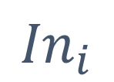
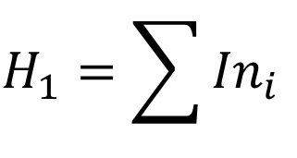


Neuron node
H₁
Multiple Inputs
Single Output
$$σ$$
$${In}_{i}$$
$$Out=σ(H_{1})$$
$$H_{1}=\sum{{In}_{i}}$$
Output has “activation” function
Sum inputs

Slide 9
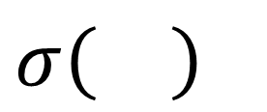
Activation Functions
$σ\left(\right)$
Similar to the idea of a “firing neuron”
Biologic neuron doesn’t fire unless input is above some threshold
Generally a non-linear function (not always)
Gives the network power to do non-linear approximations

Slide 10



Activation Functions
$$σ(x)$$
Linear / Identity / none
Essentially no activation function
Output = Input
Scaling independent
Not widespread but actually very useful for fitting linear operations
$$σ\left(x\right)=x$$
$$x$$

Slide 11
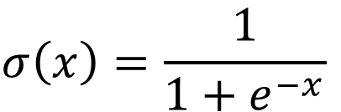
Activation Functions
$$σ(x)$$
Logistic / Sigmoid
Approximate to biological neuron
Output Range: 0 to 1
Commonly used in last layers of some classification problems
$$σ\left(x\right)=\frac{1}{1+e^{−x}}$$
$$x$$

Slide 12
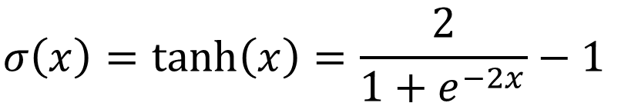
Activation Functions
$$σ(x)$$
Tanh ( hyperbolic tangent )
Output Range: -1 to 1
Similar to sigmoid but with negative outputs
Used in recent AutoMAP paper but not common
$$σ\left(x\right)=\tanh\left(x\right)=\frac{2}{1+e^{−2x}}−1$$
$$x$$

Slide 13
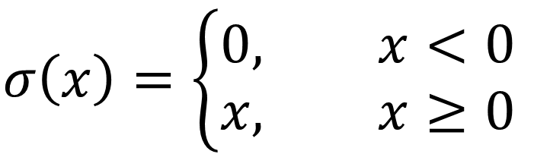

Activation Functions
$$σ(x)$$
ReLu
Rectified Linear Unit
Output range : $0 to ∞$
Most commonly used activation function
$$σ\left(x\right)=\left\{\begin{aligned}0, x<0 \\ &x, x≥0\end{aligned}\right.$$
$$x$$

Slide 14
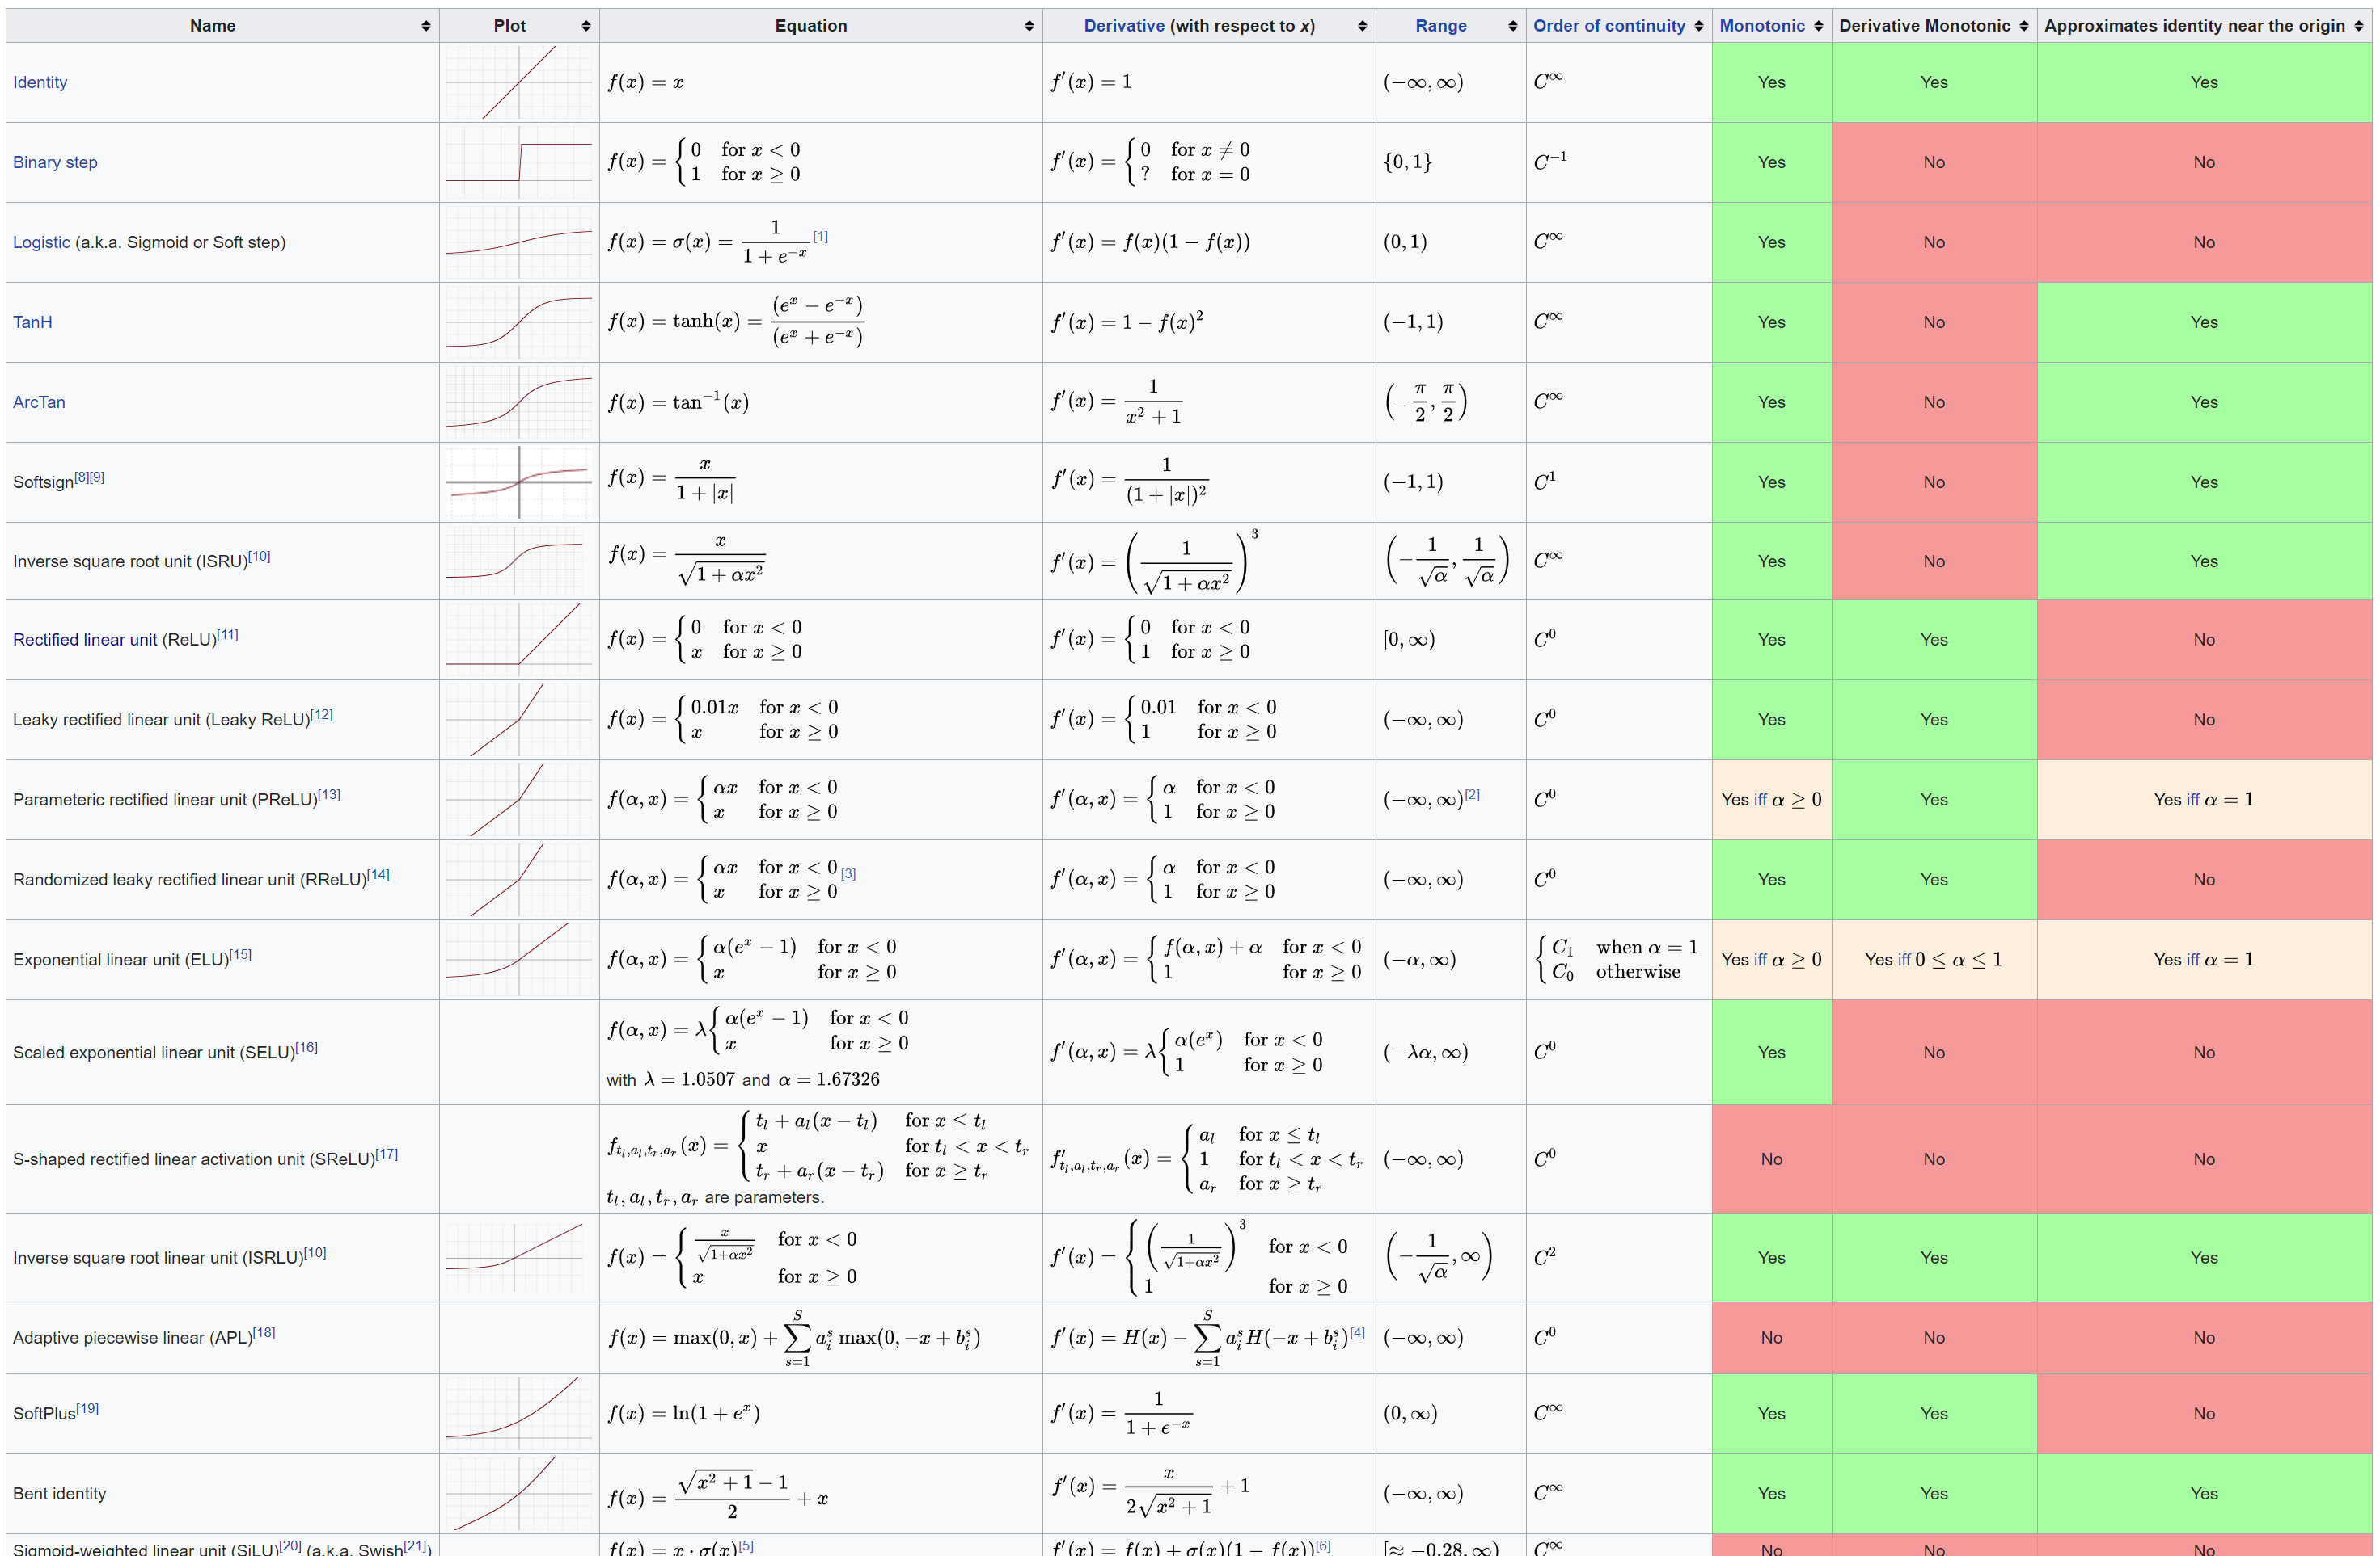
Activation Functions
Many functions (e.g. https://en.wikipedia.org/wiki/Activation_function )

Slide 15
A two neuron network graph ( Feed forward )
Hidden Layer
Inputs
X₁
w₁₁
H₁
$${Y= w_{1o}∙σ(H}_{1}) {+w_{2o}∙σ(H}_{2})$$
w_{1o}
w₁₂
Y
w₂₁
w_{2o}
X₂
w₂₂
H₂
Connections
(with weights)

Slide 16
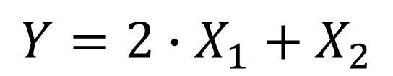
Super Simple Operation
$$Y={2∙X}_{1}+X_{2}$$
with ReLu Activations
X₁
2
H₁
1
-2
Y
1
-1
X₂
-1
H₂
Connections
(with weights)

Slide 17
How to get this?
See Keras Example: FunctionFitter.ipynb
Things to play with in example:
Change activation functions (‘linear’ , ’tanh’, ‘sigmoid’)
Scaling
Modify network to approximate other operations
Add more neurons
Machine Learned
Intuition
Layer 1
-1.2086098 1.7425349
-0.6041879 0.8712317
Layer 2
-1.654212 1.1477064
Layer 1
-2 2
-1 1
Layer 2
-1 1

Slide 18
Dense / Fully Connected Layer
Layer 1 (n=4)
Fully Connected Layers
Each input connected to every output
Large number of connections and associated weights
N_{weights}=N_{in}*N_{out}
Usually used:
At the end of networks
When required by data
Layer 2 (n=3)

Slide 19
Dense / Fully Connected Layer
Layer 1 (n=4)
Fully Connected Layers
Viewed as matrix multiply:
Layer 2 (n=3)
Layer 1
(4 x 1)
Weights
(3 x 4)
Layer 2
(3 x 1)
=

Slide 20
Convolutional Layers
1D Example : 3 pixel kernel
Layer 1 (n=4)
Layer 2 (n=4)
Convolution only connect nearby pixels
Pre-enforce spatial relationships between pixels
Use a convolution kernel [an unknown]
Number of unknown weights:
N_{kernel}
Usually far fewer unknowns than fully connected
w_{a}
w_{b}
w_{c}

Slide 21
Convolutional Layers
1D Example : 3 pixel kernel
Layer 1 (n=4)
Layer 2 (n=4)
Convolution only connect nearby pixels
Pre-enforce spatial relationships between pixels
Use a convolution kernel [an unknown]
Number of unknown weights:
N_{kernel}
Usually far fewer unknowns than fully connected
w_{a}
w_{b}
w_{c}

Slide 22
Convolutional Layers
1D Example : 3 pixel kernel
Layer 1 (n=4)
Layer 2 (n=4)
Convolution only connect nearby pixels
Pre-enforce spatial relationships between pixels
Use a convolution kernel [an unknown]
Number of unknown weights:
N_{kernel}
Usually far fewer unknowns than fully connected
w_{a}
w_{b}

Slide 23
Convolutional Layers
1D Example : 3 pixel kernel
Layer 1 (n=4)
Layer 2 (n=4)
Convolution only connect nearby pixels
Pre-enforce spatial relationships between pixels
Use a convolution kernel [an unknown]
Number of unknown weights:
N_{kernel}
Usually far fewer unknowns than fully connected
w_{b}
w_{c}

Slide 24
Convolutional Layers
1D Example : 3 pixel kernel
Layer 1 (n=4)
Layer 2 (n=4)
Convolution only connect nearby pixels
Pre-enforce spatial relationships between pixels
Use a convolution kernel [an unknown]
Number of unknown weights:
N_{kernel}
Usually far fewer unknowns than fully connected

Slide 25

Images and Layers have Channels
2D Layer
2D Image
$$f_{1}(x)$$
N x N x 3 Image
(e.g. RGB)
N x N x 1 Image
(e.g. Image processed through 1 functions)

Slide 26

Images and Layers have Channels
2D Layer
2D Image
$$f_{2}(x)$$
N x N x 3 Image
(e.g. RGB)
N x N x 2 Image
(e.g. Image processed through 2 functions)

Slide 27

Images and Layers have Channels
2D Layer
2D Image
$$f_{3}(x)$$
N x N x 3 Image
(e.g. RGB)
N x N x 3 Image
(e.g. Image processed through 3 functions)

Slide 28
Images and Layers have Channels
2D Layer
2D Image
N x N x 3 Image
(e.g. RGB)
N x N x 10 Image
(e.g. Image processed through 10 functions)

Slide 29
Convolutional Layers
1D Example : two 3 pixel kernels
Layer 2 (n=4, 2 channels)
Layer 1 (n=4)
Convolution Often used with channel increase or reduction
Multiple convolution kernels
Increases number of unknowns:
N_{kernel} N_{in} N_{out}
One kernel per input channel per output

Slide 30


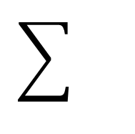

Images and Layers have Channels
2D Layer
2D Image
$$⊗$$
Kernel₁
$$⊗$$
Kernel₂
$$⊗$$
Kernel₃
N x N x 3 Image
(e.g. RGB)
N x N x 1 Image
(e.g. Image processed through 1 convolution)

Slide 31
Images and Layers have Channels
2D Layer
2D Image
$$⊗$$
Kernel₄
$$⊗$$
Kernel₅
$$⊗$$
Kernel₆
N x N x 3 Image
(e.g. RGB)
N x N x 2 Image
(e.g. Image processed through 2 convolutions)

Slide 32
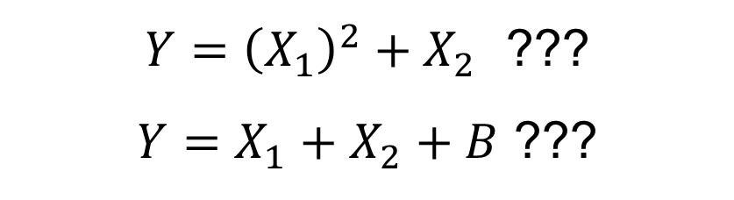
Back to two layer network
Hidden Layer
Can this network approximate:
Inputs
$Y={\left(X_{1}\right)}^{2}+X_{2}$ ???
$Y=X_{1}+X_{2}+B$ ???
X₁
w₁₁
H₁
w_{1o}
w₁₂
Y
w₂₁
w_{2o}
X₂
w₂₂
H₂
Connections
(with weights)

Slide 33
Adding Bias to Neuron
Layer Inputs
Single Output
H₁
$$Out=σ(H_{1})$$
Bias (a number)
Not a function of input

Slide 34

Effect of Bias Term
$$σ(x+b)$$
Bias
Has the affect of shifting output
Assigned to almost all neurons in a network
Essential for many non-linear fitting operations
$$x$$

Slide 35


Bias can be used to allow non-linear estimation
$$f\left(x\right)=x^{2}$$
Best fit single ReLu neuron
$$x$$

Slide 36
Bias can be used to allow non-linear estimation
$$f\left(x\right)=x^{2}$$
$$x$$
Weighted sum of two ReLu neurons does much better
But adding more neurons doesn’t help (same shape)

Slide 37
Bias can be used to allow non-linear estimation
$$f\left(x\right)=x^{2}$$
sum of outputs
$$x$$
Adding bias allows a sum of shifted neurons → much better approximation

Slide 38
Increasing neurons
Matlab example in “one_layer_backpropagation.m
Two neurons with shift

Slide 39
Increasing neurons
Matlab example in “one_layer_backpropagation.m
20 neurons

Slide 40
Fitting to complex functions
Fit to sin(x) with single layer of 200 neurons:

Slide 41
Neural networks are generally NOT! Independent of scaling
Training Range
Essentially extrapolation

Slide 42
Pooling Operations
Sometime its is important to reduce the size of images before passing to next layer
Autoencoders, global classification
Max and average pooling do this:
Keras Code
keras.layers.MaxPooling2D(pool_size=(2, 2), strides=None, padding='valid', data_format=None)
Input (4x4)
1 | 2 | 3 | 4
2 | 3 | 4 | 5
4 | 3 | 56 | 5
74 | 2 | 4 | 3
Output (2x2)
Max Pool
3 | 5
74 | 56

Slide 43
Put together a network
Hidden Layer
“feature maps”
Hidden Layer 2
“feature maps”
Input
10 - 3x3 Conv
10 - 3x3 Conv
NxNx3
NxNx10
NxNx10
9 weights per kernel,
3 kernels per input,
1 bias terms per output
10 outputs
(9*3+1)*10=280 unknowns
9 weights per kernel,
10 kernels per input,
1 bias terms per output
10 outputs
(9*10+1)*10=910 unknowns

Slide 44
Putting together a network for classification
Class Likelihood
(softmax)
Hidden Layer 2
“feature maps”
Dense
Dense
Flatten + Dense
Output=2048
Dense
Output=2048
Dense
Output=10
10x1
NxNx10
2048x1
2048x1
10N² weights output,
1 bias terms per output
2048 outputs
(10N²+1)*2048 unknowns
if N=128 → 335,546,368!
2048 weights output,
1 bias terms per output
2048 outputs
(2048+1)*2048 unknowns
2048 weights output,
1 bias terms per output
10 outputs
(2048+1)*10 unknowns

Slide 45
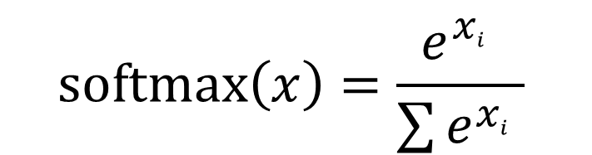
Softmax
Softmax is an activation function but operates on the whole layer:
Sum of layer adds to 1
Each value between 0 and 1
$$softmax\left(x\right)=\frac{e^{x_{i}^{}}}{\sum{e^{x_{i}^{}}}}$$

Slide 46
Putting together a network for classification
Hidden Layer 2
“feature maps”
Regression Value
(linear)
Dense
Dense
Flatten + Dense
Output=2048
Dense
Output=2048
Dense
Output=10
1x1
NxNx10
2048x1
2048x1
10N² weights output,
1 bias terms per output
2048 outputs
(10N²+1)*2048 unknowns
if N=128 → 335,546,368!
2048 weights output,
1 bias terms per output
2048 outputs
(2048+1)*2048 unknowns
2048 weights output,
1 bias terms per output
1 outputs
(2048+1) unknowns

Slide 47



Network
$$f\left(x | β\right)=y$$
$$β=\{ weights,bias,other params\}$$
Find $β$ minimizing loss function over training data
$$β=argmin Loss(xtrain,ytrain)$$

Slide 48


Two types of losses
Performance Losses
Network Losses
Gauge how well network performs
Function of input and output only
Akin to accuracy
Prevent overfitting, impose prior knowledge, improve training
Function of network unknowns
$$Loss(x,y)$$
$$Loss(β)$$

Slide 49
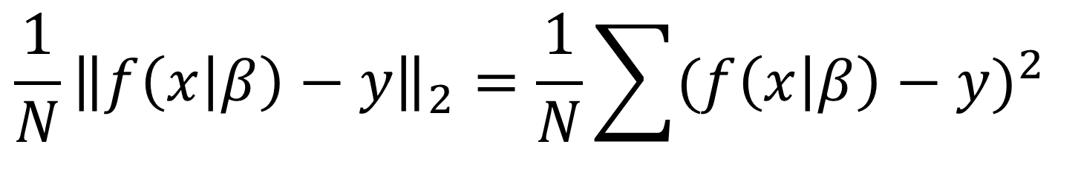
Performance losses
Very task specific!
Regression ( mean squared error = least squares regression )
$${\frac{1}{N}\left\|f\left(x | β\right)−y\right\|}_{2}=\frac{1}{N}\sum{({f\left(x | β\right)−y)}^{2}}$$
Keras Code:
model.compile(loss=losses.mean_squared_error,
optimizer=‘adam')

Slide 50
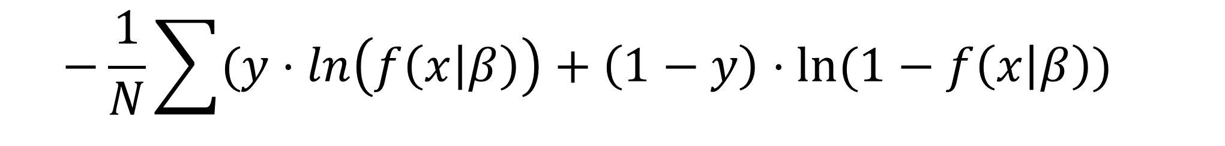
Performance losses : Classification
Classification common to use cross-entropy (e.g. logistical regression)
$$−\frac{1}{N}\sum{({y⋅ln\left(f\left(x | β\right)\right)+\left(1−y\right)⋅ln⁡(1−f\left(x | β\right))}^{}}$$
Reward zeros elsewhere
Reward similar values
Keras Code:
model.compile(loss=losses.categorical_crossentropy,
optimizer=‘adam')

Slide 51
Classification Loss : One-Hot-Encoding
Impossible to use strings as costs:
Human label { ‘Healthy’, ‘Alzheimer's’, ‘Epilepsy’ , ‘Brain Tumor’ }
Labeling desired outputs a 1,2,3,4 creates a association between nearby values
(e.g. its thresholded regression)
One-Hot-Encoding
“Makes one value hot by vector position
Allow each to be more independent
Healthy
Alzheimer's
Epilepsy
Brain Tumor
1
0
0
0
0
1
0
0
0
0
1
0
0
0
0
1

Slide 52
Why cross entropy?
Cross entropy creates a continuous function of goodness

Slide 53
Why cross entropy?
Not the same as accuracy
Top estimate is correct but loss is higher
Top estimate is wrong and loss is lower

Slide 54

Network losses
L2 loss most common (also called weight decay )
Very common in convolution kernels
Forces smoother, less specialized kernels
Sometimes put on all trainable parameters to stabilize training
$$Loss\left(β\right)=λ\sum{β^{2}}$$
Keras Code
x = Conv2D(dim, 3,
activation=‘relu’,
padding='same’,
kernel_regularizer=keras.regularizers.l2(0.001))(x)

Slide 55


Training
$$f\left(x | β\right)=y$$
$$β=argmin Loss(xtrain,ytrain)$$

Slide 56
Data and Label Sources
Need good data
Variety spans the expected variety in the input data
Good ground truth ( supervised learning )
Labels for categorical data
Gold standard for regression
Types of data:
Collected data
Clinical archived images, medical records, etc
Simulated data
Used when challenging to get gold standard
Deep learning used as inverse operator

Slide 57
Generic training procedure
1) Initialize weight and biases
Usually random drawn from a distribution ( e.g. Gaussian, Uniform )
Often scaled by the number of input and/or outputs
Keras Code
x = Conv2D(dim, 3,
activation=‘relu’,
padding='same’,
kernel_initializer=‘he_normal',
kernel_regularizer=keras.regularizers.l2(0.001))(x)

Slide 58
Generic training procedure
2 ) Generate a subset of the data, a mini-batch
Dataset is large ( or infinite with simulated data) easier to compute a small batch
Using small batch sizes can results in better trained networks
More generalized ( see Tishby – Information Bottleneck )
More stable learning
Batch sizes range from 1 to 1000’s

Slide 59
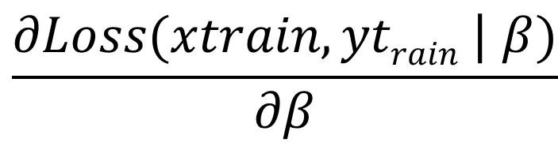
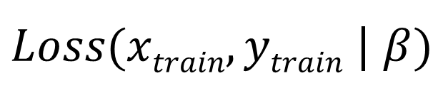
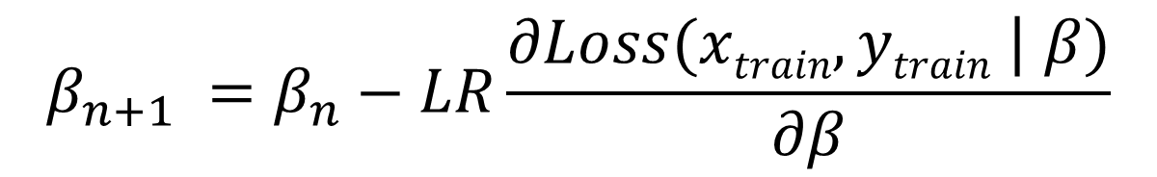
Generic training procedure
3 ) Compute the gradients with respect to weights, biases
4) Descend the loss function based on a learning rate (LR)
5) Repeat 2-4, until convergence
Loss for mini-batch
Gradient of loss
$Loss(xtrain,ytrain$ | $β)$
$$\frac{∂Loss(xtrain,ytrain\text{ |} β)}{∂β}$$
$$β_{n+1} =β_{n}−LR\frac{∂Loss(xtrain,ytrain\text{ |} β)}{∂β}$$

Slide 60
Core Training lexicon
Stochastic gradient descent:
The process of taking small batches, computing gradients and descending the loss function
Batch size
The number of examples used for each iteration
Epoch:
1 epoch means all the train examples have been used once
Learning rate:
The step size in the gradient descent

