Slide 1
ML4MI Bootcamp: Backpropagation & Stabilizing Trainable
Updated:
July 20th, 2018
Contributors:
Kevin M. Johnson ( kmjohnson3@wisc.edu)

Slide 2

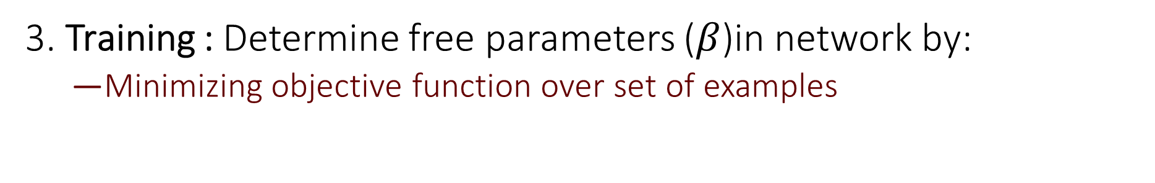
Core Architecture (Supervised Learning)
$$f\left(x | β\right)=y$$
1. Design Network
2. Loss: Set an objective function to minimize
Some metric that is a measure of goodness (0=best)
3. Training : Determine free parameters ($β$)in network by:
Minimizing objective function over set of examples

Slide 3
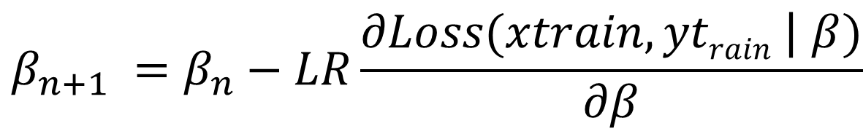
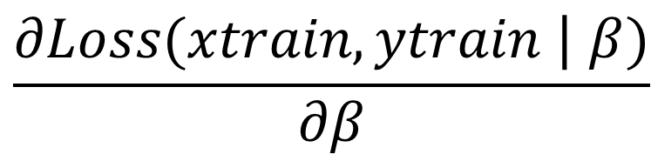
Generic training procedure
1) Initialize weight and biases
Usually random drawn from a distribution ( e.g. Gaussian, Uniform )
2 ) Generate a subset of the data, a mini-batch
3) Compute the gradients with respect to weights, biases
4) Descend the gradient of loss using a learning rate (LR) (i.e. step size):
5) Repeat
$$\frac{∂Loss(xtrain,ytrain\text{ |} β)}{∂β}$$
$$β_{n+1} =β_{n}−LR\frac{∂Loss(xtrain,ytrain\text{ |} β)}{∂β}$$

Slide 4
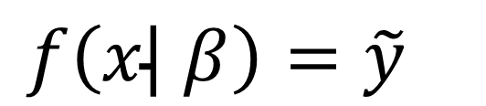
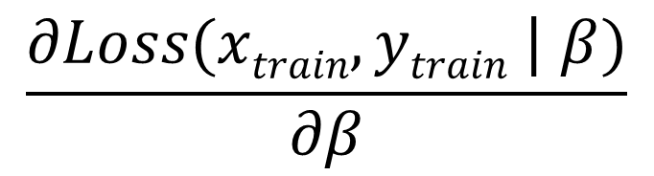
Backpropagation
Getting the gradient is not trivial ( complex function, set )
Backpropagation is a method to propagate the gradient from the output to the end
Start with a forward pass
Run a mini-batch through the network to get an estimate of the output
$$\frac{∂Loss(xtrain,ytrain\text{ |} β)}{∂β}$$
$$f\left(x\text{|} β\right)={\tilde{y}}_{}$$

Slide 5
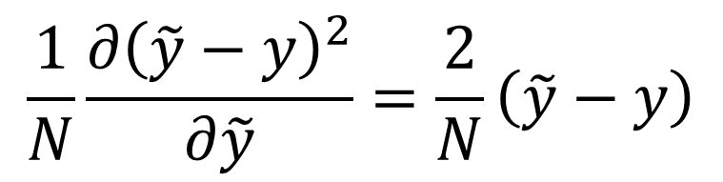

Simple layered neuron
Next get the gradient of the loss with respect to the output
Generally choose loss functions that are differentiable
Cross entropy, mean squared error, softmax, etc
Example: mean square error ( just the difference )
$$\frac{∂Loss(\tilde{y},y)}{∂\tilde{y}}$$
Y
$$\frac{1}{N}\frac{∂{\left(\tilde{y}−y\right)}^{2}}{∂\tilde{y}}=\frac{2}{N}\left(\tilde{y}−y\right)$$

Slide 6

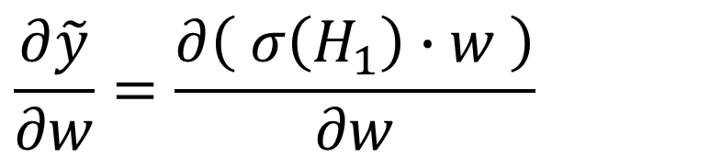
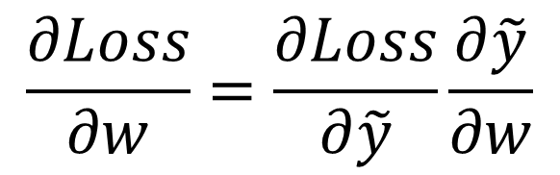


Simple layered neuron
Weight between output and neuron
Then use the chain rule to get the derivative of loss
Hidden Layer
Output (s)
$$\frac{∂\tilde{y}}{∂w}=\frac{∂\left( σ\left(H_{1}\right)∙w \right)}{∂w}$$
H₁
$$w$$
Y
$$σ$$
$$=σ\left(H_{1}\right)$$
$$\frac{∂Loss}{∂w}=\frac{∂Loss}{∂\tilde{y}}\frac{∂\tilde{y}}{∂w}$$

Slide 7

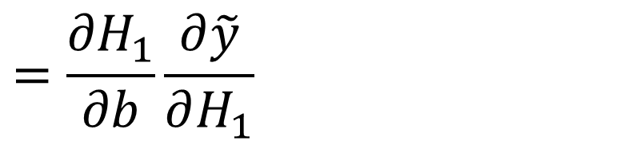
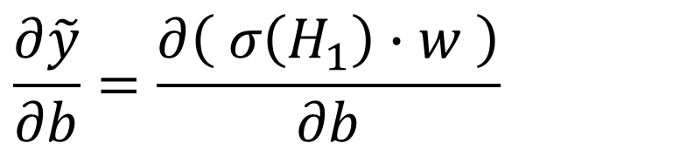



Simple layered neuron
Bias into last layer neuron
Need derivative of activation function!
ReLu, sigmoid, softmax, etc
Hidden Layer
$$b$$
Output (s)
$$\frac{∂\tilde{y}}{∂b}=\frac{∂\left( σ\left(H_{1}\right)∙w \right)}{∂b}$$
H₁
$$w$$
Y
$$w$$
$$σ$$
$$=\frac{{∂H}_{1}}{∂b}\frac{∂\tilde{y}}{∂H_{1}}$$

Slide 8
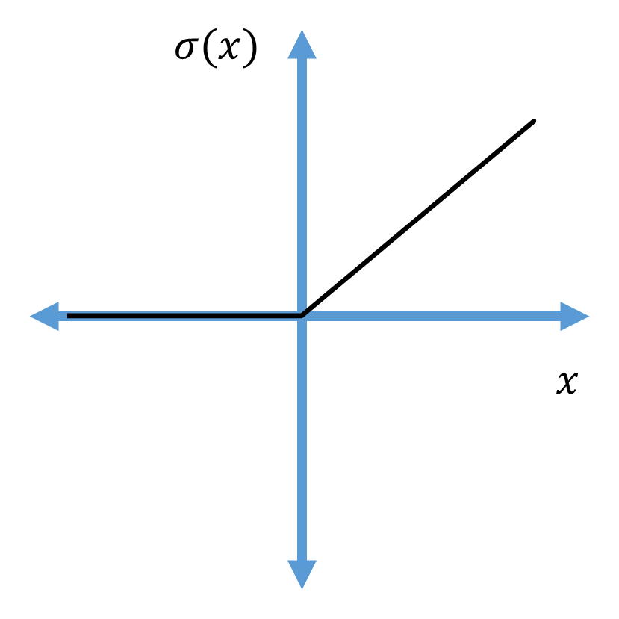
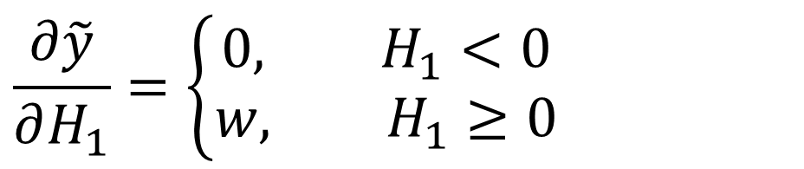
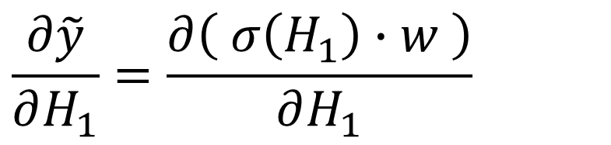
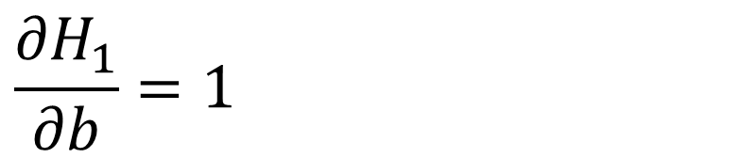
Simple layered neuron
Example with ReLu
Hidden Layer
$$b$$
Output (s)
$$\frac{{∂H}_{1}}{∂b}=1$$
H₁
$$w$$
Y
$$w$$
$$σ$$
$$\frac{∂\tilde{y}}{∂H_{1}}=\frac{∂\left( σ\left(H_{1}\right)∙w \right)}{∂H_{1}}$$
ReLu
$$\frac{∂\tilde{y}}{∂H_{1}}=\left\{\begin{aligned}0, H_{1}<0 \\ &w, H_{1}≥0\end{aligned}\right.$$

Slide 9

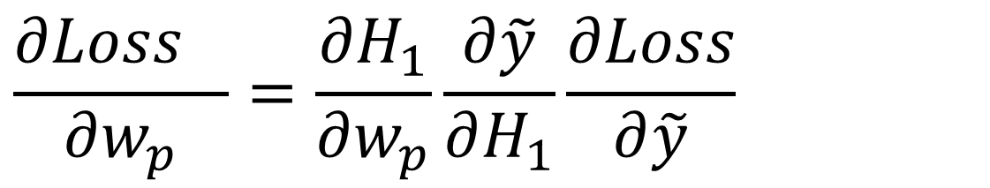


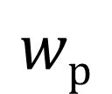

Simple layered neuron
$$b$$
Hidden Layer
Output (s)
H₀
H₁
Y
$$σ$$
$$σ$$
$$wp$$
$$w$$
ReLu
Same thing for weights from previous layer
$$\frac{{∂Loss}_{}}{∂w_{p}}=\frac{{∂H}_{1}}{∂w_{p}}\frac{∂\tilde{y}}{∂H_{1}}\frac{∂Loss}{∂\tilde{y}}$$

Slide 10

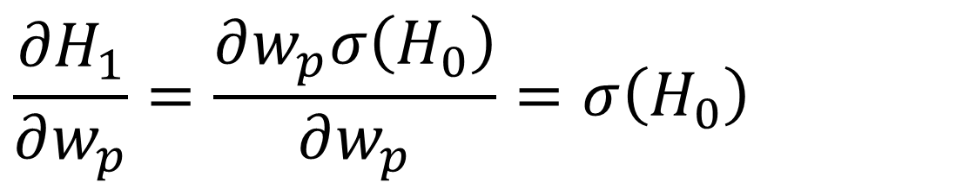


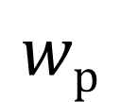

Simple layered neuron
$$b$$
Hidden Layer
Output (s)
H₀
H₁
Y
$$σ$$
$$σ$$
$$wp$$
$$w$$
Only need the partial derivative with respect to the weight
$$\frac{{∂H}_{1}}{∂w_{p}}=\frac{∂w_{p}σ\left(H_{0}\right)}{∂w_{p}}=σ\left(H_{0}\right)$$

Slide 11
Backpropagation
To get gradient of entire network just need to keep iterating back through the network
challenging in keeping track of gradient flow
Compute costs
One forward + one backwards pass
Storage of gradients
can be limiting given very high number of parameters
GPU acceleration almost always a must

Slide 12

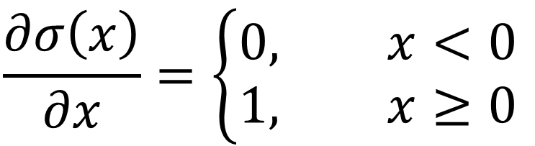
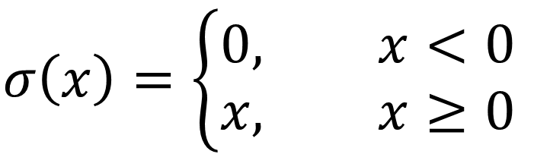

Issues with backpropagation : Vanishing Gradients
$$σ(x)$$
ReLu
Derivative is often zero !
$$σ\left(x\right)=\left\{\begin{aligned}0, x<0 \\ &x, x≥0\end{aligned}\right.$$
$$x$$
$$x$$
$$\frac{∂σ\left(x\right)}{∂x}=\left\{\begin{aligned}0, x<0 \\ &1, x≥0\end{aligned}\right.$$

Slide 13

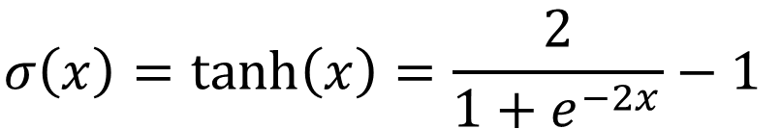
Issues with backpropagation : Vanishing Gradients
$$σ(x)$$
Tanh ( hyperbolic tangent )
Derivative goes to zero outside of small dynamic range:
Generally even worse than ReLu
$$σ\left(x\right)=\tanh\left(x\right)=\frac{2}{1+e^{−2x}}−1$$
$$x$$
$$σ\left(x\right)=1−\tanh{2\left(x\right)}$$

Slide 14
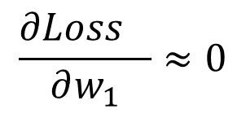
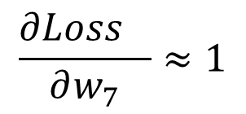
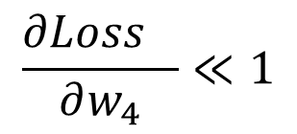
Issues with backpropagation : Vanishing Gradients
$$\frac{{∂Loss}_{}}{∂w_{1}}≈0$$
$$\frac{{∂Loss}_{}}{∂w_{4}}≪1$$
$$\frac{{∂Loss}_{}}{∂w_{7}}≈1$$
X
Y
Gradient amplitude decreases (neurons less connected with output)

Slide 15


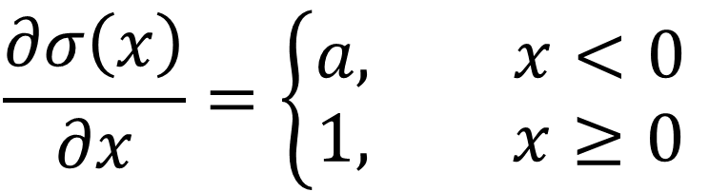
Effect of vanishing gradients
Vanishing gradient makes training very challenging
Especially with deep networks!
Slow convergence of models
Potential Solution 1 : Leaky ReLu
Small gradient value for negative inputs
$$σ(x)$$
$$\frac{∂σ\left(x\right)}{∂x}=\left\{\begin{aligned}a, x<0 \\ &1, x≥0\end{aligned}\right.$$
$$x$$
$$x$$

Slide 16
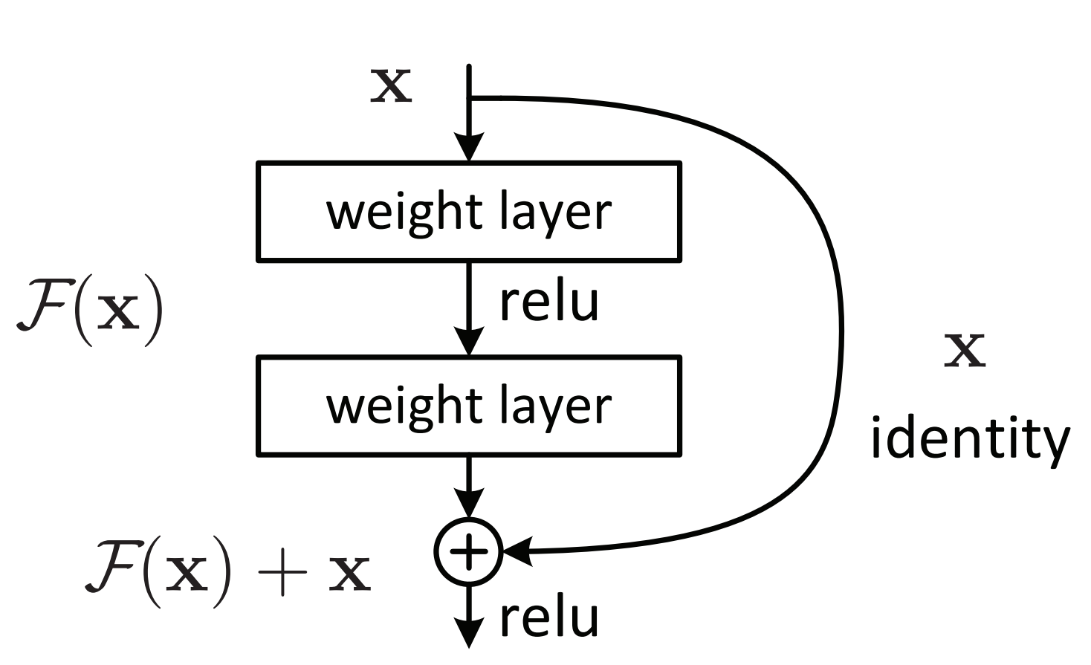
Effect of vanishing gradients
Potential Solution 2 : Improve the connection with the output
Principle of Resnet / shortcuts (as in U-Net)
Resnet
https://arxiv.org/pdf/1512.03385.pdf

Slide 17
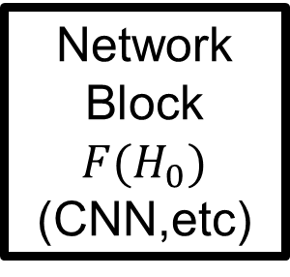

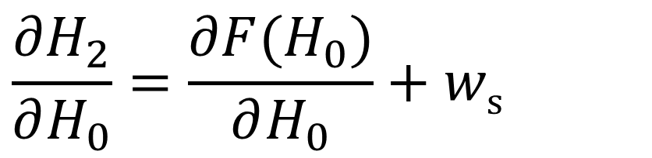
Effect of vanishing gradients
Potential Solution 2 : Improve the connection with the output
Principle of Resnet / shortcuts (as in U-Net
H₀
Network Block ${F(H}_{0})$ (CNN,etc)
H₂
$$\frac{{∂H}_{2}}{∂H_{0}}=\frac{{∂F(H}_{0})}{∂H_{0}}+ws$$
$$ws$$
Additive gradient term keeps chain rule based propagation
Skip / shortcut with learned weight

Slide 18
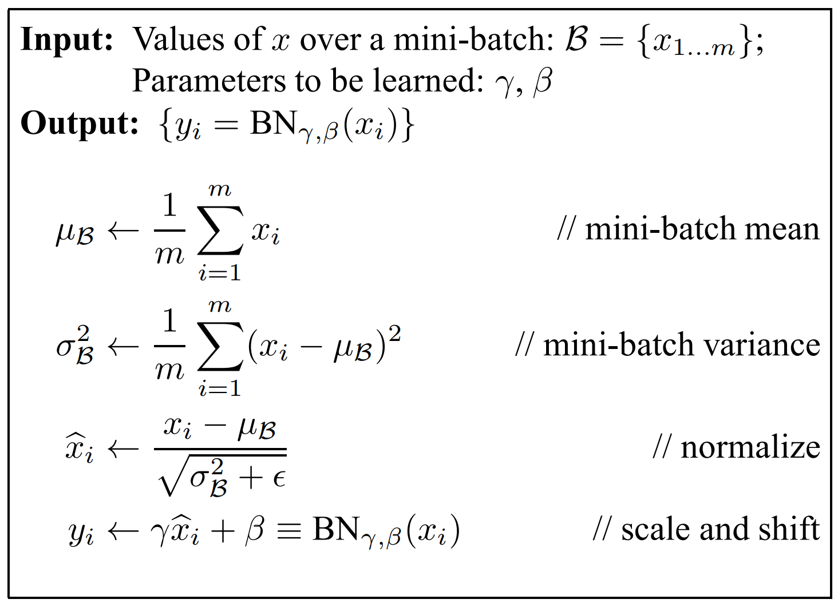
Gradients problem
Data normalization helps learning
Normalize input data if possible
Batch Normalization (internal network scaling)
Estimate mean and variance of batch
Subtract mean
Divide standard deviation
Learn a layer wise scale and shift
Batch normalization affects
Randomly perturbs network
Smooths loss
Regularizes network
https://arxiv.org/pdf/1502.03167.pdf

Slide 19
Issues with backpropagation : Exploding Gradients
Gradients can also explode
Same principle as in vanishing
Worse with:
Non-Relu activations
High learning rates
Other networks ( particularly recurrent neural networks)
Loss functions with steep gradients (e.g. regression)

Slide 20


Issues with backpropagation : Exploding Gradients
Lot’s of potential solutions
Lower learning rate, regularization
A simple technique to “clip” the gradients
Identical to slowing the learning rate at steep slopes
$$Loss(x|w)$$
Start
Without clipping
clipped
$$w$$

