Slide 1
ML4MI Bootcamp: MRI Recon Intro Slides
Updated:
July 20th, 2018
Contributors:
Kevin M. Johnson ( kmjohnson3@wisc.edu)

Slide 2
MRI : Excitation
RF Transmitter (Loop Antenna)
35 kW
RF Receiver (Loop Antenna)
Tiny net signal
Hydrogen Atoms
(each like a little magnet)
High Power RF Wave
(VHF / FM Radio Spectrum )

Slide 3
MRI : Signal Encoding
The frequency of the signal is related to the magnet strength
Low Field→ Low Frequency
(Left side)
High Field → High Frequency
(Right side)
Dynamic Magnets create spatial gradients

Slide 4
MRI : Spatial Encoding
Dynamic Magnets
Magnet On
Antenna
Dynamic Magnets create a frequency dependency which is spatially dependent
Excite
(62.5 MHz)

Slide 5
MRI : Spatial Encoding
Raw Data Matrix
MRI Image
Signal Separator
(~Fourier transform)
Each Line takes ~5ms
256 x 256 2D image = 1.2 s
256³ 3D image = ~5 minutes

Slide 6
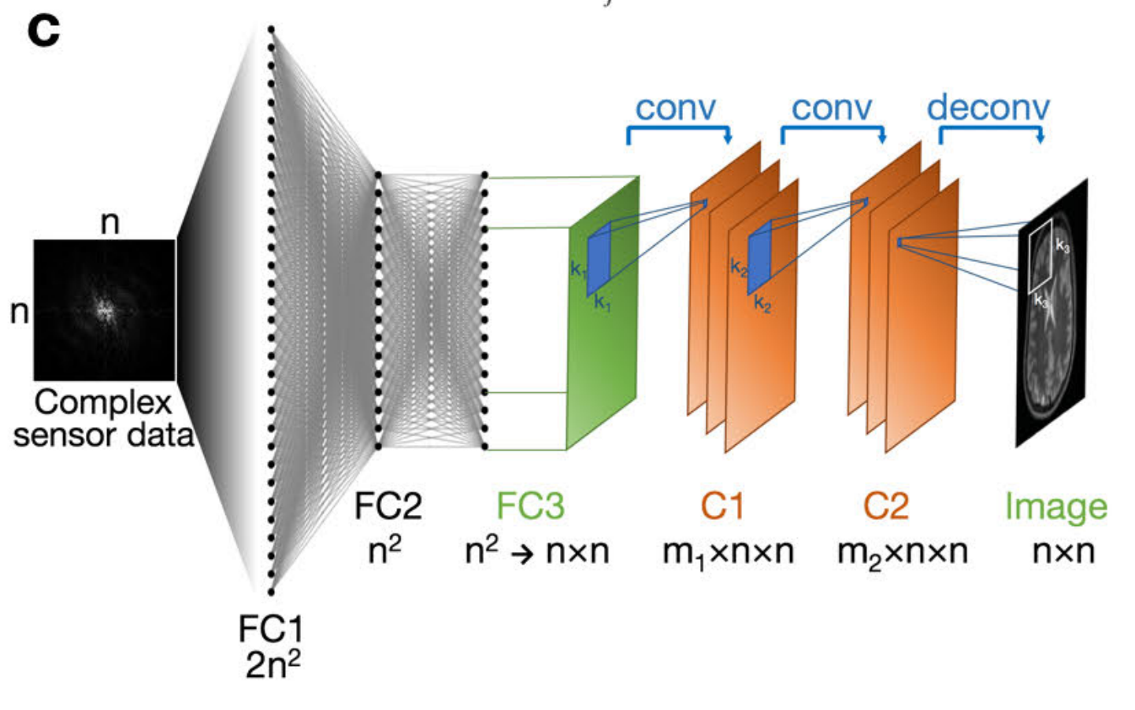
AutoMap (https://arxiv.org/abs/1704.08841 )
Tries to learn the mapping from raw data to images using simulated pairs of image and raw data

Slide 7
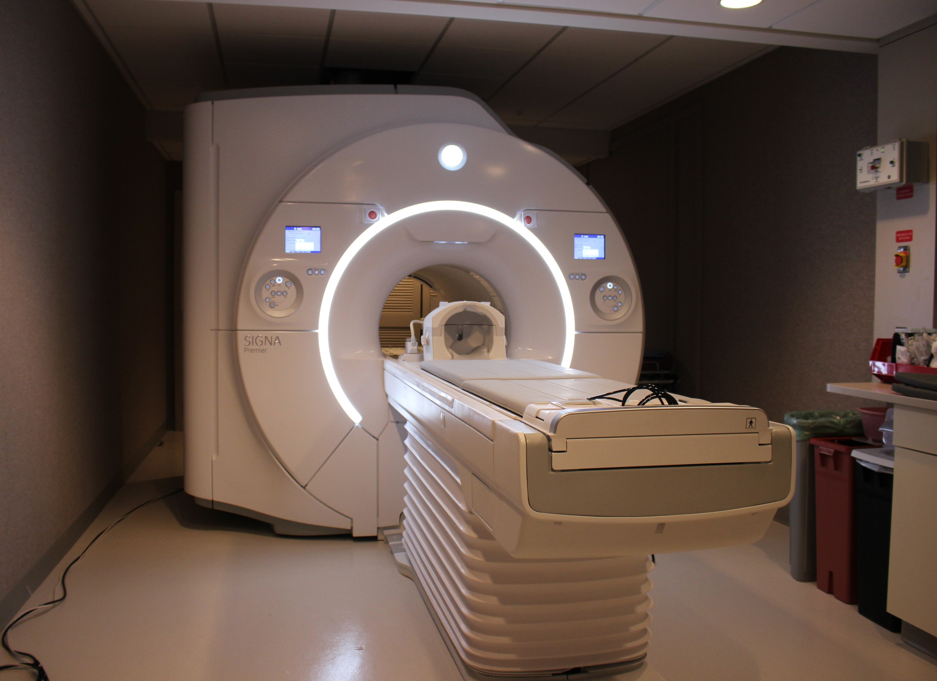
Neural Network as an unencoder
Network estimates image from encoded data
Goals:
Faster imaging (fewer encodings)
Less noise
Actual Signal
Encoded Signal
Decoded Signal

