Slide 1


Axiomatic Foundations and Algorithms
for Deciding Semantic Equivalences of SQL Queries
VLDB 2018

Slide 2
Outline
Background
Algebraic representation
Semi-decision procedure
Evaluation
Reflection

Slide 3
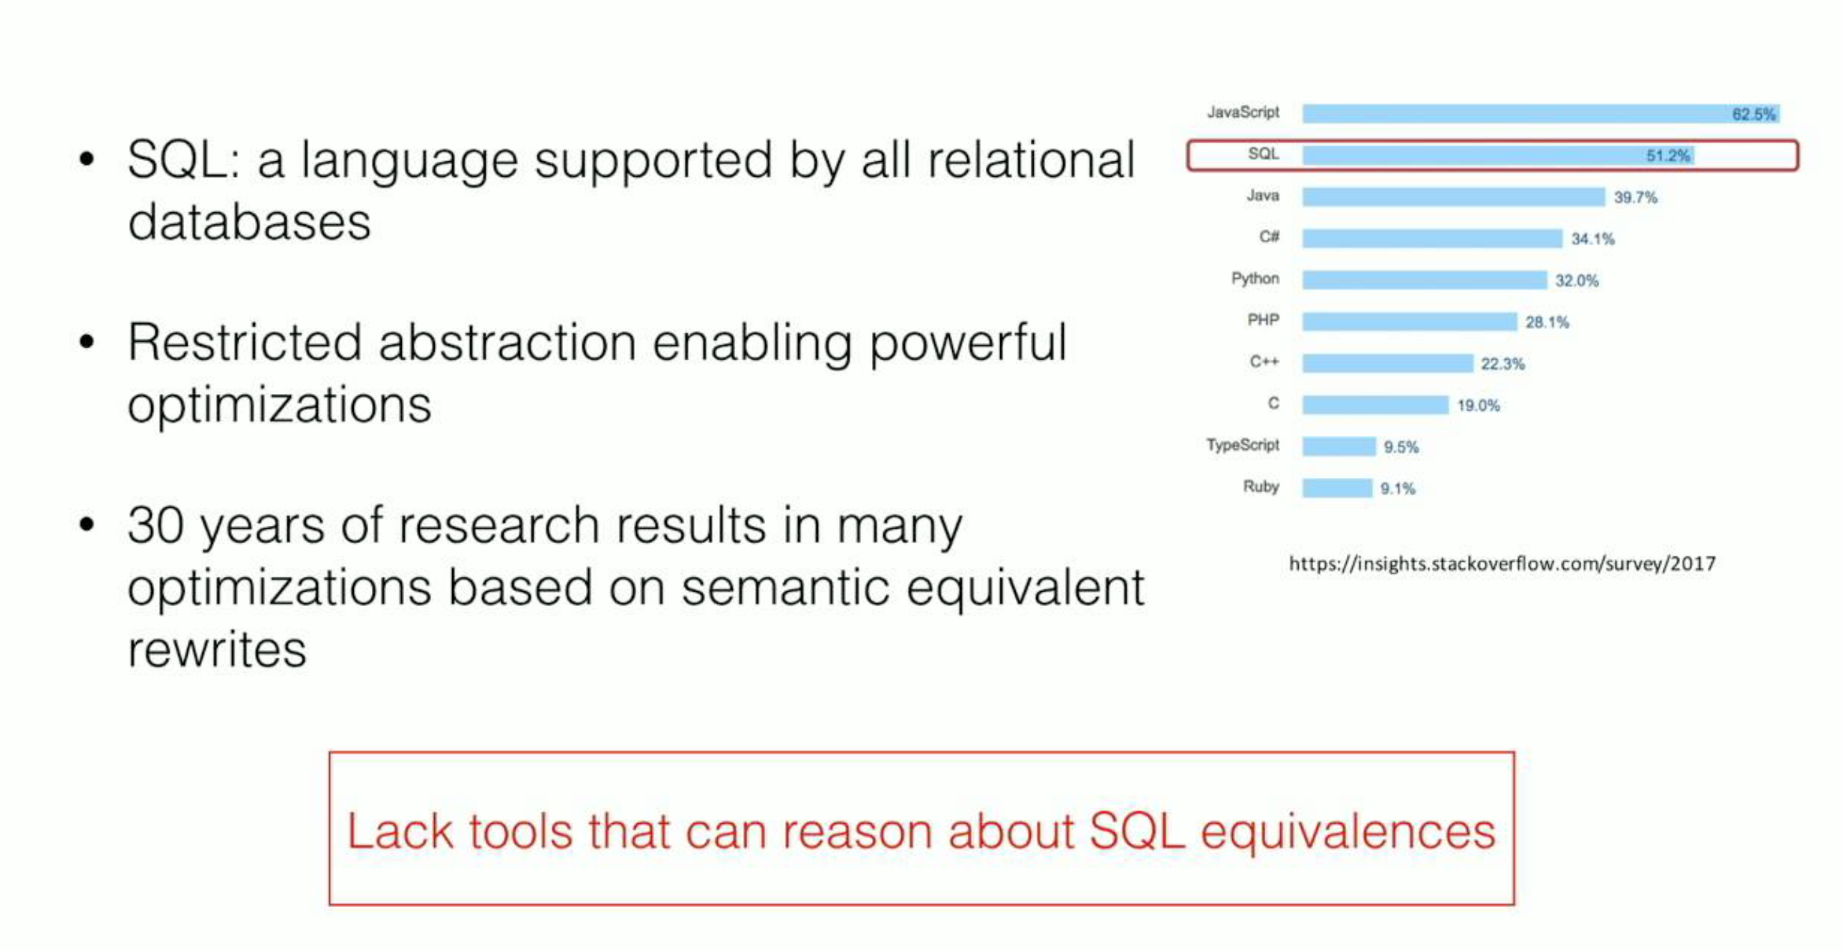

Slide 4
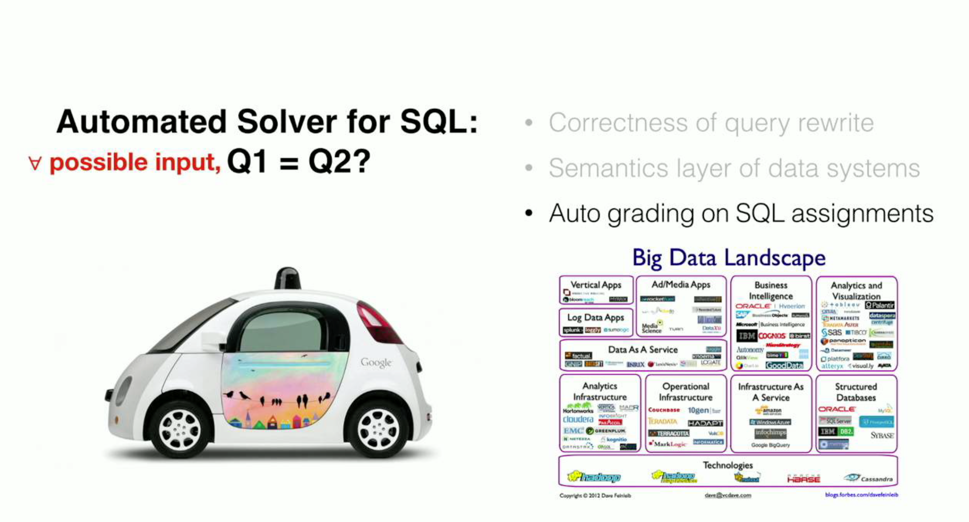
Correctness of query write
Semantics layer of data systems
Auto grading on SQL assignments

Slide 5

Challenge
Rich language features
Aggregation and grouping
Index and integrity constraints
Correlated subqueries
Determining if two SQL queries are semantically equivalent is undecidable

Slide 6
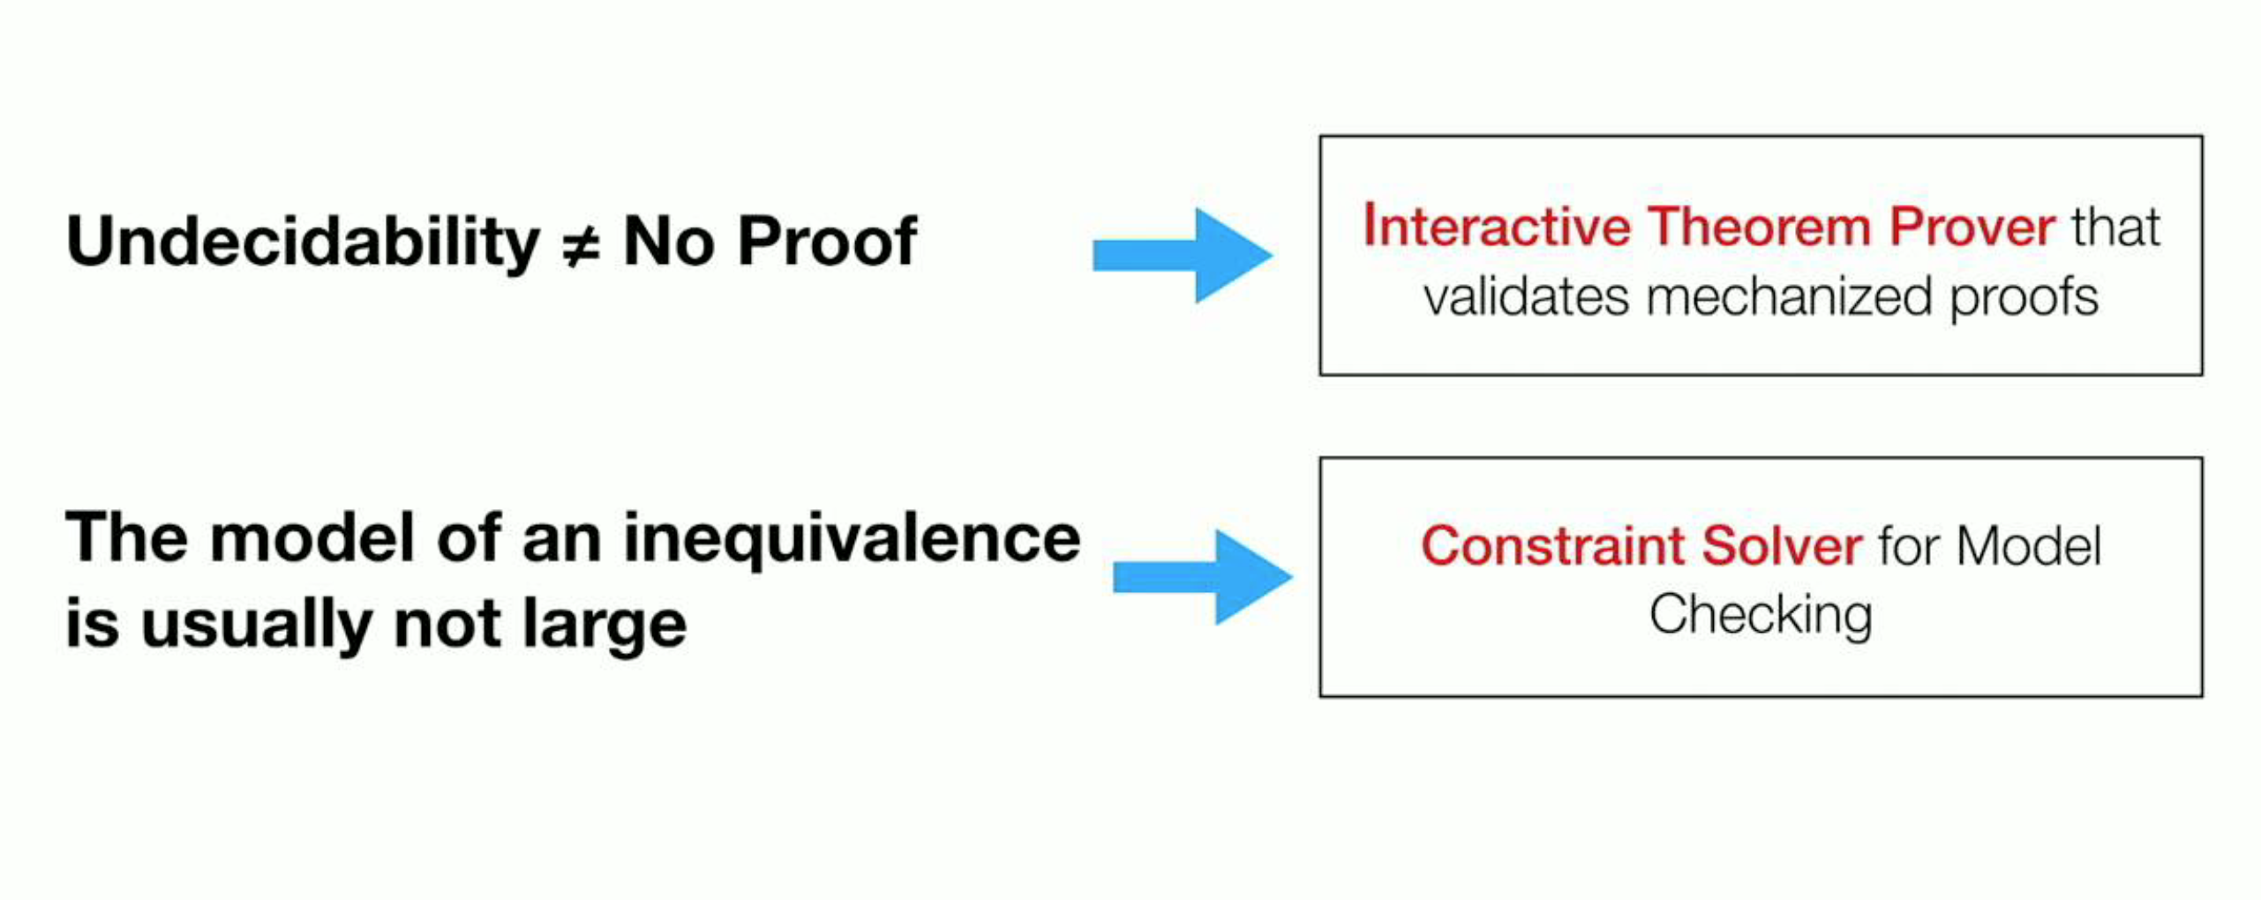

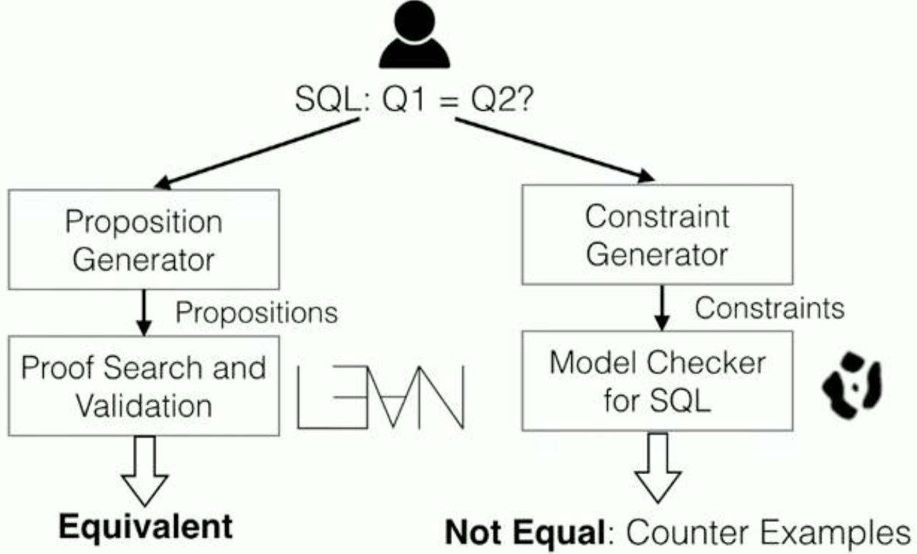

Slide 7
Outline
Background
Algebraic representation
Semi-decision procedure
Evaluation
Reflection

Slide 8
Preliminary: SQL Query
Data model: relations
A relation is an unordered collection of tuples
Schema: set of attributes, each tuple in a relation must have same schema
SQL query: Q(R1, R2, …, Rk) = R

Slide 9
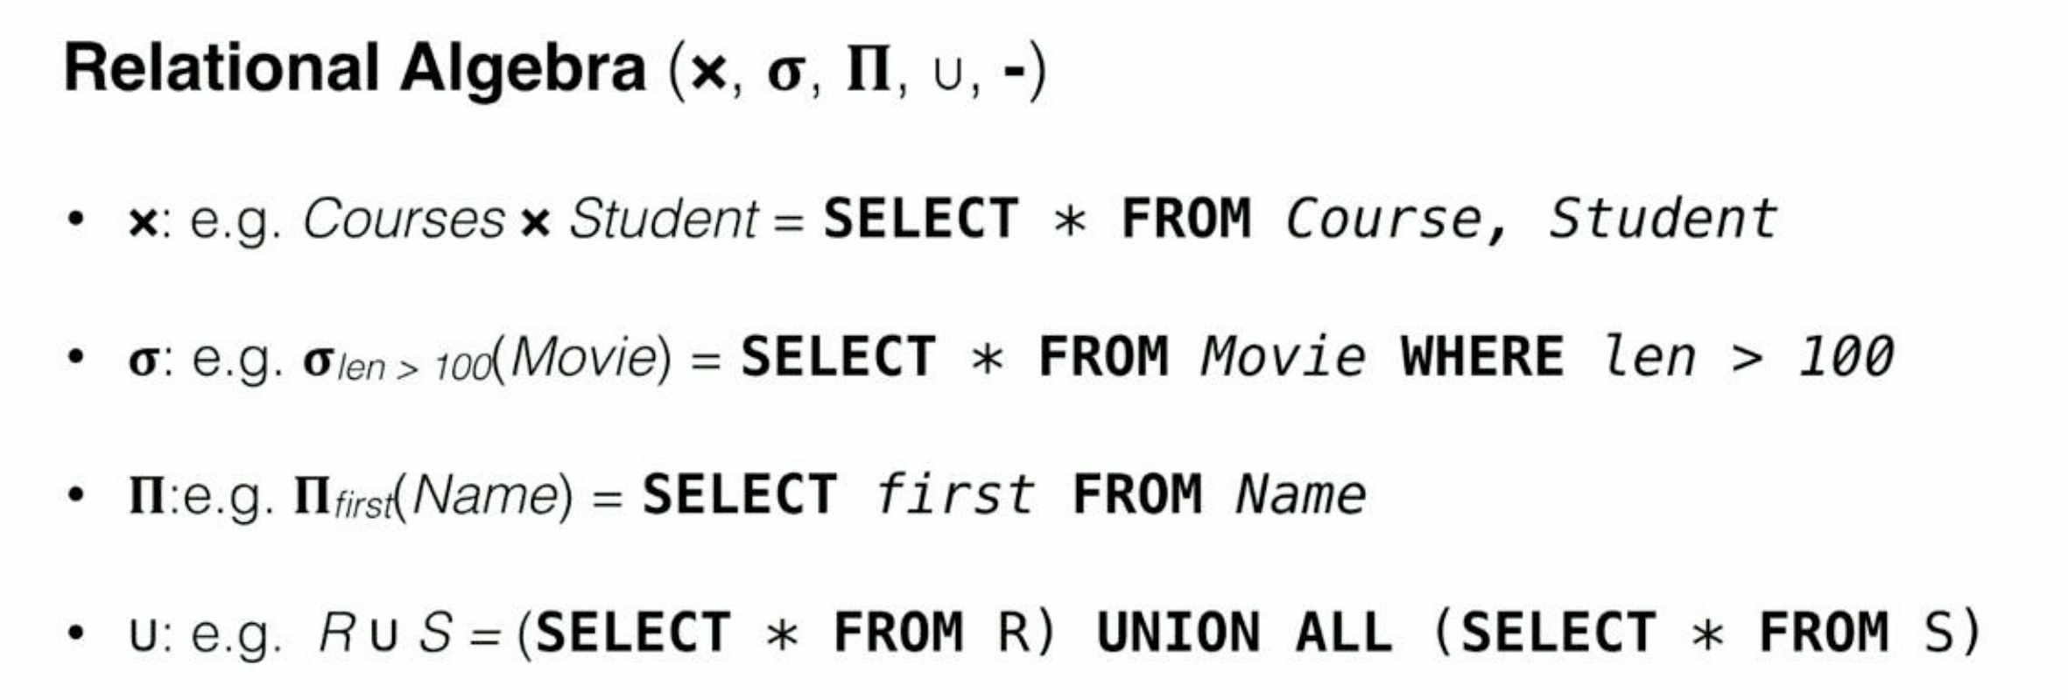
Preliminary: Relation Algebra

Slide 10

Semantic Formulation
Set semantics
Two queries are equivalent if the sets of the returned results are the same for all input relations
List/Bag semantics
Two queries are equivalent if returning the same result for all possible input relations
Need to reason about two lists are equivalent up to permutations

Slide 11
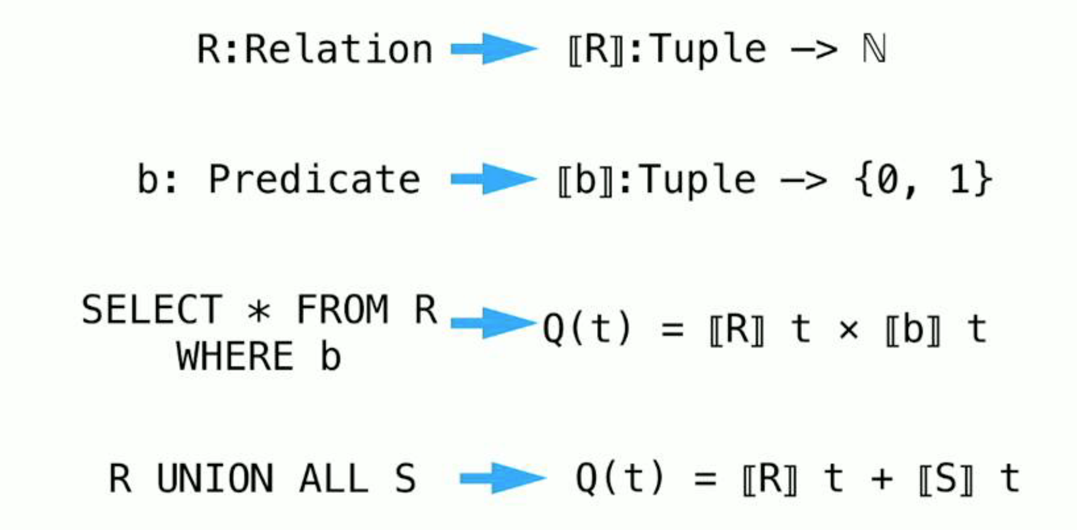
Relation as Function

Slide 12
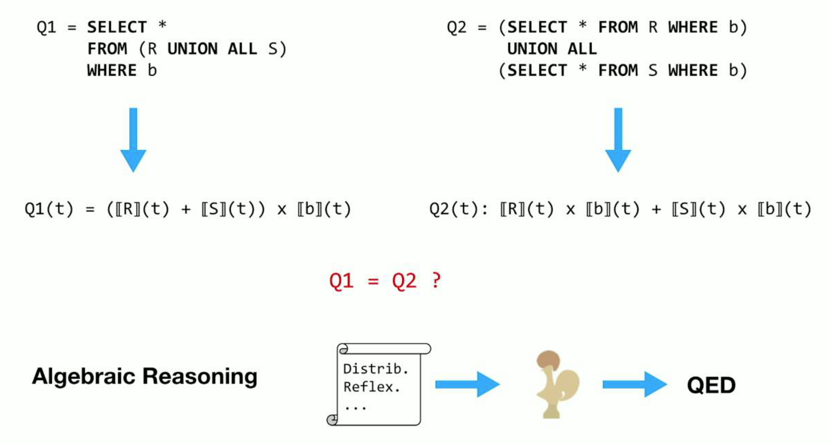

Slide 13
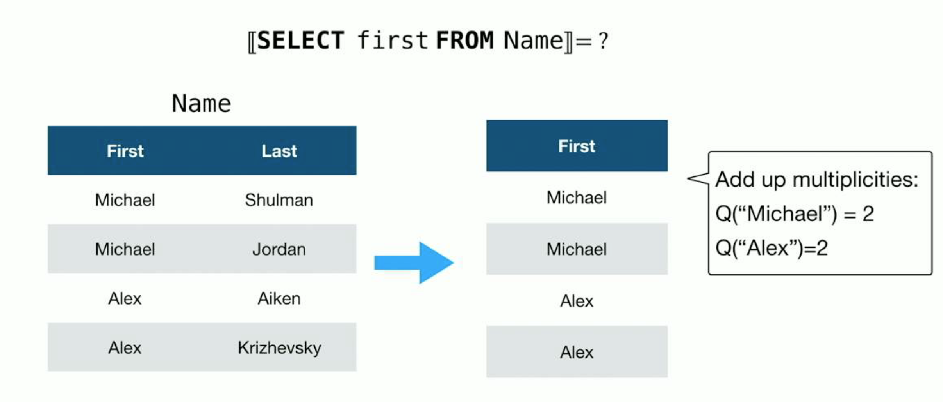
Abstract Semantics: Projection

Slide 14
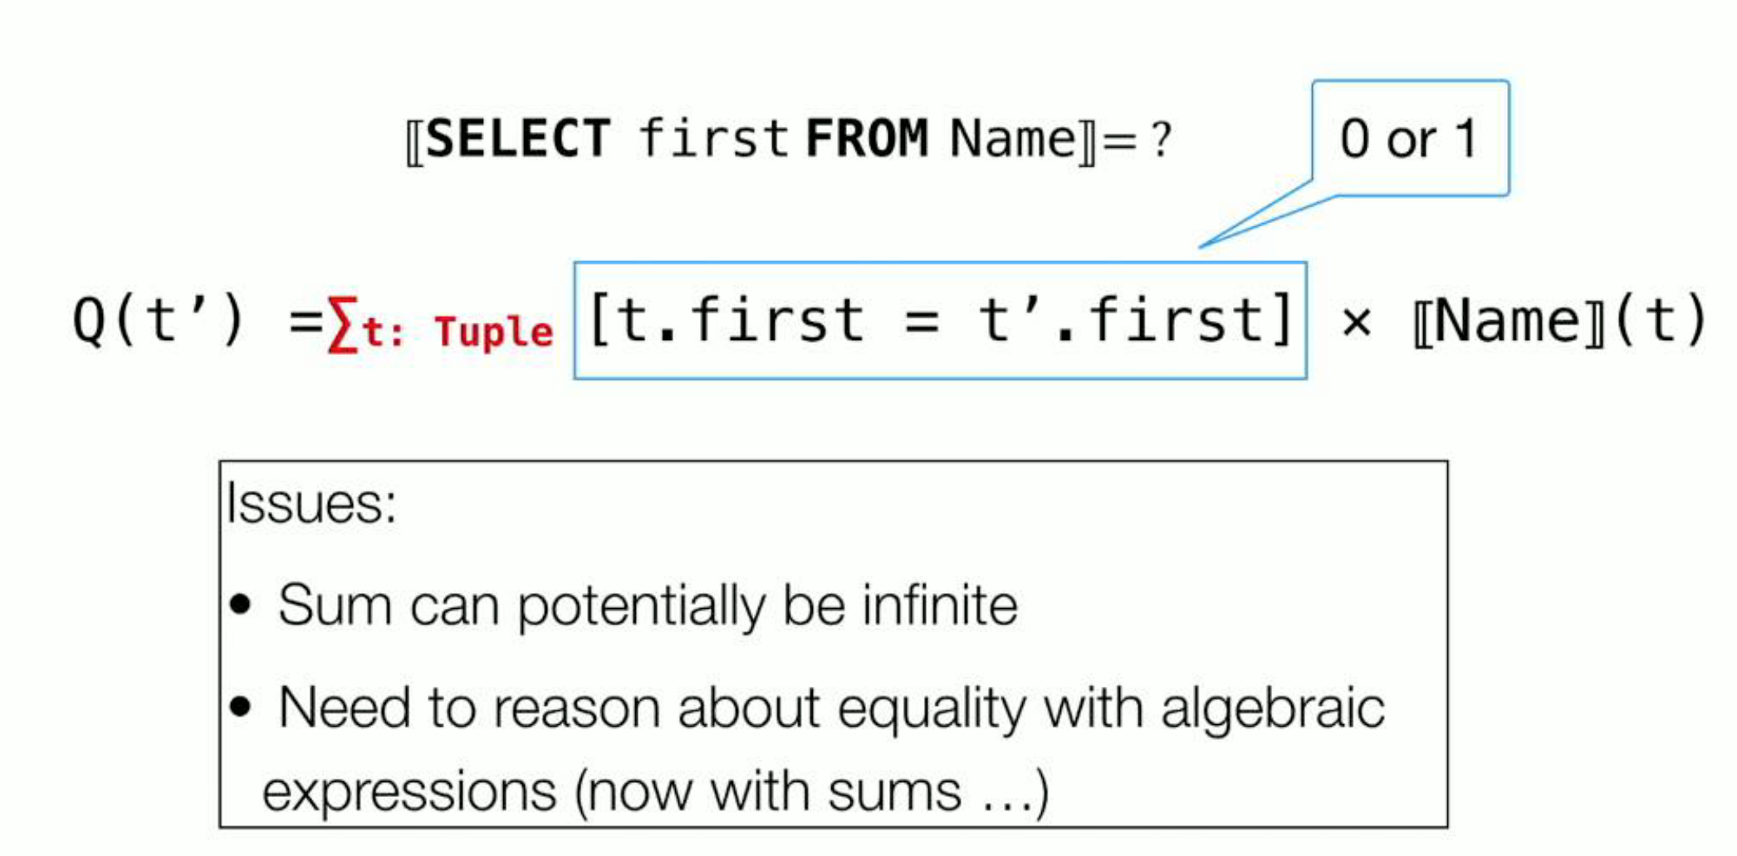
Abstract Semantics: Projection

Slide 15
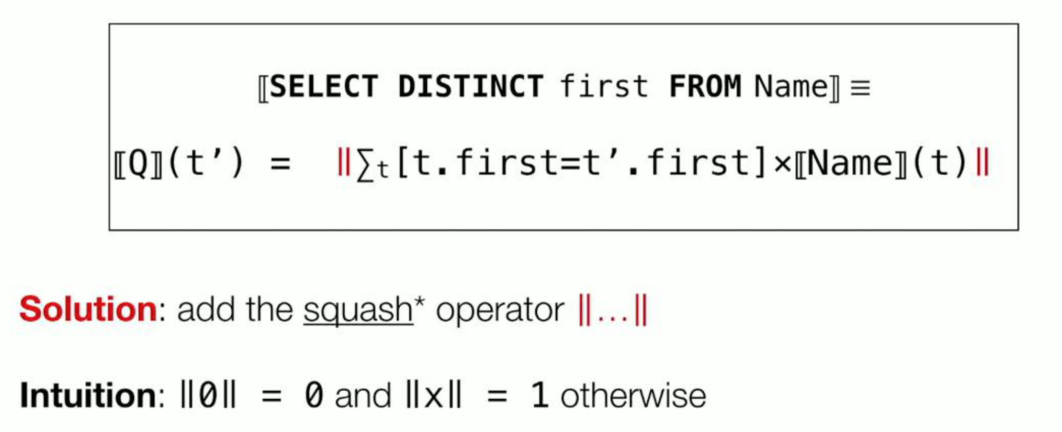
Abstract Semantics: DISTINCT
Convert bags to sets

Slide 16

Abstract Semantics: EXCEPT, NOT EXIST
Negation

Slide 17


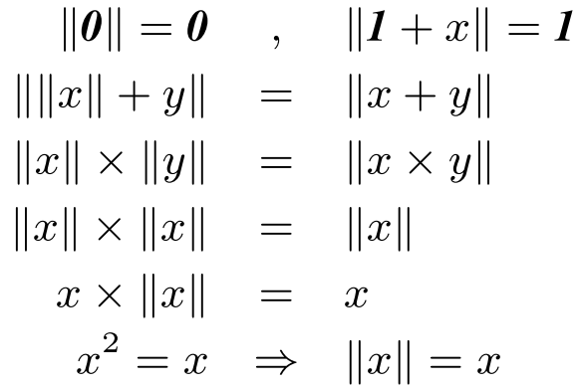
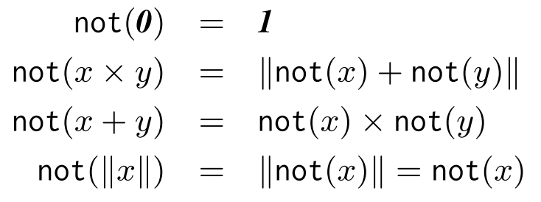
Algebraic Representation
U-Semiring: An Unbounded-semiring is a structure
forms a commutative semiring (polynomial ring)

Slide 18
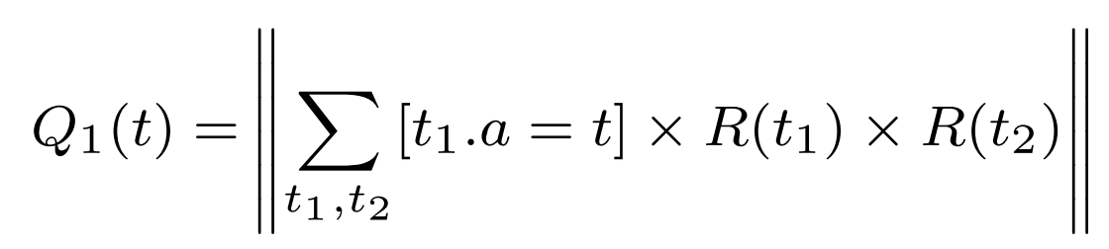
Example
SQL
U-expression

Slide 19
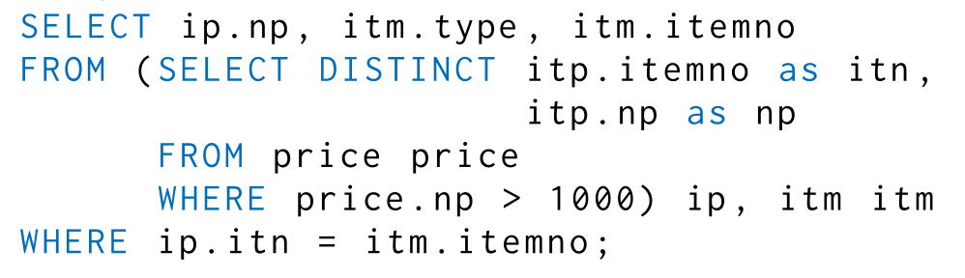
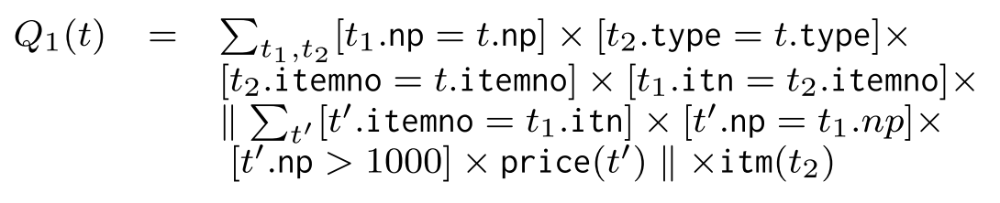
More Complex Example
SQL
U-expression

Slide 20
Outline
Background
Algebraic representation
Semi-decision procedure
Evaluation
Reflection

Slide 21
Semi-decision Procedure
Say yes if two SQL queries are equivalent under bag semantics
Provide the proof
Semi-decision Procedure
Convert SQL queries to U-expressions
Search the transformation between U-expressions
Transformation: preserve bag semantic equivalence

Slide 22
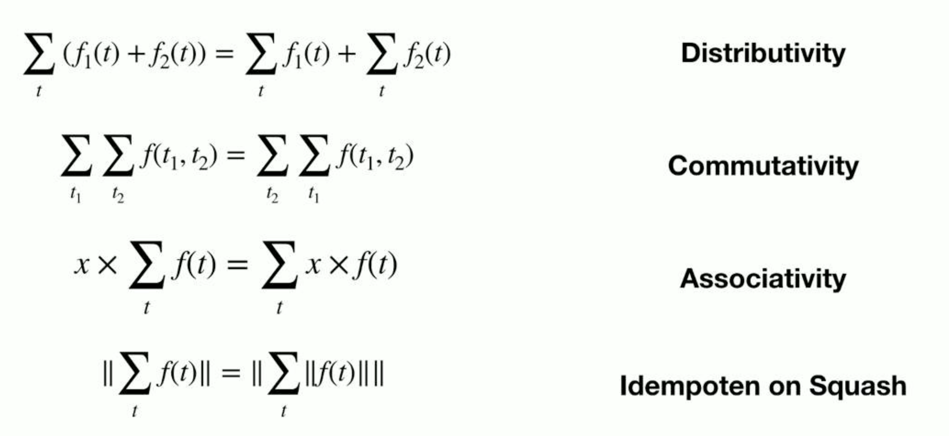
Axiomatic Foundations
Axiomization of Sum

Slide 23
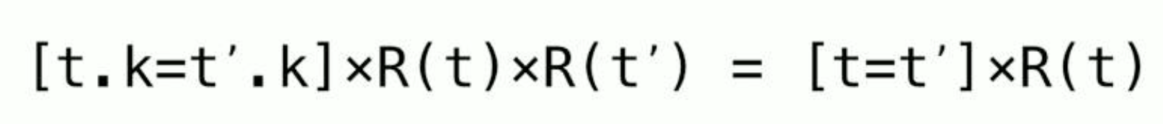
Axiomatic Foundations
Axiomization of Integrity Constraints
The key constraint on R.k is the identify
The foreign key constraint from S.fk to R.k

Slide 24

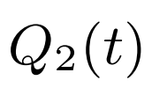
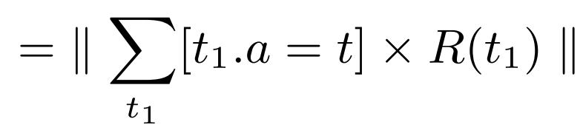
Example
Prove the equivalence of Q1 and Q2

Slide 25
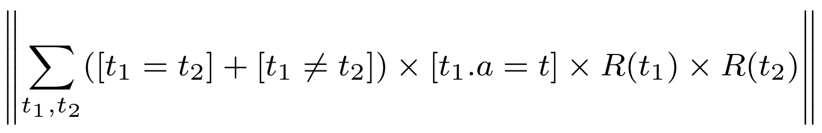

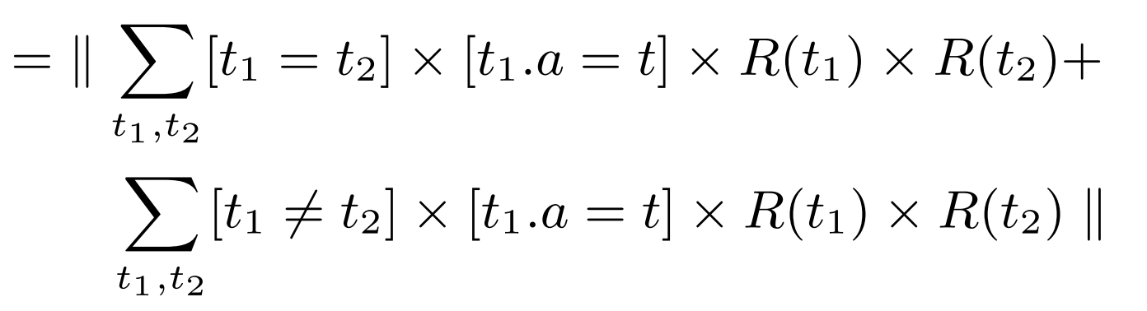
Example
Apply the axioms to rewrite Q1(t)

Slide 26
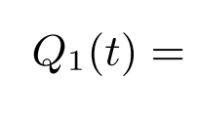
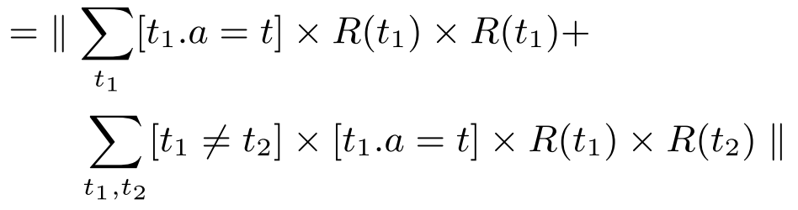
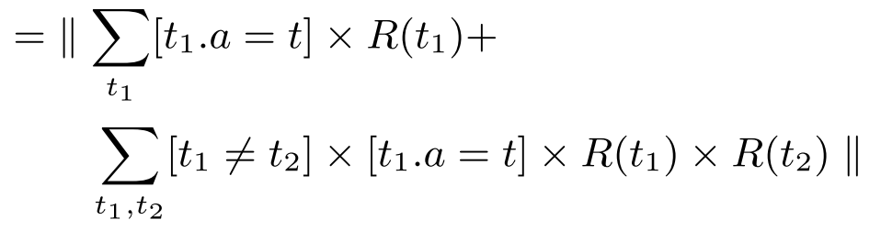
Example
Apply the axioms to rewrite Q1(t)

Slide 27
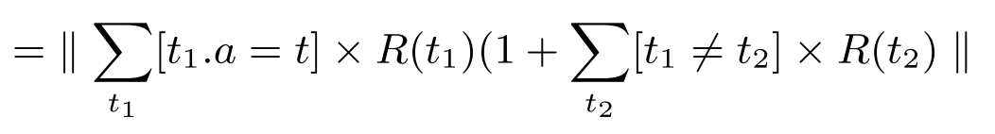
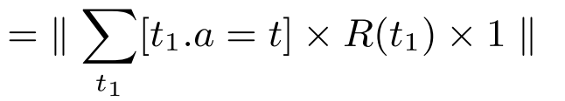
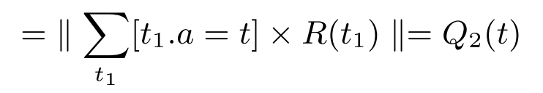
Example
Apply the axioms to rewrite Q1(t)

Slide 28
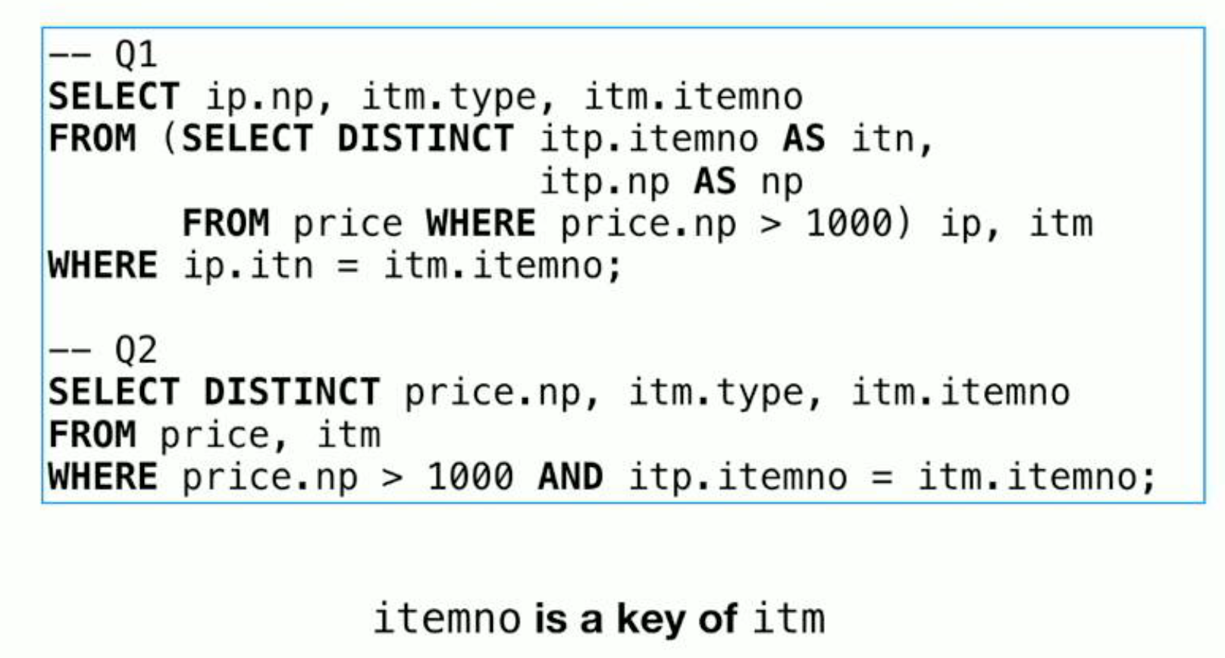
More Complex Case
Prove equivalence with ICs (Integrity Constraints)

Slide 29
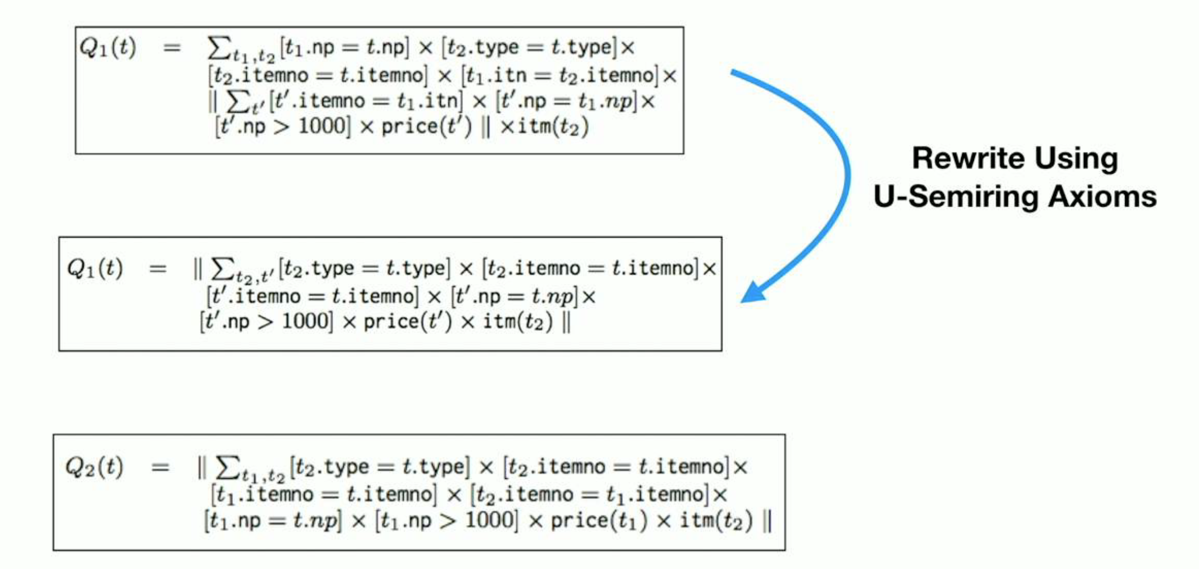
More Complex Case

Slide 30
Outline
Background
Algebraic representation
Semi-decision procedure
Evaluation
Reflection

Slide 31
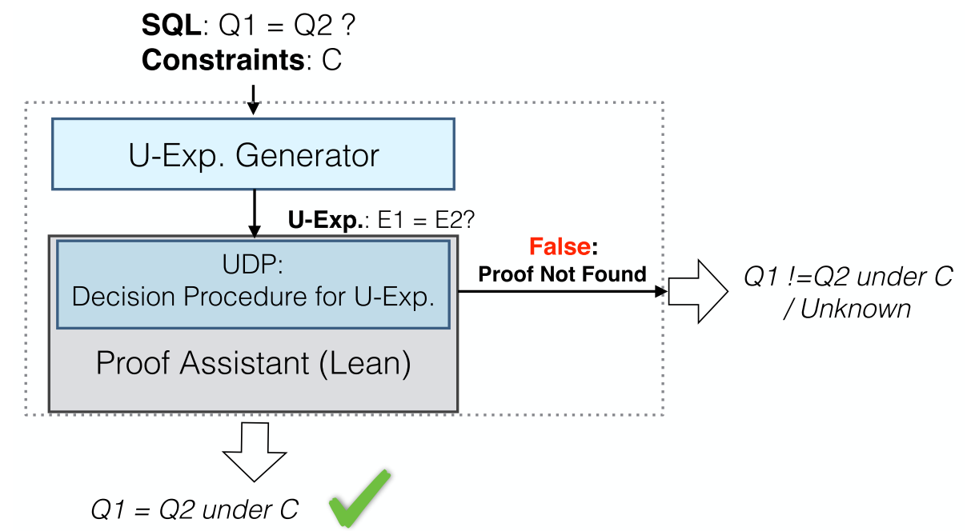
Evaluation
Subject: SQL queries
Literature
Benchmark in Calcite
Setting
Pair-wise checking

Slide 32
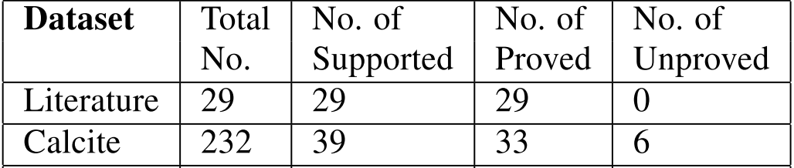
Summary of Proved and Unproved Cases
Unsupported SQL features (193 queries in Calcite)
CASE, UNION, NULL, PARTITION BY
Unproved case
Involve integer arithmetic and string cast
Long query

Slide 33
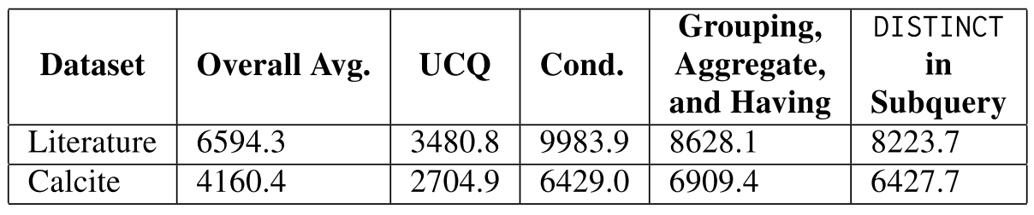
Summary of Overhead
UDP takes 6594.3 ms on average for Literature
UDP takes 4160.4 ms on average for Calcite
UDP takes longer time on rewrites with rich SQL features
integrity constraints, grouping and aggregate, DISTINCT in subquery

Slide 34
Outline
Background
Algebraic representation
Semi-decision procedure
Evaluation
Reflection

Slide 35
Discussion
Search the proof
Find a sequence of axioms (rewrite rules)
Semi-decision procedure
Sound
Only complete for a restrictive form of SQL queries
Simplified solver
Finding the proof is a solving process
Support the new theory (on relation algebra)
Check the bag equivalence

Slide 36
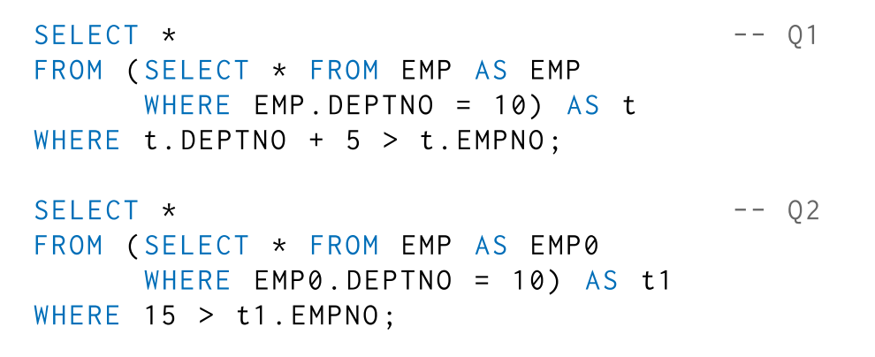
Drawback
Huge searching space
The size of the SQL query
Complexity of SQL features
Demand the support for general SQL features
More axioms/rewrite rules
Even larger searching space

Slide 37

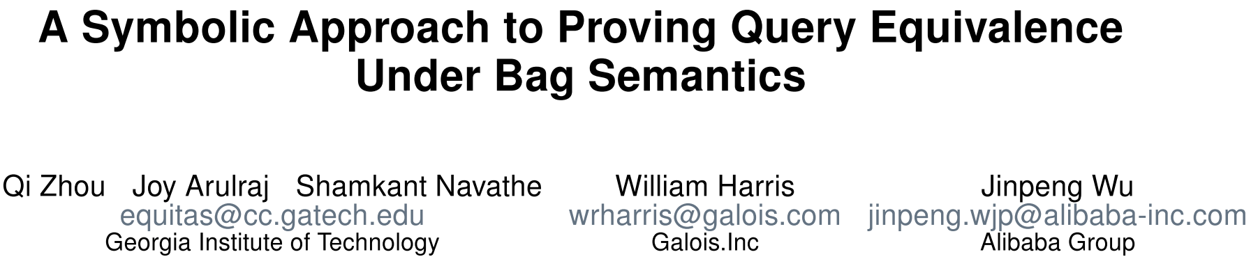
New Advances
Support more SQL features
More efficient (27 times faster)
Only support set semantics
Support bag semantics

Slide 38


More Remark
Redundant computation in the pair-wise checking upon a SQL set
SELECT DISTINCT x.a FROM R x, R y, R z -- Q3
$Q_{3}\left(t\right) ↪Q_{3}^{′}\left(t\right)↪$ … $↪Q_{1}(t)$
Rewrite rule sequences overlap
$Q_{3}\left(t\right) ↪Q_{3}^{′}\left(t\right)↪$ … $↪Q_{2}(t)$

Slide 39
Indexing Partial Equivalence Class
Orbit: Partial equivalence class of element
Define and apply restrictive rewrite rules to saturate the orbit
Q1
Q2
Q3
compare with each and

Slide 40

Indexing Partial Equivalence Class
Example: Reuse equivalent variants in the orbit
Applicable scope
Elements have very limited equivalent variants
Otherwise might suffer the orbit explosion problem
SELECT DISTINCT x.a FROM R x, R y, R z -- Q3
$Q_{3}\left(t\right) ↪Q_{3}^{′}\left(t\right)↪$ … $Q_{1}(t)↪Q_{2}(t)$
Form the orbit of Q3

Slide 41
Summary
A semi-decision procedure for SQL equivalence under bag semantics
Interesting algebraic representation but not general enough
Proof synthesis might suffer space explosion problem
Enhanced by symbolic reasoning and other strategies

Slide 42

Thank you for your listening!

Slide 43
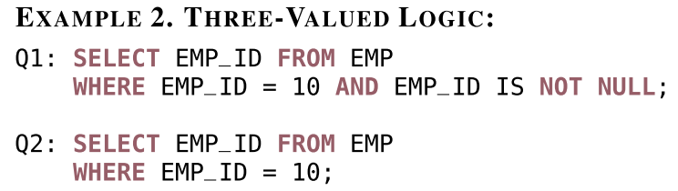
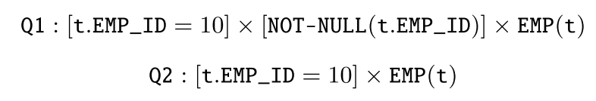
Unproved Case

