Slide 1
When E-commerce Meets Virtual Network Operator: Boosting Sales via Data Rewards
Qi Cheng
3150104884@zju.edu.cn

Slide 2
Outline
Background
Related work
System model
Problem formulation

Slide 3

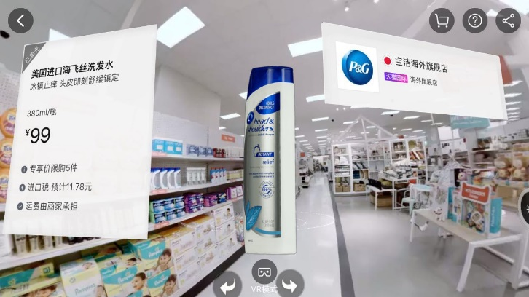
5G + E-commerce
  Changes of sale pattern: live, video, AR/VR
  ISP(e-commerce platform) requirements: broadband, low latency, computation-intensive tasks
  User’s requirements: lower data fee, more data, cheaper goods(discount)
  Merchant: more sales/profit
Fig. 1. Sales via live streaming
Fig. 2. Sales via AR/VR

Slide 4
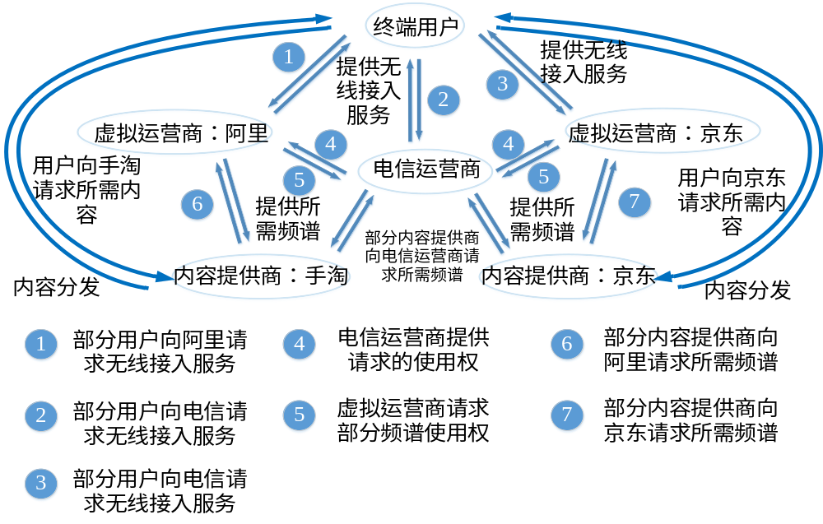
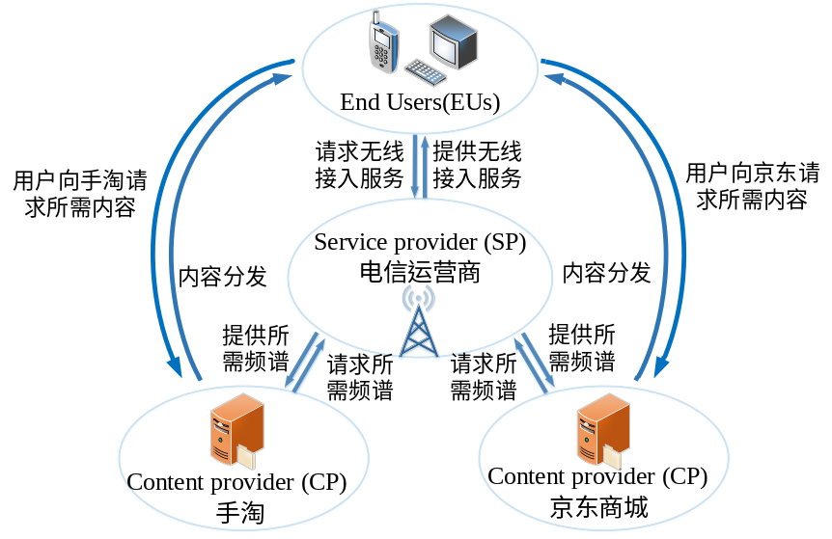
Virtual network operator(VNO) + E-commerce
  Traditional architecture of VNO
  Alibaba/JD/Xiaomi/Tencent/ByteDance
  Pros of dual identity: service priority(latency, fee), new business model(incentive mechanism)
Fig. 3. Traditional network architecture of e-commerce
Fig. 4. The joint design of e-commerce platform and VNO

Slide 5
Outline
Background
Related work
System model
Problem formulation

Slide 6
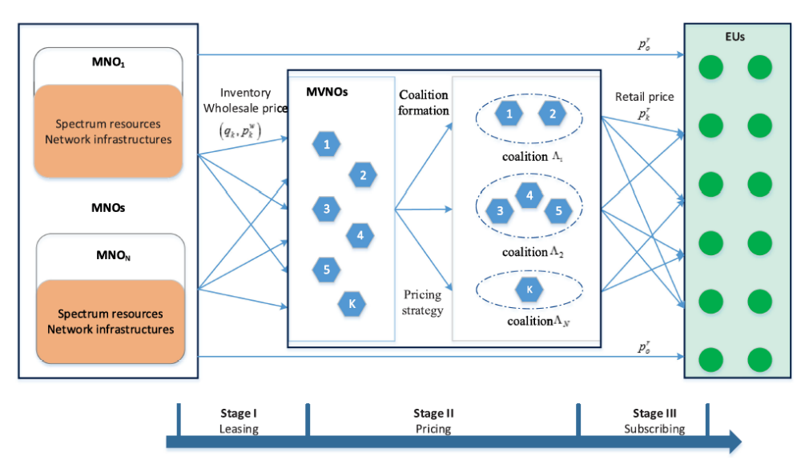
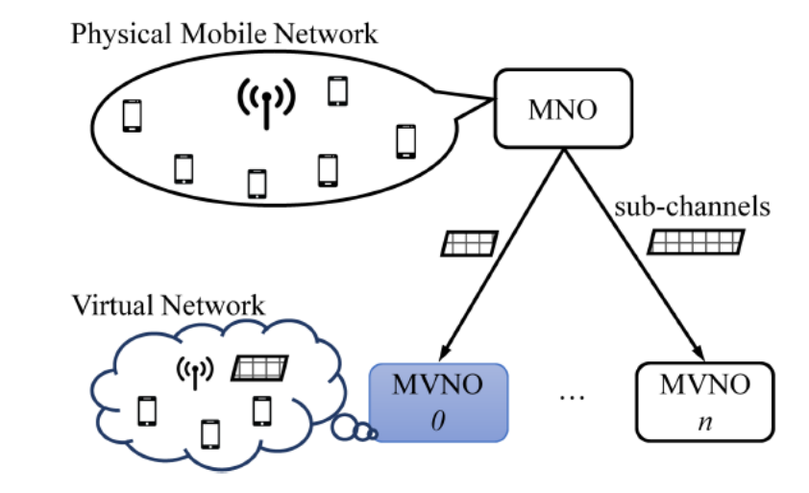
Data offloading of VNO
  NO: monopoly [Sun et al. 2018], oligopoly
  VNO: single [Zhu et al. 2019] or multiple [Zhang et al. 2018]
  Game theory: Cournot game, Stackelberg game, Bayesian coalition formation game [Li et al. 2019]
Fig. 5. Single NO and multiple VNO
Fig. 6. System model of coalition game

Slide 7
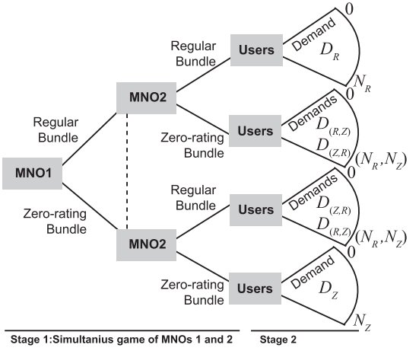
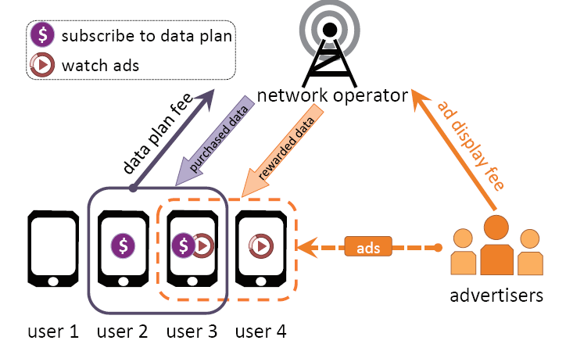
Sponsored data and mobile marketing
  Added value MVNO’s perspective [Zhu et al. 2019]
  Free service bundles [Asghari et al. 2019]
  Monetizing mobile data [Yu et al. 2020] [Yu et al. 2017]
Fig. 7. Model of NO and free service bundles included
Fig. 8. Data rewarding ecosystem in advertisement business

Slide 8
Existing problems
  How to take advantage of dual identity
  How to build new business model/design business pattern
  The optimal decisions of NO,VNO(platform), merchant and users

Slide 9
Outline
Background
Related work
System model
Problem formulation

Slide 10
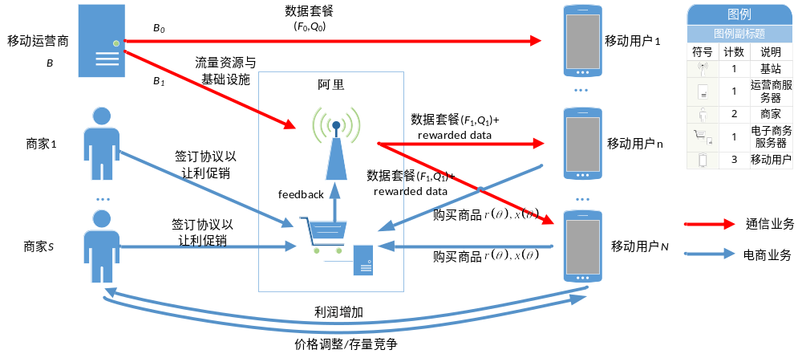
Fig.9. The joint design of e-commerce and VNO business

Slide 11

Network operator(NO)
  Data contract with VNO:
  Price of unit data: c, unit: $/GByte
  Data plan for users who chooses NO: (F₀, Q₀) [Joe-Wong et al. 2018] [Zhang et al. 2015]
  F₀: fixed data plan fee, unit: $/month
  Q_{0:} fixed data plan amount, unit: Gbyte/month
Merchant
  Amount of goods for promoting sales: m_{s}
  Price equilibrium when the market is in perfect competition: e
  Surrender part of the profits of each merchant to e-commerce platform: p_{s}
  Unit cost of each good: a_{s}

Slide 12

E-commerce platform(VNO)
  VNO business
    Data plan for users who chooses VNO: (F₁, Q₁)
      F₁: fixed data plan fee, unit: $/month
      Q_{1:} fixed data plan amount, unit: Gbyte/month
  E-commerce
    Rewarded data for users who buy goods in its platform and chooses its data plan:
    Unit: Gbyte/item

Slide 13



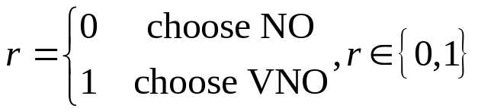


Users
User’s type which parameterizes its valuation/utility for mobile service and goods.
is a continuous random variable:
PDF:
Data plan choice
Amount of goods:
x and r can be fractional [Yu et al. 2017]
Total amount of mobile data:

Slide 14

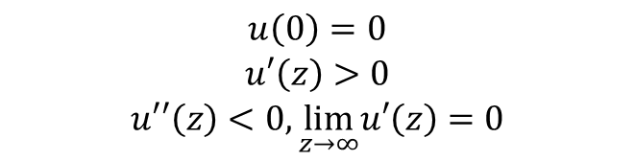

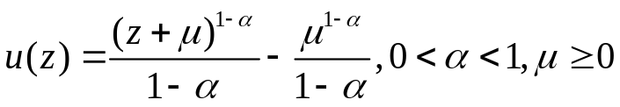


Users
User’s primary utility function
Initial condition
Strictly increasing
diminishing marginal utility
Examples
Logarithmic function [Duan et al. 2015]
Generalized α-fair function [Joe-Wong et al. 2018]
Exponential function [Zhou et al. 2005]
A type user’s total utility is

Slide 15
Four-stage Stackelberg game
阶段 | 决策变量
第一阶段 | 流量单价c
第二阶段 | 阿里决策购买流量的数量B₁、单位商品的激励w
第三阶段 | 让利p_{s}
第四阶段 | 用户决策套餐选择r和购买商品的数量x
Table 1. Four-stage Stackelberg game
Analysis method to find equilibria is backward induction [Han et al. 2012]

Slide 16
Outline
Background
Related work
System model
Problem formulation

Slide 17
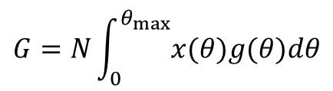
User
optimization problem
Total demand of goods

Slide 18

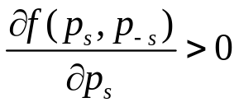
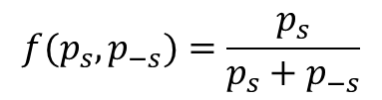

Merchant
No price discrimination in the market
The user has no preference to merchant
The choice of user depends on the advertisement and recommendation system of the e-commerce App
The choice of user depends on how much profit the merchant would like to give to e-commerce platform
The sale quantity of merchant S:
an example:
The total utility of the merchant

Slide 19
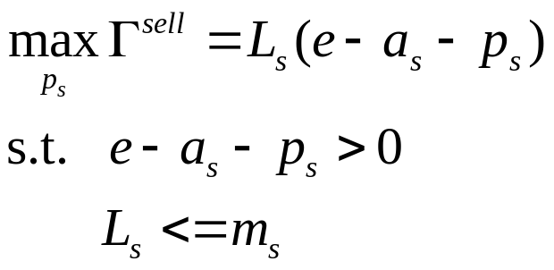
Merchant
  Optimization problem

Slide 20
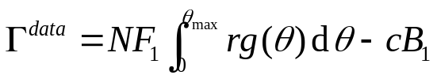
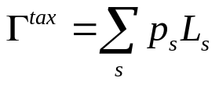
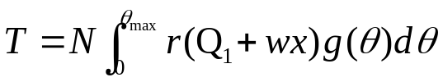
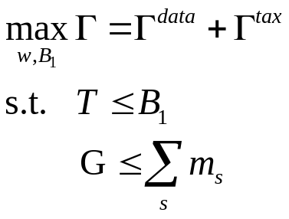
VNO(e-commerce platform)
  Utility of VNO business
  Utility of e-commerce
  Total network data
  Optimization problem

Slide 21
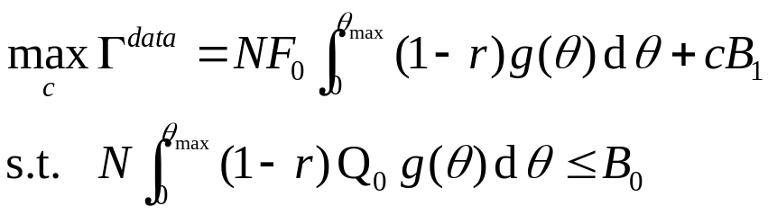
NO
  Optimization problem

Slide 22
Some questions
  The preference of consumers is neglected
  The price equilibrium and sale quantity are simple
  The relationship of demand and supply

Slide 23
参考文献
  [1] F. Sun, F. Hou, H. Zhou, B. Liu, J. Chen and L. Gui, "Equilibriums in the Mobile-Virtual-Network-Operator-Oriented Data Offloading," in IEEE Transactions on Vehicular Technology, vol. 67, no. 2, pp. 1622-1634, Feb. 2018
  [2] Y. Zhang, S. Bi and Y. A. Zhang, "Joint Spectrum Reservation and On-Demand Request for Mobile Virtual Network Operators," in IEEE Transactions on Communications, vol. 66, no. 7, pp. 2966-2977, July 2018
  [3] C. Li, J. Li, Y. Li and Z. Han, "Pricing Game With Complete or Incomplete Information About Spectrum Inventories for Mobile Virtual Network Operators," in IEEE Transactions on Vehicular Technology, vol. 68, no. 11, pp. 11118-11131, Nov. 2019
  [4] Y. Zhu, H. Yu, R. A. Berry and C. Liu, "Cross-Network Prioritized Sharing: An Added Value MVNO’s Perspective," IEEE INFOCOM 2019 - IEEE Conference on Computer Communications, Paris, France, 2019, pp. 1549-1557
  [5] M. Asghari, S. Yousefi and D. Niyato, "An Analysis of Service Bundles of Mobile Network Operators with Free Services Included," in IEEE Transactions on Mobile Computing, vol. 19, no. 8, pp. 1789-1803, 1 Aug. 2020
  [6] H. Yu, E. Wei and R. A. Berry, "Monetizing Mobile Data via Data Rewards," in IEEE Journal on Selected Areas in Communications, vol. 38, no. 4, pp. 782-792, April 2020
  [7] H. Yu, M. H. Cheung, L. Gao and J. Huang, "Public Wi-Fi Monetization via Advertising," in IEEE/ACM Transactions on Networking, vol. 25, no. 4, pp. 2110-2121, Aug. 2017
  [8] L. Duan, J. Huang and B. Shou, "Pricing for Local and Global Wi-Fi Markets," in IEEE Transactions on Mobile Computing, vol. 14, no. 5, pp. 1056-1070, 1 May 2015
  [9] C. Joe-Wong, S. Sen and S. Ha, "Sponsoring Mobile Data: Analyzing the Impact on Internet Stakeholders," in IEEE/ACM Transactions on Networking, vol. 26, no. 3, pp. 1179-1192, June 2018
  [10] C. Zhou, M. L. Honig and S. Jordan, "Utility-based power control for a two-cell CDMA data network," in IEEE Transactions on Wireless Communications, vol. 4, no. 6, pp. 2764-2776, Nov. 2005
  [11] Z. Han, D. Niyato, W. Saad, T. Baar, and A. Hjrungnes. Game Theory in Wireless and Communication Networks: Theory, Models, and Applications (1st. ed.). Cambridge University Press, USA. .

Slide 24
Thanks!
Q&A

