Slide 1
Factors affecting COVID-19 in South Korea its statistical application
CHENG Wing Ryan
1155102964

Slide 2
Introduction
Two parts
First part --- Variables analysis
Second part --- Application of different machine learning models

Slide 3
Variables analysis
Relationship between keyword search, government policy and confirmed case
Relationship between age group, gender, confirmed case and death case
Relationship between the province and confirmed case
Autocorrelation within the dataset

Slide 4
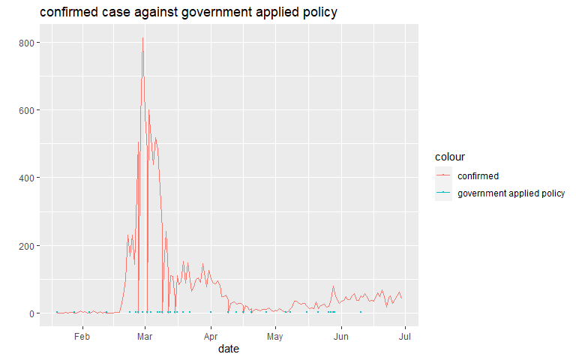
Relationship between keyword search, government policy and confirmed case
Government policy does not affect the number of infection much
Correlation < 0.1

Slide 5
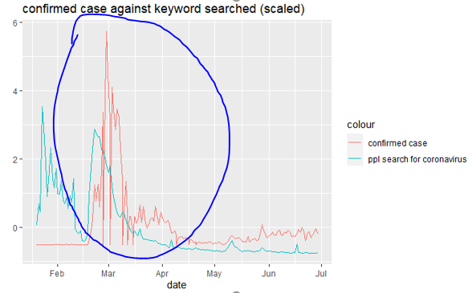
Relationship between keyword search, government policy and confirmed case
Keyword searched in Korea’s popular browser does affect the number of confirmed cases.
Correlation = 0.35
we can see the trend of people
searching for keyword ‘coronavirus’s
and confirmed case are
pretty similar after mid-February

Slide 6
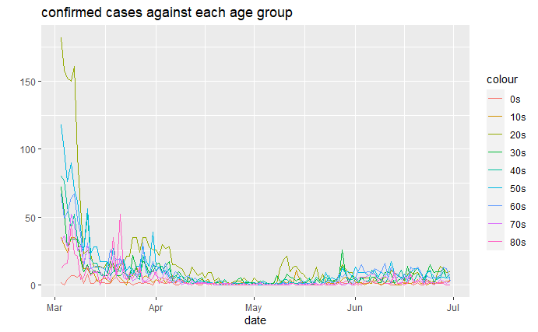
Relationship between age group, gender, confirmed case and death case
20s are more likely to be infected

Slide 7
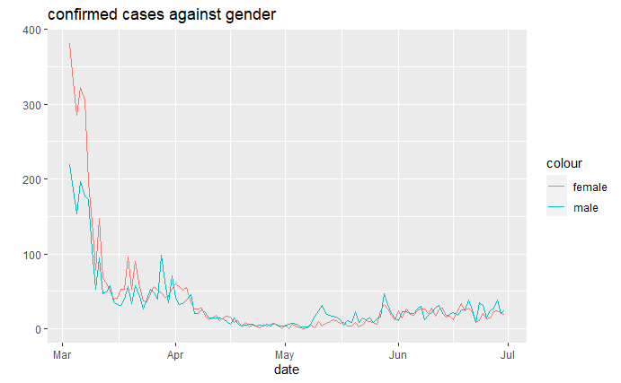
Relationship between age group, gender, confirmed case and death case
Gender has weak correlation against confirmed rate and death rate
female has more confirmed cases in the first peak of the explosion, but after the peak female has a similar number of confirmed cases against the male.

Slide 8
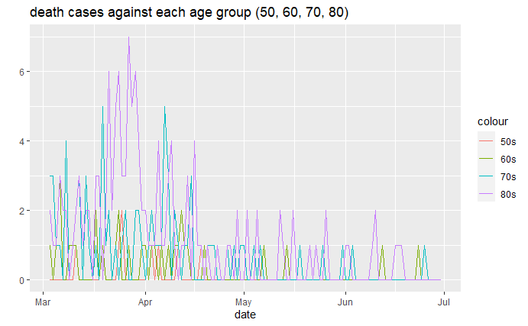
Relationship between age group, gender, confirmed case and death case
Age group 50s, 60s, 70s, 80s dominate death cases

Slide 9
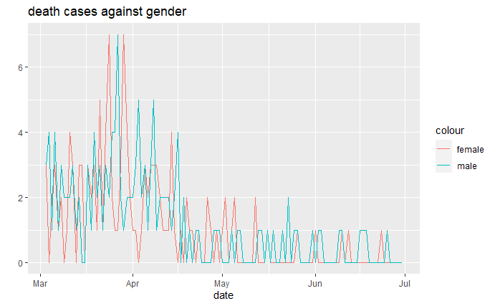
Relationship between age group, gender, confirmed case and death case
Not much difference between death case and gender
No further investigation

Slide 10
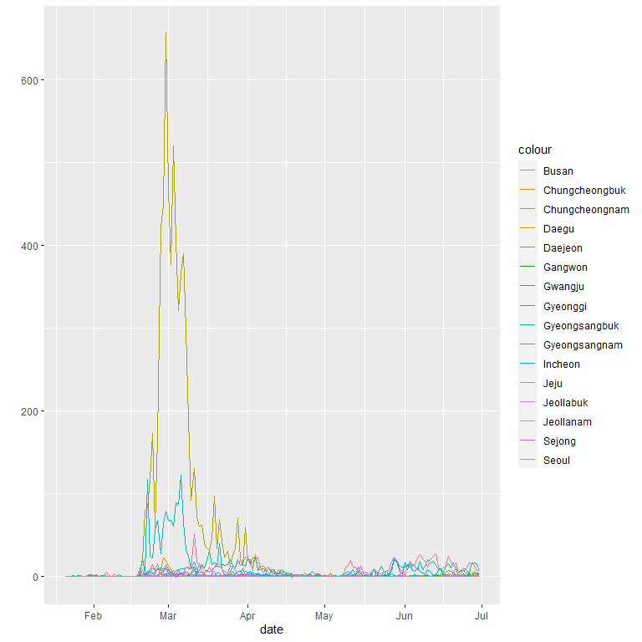
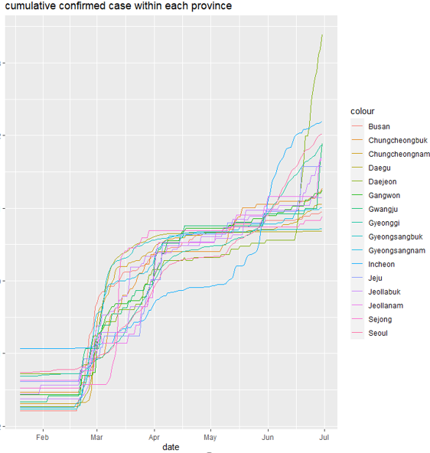
Relationship between the provinces and confirmed case
some providences dominate the confirmed cases
Below are scaled version, second peak can be found

Slide 11
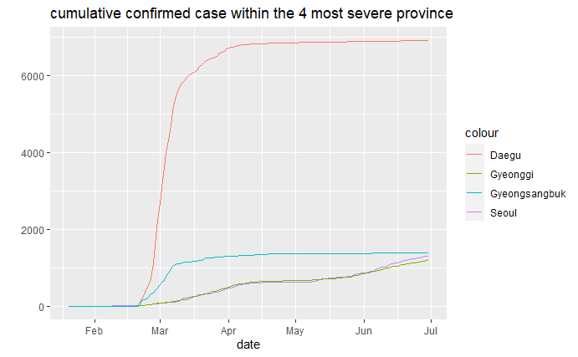
Relationship between the provinces and confirmed case
a dominating effect from Daegu still exists even though we are comparing with the most severe provinces

Slide 12
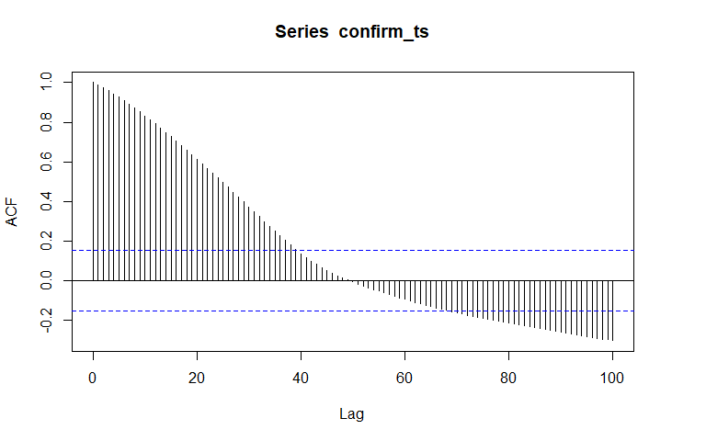
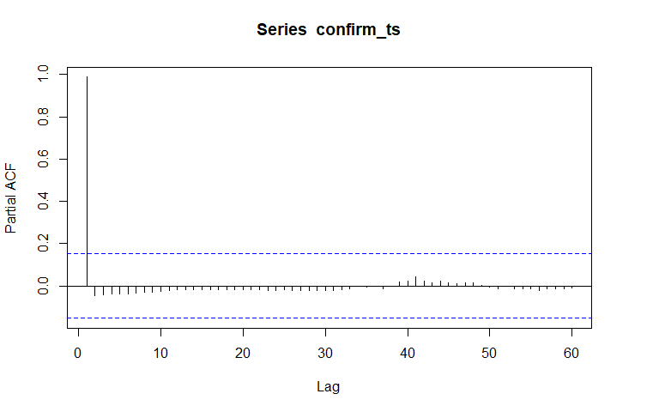
Autocorrelation within the dataset
No seasonal effect, but the dataset contains time dependency
Suggest a AR(2) model, box-Pierce test shows p=0.9251, the residual are not white noise

Slide 13
Forecasting
no neural network will be considered due to the computation limit

Slide 14
Data cleansing and splitting
From the above analysis, we figured out which factors are useful and which doesn’t tell us enough information
Linear regression and the AR(2) model told us utilizing the time effect is better
Thus, the data will not be shuffle

Slide 15
Model selection
We will use 3 models to approach
criteria: balance between easiness to tune the parameters and state-of-art model
Linear regression has already be done, RMSE = 40.23015
The remaining 2 models are Gradient boosting machine (GBM) and random forest

Slide 16
Extreme Gradient Boosting (XGboost)
XGboost is a faster and more accurate version of Gradient Boosting Machine (GBM)
XGboost is a combination of decision trees
Those decision trees are correlated

Slide 17
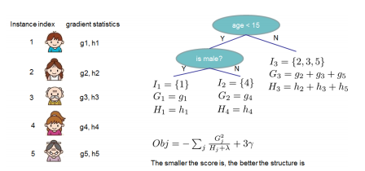
Extreme Gradient Boosting (XGboost)
1) It trains a decision tree base on the training dataset.
2) Train a new decision tree base on the residual from the previous tree.
3) Repeat 1-2 for n times and give weights to the current tree.
4) calculating the result base on the
weighting of the trees

Slide 18
Advantages
Unlike other type of GBM, it supports parallel computing, reduces the time needed for training
Normal GBM only utilize the first term of the Taylor series, XGboost utilizes the second term of the Taylor series, resulting in higher accuracy.
It can deal with missing value, thus we don’t need to fill in the missing values by ourself.

Slide 19
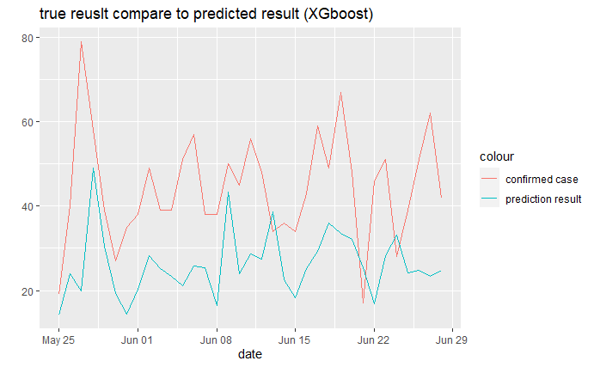
Result
XGboost underestimates the number of cases
this may due to the number of outliers
leading to this underestimate result

Slide 20
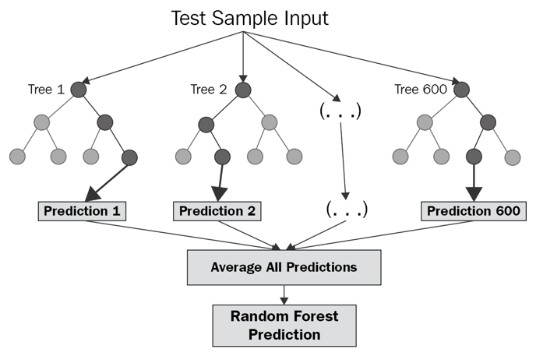
Random forest
random forest is a brunch of individual decision trees and work as an ensemble algorithm.
1) It selects n samples from the training dataset
2) train a decision tree
3) repeat 1-2 for k times
4) averaging the trees to get the optimal result

Slide 21
Advantages
It does not require so much tuning to provide a decent result.
It usually provides an internal validation set, which means more data can be fit into the model.
It can deal with both continuous data and categorical data, thus no pre-processing is needed
It excels at dealing with an outlier.

Slide 22
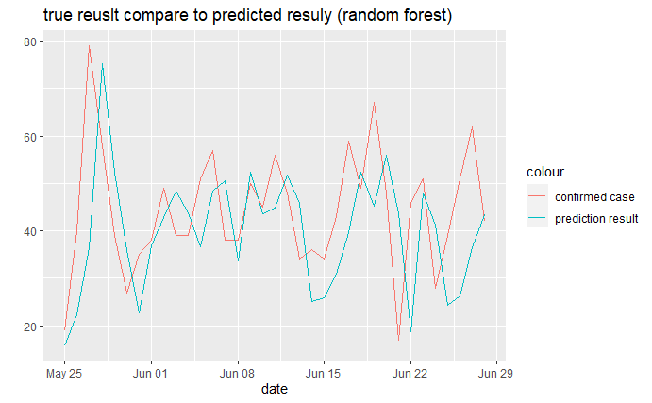
Result
Surprisingly, random forest did better than XGboost

Slide 23
Evaluation
We successfully to find some interesting result between the dataset.
However, we are not doing an impressive job of predicting the result. This may cause by the amount of data is not enough.
We believe the result will be better if more data is provided.

Slide 24
THANK YOU

