Slide 1
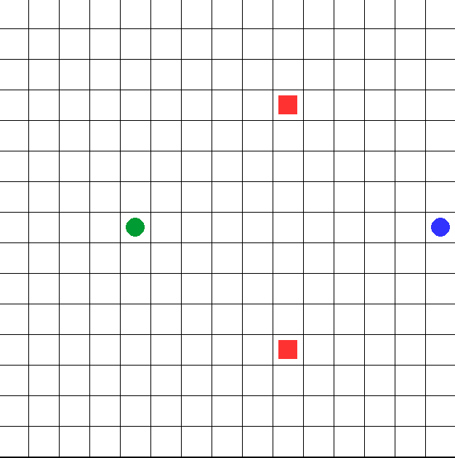
Welcome to the experiment!
You two are hungry travelers (No.1 blue circle, No.2 green circle) who need to reach a restaurant as soon as possible to replenish your food. There are two restaurants on the map (red squares). Your goal is to maneuver the keys (up, down, left, right) to navigate and reach one of the restaurants for a meal in as few steps as possible. The blue circle is controlled by WSAD keys, and the green circle is controlled by arrow keys ↑↓←→.
Please note:
Your positions can overlap and you can reach the same restaurant. However, for each person, in each round (total 10 rounds) only one restaurant can be reached for dining.
Press the spacebar to start the experiment!

Slide 2
The formal experiment will
start in 5 seconds.
Please focus.

Slide 3
Press the spacebar to start the game!

Slide 4
You have finished the game!
Please scan the QR code below to fill out the questionnaire and complete the experiment.

Slide 5
Practice round
Welcome to the experiment!
You two a hungry traveler (blue circle) who need to reach a restaurant as soon as possible to replenish your food. There are two restaurants on the map (red squares). Your goal is to maneuver the keys (up, down, left, right) to navigate and reach one of the restaurants for a meal in as few steps as possible. The blue circle is controlled by WSAD keys, and the green circle is controlled by arrow keys ↑↓←→.
Please note:
Your positions can overlap and you can reach the same restaurant. However, for each person, in each round (total 10 rounds) only one restaurant can be reached for dining.
Press the spacebar to start the experiment!

Slide 7
Welcome to the game!
In this game there are two hungry travelers, who need to reach a restaurant as soon as possible to get some food.
One of the travelers is you, this blue dot
The other traveler is my friend Alex, he is this green dot
On this map, there are restaurants, which we can say are these red squares

Slide 8
Sometimes there is one restaurant and sometimes there are two restaurants. Sometimes Alex will be there, and sometimes he won’t, and it will just be you playing.
Your goal is to use the arrow keys (↑↓←→) on the computer to reach one of the restaurants for a meal
as fast as possible.

