Slide 1
Welcome to the game!
In this game there are two hungry travelers, who need to reach a restaurant as soon as possible to get some food.
One of the travelers is you, the blue dot.
The other traveler is my friend Alex, he is the green dot.
Alex
restaurant
restaurant
You

Slide 2
Sometimes there is one restaurant and sometimes there are two restaurants. Sometimes Alex will be there, and sometimes he won’t, and it will just be you playing.
Your goal is to use the arrow keys (↑↓← →) on the computer to reach one of the restaurants for a meal
as fast as possible.

Slide 3
First, let’s practice!
Alex won’t be playing with us on these first few tries.
On this first practice, there is just one restaurant.
Press the spacebar when you are ready to go!

Slide 4
Great job! Now let's practice one more time.
On this map, there are two restaurants, you can go to either one. See if you can reach one of the restaurants as fast as possible.
Press the spacebar when you are ready to go!

Slide 5
Great job! Are you ready to play the game?
One last thing before you start, you and Alex can go to different restaurants or you can go to the same restaurant, and it doesn’t matter either way. You can also cross paths or touch sometimes, that’s okay too!
Press the spacebar when you are ready to go!

Slide 6
Great job! Now, if you want to, we have one more round of the game that we can play.
In this round, it is just you again, and Alex won’t be playing with us. Would you like to play one last time?
Press the spacebar when you are ready to go!

Slide 8
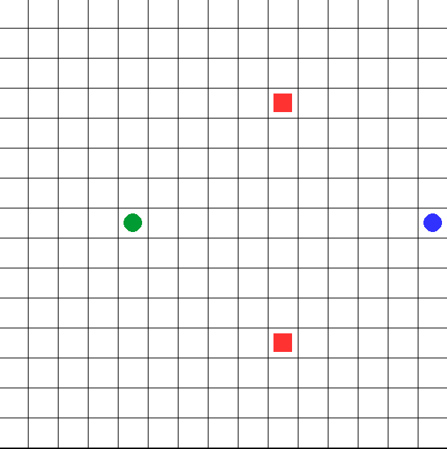
Welcome to the experiment!
You two are hungry travelers (No.1 blue circle, No.2 green circle) who need to reach a restaurant as soon as possible to replenish your food. There are two restaurants on the map (red squares). Your goal is to maneuver the keys (up, down, left, right) to navigate and reach one of the restaurants for a meal in as few steps as possible. The blue circle is controlled by WSAD keys, and the green circle is controlled by arrow keys ↑↓←→.
Please note:
Your positions can overlap and you can reach the same restaurant. However, for each person, in each round (total 10 rounds) only one restaurant can be reached for dining.
Press the spacebar to start the experiment!

Slide 9
The formal experiment will
start in 5 seconds.
Please focus.

Slide 10
Press the spacebar to start the game!

Slide 11
You have finished the game!
Please scan the QR code below to fill out the questionnaire and complete the experiment.

Slide 12
Practice round
Welcome to the experiment!
You two a hungry traveler (blue circle) who need to reach a restaurant as soon as possible to replenish your food. There are two restaurants on the map (red squares). Your goal is to maneuver the keys (up, down, left, right) to navigate and reach one of the restaurants for a meal in as few steps as possible. The blue circle is controlled by WSAD keys, and the green circle is controlled by arrow keys ↑↓←→.
Please note:
Your positions can overlap and you can reach the same restaurant. However, for each person, in each round (total 10 rounds) only one restaurant can be reached for dining.
Press the spacebar to start the experiment!

