Slide 1
Applying machine learning to biological promoters
Nathan Hu

Slide 2
What is the research problem
Notes:
A set of token embeddings is X, Q,V,K are created from X (matrix multiplied with a learned weight matrix). QK are multiplied and softmax’d to normalise the weights, these are then multiplied with the V matrix to create a weighted matrix
Use single token embedding as example
Single tken embedding ultiplied by matrix of many token embeddings to get m-dim vector, apply soft max and this provides a weighting for each token relative to the query token. Finally multiply

Slide 3
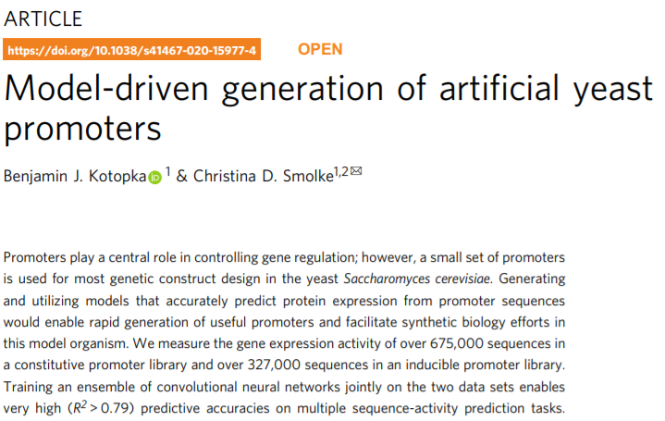
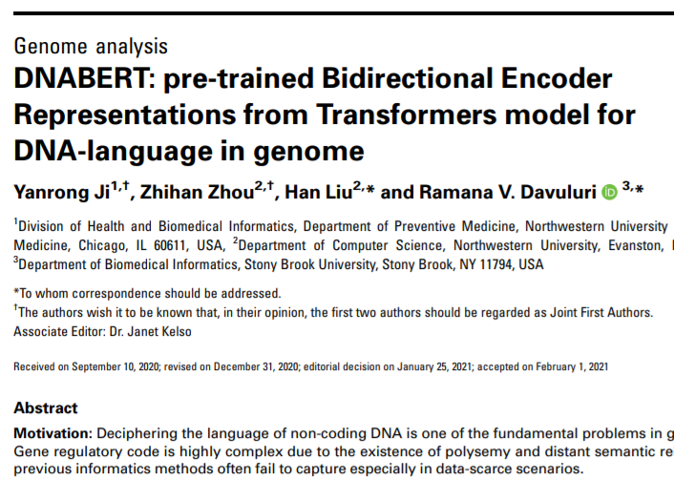
Project overview
Largely based off two papers applying machine learning to promoter prediction
Notes:
Give overview at the beginning of the background
What the project is based on (papers), findings
Add page numbers
After each section return to contents page to keep everyone on track
Spend up to 10 mins or less on background, make a stronger link between background and actual work done
Add picture

Slide 4
What is a promoter
Promoters are the key non-coding regions of the genome²
Found near the transcription start site of a gene²
Important for initiation of transcription and for regulating gene expression¹ by serving as recognition sites for necessary proteins²
¹Ayoubi & Van De Yen 1996
²Oubounyt et al. 2020
Notes:
Give overview at the beginning of the background
What the project is based on (papers), findings
Add page numbers
After each section return to contents page to keep everyone on track
Spend up to 10 mins or less on background, make a stronger link between background and actual work done
Add picture

Slide 5
Green Fluorescence Protein (an example)
Transcription
Promoter Region
GFP
DNA-Binding protein
¹Ayoubi & Van De Yen 1996
Notes:
Give overview at the beginning of the background
What the project is based on (papers), findings
Add page numbers
After each section return to contents page to keep everyone on track
Spend up to 10 mins or less on background, make a stronger link between background and actual work done
Add picture

Slide 6
Motivation
Precise gene expression control is required in³:
Engineered metabolic pathways
Gene circuits
Finding promoters or creating artificial promoters with useful properties may aid gene construct design³
Studying DNA with machine learning may aid understanding of promoters and DNA regulation in general
³Kotopka & Smolke 2020
Notes:
Use a real example
Use GFP (include a picture) as an example of how promtoers work in general
Give a higher order example of how tfs recognise promoters as almost a signal to start transcription

Slide 7
Question:
How can we use machine learning to make predictions on promoters?
Notes:
This is a vague question, here are two ways this question can be answered

Slide 8
Research question
How can we use machine learning to make predictions on promoters?
Regression
How strong is this promoter?
(number value)
Notes:
Say how classification is 1,0
Regression is continuum

Slide 9
Example: Creating artificial promoters
ATGTAAGTGACASTARTGACAGGACATAGACATTACATAT
Unknown New Sequence
Regression
Model says it’s a strong promoter
Verify model prediction in vivo
New promoter sequence found!
Notes:
Clearly separate the two tasks

Slide 10

Goal
AGGACATAGACATTACATAT
Input DNA sequence
REGRESSION MODEL
Blackbox model
Model output (promoter strength)
$$0.67$$
Notes:
Can think of each model as a mathematical function that takes in an input and returns an output

Slide 11
DNA vector representation
DNA is a sequence of 4 base pairs
How do we represent a sequence such as ATTGCT in a computer readable way?

Slide 12
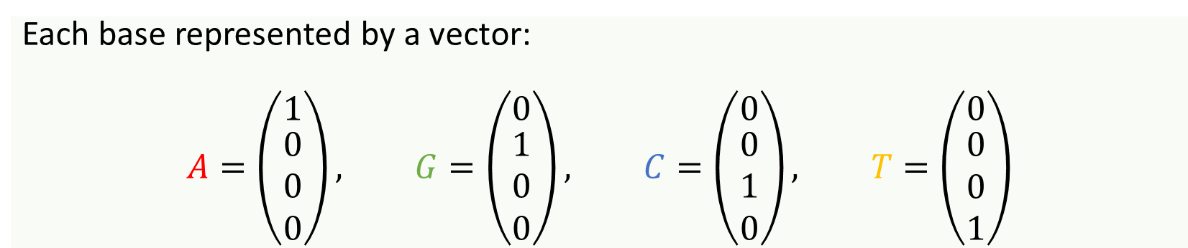
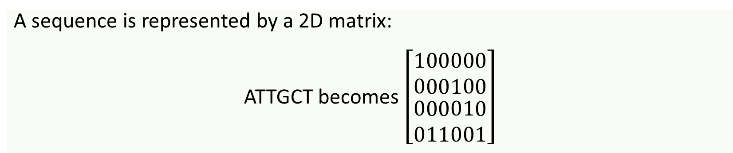
One-hot encoding
Each base represented by a vector:
$$A=\left(\begin{matrix}1 \\ \begin{aligned}0 \\ 0 \\ 0\end{aligned}\end{matrix}\right), G=\left(\begin{matrix}0 \\ \begin{aligned}1 \\ 0 \\ 0\end{aligned}\end{matrix}\right), C=\left(\begin{matrix}0 \\ \begin{aligned}0 \\ 1 \\ 0\end{aligned}\end{matrix}\right), T=\left(\begin{matrix}0 \\ \begin{aligned}0 \\ 0 \\ 1\end{aligned}\end{matrix}\right)$$
A sequence is represented by a 2D matrix:
ATTGCT becomes $\left[\begin{matrix}\begin{aligned}1 \\ 0\end{aligned} \\ 0 \\ 0\end{matrix}\begin{matrix}\begin{aligned}0 \\ 0\end{aligned} \\ 0 \\ 1\end{matrix}\begin{matrix}\begin{aligned}0 \\ 0\end{aligned} \\ 0 \\ 1\end{matrix}\begin{matrix}\begin{aligned}0 \\ 1\end{aligned} \\ 0 \\ 0\end{matrix}\begin{matrix}0 \\ 0 \\ \begin{aligned}1 \\ 0\end{aligned}\end{matrix}\begin{matrix}0 \\ 0 \\ \begin{aligned}0 \\ 1\end{aligned}\end{matrix}\right]$
A T T G C T
Notes:
Explain ghe matrix better, use a longer sequence
Ezplain step by step

Slide 13
What architectures can we use?
Notes:
Therefore, we can define the same model architectures and they will work for either task, we just need to tweak the final layer of each model to return the correct output

Slide 14
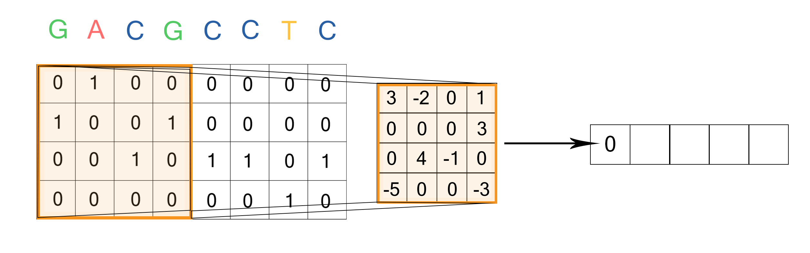
Convolutional neural network (CNN)
Usually applied to images and video
Based off the concept of a convolution
Focuses on the input 1 section at a time
Input
Kernel
Feature map
Notes:
CNN and other techniques focus on local DNA elements and aren’t able to take in global contextual information
DNABERT on the other hand is trained on a large corpus of DNA which allows it to have a more comprehensive understanding of DNA semantics and when passing inputs to the model, it considers the entire sequence.

Slide 15

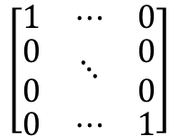
Pipeline 1
AGGACATAGACATTACATAT
Input DNA sequence
$$\left[\begin{matrix}1 & ⋯ & 0 \\ \begin{aligned}0 \\ 0\end{aligned} & ⋱ & \begin{aligned}0 \\ 0\end{aligned} \\ 0 & ⋯ & 1\end{matrix}\right]$$
One-hot encoding
CNN
Blackbox model
Model output (promoter strength)
$$0.67$$
Notes:
Can think of each model as a mathematical function that takes in an input and returns an output

Slide 16
How else can we represent a sequence
We have one-hot encoding
Another approach is to learn a representation for DNA
5
⁵Ji et al. 2021

Slide 17
DNABERT⁵
Based off BERT⁷, a state-of-the-art natural language model
Able to take in sentences as input and make different predictions
⁷Devlin et al. 2018

Slide 18
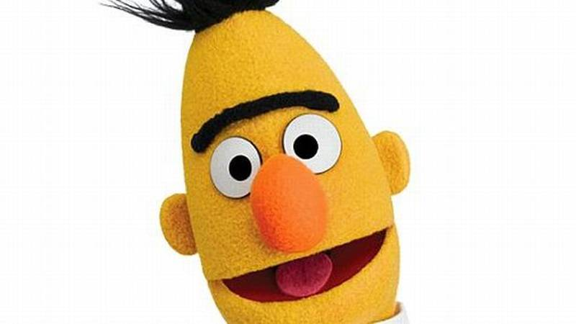
BERT⁷ Language Example
Sentiment analysis⁶
I think this sentence is NEGATIVE
I think this sentence is POSITIVE
“I love you”
“I hate you”
BERT
⁶Hugging Face 2020
⁷Devlin et al. 2018

Slide 19
Sentence representations
BERT can ‘embed’ or represent each sentence as a vector
“I hate you”
$$[1.3221, −11.823, 0.332⋯2.398]$$
“I love you”
$$[−3.928, 0.991, 6.122⋯7.082]$$

Slide 20
Sentence representations

Slide 21
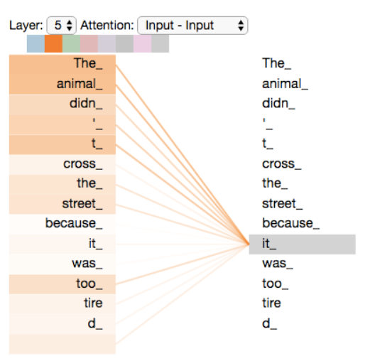
Attention mechanism
BERT can separate different sentences by understanding context
Understands context by using the “attention mechanism” on each word
“I”
“I love you”
“love”
“you”
⁴Alammar 2018

Slide 22
Link to DNA
A sequence of DNA is analogous to a sentence
GACAGGACATAGACATTACAT is a ‘sentence’

Slide 23
DNABERT
DNABERT⁵ embeddings are first trained using the human genome for 25 days on 8 GPUS
Provides it with a general and transferrable understanding of DNA⁵
So can be transferred to different downstream tasks and organisms
Yeast promoter strength prediction
⁵Ji et al. 2021

Slide 24
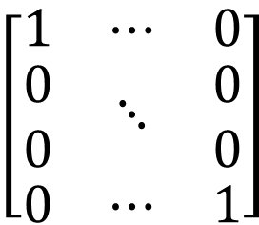
One-hot vs DNABERT
AGGACATAGACATTACATAT
One-hot encoding
DNABERT learned embedding
$$\left[\begin{matrix}1 & ⋯ & 0 \\ \begin{aligned}0 \\ 0\end{aligned} & ⋱ & \begin{aligned}0 \\ 0\end{aligned} \\ 0 & ⋯ & 1\end{matrix}\right]$$
$$[1.3221, −11.823, 0.332⋯2.398]$$

Slide 25
Pipeline 2
AGGACATAGACATTACATAT
Input DNA sequence
$$[1.3221, −11.823, 0.332⋯2.398]$$
DNABERT embedding
Dense Linear Layer
Blackbox model
Model output (promoter strength)
$$0.67$$

Slide 26
Pipeline 3
AGGACATAGACATTACATAT
Input DNA sequence
$$[1.3221, −11.823, 0.332⋯2.398]$$
DNABERT embedding
CNN
Blackbox model
Model output (promoter strength)
$$0.67$$

Slide 27
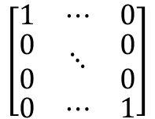



Summary of architectures
1. One-hot + CNN
2. DNABERT + Dense
3. DNABERT + CNN
AGGACATAGACATTACATAT
AGGACATAGACATTACATAT
AGGACATAGACATTACATAT
$$\left[\begin{matrix}1 & ⋯ & 0 \\ \begin{aligned}0 \\ 0\end{aligned} & ⋱ & \begin{aligned}0 \\ 0\end{aligned} \\ 0 & ⋯ & 1\end{matrix}\right]$$
$$[1.3221, −11.823, 0.332⋯2.398]$$
$$[1.3221, −11.823, 0.332⋯2.398]$$
Dense Linear Layer
CNN
CNN
$$0.67$$
$$0.67$$
$$0.67$$

Slide 28
Methods & Results
Notes:
Therefore, we can define the same model architectures and they will work for either task, we just need to tweak the final layer of each model to return the correct output

Slide 29
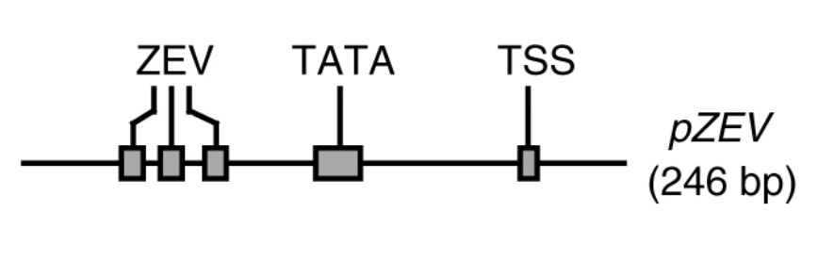
The dataset³
327,000 yeast promoters containing a binding site for artificial transcription factor ZEV
Each sequence is 246 base pairs and has a label for measured promoter strength
³Kotopka & Smolke 2020

Slide 30
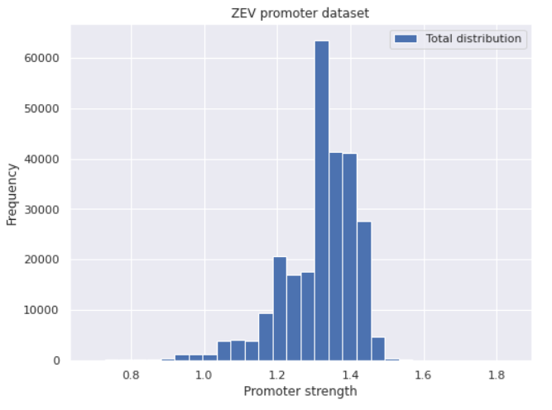
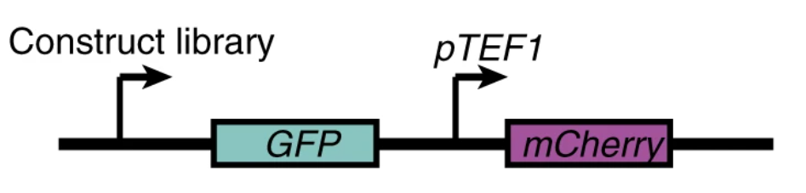
The dataset
How was promoter strength measured?
³Kotopka & Smolke 2020

Slide 31
Training
Each model needs to be trained to make accurate predictions
We split the 327,000 promoters into
261,584 training examples
32,708 validation examples
32,708 test examples

Slide 32
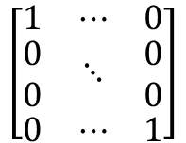

One-hot+CNN Training
One-hot + CNN
AGGACATAGACATTACATAT
Not learned
$$\left[\begin{matrix}1 & ⋯ & 0 \\ \begin{aligned}0 \\ 0\end{aligned} & ⋱ & \begin{aligned}0 \\ 0\end{aligned} \\ 0 & ⋯ & 1\end{matrix}\right]$$
Learned
CNN
$$0.67$$

Slide 33

DNABERT Training
DNABERT + Dense/CNN
AGGACATAGACATTACATAT
$$[1.3221, −11.823, 0.332⋯2.398]$$
Learned
DNABERT
Embedder
Learned
Dense/CNN
$$0.67$$

Slide 34
DNABERT Training
DNABERT has lots of layers
DNABERT
Embedder
We download a pre-trained version that is trained using the entire human genome
We then make fine adjustments using the yeast promoter dataset
Very big!!

Slide 35
1. One-hot + CNN
Notes:
Therefore, we can define the same model architectures and they will work for either task, we just need to tweak the final layer of each model to return the correct output

Slide 36
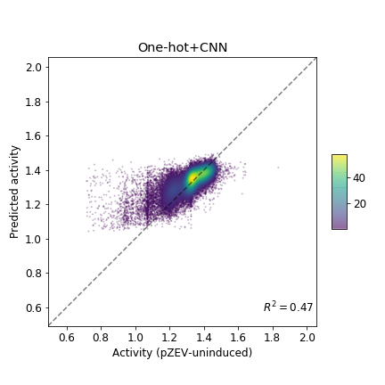
1. One-hot + CNN
Notes:
All models overpredict, likely because the labels are skewed towards the higher values

Slide 37
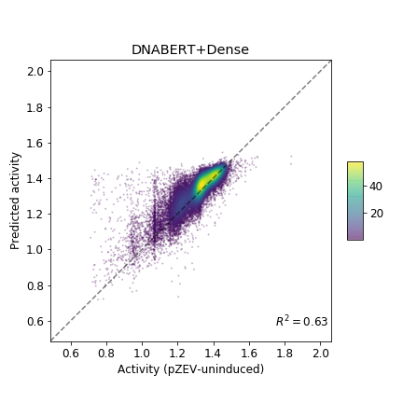
2. DNABERT + Dense
Notes:
Therefore, we can define the same model architectures and they will work for either task, we just need to tweak the final layer of each model to return the correct output

Slide 38
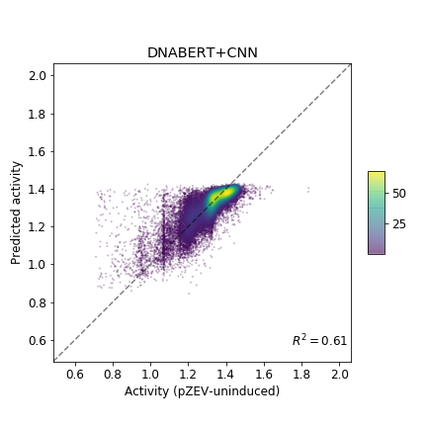
3. DNABERT + CNN
Notes:
Therefore, we can define the same model architectures and they will work for either task, we just need to tweak the final layer of each model to return the correct output

Slide 39
Summary of results
Notes:
Therefore, we can define the same model architectures and they will work for either task, we just need to tweak the final layer of each model to return the correct output

Slide 40
Summary of results
Notes:
Therefore, we can define the same model architectures and they will work for either task, we just need to tweak the final layer of each model to return the correct output

Slide 41
Interpretation
DNABERT generalises well to different tasks and organisms
DNABERT Performs better than one-hot+CNN
CNN is restricted by receptive field, unable to easily take in global contextual information of sequence
Results could imply this is important
Not enough time to spend hyperparameter tuning, these scores could be improved slightly
Notes:
Therefore, we can define the same model architectures and they will work for either task, we just need to tweak the final layer of each model to return the correct output

Slide 42
Future work
Pre-train DNABERT on yeast genome and compare performance
Evaluate the three pipelines on a classification task instead of a regression task
Need to create a non-promoter dataset
Visualise what DNABERT is focusing its ‘attention’ on
Could elucidate important features of promoters that make it strong

Slide 43
References
¹Ayoubi, T.A.Y. and Van De Yen, W.J.M. (1996), Regulation of gene expression by alternative promoters. The FASEB Journal, 10: 453-460. https://doi.org/10.1096/fasebj.10.4.8647344
²Oubounyt, M., Louadi, Z., Tayara, H., & Chong, K. T. (2019). DeePromoter: Robust Promoter Predictor Using Deep Learning. Frontiers in genetics, 10, 286. https://doi.org/10.3389/fgene.2019.00286
³Kotopka, B.J., Smolke, C.D. Model-driven generation of artificial yeast promoters. Nat Commun 11, 2113 (2020). https://doi.org/10.1038/s41467-020-15977-4
⁴Alammar, J. (2018) The Illustrated Transformer.
http://jalammar.github.io/illustrated-transformer/
⁵Yanrong Ji, Zhihan Zhou, Han Liu, Ramana V Davuluri, DNABERT: pre-trained Bidirectional Encoder Representations from Transformers model for DNA-language in genome, Bioinformatics, 2021, btab083, https://doi.org/10.1093/bioinformatics/btab083
⁶Hugging Face (2020). Summary of the tasks https://huggingface.co/transformers/task_summary.html
⁷Devlin J. et al. (2018) Bert: Pre-training of deep bidirectional transformers for language understanding. arXiv preprint arXiv : 1810.04805.

Slide 44
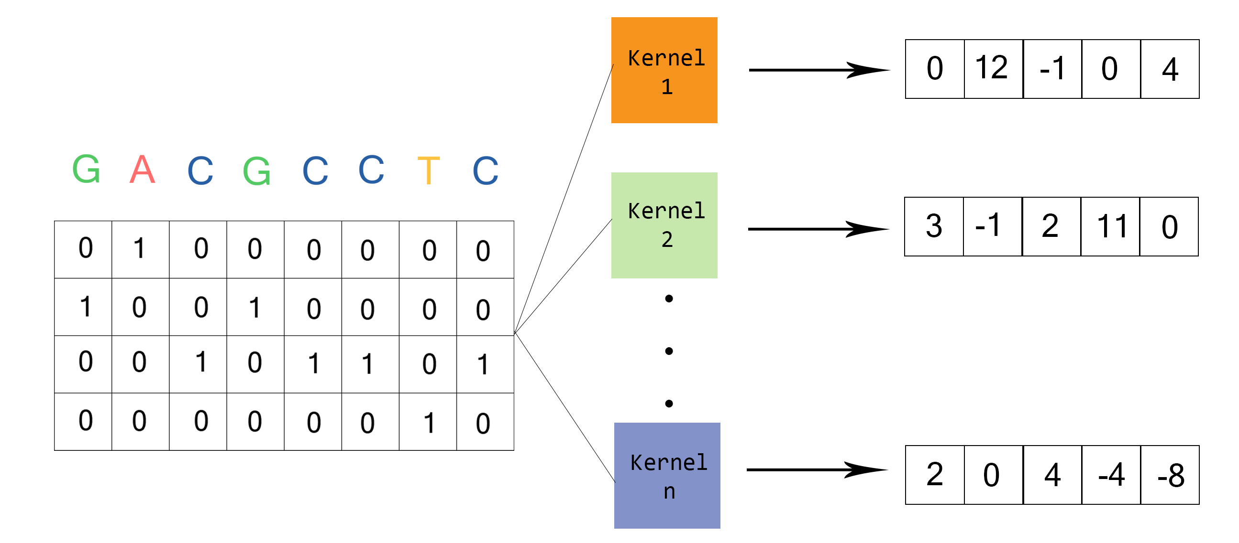
Convolutional neural network (CNN)
Usually create more than one feature map from the same input using different kernels
Feature map 1
Feature map 2
Feature map n
Notes:
Give overview at the beginning of the background
What the project is based on (papers), findings
Add page numbers
After each section return to contents page to keep everyone on track
Spend up to 10 mins or less on background, make a stronger link between background and actual work done
Add picture

Slide 45
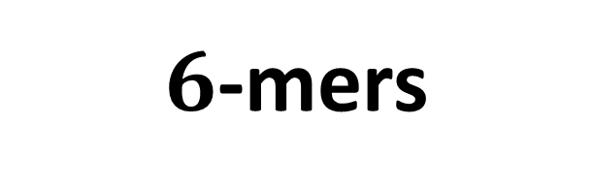

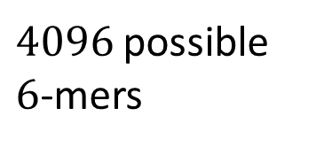

$k$-mers
GACAGGACATAGACATTACAT
GACAGG
ACAGGA
$$⋯$$
TTACAT
$6$-mers
$4096$ possible $6$-mers

