Slide 1
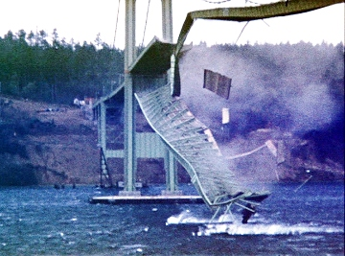
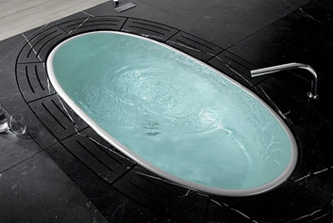
Cheng's EP presentation
“Exploring and implementing real-time computer graphics and accurate physics”

Slide 2
Topic title
“Exploring and implementing real-time computer graphics and accurate physics”

Slide 3
Topic title
“Exploring and implementing real-time computer graphics and accurate physics”

Slide 4
Topic title
“Exploring and implementing real-time computer graphics and accurate physics”

Slide 5
Inspiration
“Exploring and implementing real-time computer graphics and accurate physics”

Slide 6
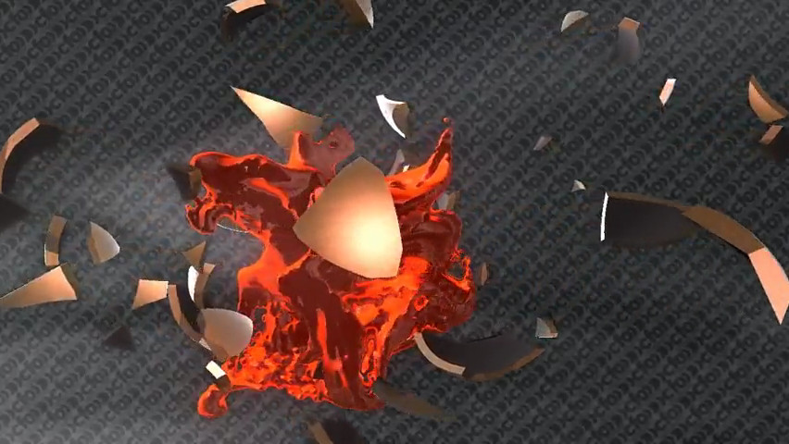
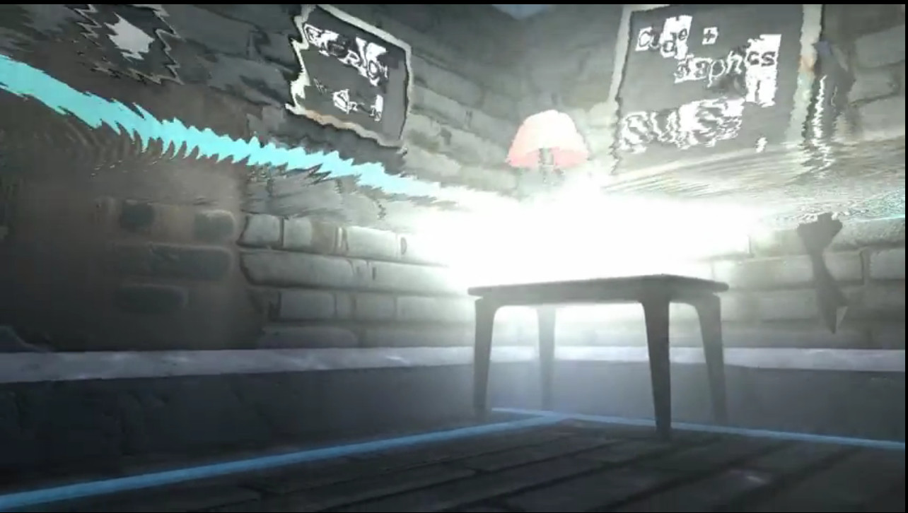
Inspiration
“Exploring and implementing real-time computer graphics and accurate physics”
The demoscene
Realtime animations
Designed to push a computer to its limits

Slide 7
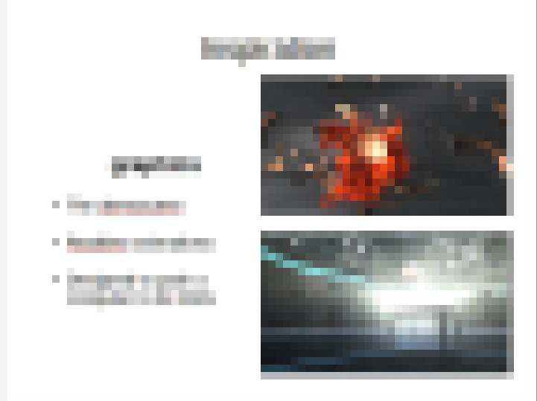

Slide 8
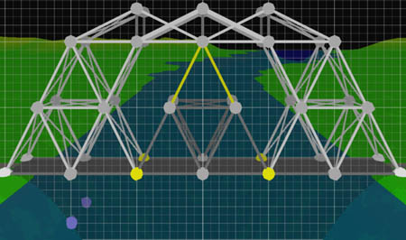
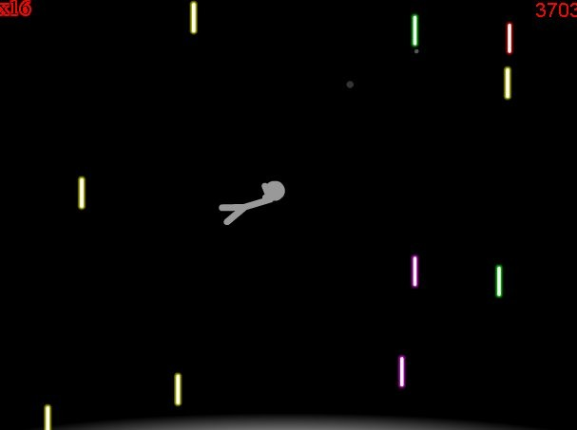
Inspiration
“Exploring and implementing real-time computer graphics and accurate physics”
Ragdoll and bridge simulation games
Realistic rigid-body physics
Designed to be fun to play

Slide 9
Research
Meshes
3D transforms
Rigid body simulation
Wave simulation
Lighting
Fast!

Slide 10
Research sources
Lectures
Presentations
Books
Websites
Papers
Software

Slide 11
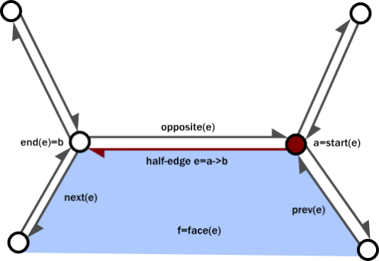
Mesh representations

Slide 12

3D transforms
Use 4-by-4 matrices
Homogeneous coordinates (x,y,z,w)
Perspective and translation is controlled by “4th dimension”

Slide 13
Verlet integration
Integration of acceleration to find position
Forms the heart of a rigid-body physics engine

Slide 14
Wave heightmaps
float basis = (D(x, y-1) +
D(x-1, y) +
D(x+1, y) +
D(x, y+1)) / 4;
float re = D(x,y) - basis,
im = Di(x,y);
re *= 0.998f;
im *= 0.998f;
D(x,y) = basis + re*costheta - im*sintheta;
Di(x,y) = im*costheta + re*sintheta;
Average energy calculated from four surrounding points
Current energy calculated
“Damping” is applied
Energy lost from current point, and gained from neighbouring points

Slide 15
Fragment shader
Run for every pixel that is displayed on the screen
Calculates amount of light reflected into the camera
Run in parallel on GPU

Slide 16
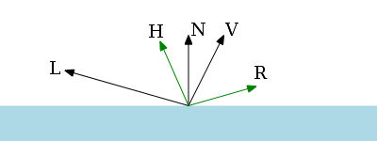

Blinn-Phong lighting
Lighting approximation
Calculates angle of light reflection off a surface
Modeled on bidirectional reflectance distribution functions

Slide 17
Technology – C++
Programming language
Been around for a long time
Quite tedious to write code in
Very efficient

Slide 18

Technology – OpenGL
A way to run code in parallel on GPU
Industry standard for 3D rendering
Carries over 20 years of historical baggage
  A pain to get anything working at all!

Slide 19

Technology – HTML5 and JavaScript
Programming language
Not designed for 3D
But easy to write prototypes in
Can be viewed easily by others in a browser

Slide 20


Technology – git
Keeps track of old versions of code
Easy to revert mistakes
Backed up online on GitHub

Slide 21
Development of ideas
T
I
M
E
Waterfall simulation
Points rendering
SDF shader code
Mesh rendering
Water wave simulation
Rotating 3D Cube
Ribbon physics
Texture rendering
Ragdoll simulation
Bridge simulation
3D water wave lighting

Slide 22
Outcome
4785 lines of code
14257 “words”
137KiB total

Slide 23
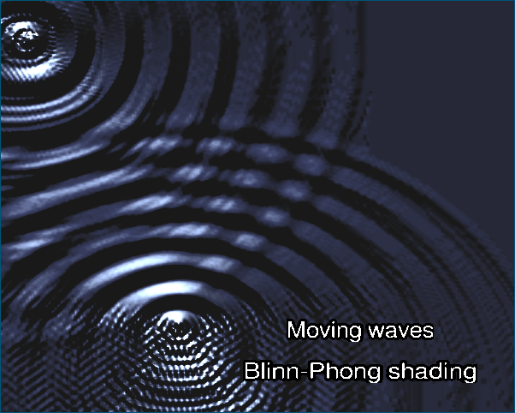
Outcome – 3D lighting

Slide 24
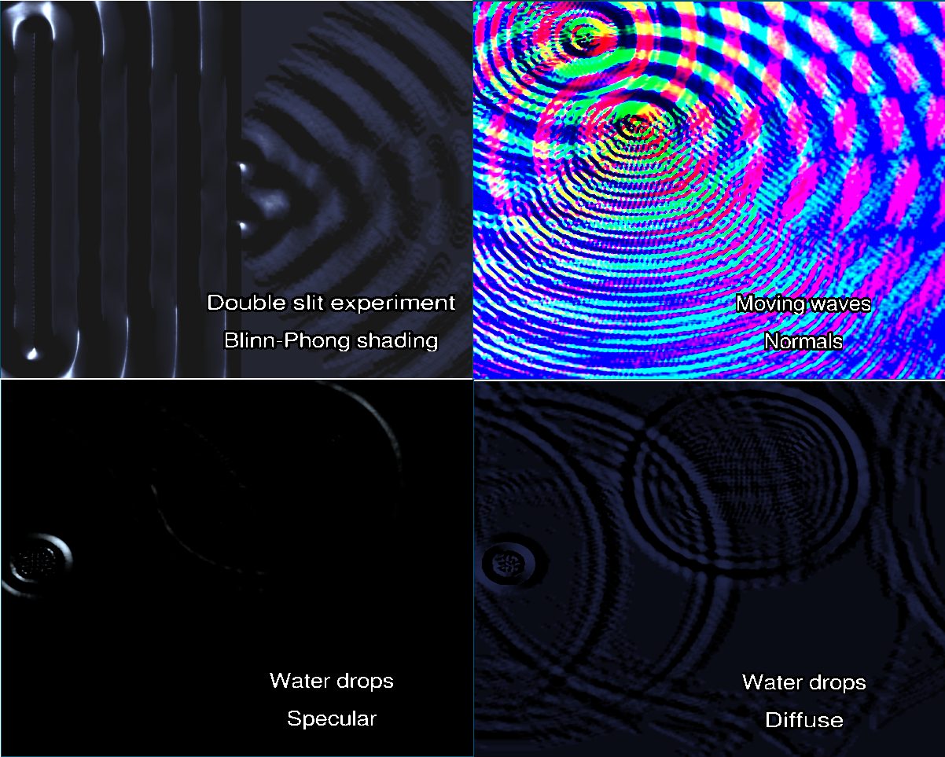
Outcome

Slide 25
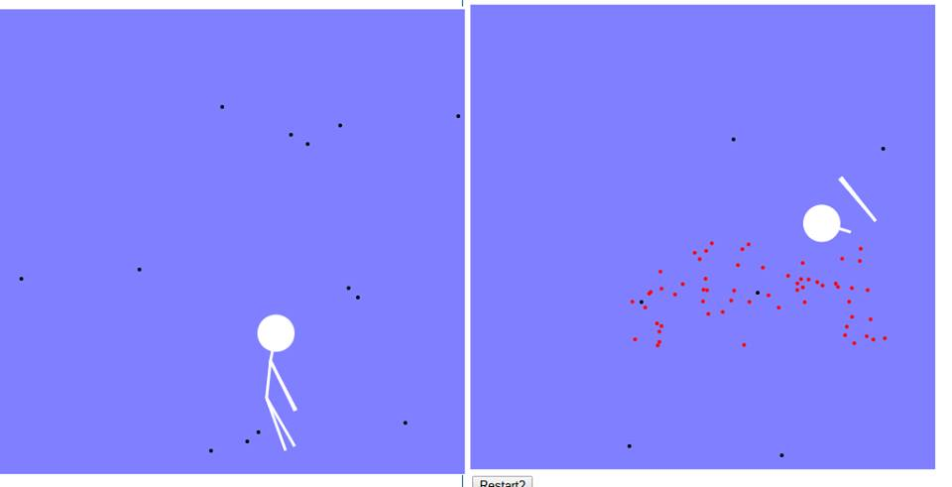
Outcome – ragdoll physics

Slide 26
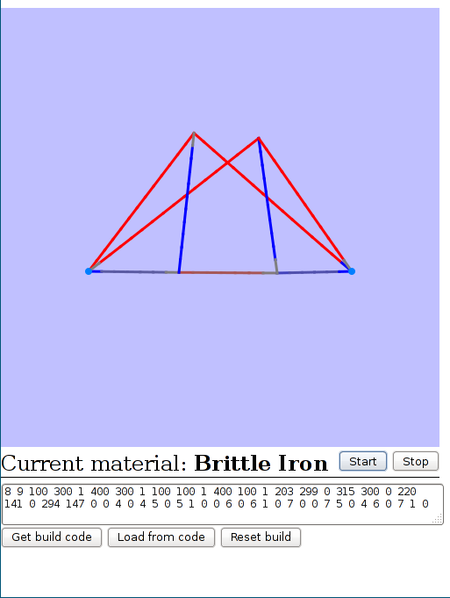
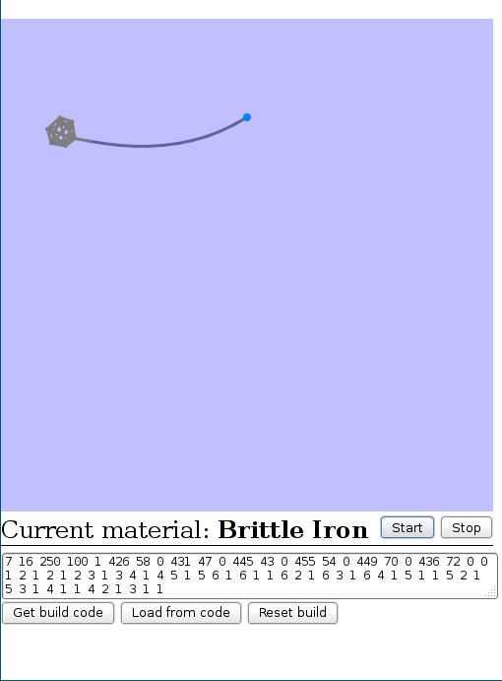
Outcome – rigid-body physics

Slide 27
Did it go well?
Yes!
Simulation worked very well
Result is appealing and realistic
Positive response from friends

Slide 28
Could it have gone better?
Yes!
Some research led to dead ends
Initial time management was poor
Burn out
Too many ideas, not enough time

Slide 29
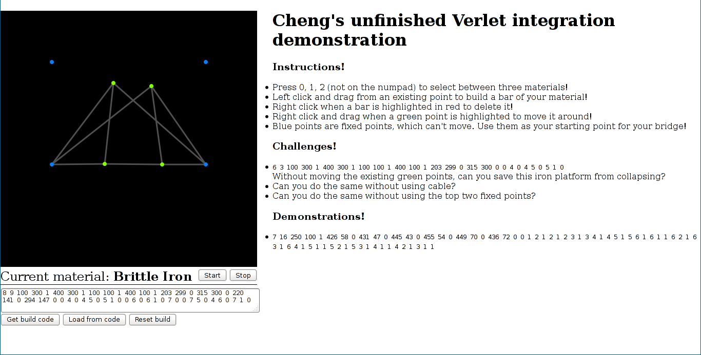
Fighting perfectionism
Stick to the plan
When my original objectives have already been achieved – ship it!
Points should snap-to-grid?
Replace black background with pretty picture?
Add “Share on Facebook” button?

Slide 30
What I would do next time
Plan it out
Start early
Make prototypes
Evaluate and iterate
Change tack if necessary
STICK TO THE PLAN
External validation

Slide 31
What did I get out of it all?
Better at using sources
Much better time management
More confidence in problem-solving
More able to see when to change direction
Vastly improved programming skills!

Slide 32
Questions?

