Slide 1
机器学习第五讲(上)
贝叶斯模型的应用
——一维情况
卢志茂

Slide 2



参数分类（1）
贝叶斯分类的要求
概率分布的类型
确定参数 θ
or
Notes:
2

Slide 3


参数分类（2）
贝叶斯分类的要求
假定高斯类型的概率分布
then
Notes:
3

Slide 4
参数分类（3）
举例
销售 K 种汽车
let us say that the sole factor that affects a customer’s choice is his or her yearly income，x
P(C_{i}) is the proportion of customers who buy car type i
If the yearly income distributions of such customers can be approximated with a Gaussian, then p(x|C_{i} ∼ n N(μ_{i}, σ_{i}²),
estimate P(C_{i}) and p(x|C_{i}) from a sample and get the estimate for the discriminant function
Notes:
4

Slide 5


参数分类（4）
举例
销售 K 种汽车
For a sample
6
Notes:
5

Slide 6
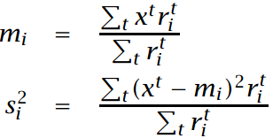

参数分类（5）
举例
销售 K 种汽车
For each class separately
the estimates for the priors
Notes:
6

Slide 7
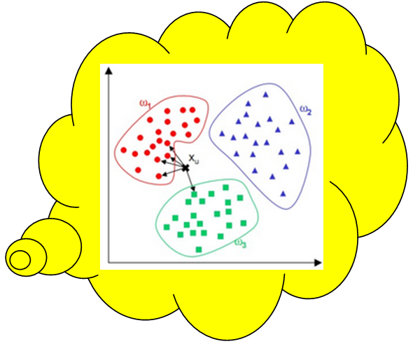



参数分类（6）
举例
销售 K 种汽车
Plugging these estimates into front equation , we get
We can simplify this function
Thus
大类吃小类
Notes:
7

Slide 8
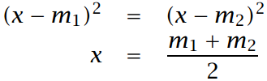
参数分类（7）
举例
销售 K 种汽车
With two adjacent classes
the midpoint between the two means is the threshold of decision
Notes:
8

Slide 9
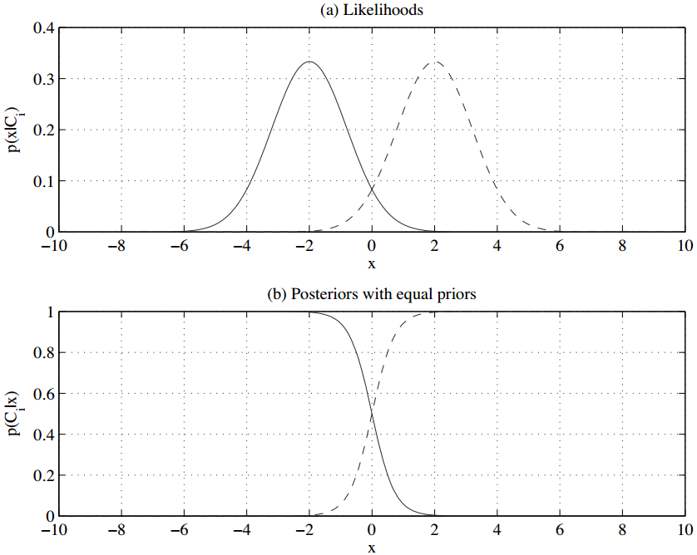
率先验概率相等的后验概

Slide 10
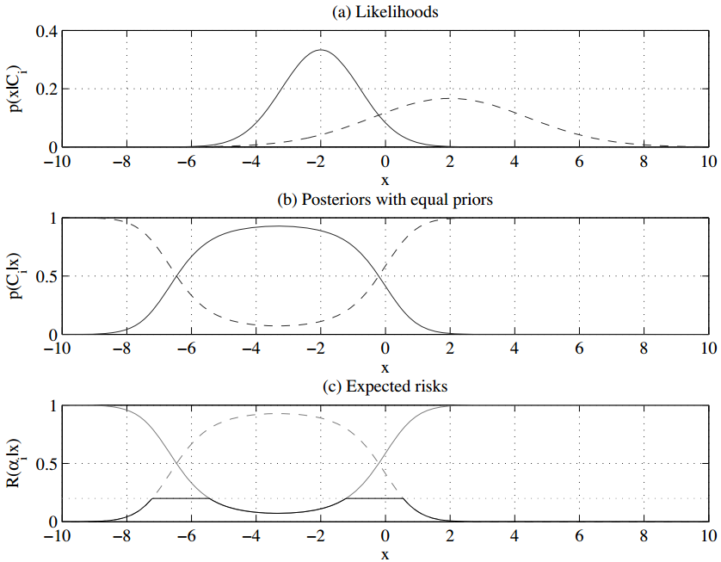
相等先验的后验
λ = 0.2

Slide 11
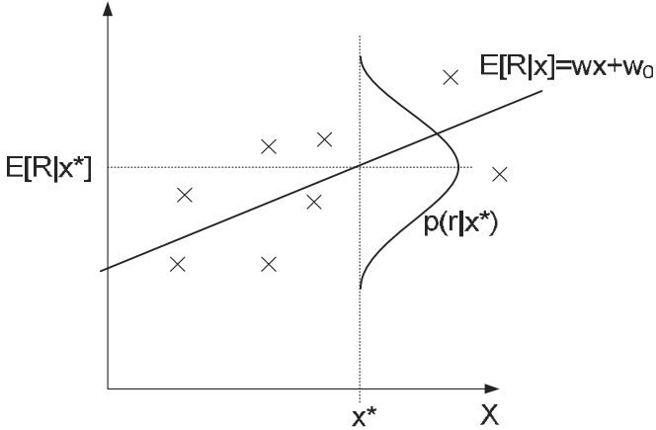


回归（1）
输入输出的函数
If we assume that is zero mean Gaussian with constant variance σ², namely, ε∼ N(0, σ²),
placing our estimator g(· ) in place of the unknown function f(· )
Notes:
11

Slide 12


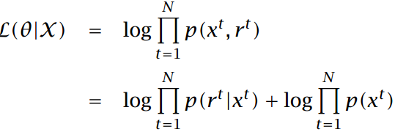
回归（2）
输入输出的函数
Learning parameters θ from samples
忽略第二项
Notes:
12

Slide 13
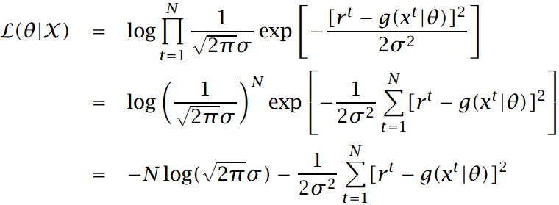

回归（3）
输入输出的函数
Simplify
Maximizing this is equivalent to minimizing
第一项可忽略
1/σ²也可忽略
Notes:
13

Slide 14
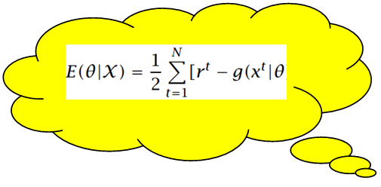

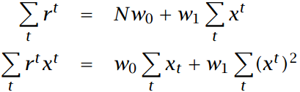

回归（4）
线性回归
取误差平方和的导数，得到 w₁ 、 w₀ 如下方程
can be written in vector-matrix form as Aw = y
can be solved as w = A⁻¹y
Notes:
14

Slide 15
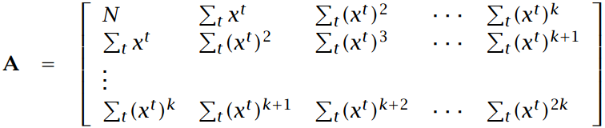
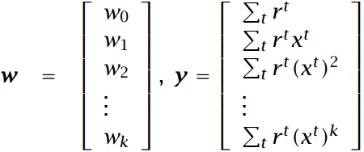
回归（5）
多项式回归
Written as Aw = y
can be solved as w = A⁻¹y
Notes:
15

Slide 16
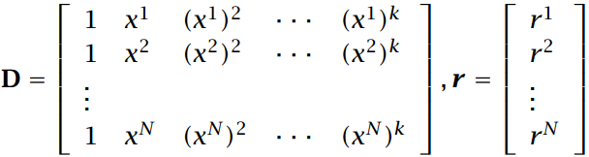
回归（6）
多项式回归
write A = D^{T}D and y = A D^{T}r
w = (D^{T}D) ⁻¹ D^{T}r
Notes:
16

Slide 17

回归（7）
相对平方误差 relative square error (RSE)
ERSE is close to 1, prediction is as good as predicting by the average and using a model based on input x does not work better than using the average which would be our estimator if there were no x
ERSE is closer to 0， better fit and input x helps
Notes:
17

Slide 18


调整模型的复杂度（1）
偏倚与方差
分析
给定样本
概率密度
构建的估计
Notes:
18

Slide 19
调整模型的复杂度（2）
偏倚与方差
分析
The first term on the right is the variance of r given x; it does not depend on g(· ) or X.
It is the variance of noise added, σ ² .
The second term quantifies how much g(x) deviates from the regression function, E[r| x] .
Notes:
19

Slide 20
调整模型的复杂度（3）
偏倚与方差
讨论 g(· )
bias measures how much g(x) is wrong disregarding the effect of varying samples
variance measures how much g(x) fluctuate around the expected value, E[g(x)], as the sample varies
Notes:
20

Slide 21

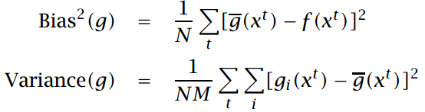
调整模型的复杂度（4）
偏倚与方差
举例 ：估计偏倚和方差
generate a number of datasets X_{i} = {x^{t}_{i} , r_{i}^{t}}, i = 1, . . . , M, from some known f (· ) with added noise
use each dataset to form an estimator g_{i}(· )
do not know f (· ) or the parameters of the added noise. Then E[g(x)] is estimated by the average over g_{i}(· ):
Notes:
21

Slide 22


调整模型的复杂度（5）
偏倚与方差造成的艰难选择
举例 ：常数拟合
This has no variance because we do not use the data and all g_{i}(x) are the same.
But the bias is high, unless of course f (x) is close to 2 for all x
If we take the average of r^{t} in the sample
Notes:
22

Slide 23
调整模型的复杂度（5）
偏倚与方差造成的艰难选择
举例 ：均值拟合
this decreases the bias because we would expect the average in general to be a better estimate
But this increases the variance because the different samples X_{i} would have different average values.
Normally in this case the decrease in bias would be larger than the increase in variance, and error would decrease.
Notes:
23

Slide 24
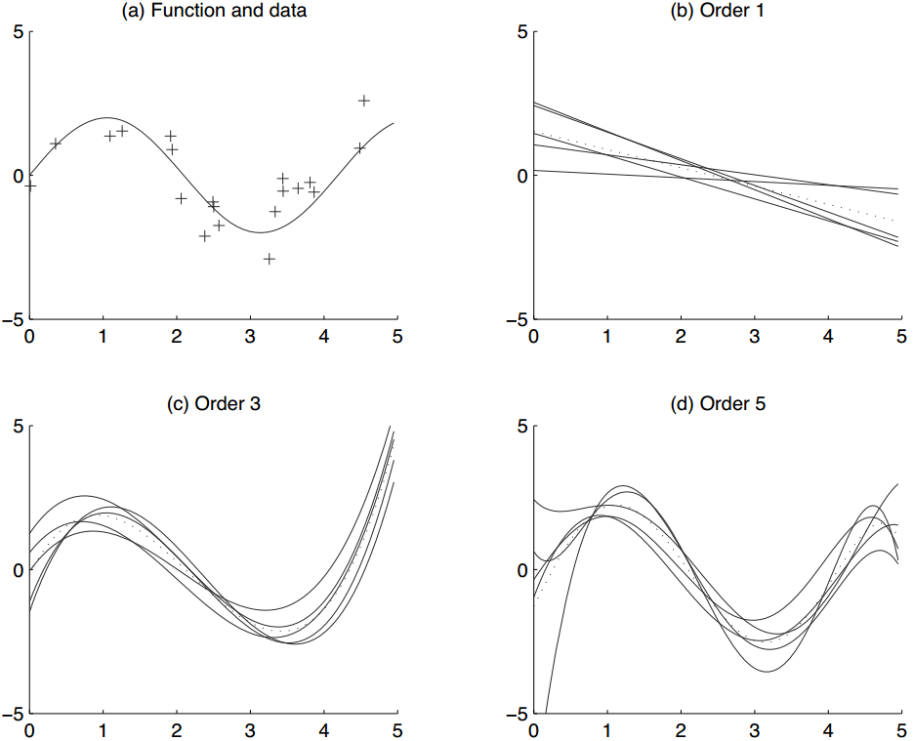
五个模型

Slide 25
调整模型的复杂度（6）
偏倚与方差造成的艰难选择
讨论
If there is bias, this indicates that our model class does not contain the solution; this is underfitting.
If there is variance, the model class is too general and also learns the noise; this is overfitting.
Notes:
25

Slide 26
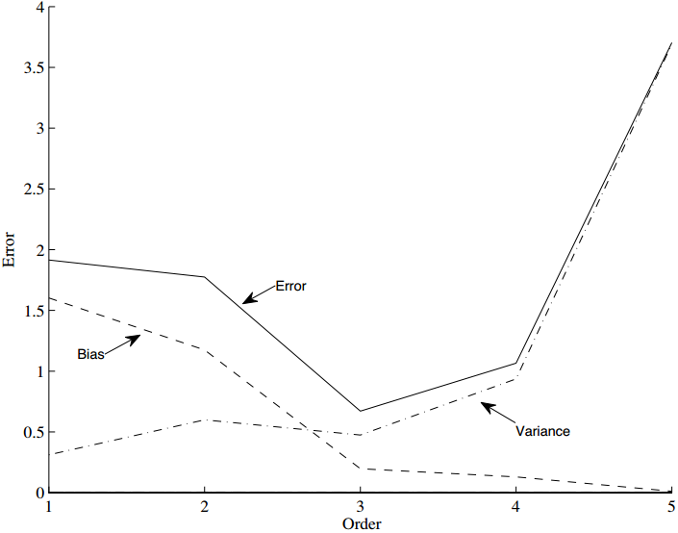
100个模型

Slide 27
调整模型的复杂度（7）
偏倚与方差造成的艰难选择
讨论
To sum up, to get a small value of error, we should have the proper inductive bias (to get small bias in the statistical sense) and have a large enough dataset so that the variability of the model can be constrained with the data.
Note that when the variance is large, bias is low: this indicates that g(x) is a good estimator.
So to get a small value of error, we can take a large number of high-variance models and use their average as our estimator.
Notes:
27

Slide 28
the END

