Slide 1

Loan Status Prediction
Springboard Capstone Project
Changmin Cheng
December 2021

Slide 2

Q: How does a loan company make decision to approve or deny a loan application?
A: They will collect many information from the borrower, such as credit score, income, asset, etc. Based on these information, they will try to predict if the borrower will be able to or be willing to make all payments for the loan.

Slide 3




The prediction must be as accurate as possible:
If “bad” loans are approved: Lenders are in trouble trying to collect payments;
If “good” loans are denied: Lenders are losing business opportunities.

Slide 4

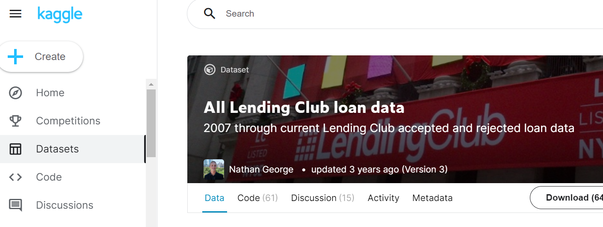
So in this study, we are using a dataset originally from Lending Club (downloaded from Kaggle.com*) to build a model to effectively predict the loan status.
* Data Resource: https://www.kaggle.com/wordsforthewise/lending-club
About the data:
Rows: 2,260,701
Columns: 151
Size: 392MB

Slide 5
About the target variable
Target Column: “loan_status”
It has two main values: “charged off” which means the loan is in default; “fully paid” means the loan is fully paid.
There are also large amount of current loans. We don’t know if they will be paid in full or will be default. So they are useless to our model and will be removed.

Slide 6
Four steps of this study
1. Data Wrangling
data cleaning, dealing with missing data, data size reduction,
check outliners.
2. Exploratory Data Analysis
data distribution visualizing, PCA, relations between numerical/
categorical columns with target variable.
3. Preprocessing and Training Data Development
data balancing, selecting features for final modeling, trying
a few model and compare the performance.
4. Modeling
cross validation, hyperparameter tuning, running model and visualizing
the result.

Slide 7
1. Data Wrangling (1/3)
Observations on Initial Data:
Initial data was clean. No messy signs found in continuous data;
Large amount of data are missing;
Data size is too big, especially too many columns. Not all of them are related to our target. So we need to reduce the data size by dropping those unrelated columns.

Slide 8
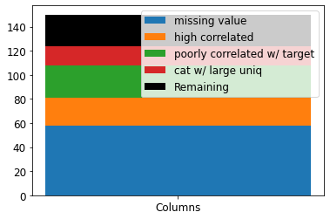
1. Data Wrangling (2/3)
Drop Columns:
Step 1: drop columns with more than 30% missing data. (58 columns dropped)
Step 2: drop columns which have correlation coefficients at least 0.8 with other columns (23 columns dropped)
Step 3: drop columns which have correlation coefficient smaller than 0.1 with target (27 columns dropped)
Step 4: drop categorical columns with more than 40 unique values (16 columns dropped)
Remaining columns: 27

Slide 9
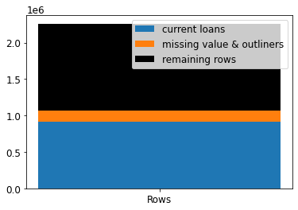
1. Data Wrangling (3/3)
Drop Rows:
Step 1: drop rows whose “loan status” is current. 912,569 rows are dropped.
Step 2: drop rows with missing value and outliner rows. 159,704 rows are dropped.
Remaining rows: 1,188,428

Slide 10
1. Data Wrangling (summary)
In this step we have finished a few tasks:
Drop columns with too many missing values, columns with high correlation with other columns, and columns with poor correlation with the target variable (loan status);
Drop categorical columns with too many unique values;
Drop rows with missing values, rows with a current loan status, and rows with some outliners.
Therefore the final data for modeling is 1,188,428 rows and 28 columns
Comparing to the original data: 2,260,701 rows and 151 columns

Slide 11
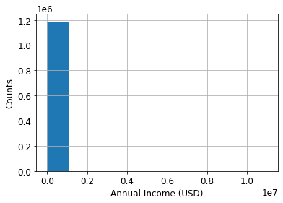
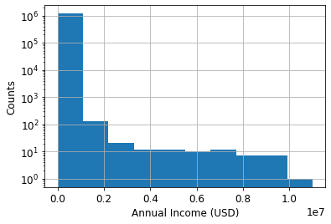
2. Exploratory Data Analysis – Data Distribution
Let’s have a look on the histogram of continuous columns.
For those with long tails, we use logarithm axis to plot it more clearly. Compare the two plots on the right side.
So far they all look good. So we don’t need to do anything on them.

Slide 12
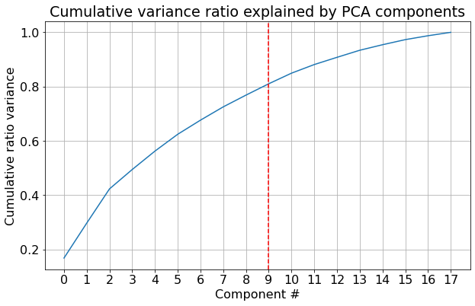
2. Exploratory Data Analysis – PCA (1/2)
From this plot we can see that to reach 80% or more explained variance, at least 9 principal components should be selected.

Slide 13
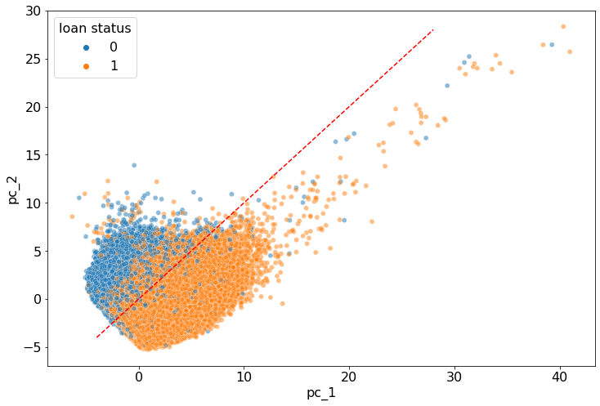
2. Exploratory Data Analysis – PCA (2/2)
pc_1 = pc_2
Visualizing all data points in the coordinate system of the first two principal components
Default loans
(loan status = 0)
Overlapping zone
Fully paid loans
(loan status = 1)
With only two principal components, only 42% variance is explained, which means two components are not enough for our model

Slide 14
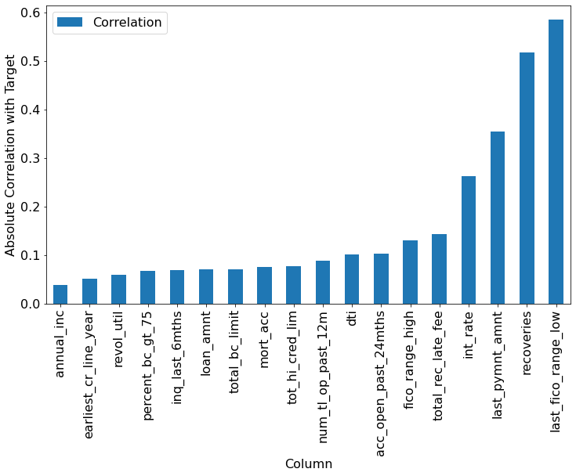
2. Exploratory Data Analysis – Correlation with Target (1/2)
For numerical (continuous) columns, we want to understand the correlation coefficient with the target variable.
The chart on the right shows the absolute value of this coefficient.
Our interests are those columns with high correlation with the target variable.

Slide 15
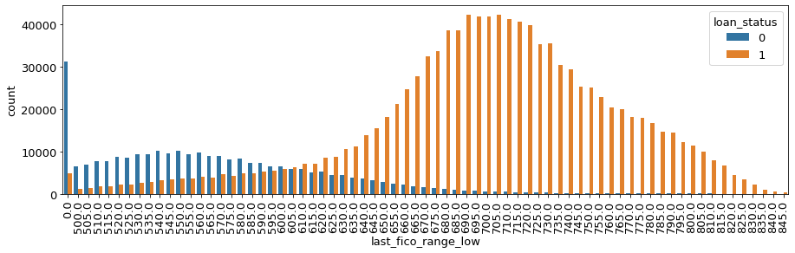
2. Exploratory Data Analysis – Correlation with Target (2/2)
The most correlated column is “last_fico_range_low”. Let’s have a look on its histogram under loan status = 0 (default) and loan status = 1 (fully paid).
Threshold

Slide 16
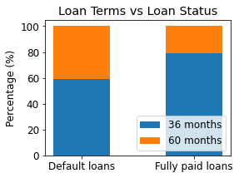
2. Exploratory Data Analysis – Categorical Columns
For those categorical columns, our interests are on those columns whose value counts are quite different in the two target classes.
For example, in the column “terms”, there are two values: “36 months” and “60 months”. For default loans, about 60% data points are with value of “36 months”, 40% are with “60 months”; while for fully paid loans, about 80% data points are with value of “36 months”,
and only 20% are with “60 months”. This indicates that for longer term loans, they are more likely to be defaulted.
So column “terms” is one of the categorical columns that we are interested in.
By using the same analysis, we can figure out that column “grade” and “debt_settlement_flag” are also our interested columns.

Slide 17
2. Exploratory Data Analysis (summary)
In this step we have finished a few tasks:
Plot the distribution histogram of continuous columns;
Apply PCA for this study, plot the principal components number vs explained variance ratio; visualize the data points in the coordinate system by the first two principal components;
Calculate and plot the correlation coefficient between each numerical features with the target variable.
Study the relations between categorical features and the target variable, and select those with the most impact to the target variable.

Slide 18
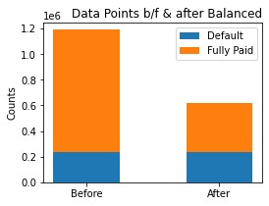
3. Preprocessing and Training Data Development
The first task for this part is to make the data balanced by dropping about 60% of data points for fully paid loans.
Data before balanced:
953,495 rows with fully paid loans;
234,933 rows with default loans;
After balanced:
381,398 rows with fully paid loans;
234,933 rows with default loans;

Slide 19
3. Preprocessing and Training Data Development
Next, we would like to ask a few questions such as:
How many features we should use for our model?
Should we scale our data?
Should we use PCA for our final model?
Which model gives best performance?
Let’s try to answer them one by one.

Slide 20
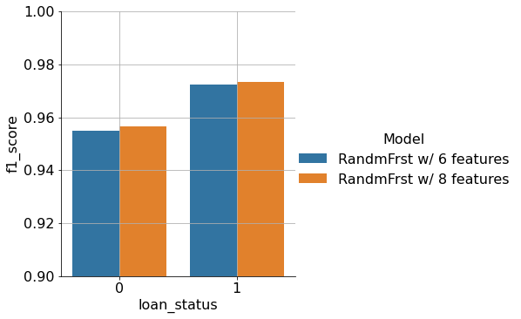
3. Preprocessing and Training Data Development – How Many Feature Should We Use?
Let’s use f1 score as our matrix, and compare the model of Random Forest with two different predictor features: 1) 6 features, including 4 most correlated numerical and 2 categorical; 2) 8 features, including 6 most correlated numerical and 2 categorical.
Results show f1 score improves slightly by using 2 more features. So we will use 8 features for our final model.
This also gives us hint that if we include more features, the prediction accuracy will not improve much.

Slide 21
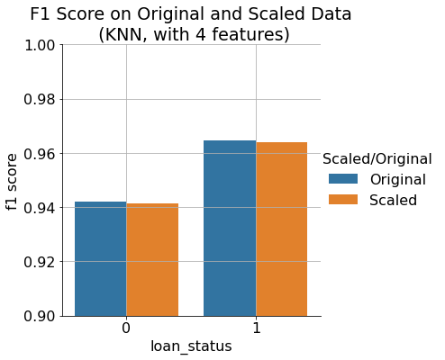
3. Preprocessing and Training Data Development – Should We Scale the Data?
By using 4 features and the model of K Nearest Neighbors, we can see that f1 score drops slightly after the data scaling.
So we get the conclusion that for our study the scaling does not help to give better performance. So we will not scale the data in our final model.

Slide 22
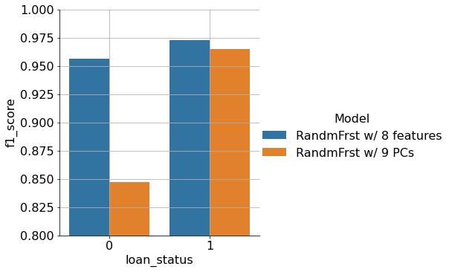
3. Preprocessing and Training Data Development – Should We Use PCA?
PCA could be very useful to for high dimensional models. In our case, we can see that if we use 9 principal components, the prediction score is not as good as the model with 8 features, especially for the prediction of default loans. So we will not use PCA in our final model.

Slide 23
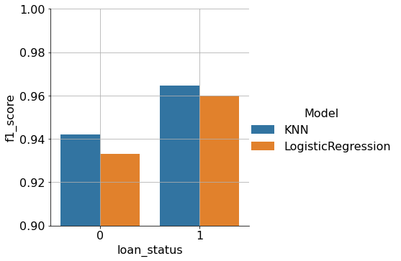
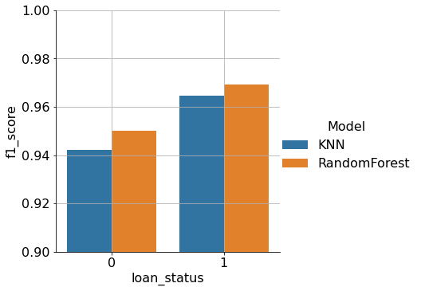
3. Preprocessing and Training Data Development – Which Model Gives The Best Performance?
Three models have been tried: KNN, Logistic Regression, and Random Forest. It is very clear that Random Forest gives the best performance.

Slide 24
3. Preprocessing and Training Data Development – Summary
In this part of the study a few tasks have been completed:
Balance the data by dropping data points for fully paid loans.
By comparing the results, we decide not using data scaling or PCA.
Since the 8 features (6 most correlated continuous features and two categorical features) give good model performance, we will use these 8 features in the final model.
Random Forest gives best prediction performance.

Slide 25
4. Modeling - Hyperparameter Tuning
In the final modeling, 4 models have been tried, and hyperparameter tunings have been done on all of them.
For K Nearest Neighbors, n_neighbors = 11 gives the best score, so we will use this value for the KNN model.
For the Decision Tree model, we tried criteria = gini and criteria = entropy. We found that the gini criteria gives slightly better performance. So we will use criteria = gini for Decision Tree model.
For Logistic Regression model, we have tried different C value (regularization strength). We found that the prediction score is independent from C value, which means any C value is fine (ranging from 0.01 to 100).
For the model of Random Forest, cross validation of n_estimators have been done and the value of 63 gives the best performance. So this value is used in the final model.

Slide 26
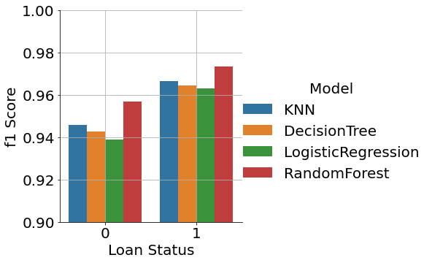
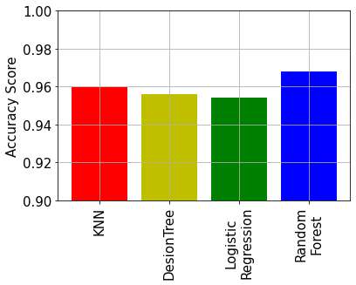
4. Modeling – Comparison of Model Performances
This plot shows clearly that the random forest gives the best performance.

Slide 27
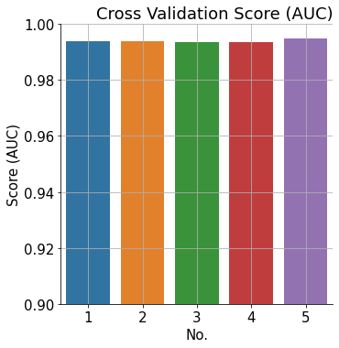
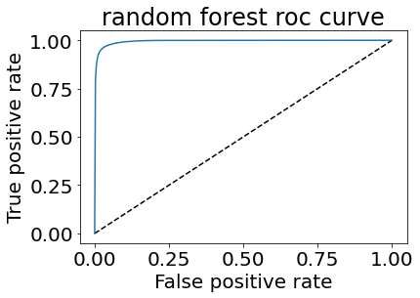
4. Modeling – Final Model Performances
The prediction performance of the final Random Forest model.
 | Predicted Default loans | Predicted fully paid loans
True default loans | 56165 | 2515
True fully paid loans | 2548 | 92847

Slide 28
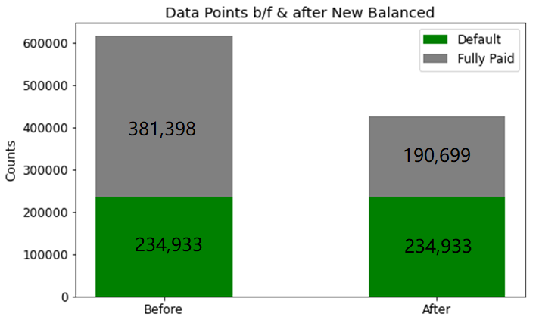
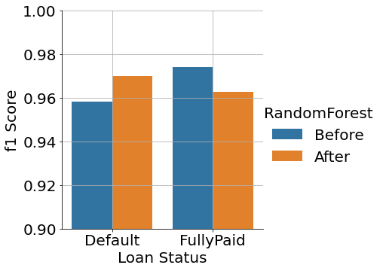
4. Modeling – Which Class is More Important?
The final model predicts the fully paid loans more successful than predicting the default loans. What if we wish it to be more successful to predict the default loans?
We can see that the model predicts default loans much better after dropping half of fully loan datapoints.

Slide 29
4. Modeling – Summary
In this study, the random forest model is proved to be more successful in predicting loan status.
In the model it is not necessary to have many features. With just 8 features we can get a prediction accuracy of 96.8%.
If we want the model to be more successful in predicting default loans, we can increase the proportion of data points with default loans in the whole dataset. This can be very useful for our lender customers.

Slide 30



