Slide 1

Building a Movie Recommender System
Springboard Capstone Project
Changmin Cheng
March 2022

Slide 2
Contents
Brief Introduction of Recommender Systems
Data and Models in This Study
Building Various Recommenders
Conclusions

Slide 3
Contents
Brief Introduction of Recommender Systems
Data and Models in This Study
Building Various Recommenders
Conclusions

Slide 4
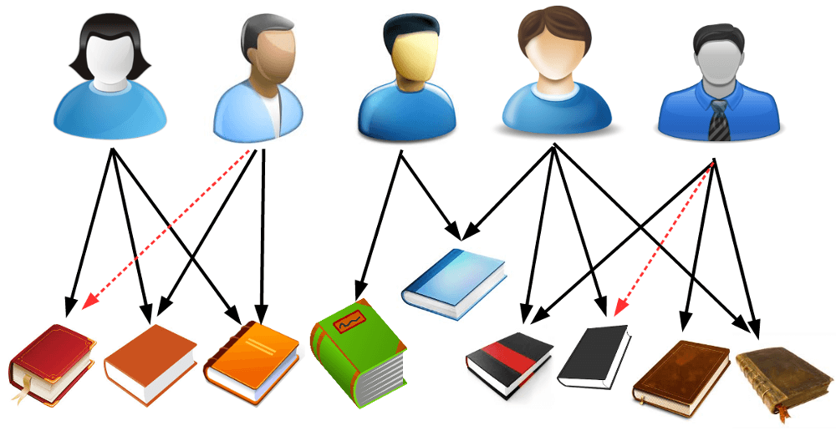
What is a recommender system?
A recommender system is a subclass of information filtering system that seeks to predict the "rating" or "preference" a user would give to an item. (From wikipedia)
In my understanding, a recommender system includes a model to predict a user’s rating on an item, and it also recommend a user with items he/she might be interested to use.

Slide 5





Recommender systems are widely used
If you bought baby formula at Amazon, maybe they will recommend diapers to you;
YouTube predicts videos you might like to watch and recommend them to you;
Facebook recommend groups and users you might interested to join in;
……

Slide 6
Two main models for building recommender systems
Collaborative Filtering
Content Based Filtering
User Based
Item Based

Slide 7
Two types of data set format for building recommender systems
 | Item_1 | Item_2 | Item_3 | Item_4
User_1 | 3.0 | 0 | 0 | 0
User_2 | 0 | 0 | 0 | 0
User_3 | 0 | 0 | 0 | 4.5
User_4 | 0 | 0 | 3.5 | 0
User_5 | 3.0 | 0 | 0 | 0
……
User | Item | Rating
User_1 | Item_1 | 3.0
User_1 | Item_3 | 4.5
User_2 | Item_5 | 2.5
User_4 | Item_5 | 4.0
Most algorithms accept the type on the left side.
They can be switched to each other easily.

Slide 8
Contents
Brief Introduction of Recommender Systems
Data and Models in This Study
Building Various Recommenders
Conclusions

Slide 9

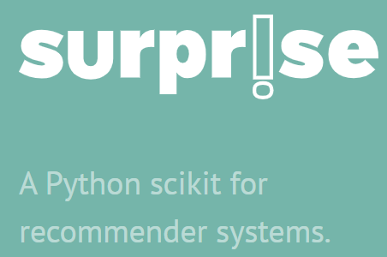

In this study………….
Dataset is the MovieLens 20M
Models are mainly from the “Surprise” module
Evaluation Metrics are from “RecMetrics” module

Slide 10
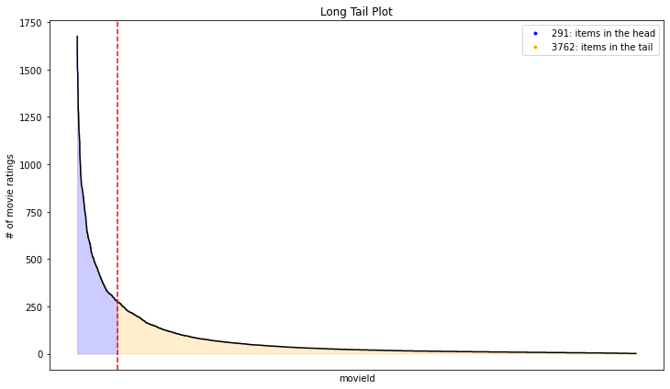
Understanding the data: The Long Tail Plot
Do all movies have same amount of ratings?
Typically only a small part of movies have a high volume of interactions. They are the “head”. Remaining large amount of movies have small interactions. They are the “tail”.

Slide 11
Understanding the data: The Facts
The rating matrix sparsity is 5.4%;
The average rating for all movies from all users is 3.5;
On average, each user gives 144 ratings;
On average, each movie has 748 ratings;
The most rated movie is the Pulp Fiction (1994). It has 67,310 ratings.

Slide 12
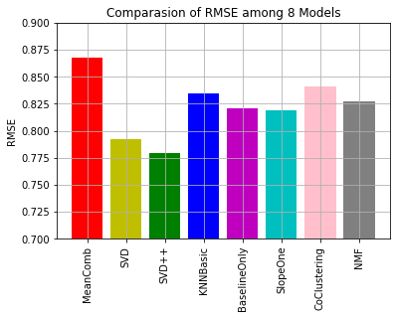
Comparison on Model Performances
A few models from “Surprise” were used to predict the rating of a (user, movie) pair;
Rating data were split into train set and test set;
Use train set to fit the models and test set to test the models;
RMSE (root mean square error) was used as the metrics.
The SVD++ (singular value decomposition ++) gives the best performance. Thus it is selected as the final model.

Slide 13
Contents
Brief Introduction of Recommender Systems
Data and Models in This Study
Building Various Recommenders
Conclusions

Slide 14
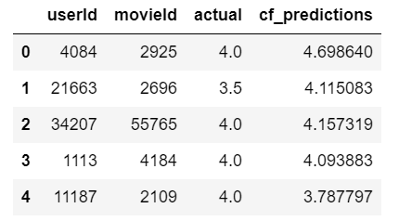
Building Collaborative Filtering Recommender
Steps to Build the Collaborative Filtering Recommender:
1. Predict ratings for every (user, movie) pair in test set;
2. Sort data by user id first, and then by predicted rating;
3. Recommend movies with highest predicted ratings to the user.

Slide 15
Building Popularity Recommender and Random Recommender
Popularity Recommender: Recommend movies with highest ratings to every user in test set
Random Recommender: Randomly select movies and recommend them to users in test set

Slide 16


Building the Parallel Recommender
Step 1: for every user in the test set, find top 5 movies he/she rated highest.
Total rating on 5 movies
24.5
5.0
4.5

Slide 17



Building the Parallel Recommender
Step 2: Find top 10 users who give highest total ratings on these 5 movies.
25
24.5
24.5
……
5.0
4.5
23

Slide 18
Building the Parallel Recommender
Step 3: for every user in these 10 users, find one movie he/she gave highest rating. This movie is not included in the 5 movies. So totally we get 10 movies.
25
24.5
24.5
……
……
5.0
4.5
23

Slide 19
Building the Parallel Recommender
Step 4: Recommend these 10 movies to the original user.
This recommender just follow the rule “people who love these movies also loves….”
25
24.5
24.5
……
……
5.0
4.5
23

Slide 20

Building the Unrated Recommender
As explained before, an effective recommender should recommend items a user has not touched but is very likely interested to use. This gives us the hint to build the unrated recommender.

Slide 21
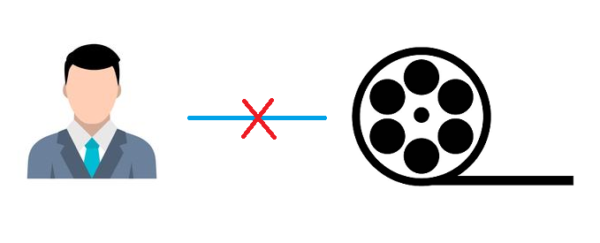
Building the Unrated Recommender
Step 1: for every user in the test data, find all movies he has not rated.

Slide 22
Building the Unrated Recommender
Step 2: Create a data frame with three columns. The first column is the user id to whom we are going to recommend movies; the second column is a list of movies the user has not rated; the third column are all 0.0 (the algorithm will not use these values in this column, but if the data frame does not have this column, the algorithm cannot proceed.
User id | Movie id (movies user_1 has not rated) | rating
User_1 | Movie_3 | 0.0
User_1 | Movie_4 | 0.0
User_1 | Movie_6 | 0.0
User_1 | Movie_8 | 0.0
User_1 | Movie_11 | 0.0
User_1 | Movie_12 | 0.0
…… | …… | ……

Slide 23
Building the Unrated Recommender
User id | Movie id (movies user_1 has not rated) | rating | Predicted rating
User_1 | Movie_3 | 0.0 | 3.88
User_1 | Movie_4 | 0.0 | 2.57
User_1 | Movie_6 | 0.0 | 4.55
User_1 | Movie_8 | 0.0 | 4.87
User_1 | Movie_11 | 0.0 | 1.5
User_1 | Movie_12 | 0.0 | 4.62
…… | …… | ……
Step 3: Apply this data frame to the SVD++ algorithm, and add a new column with predicted ratings by the algorithm.

Slide 24
Building the Unrated Recommender
User id | Movie id (movies user_1 has not rated) | rating | Predicted rating
User_1 | Movie_8 | 0.0 | 4.87
User_1 | Movie_6 | 0.0 | 4.62
User_1 | Movie_12 | 0.0 | 4.55
User_1 | Movie_3 | 0.0 | 3.88
User_1 | …… | …… | ……
User_1 | Movie_4 | 0.0 | 2.57
User_1
Step 4: Sort the data by values of predicted rating

Slide 25
Building the Unrated Recommender
User id | Movie id (movies user_1 has not rated) | rating | Predicted rating
User_1 | Movie_8 | 0.0 | 4.87
User_1 | Movie_6 | 0.0 | 4.62
User_1 | Movie_12 | 0.0 | 4.55
User_1 | Movie_3 | 0.0 | 3.88
User_1 | …… | …… | ……
User_1 | Movie_4 | 0.0 | 2.57
User_1
Step 5: Recommend top 10 movies to the user.

Slide 26
Contents
Brief Introduction of Recommender Systems
Data and Models in This Study
Building Various Recommenders
Conclusions

Slide 27
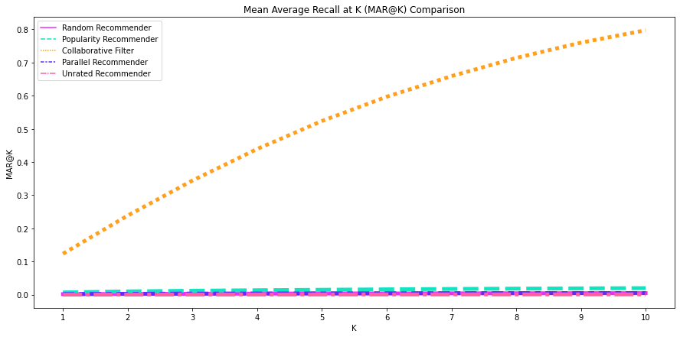
Plot of Mean Average Recall at K (MAR@K)

Slide 28
Is the Collaborative Filtering Recommender the best?
We can see that the line slope of collaborative filtering recommender is much larger than those of other recommenders. Does this mean the collaborative filtering recommender is much better than all the others?
Maybe this is not true. Let’s first look at the definition of recall at K. R@K shows that among all high rated items, how many are included in the K recommended items.
In the collaborative filtering recommender, items with high predicted ratings were recommended to users. Since our predicting model is proved to be quite effective (RMSE=0.43), it is believed that items with high predicted ratings are quite likely with real high ratings. That’s why it gives high MAR@K.
But why should we recommend items to users which they already gave high rating ? ?

Slide 29
My Favorite Recommender: the Unrated
My favorite recommender is the unrated recommender. This recommender predicts users’ rating on items they have not rated, and recommend items with highest predicted ratings to users.
Since our predicting model (SVD++) has been proved to be quite effective (RMSE=0.43), we have confidence to see that items with high predicted ratings are very likely those loved by the user.
So in my understanding the unrated recommender is what a successful recommender should be.

Slide 30
Conclusions
1. The SVD++ is the best model in predicting users’ ratings in this study.
2. It is doubtful that the MAR@K is an effective metrics to evaluate the performance of a recommender system;
3. The unrated recommender is believed to be the best recommender in all;
4. List of remaining recommenders from my most favorite to least favorite: parallel recommender, popularity recommender, collaborative filtering recommender, and random recommender.

Slide 31



