Slide 1
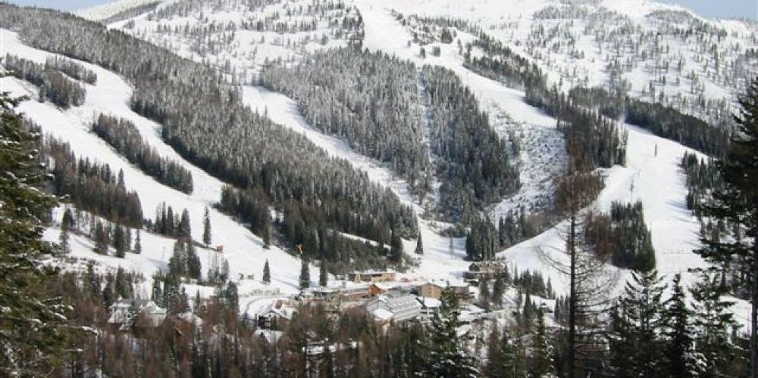
Big Mountain Ticket Pricing Project

Slide 2
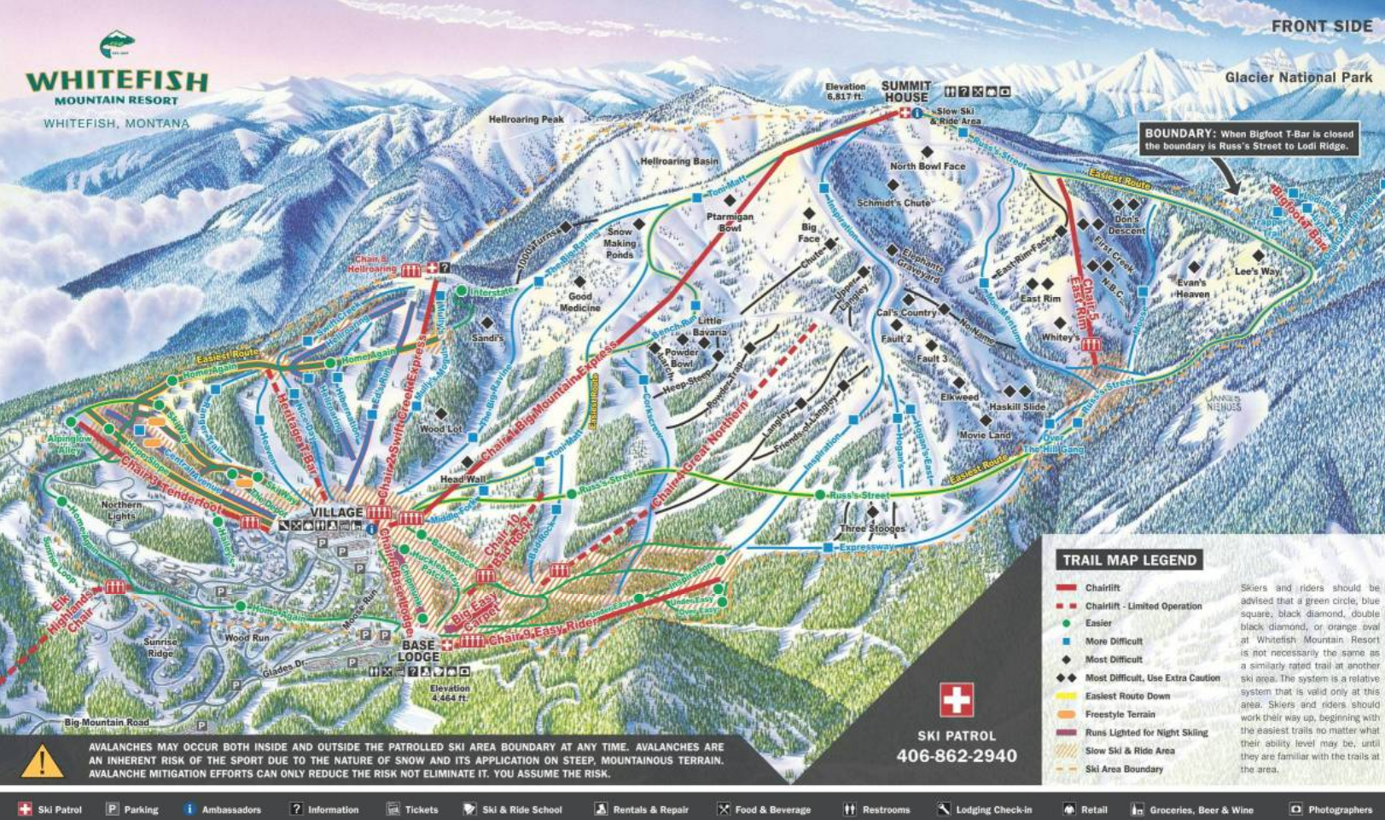
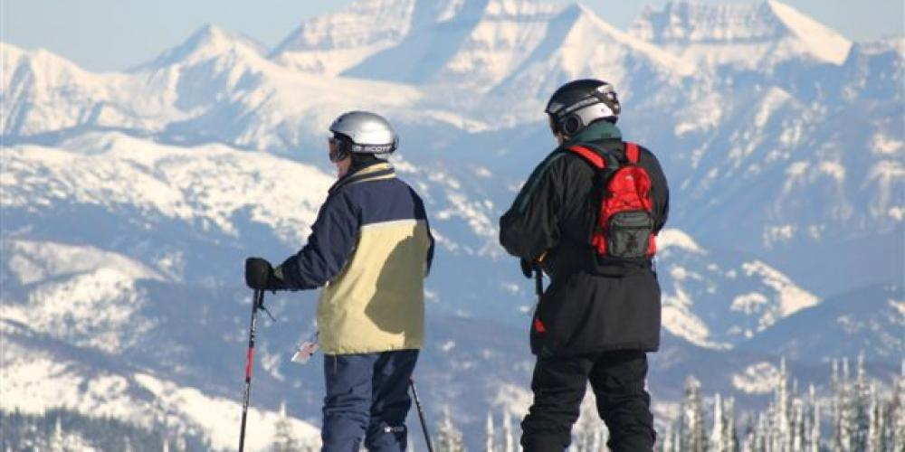
Content:
Problem Identification
Recommendation and Key Findings
Modeling Result and Analysis
Summary and Conclusion

Slide 3
1. Problem Identification
A new chair lift was installed, which increases the operating cost by $1.54 million each season;
This cost increase brings pressure to keep good revenue.
To keep a good profit, we are wondering if we should increase the ticket price, or reduce the cost by closing a few facilities which are not used frequently.
This project is one effort to give a primary answers to the questions above.

Slide 4
2. Recommendation and Key Findings
We have collected data from 319 other ski resorts all around the country, and we built one model to analyze the relations between ticket price and all other features (such as facility type and amount, skiing area, etc) in those resorts.
Based on the analysis , it shows that the reasonable price is $96, comparing to the current price of $81.
For options of closing facilities to reduce cost, the model shows that the price should drop $0 if we only close one run, $0.67 for closing 3~5 runs, and $1.26 for closing 6~8 runs.

Slide 5
2. Recommendation and Key Findings (cont)
Scenario | Action | Impact to price | Impact to revenue
1 | Increase vertical drop by 150 feet | $1.99 | $3.47 million
2 | Scenario 1 plus adding 2 acres of snow making area | $0 | $0
3 | Increase longest run by 0.2 mile and add 4 acres of snow making area | $0 | $0

Slide 6
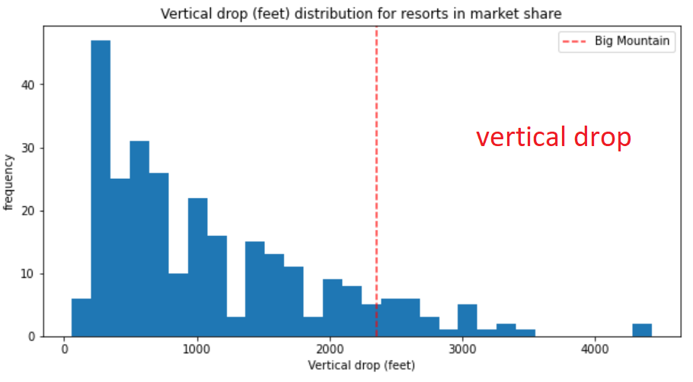
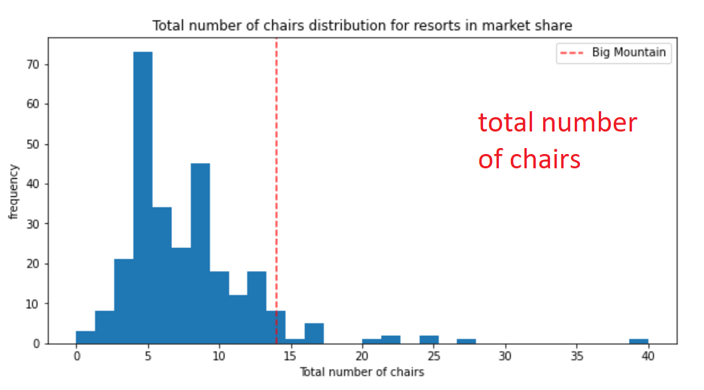
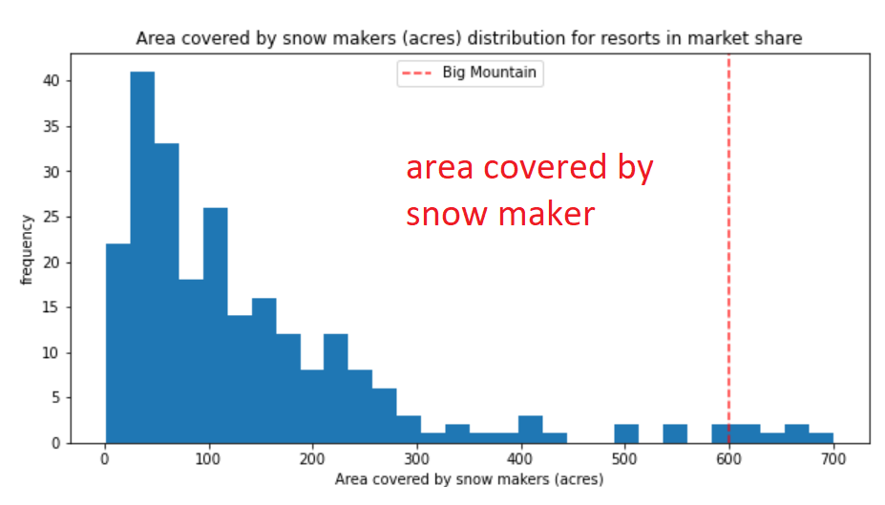
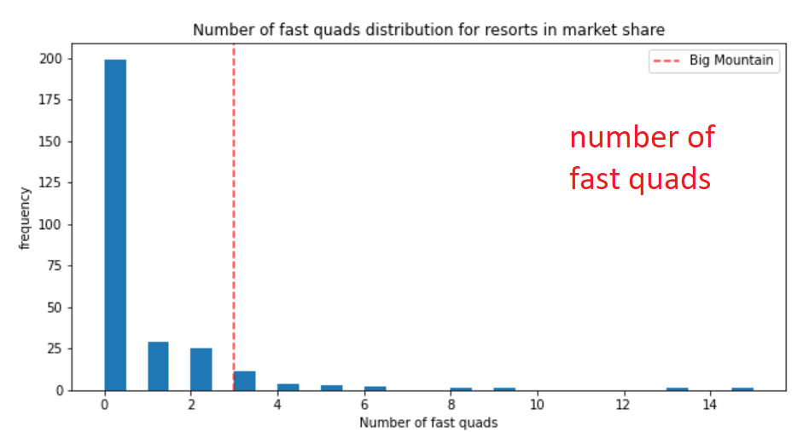
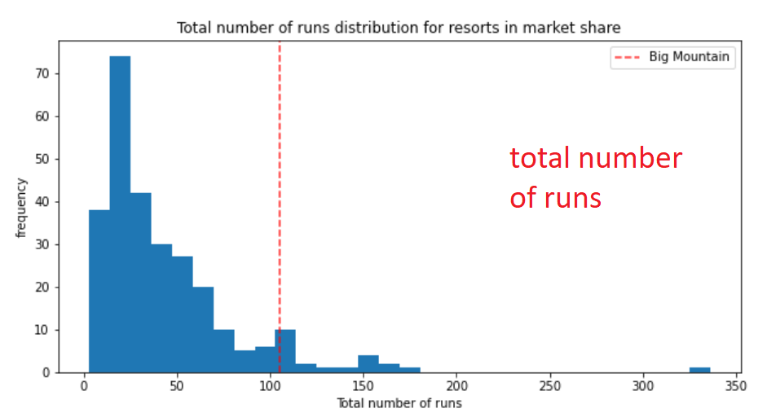
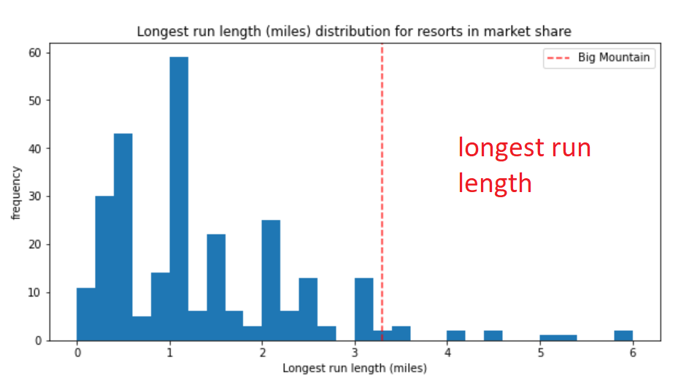
3. Modeling Result and Analysis
Model shows that the first few features dominating the price are:
vertical drops;
snow making area;
total chairs amount;
fast quads amount;
number of runs;
length of longest run.
Distributions of all those features among all resorts are shown in the right plots. Red dotted line shows the position of our Big Mountain resort.
Those plot shows that of all those features, Big Mountain is far beyond the majority, which gives us confidence to increase the ticket price.

Slide 7
4. Summary and Conclusion
Daily ticket price should increase to $96;
If a few runs should be closed, the best number to close is 1, 5, and 8;
Among all scenarios, increasing vertical drop by 150 feet with no adding snow making area will best benefit the revenue with no extra cost added.

