Slide 1
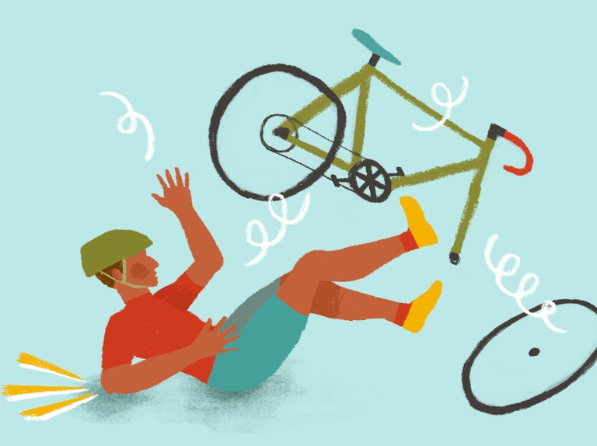
Bicycle Accidents in Great Britain
(1979 to 2018)

Slide 2
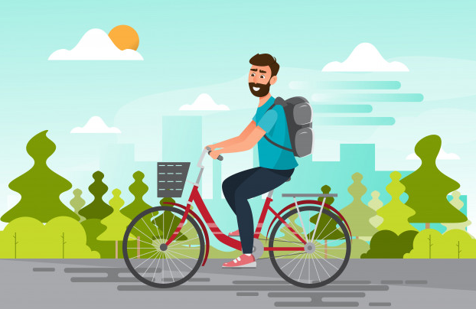
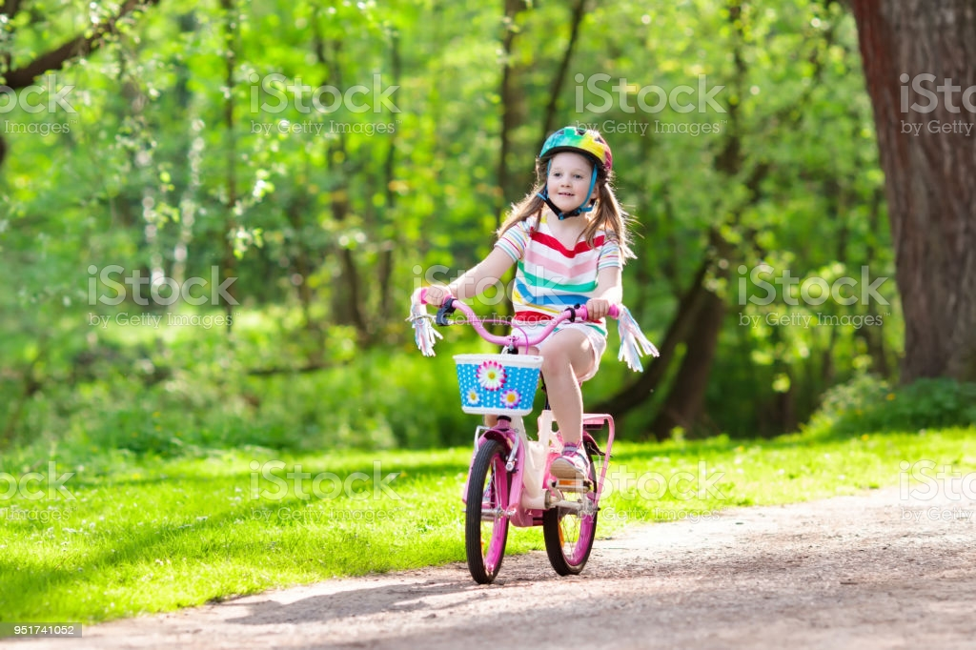
Riding bicycle is fun……
Riding a bicycle is a popular sports everywhere all over the world. Outdoor riders can both do physical exercise and enjoy the views around them. It is a pleasant experience.

Slide 3
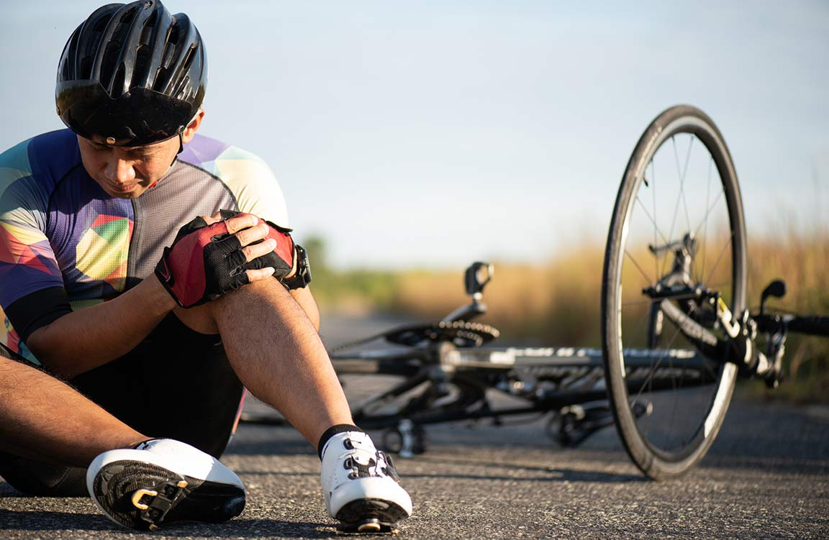
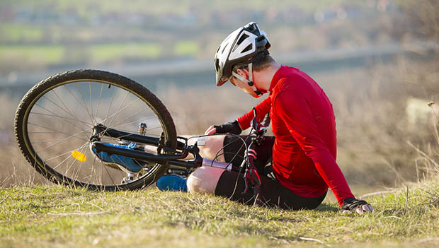
…… and dangerous
But bicycle riding can also be dangerous.
“In 2015, there were 45,000 reported bicycle accidents in the United States.”*
“A total of 843 bicyclists were killed in crashes with motor vehicles in 2019.”**
* https://www.peoplepoweredmovement.org
** https://www.iihs.org/topics/fatality-statistics/detail/

Slide 4

Let’s see what data told us about bicycle accidents in the UK
The data set is from Kaggle. (https://www.kaggle.com/johnharshith/
bicycle-accidents-in-great-britain-1979-to-2018)

Slide 5
Data size: 827,861 rows, 15 columns.
All columns can be allocated to 4 groups, according to how they describe the accidents.
When it happens? | Under what conditions it happens? | To whom it happens | How bad it happens?
Year | Road condition | Gender | Severity
Month | Weather condition | Age group
Day | Road type
Time | Light condition

Slide 6

First let’s see the time related features:
When it happens ?
Year
Month
Day
Hour

Slide 7
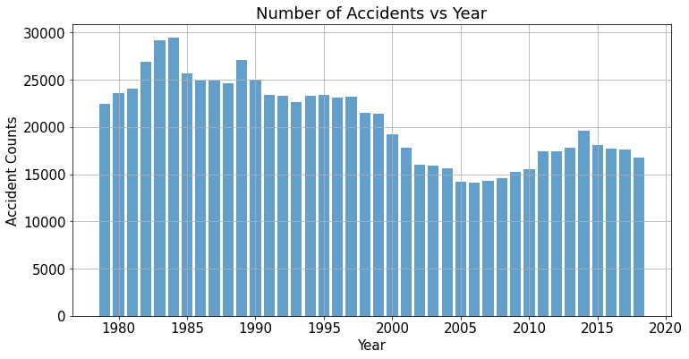
When it happens – which Year?
Overall trend is decreasing. But we do see an obvious increase between 2005 ~ 2014.

Slide 8
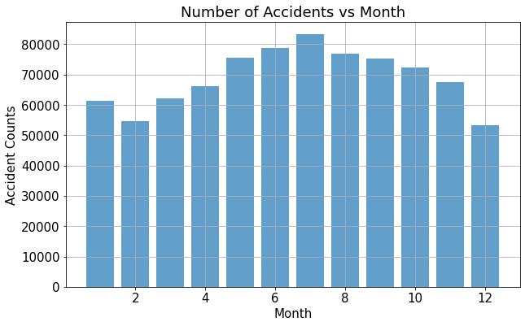
When it happens – which Month?
There are more accidents in summer months than in winter months, which might indicate that people are more likely riding bicycles in good weather in summer.

Slide 9
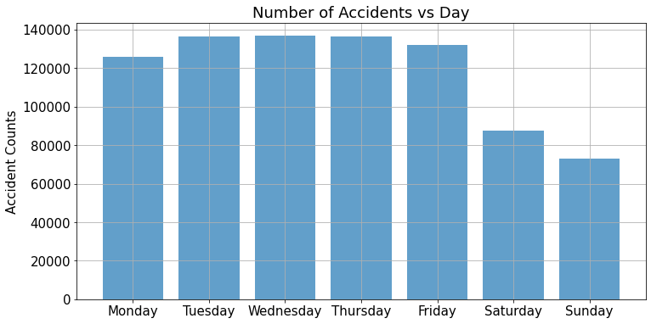
When it happens – which Day?
Trends seems very obvious: We see more accidents happened on week days than weekend. Maybe that is because many people ride a bicycle to their office, or they are more in a hurry on the way to office.

Slide 10
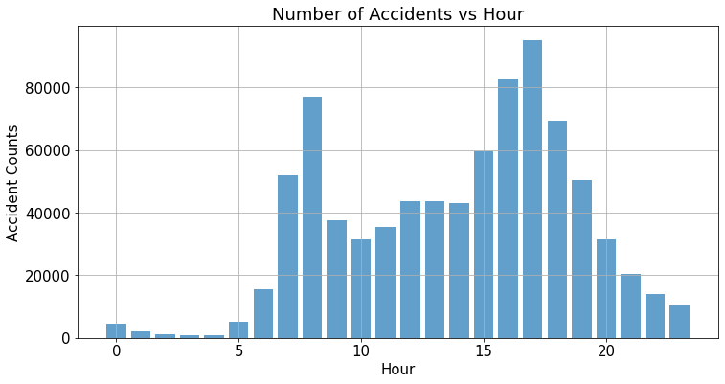
When it happens – which Hour?
We see more accidents happened during morning and afternoon rush hours, and more accidents on afternoon rush hour than morning.
(remember there are more accidents on week days than on weekend.)

Slide 11
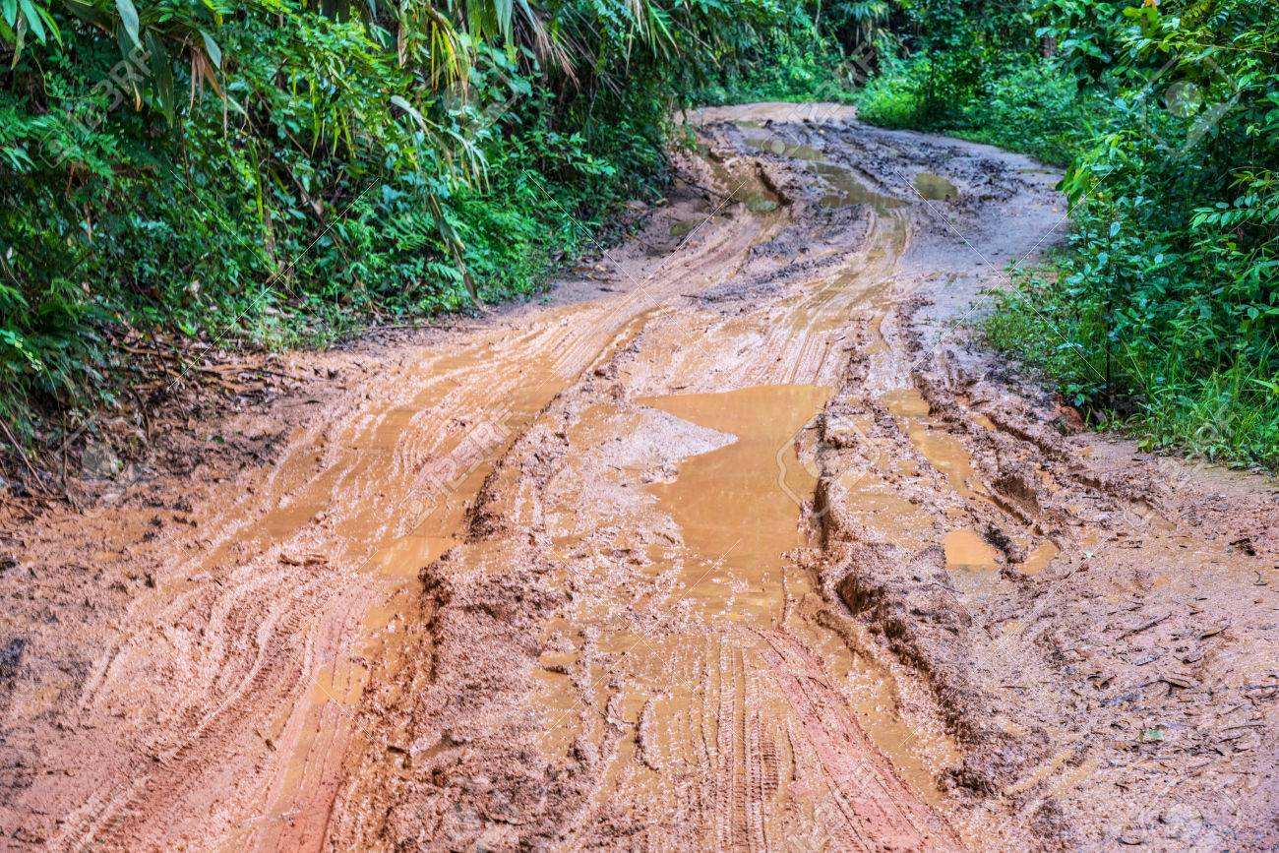

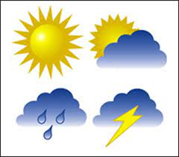
Then, let’s see under what conditions it happens?
Then, let’s see under what conditions it happens?
Road condition
Road type
Weather condition
Light condition

Slide 12
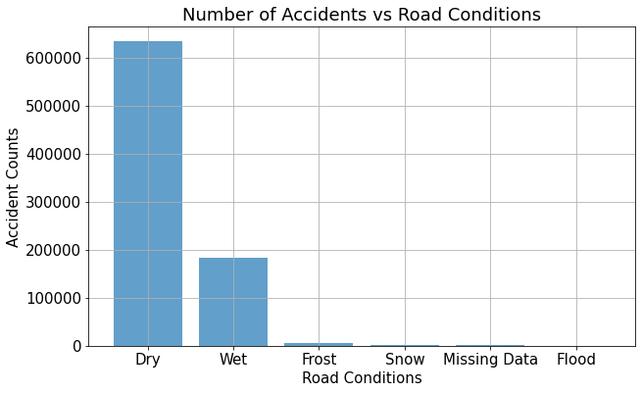
What condition it happens – Road conditions
This plot is very interesting. We see more accidents happened on dry roads more than wet roads or frost/snow roads. That indicate that the road condition does not play a big rule in bicycle accidents. It is more likely the rider’s cautiousness.

Slide 13
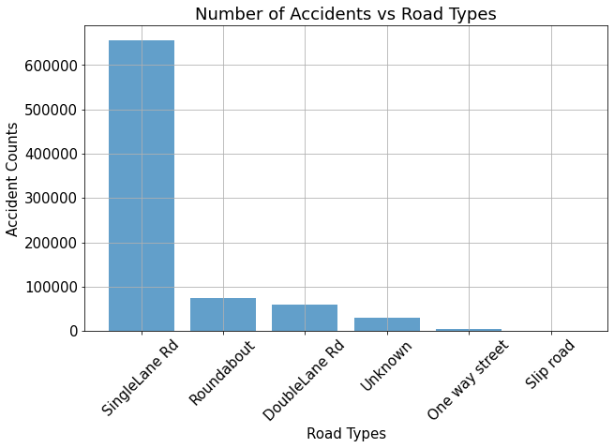
What condition it happens – Road Types
There are more accidents on single lane roads than other types of road. That makes sense. Actually we believe most bicycle lanes are single.

Slide 14
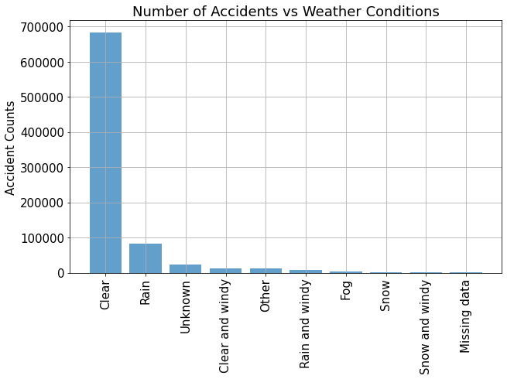
What condition it happens – Weather conditions
There are much more accidents on good weather (clear) than on bad weathers, which indicates that the weather is not an important factor in resulting bicycle accidents.

Slide 15
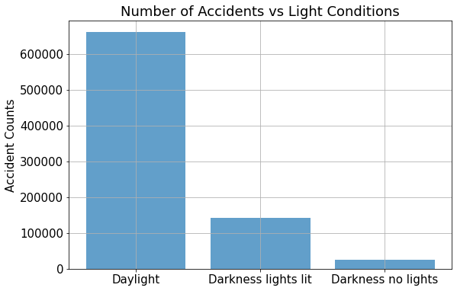
What condition it happens – Light conditions
Again, accidents happen under very good light conditions. Light is not the main reason which causes the accidents.

Slide 16

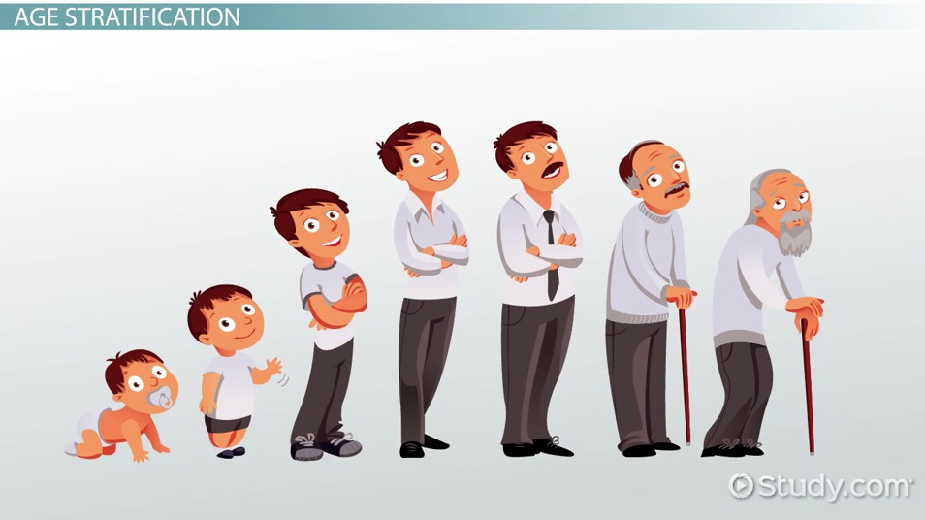
Now, let’s see to whom it happens?
Gender
Age

Slide 17
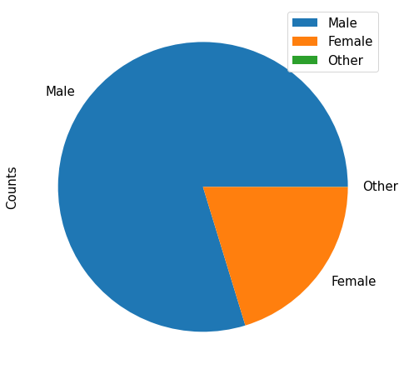
To Whom it happens - Gender
No surprisingly, more accidents happen on male riders than female riders. Basically male riders are more bold and more likely take risks.

Slide 18
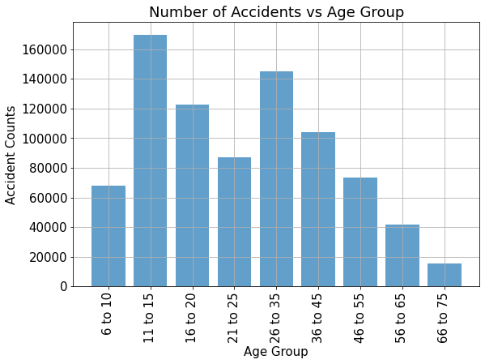
What condition it happens – Ages
There are two peaks in this plot. First one is in the age group 11 – 15, which are quite bold teenagers who want to try everything. Not quite sure why there is another peak at group 26 -35.

Slide 19

Finally, let’s see how bad an accident can happen?
Injury Severity

Slide 20
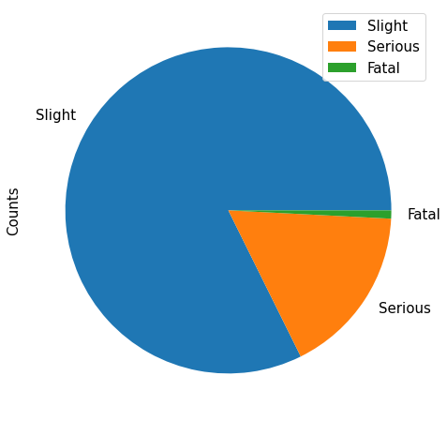
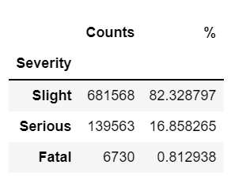
How bad it happens – Severity
Luckily most injuries are slight. But there are about 17% injuries are serious and less than 1% are fatal.

Slide 21
What is our conclusion from the data analysis?
More accidents happen in summer;
It is dangerous to ride a bicycle to and from your office.
Road conditions and weathers are not likely the main reasons for bicycle accidents. Rider’s cautiousness is a more important factor than any other factors.
Male riders are more likely taking risks and having accidents.

