Slide 1
Package ‘plsropt’
2015.11
Y. Uwadaira

Slide 2
Content
Flowchart
How to install
How to use
Preparing data set
Import data
PLS regression
PLS regression with test set
Result

Slide 3
Flowchart
Raw data
makex
X-variables data
PLSR
Y-variable data
Region selected X-variables data
snv
matsgolay
- sgolayfilt¹
autoscaling
plsrauto
Preprocessed X-variables data
4 plots
Cross-validation plot
Regression coef. & VIP plot
Loading plot
Actual vs. Predicted plot
plsrPlot
- plsr²
- VIP²
- ncompopt
- rowpeak
Outlier plot (Bland-Altman)
¹ stats package, ² pls package (function ‘VIP’ is an add-on)

Slide 4
How to install
> install.packages("devtools")
> library(devtools)
> install_github(“uwadaira/plsropt", dependencies = TRUE)

Slide 5
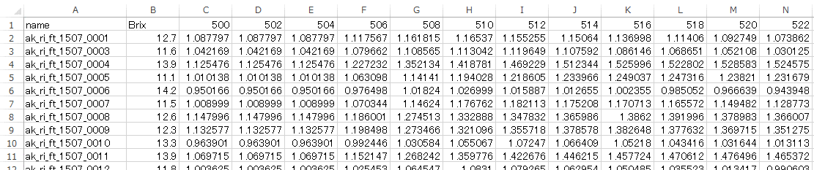
How to use – 01. preparing data set
Data file (CSV format)
m-n matrix
Variables: sample name (1st row), objective variable(s), explanatory variables (ex. NIR spectra)
Sample
name
Objective variable
Explanatory
variables

Slide 6
How to use – 02. import data
# import a CSV file
> dat <- read.csv(file = "filename.csv", row.names = 1, check.names = F)
# make X-variable data
> x <- makex(dat, start = 500, end = 1000)
# set X-variable ranges as a list variable
> xrange <- list( c(600, 950), c(600, 750), c(750, 950) )

Slide 7
How to use – 03. PLSR
# if you use all samples as training set (calibration and cross-validation)
> result.all <- plsrauto( x=x, y=dat$Brix, xrange=xrange, output = TRUE,
validation = "CV", segment.type ="interleaved“)
# validation, segment.type and segments are the arguments of function plsr in ‘pls’ package. interleaved means “Venetian blinds”.

Slide 8
How to use – 04. PLSR with prediction
# if you perform prediction with test set
> result.all <- plsrauto( x=x.train, y=dat.train$Brix,
x.test=x.test, y.test=dat.test$Brix,
xrange=xrange, output = TRUE,
validation = "CV", segment.type ="interleaved")

Slide 9
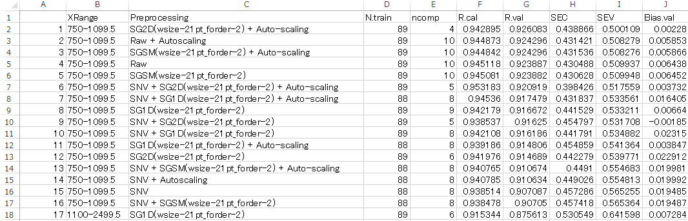
Result – result.csv
PLSR results are output as a CSV file in “PLSR_auto” directory.
Sorted by “R.val” (correlation coefficient for validation set) or “R.test”

Slide 10
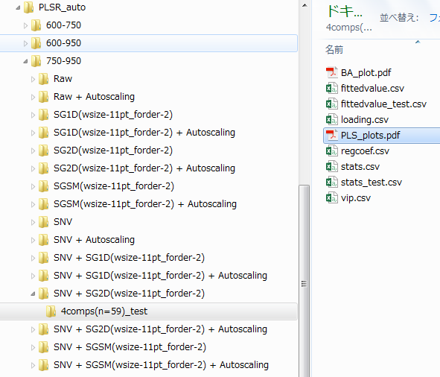
Result – output for each model
CSV and PDF files of regression result are created in a directory.

Slide 11
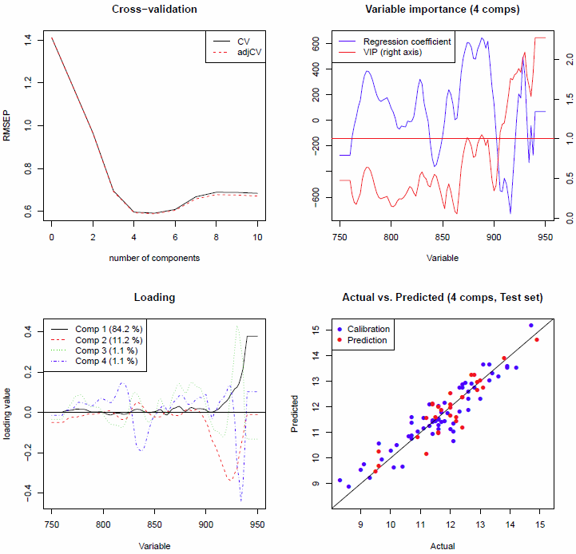
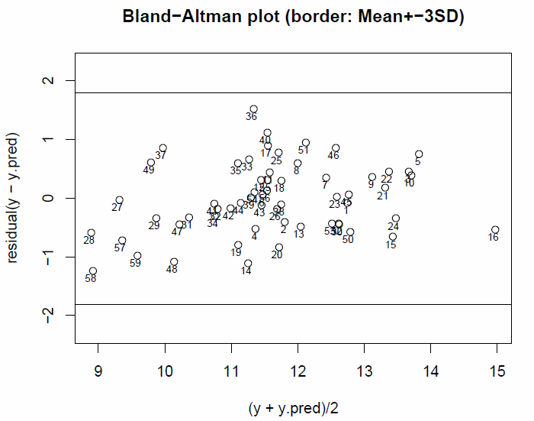
Result – PLS_plots, BA_plots

Slide 12
Result – stats_test.csv

