Slide 1

Peak Prediction Hedging for Saving More
Team Name: Hedging-Saving
Team members: Cheng-Wei Lin (Chemical Engineering)
Ling Zhang (Electrical & Computer Engineering)
Lester Jiang (Materials Science & Engineering)
Project Mentor: Shane Daly (Enel North America - USA)

Slide 2
Outline
Background
Spread Battery Capacity over Different Number of Hours
Results

Slide 3
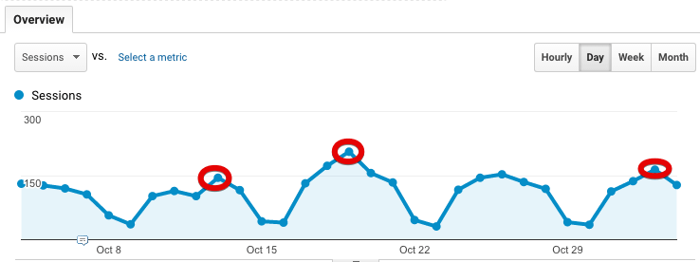
Background
Expensive!

Slide 4


Background
How to save more on electricity bills?
Enel X: System Peak Program
Forecast the most likely peak hour.
Discharge battery during predicted peak hour.

Slide 5
Background
Error in forecasting
Forecasted peak hour is 17:00:00-18:00:00
Discharge battery from 17:00:00 to 19:00:00 (2-hour capacity)
True peak hour is 20:00:00-21:00:00
Have to consume expensive grid-power
Study a different discharging strategy to minimize the risk of wrong forecasts!

Slide 6
Spread Capacity over Different Number of Hours
Discharge in proportional to probabilities
Forecasted probabilities of being the peak on some day:
0.4, 0.2, 0.4
Discharge the battery
40%, 20%, 40%
of the capacity
top_n_probs: number of forecasted probabilities to consider

Slide 7
Spread Capacity over Different Number of Hours
Algorithm Outline
Step 1
Specify parameters top_n_peaks (number of peaks to consider in a season) and top_n_probs, i.e, top_n_peaks =n, top_n_probs=k
Filter out the 365 peak hours in a season and keep the n highest peak hours
For each selected peak hour, look at the k largest forecasted probabilities on that day

Slide 8
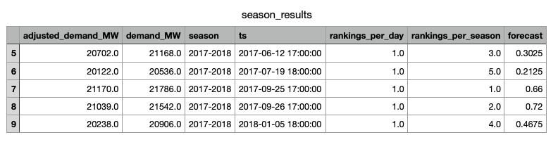
Spread Capacity over Different Number of Hours
Algorithm Outline
Step 1
Highest demand of the day
Actual demand
Forecasted probability
Notations:
Season: from Apr. 30th to next year’s Apr. 30th
4-th Highest demand of the season

Slide 9
Spread Capacity over Different Number of Hours
Algorithm Outline
Step 2
Adjust the selected k probabilities to sum up to one
The selected 3 probabilities are
0.2, 0.1, 0.4
Then the adjusted probabilities are
0.2/(.2+0.1+0.4), 0.1/(.2+0.1+0.4), 0.4/(.2+0.1+0.4)

Slide 10
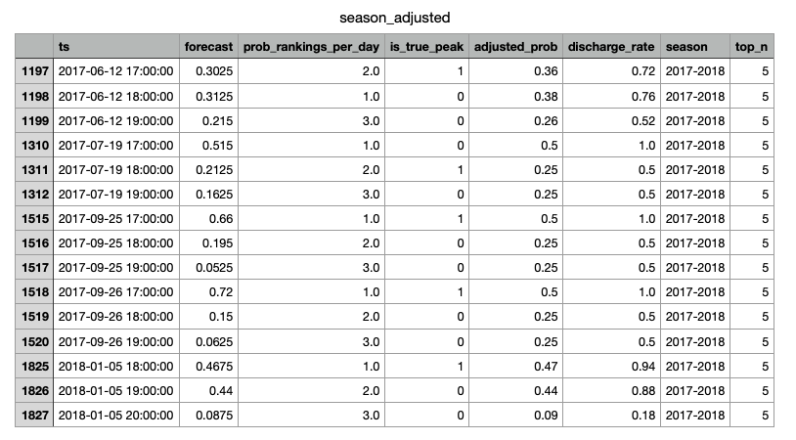
Spread Capacity over Different Number of Hours
Algorithm Outline
Step 2

Slide 11
Spread Capacity over Different Number of Hours
Algorithm Outline
Step 3
Calculate the relative discharged energy
Battery capacity is 2-hours long; maximum discharge per hour is 0.5 unit.
If the adjusted probabilities are
0.6, 0.1, 0.3
then discharge 50%, 25%, 25% of the capacity.
Relative discharge are 0.5/0.5=100%, 0.25/0.5=50%, 0.25/0.5=50%
Fully used!

Slide 12
Spread Capacity over Different Number of Hours
Algorithm Outline
Step 4
Metric
total energy successfully discharged / top_n_peaks
More closer to 100%, better performance
Evaluate our discharging strategy for top 1, top 5, top 10 and top 20 peaks in a season
By varying the value of top_n_probs, study the changes in performance

Slide 13
Spread Capacity over Different Number of Hours
Algorithm Outline
Step 4
Metric
Hit rate x/y
Successfully discharge x out of y peaks
17 x/y(p%)
Successfully discharge x out of y peaks which appear at 17 and the averaged discharge is p%

Slide 14
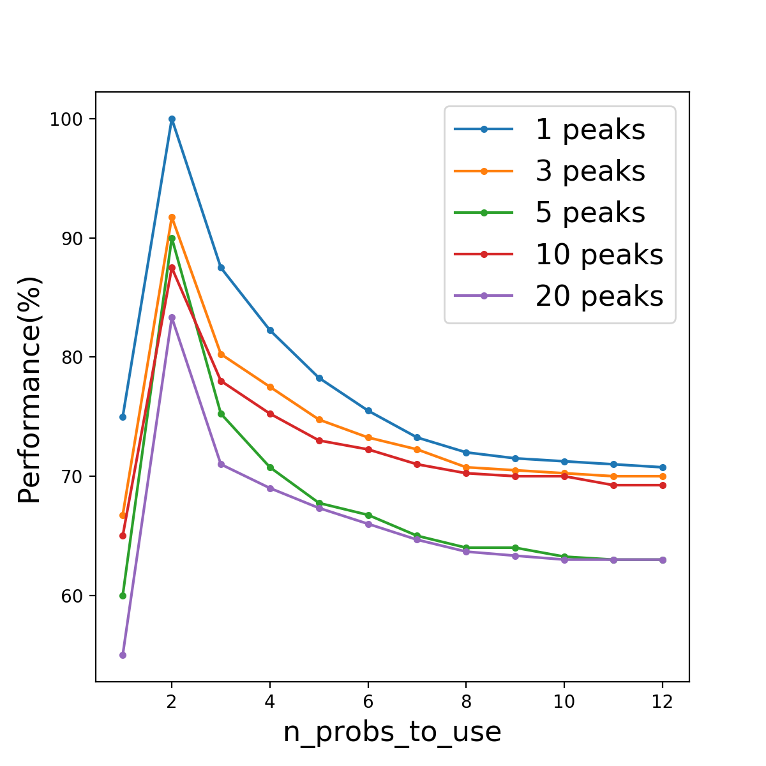
Results
Baseline: n_probs_to_use = 1
n_probs_to_use=2: best performance for all top_n_peaks
n_probs_to_use>2: except for top 1 peak, always better than baseline
Spread capacity over more hours, relative discharge decrease in each hour
Baseline!

Slide 15
Thank you!

