Slide 1


机器学习第10讲
感知机与人工神经网络

Slide 2
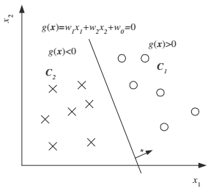
主要内容
线性判别式
单层感知机
多层感知机
神经网络
深度学习

Slide 3
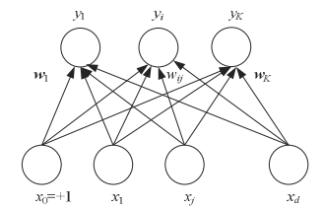
感知机与人工神经网络
我们的问题
  什么是感知机？
  什么是人工神经网络？
  什么是深度学习？

Slide 4
Perceptron
Linear Discrimination （线性判别式）（ 1）
  一种非参数机器学习方法
    对比参数方法
      参数估计是定义在整个空间上的模型
      所有训练数据参与估算
      所有的检验输入都用相同的模型和参数

Slide 5
Perceptron
Linear Discrimination （ 2）
  一种非参数机器学习方法
    对比参数方法
      非参数估计采用局部模型
      输入空间被划分为一系列可以用距离度量的局部空间
      每个输入只使用邻近区域由训练样本计算得到的局部模型

Slide 6


Perceptron
Linear Discrimination （3）
  This is a discriminant based approach that estimates the parameters of the Linear Discriminant directly from a given labeled sample
  Discriminant functions

Slide 7

Perceptron
Linear Discrimination （4）
  likelihood-based classification
    introduced previously
    6
    6

Slide 8
Perceptron
Linear Discrimination （5）
  New Method
    Discriminant-based classification
      Assume a model directly for the Discriminant
      Bypass the estimation of likelihoods or posteriors
      make an assumption on the form of the discriminant between the classes

Slide 9

Perceptron
Define a model for the Discriminant
  G_{i}
    explicitly parameterized with the set of parameters Φ_{i}
    make an assumption on the form of the boundaries separating classes
    Learning is the optimization of Φ_{i}
    Maximize the quality of the separation

Slide 10
Perceptron
Discriminant-based approach
  The estimation of the boundaries between the class regions
  “ estimating the class densities is a harder problem than estimating the class discriminants ”

Slide 11

Perceptron
Linear discriminant functions (1)
  6
  6
    The linear discriminant is used frequently
    both the space and time complexities are O(d)
    The magnitude of the weight w_{j} shows the importance of x_{j}

Slide 12
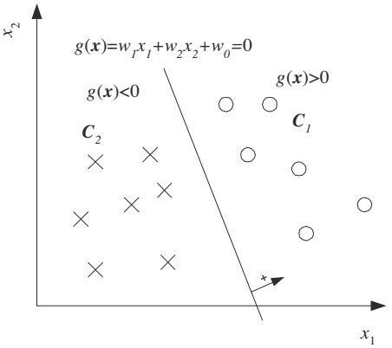
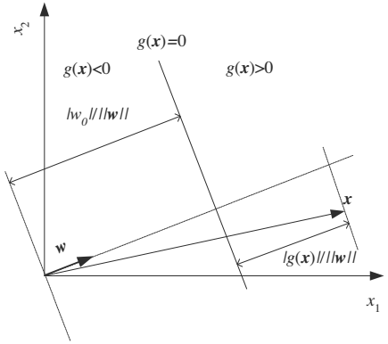
Perceptron
Linear discriminant functions (2)
    Two Classes

Slide 13
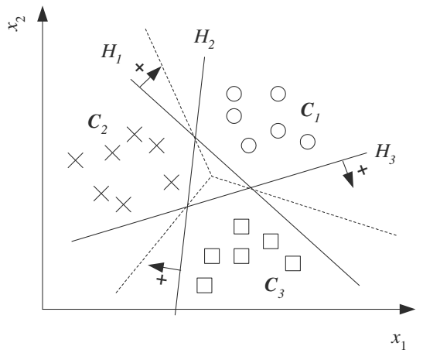
Perceptron
Linear discriminant functions (3)
    Multiple Classes

Slide 14

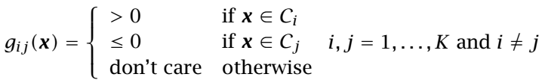
Perceptron
Linear discriminant functions (4)
    Pairwise Separation
      If the classes are not linearly separable, one approach is to divide it into pairwise separation a set of linear problems. One possibility is pairwise separation of classes
      It uses K(K - 1)/2 linear discriminants, g_{ij}(x), one for every pair of distinct classes
      The parameters wij, j _x0007_= i are computed during training so as to have:

Slide 15
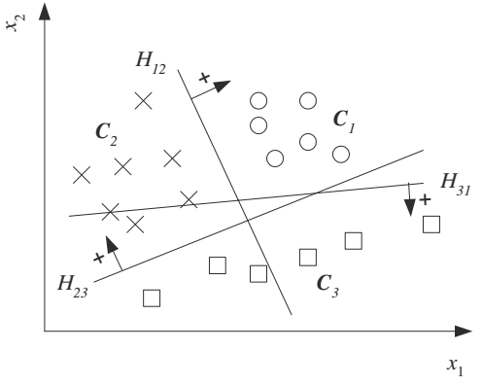
Perceptron
Linear discriminant functions (5)
    Pairwise Separation
      Even if the classes are not linearly separable, if the classes are pairwise
      linearly separable
      Pairwise separation can be used, leading to nonlinear separation of classes
      Decision trees that use this idea

Slide 16

Perceptron
Our strategy in Linear Discriminant functions
  finding a linear discriminant function as a search
    Search the parameter values
    Minimize an error function

Slide 17


Perceptron
Our strategy in Linear Discriminant functions
  Gradient Descent methods 梯度下降方法
    optimizing a criterion function 准则（判别）函数
where η is called the stepsize, or learning factor, and determines how
much to move in that direction

Slide 18

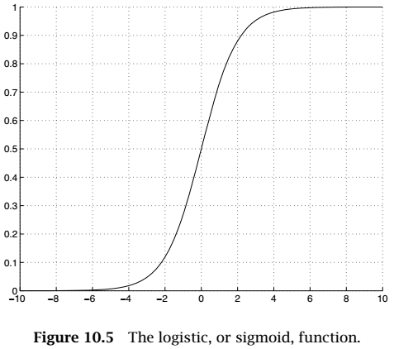
Perceptron
Sigmoid Discrimination (1)
  Two Classes
  6

Slide 19
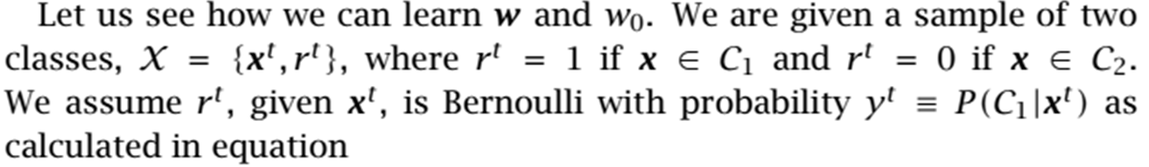


Perceptron
Sigmoid Discrimination(2)
  Two Classes
    Minimize an error function
cross-entropy

Slide 20
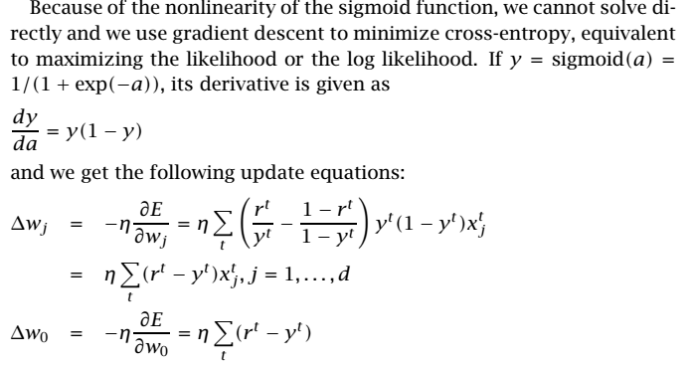
Perceptron
Sigmoid Discrimination(3)
  Two Classes
    Minimize an error function

Slide 21
Perceptron
Sigmoid Discrimination(4)
  Two Classes
    Minimize It is best to initialize w_{j} with random values close to 0
    generally they are drawn uniformly from the interval [-0.01, 0.01]

Slide 22
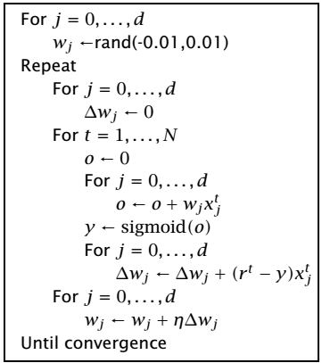
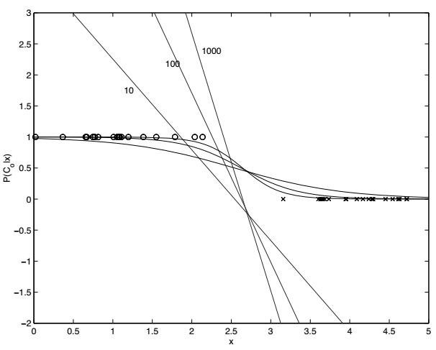
Perceptron
Sigmoid Discrimination(5)
  Two Classes

Slide 23
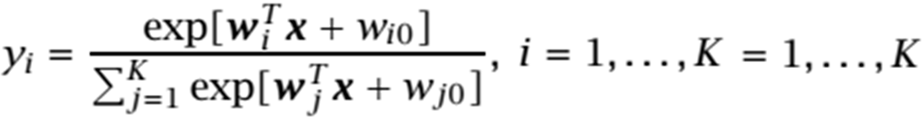
Perceptron
Sigmoid Discrimination(6)
  Multiple Classes
    which is called the softmax function
    +6

Slide 24


Perceptron
Sigmoid Discrimination(7)
  Multiple Classes
    The sample likelihood
    Cross-entropy

Slide 25
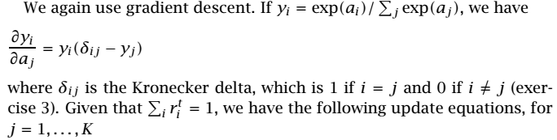
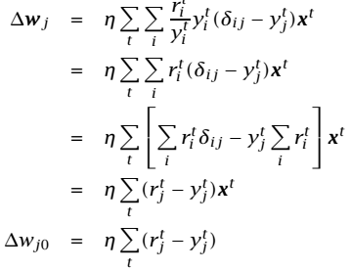
Perceptron
Sigmoid Discrimination(8)
  Multiple Classes
    The sample likelihood

Slide 26
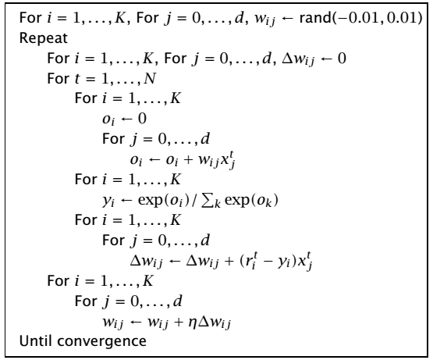
Perceptron
Sigmoid Discrimination(9)
  Multiple Classes
    The sample likelihood

Slide 27
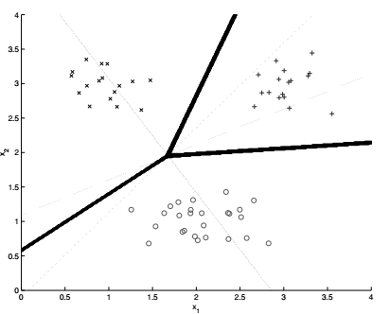
Perceptron
Sigmoid Discrimination(10)
  Multiple Classes
    The sample likelihood

Slide 28
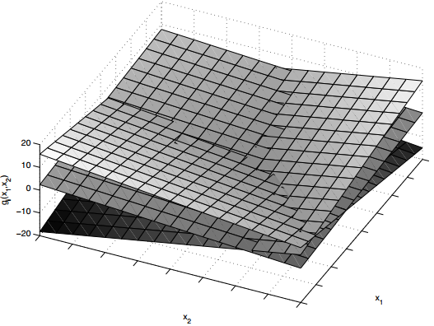
Perceptron
Sigmoid Discrimination(11)
  Multiple Classes
    The sample likelihood

Slide 29
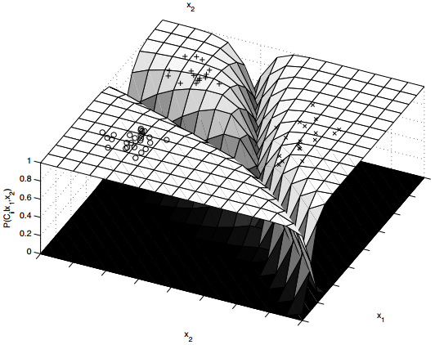
Perceptron
Sigmoid Discrimination(12)
  Multiple Classes
    The sample likelihood

Slide 30
Perceptron
Sigmoid Discrimination(13)
  Summary
    During testing, we calculate all y_{k}, k = 1, . . ., K and choose C_{i} if y_{i} = max_{k} y_{k}.
    Again we do not need to continue training to minimize crosse ntropy as much as possible
    Train only until the correct class has the highest weighted sum, and therefore we can stop training earlier by checking the number of misclassifications

Slide 31
Perceptron
Sigmoid Discrimination(14)
  Summary
    When data are normally distributed, the logistic discriminant has a comparable error rate to the parametric, normal-based linear discriminant
    Logistic discrimination can still be used when the
    class-conditional densities are nonnormal or when they are not unimodal, as long as classes are linearly separable

Slide 32
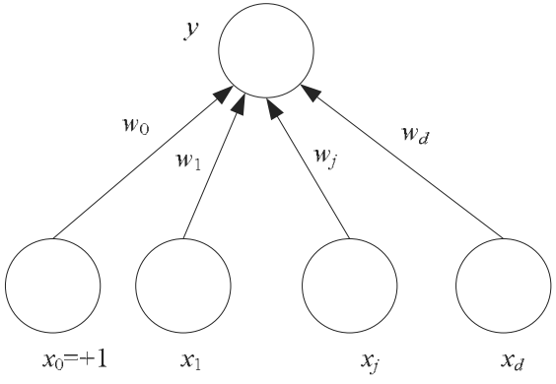

Perceptron
Perceptron (1)
  Its inputs that may come from the environment or may be the outputs of other perceptrons
  Associated with each input, x_{j} ∈ , j = 1, . . . , d, is a connection weight, synaptic weight wj ∈R , and the output, y, in the simplest case is a weighted sum of the inputs

Slide 33

Perceptron
Perceptron (2)
  We can write the output of the perceptron as a dot product:
  The perceptron with one input and one output can be used to implement a linear fit. With more than one input, the line becomes a (hyper)plane, and the perceptron with more than one input can be used
  to implement multivariate linear fit

Slide 34
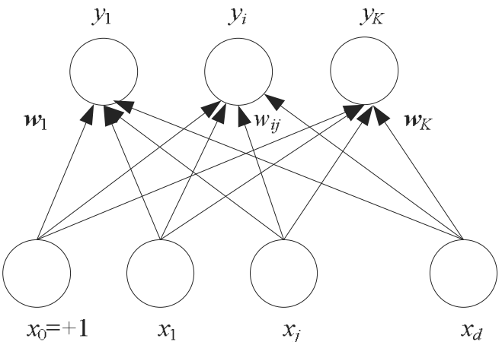
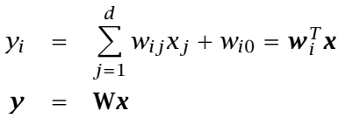
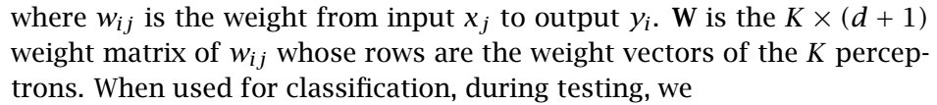

Perceptron
Perceptron (3)
  Multiple Classes
    there are K perceptrons, each of which has a weight vector w_{i}

Slide 35
Perceptron
Multilayer Perceptrons (1)
  A perceptron cannot be used for nonlinear regression
  Multilayer perceptrons (MLP) with intermediate or hidden layers between the input and the output layers
  Implement nonlinear discriminants
  For regression, can approximate nonlinear functions of the input

Slide 36
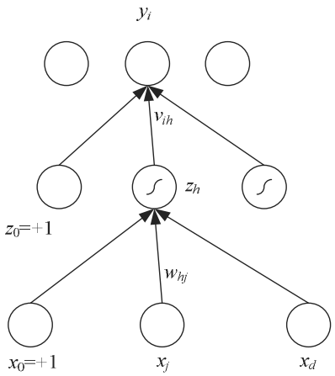

Perceptron
Multilayer Perceptrons (2)
  Each hidden unit is a perceptron by itself and applies the nonlinear sigmoid function to its weighted sum

Slide 37

Perceptron
Multilayer Perceptrons (3)
  The output y_{i} are perceptrons in the second layer taking the hidden units as their inputs
  There is a hidden layer, this is a two-layer network

Slide 38
Perceptron
Multilayer Perceptrons (4)
  In a regression problem, there is no nonlinearity in the output layer in calculating y
  In a two-class discrimination task, there is one sigmoid output unit
  When there are K > 2 classes, there are K outputs with softmax as the output nonlinearity

Slide 39
Perceptron
Multilayer Perceptrons (5)
  Sigmoid is the continuous, differentiable version of thresholding
  We need differentiability because the learning equations we will see are gradient-based
  Another sigmoid (S-shaped) nonlinear basis function that can be used is the hyperbolic tangent function, tanh, which ranges from -1 to +1, instead of 0 to +1
  Another possibility is the Gaussian which uses Euclidean distance instead of the dot product for similarity

Slide 40

Perceptron
Back Propagation (BP) Algorithm (1)
  The output is a nonlinear function of the input
  For the first-layer weights, w_{hj}, we use the chain rule to calculate the gradient:
  It is as if the error propagates from the output y back to the inputs

Slide 41



Perceptron
BP Algorithm (2)
  Nonlinear Regression
    take the case of nonlinear regression (with a single output) calculated as :
    The error function over the whole sample in regression is :
    use the least-squares rule to update the second-layer weights:

Slide 42
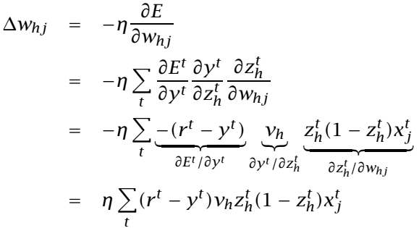
Perceptron
BP Algorithm (3)
  Nonlinear Regression
    The first layer are also perceptrons with the hidden units as the output units but in updating the first-layer weights :

Slide 43
Perceptron
BP Algorithm (4)
  Nonlinear Regression
    The product of the first two terms (r^{t}-y^{t})v_{h} acts like the error term for hidden unit h
    This error is backpropagated from the error to the hidden unit.
    (r^{t}-y^{t})is the error in the output, weighted by the “responsibility” of the hidden unit as given by its weight v_{h}
    In the third term, z_{h}(1 - z_{h}) is the derivative of the sigmoid and x^{t}_{j} is the derivative of the weighted sum with respect to the weight w_{hj}

Slide 44
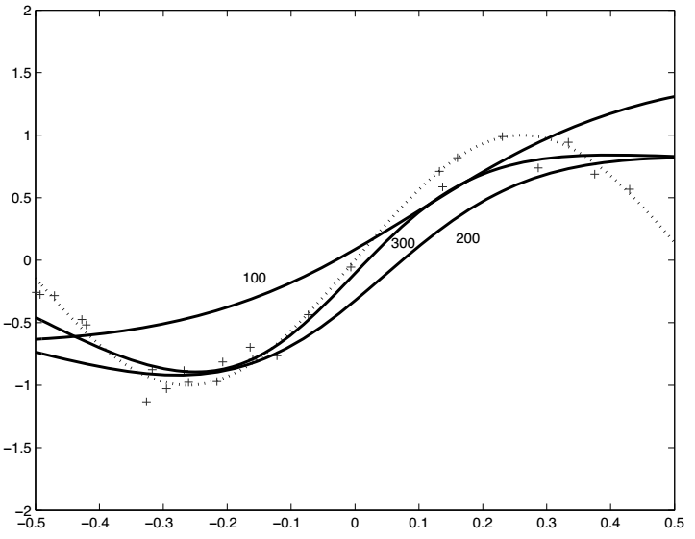
Perceptron
BP Algorithm (5)
  Nonlinear Regression

Slide 45


Perceptron
BP Algorithm (6)
  Two-Class Discrimination
    When there are two classes, one output unit suffices:
    The error function in this case is:

Slide 46
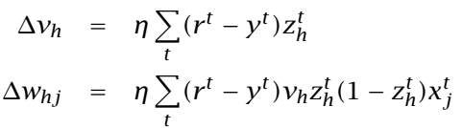
Perceptron
BP Algorithm (7)
  Two-Class Discrimination
    The update equations implementing gradient descent are:
    As in the simple perceptron, the update equations for regression and classification are identical

Slide 47


Perceptron
BP Algorithm (8)
  Multiclass Discrimination
    In a (K > 2)-class classification problem, there are K outputs :
    Use softmax to indicate the dependency between classes

Slide 48

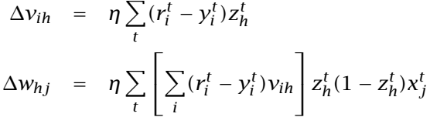
Perceptron
BP Algorithm (9)
  Multiclass Discrimination
    The error function is :
    The update equations using gradient descent:

Slide 49
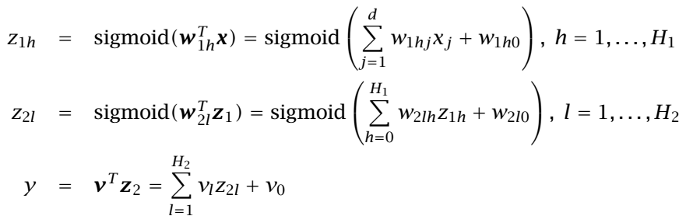
Perceptron
BP Algorithm (11)
  Multiple Hidden Layers
    If we have a multilayer perceptron with two hidden layers, we write
    The update equations using gradient descent:

Slide 50


Perceptron
BP Algorithm (12)
  Training Procedures
    Improving Convergence
      Momentum
      Adaptive Learning Rate
        It is generally taken between 0.0 and 1.0, mostly less than or equal to 0.2
        It can be made adaptive for faster convergence

Slide 51
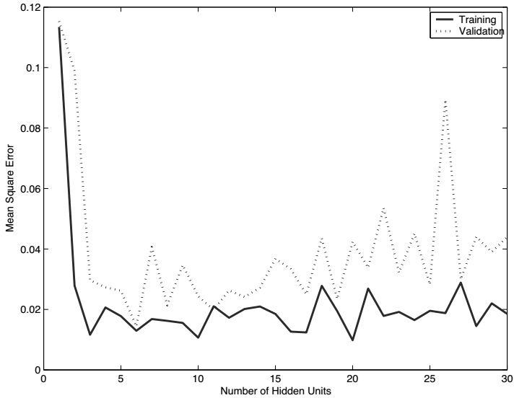
Perceptron
BP Algorithm (13)
  Training Procedures
    Overtraining
Over fitting

Slide 52
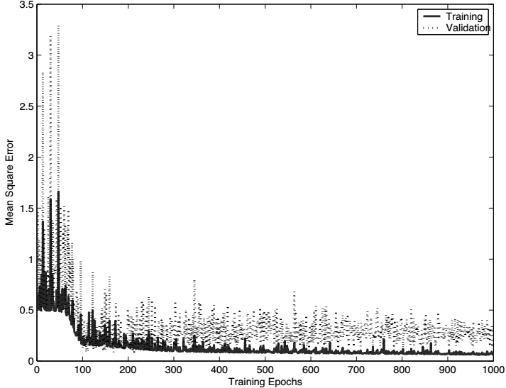
Perceptron
BP Algorithm (14)
  Training Procedures
    Overtraining
Over fitting too

Slide 53
Perceptron
Tuning the Network Size
  Here are two ways adaptation this can be done:
    The destructive approach
      We start with a large network and gradually remove units and/or connections that are not necessary
    The constructive approach
      We start with a small network and gradually add units and/or connections to improve performance.

Slide 54
Perceptron
Deep Learning

