Slide 1
Research directionality study in neutrino detectors in a Nutshell

Slide 2
TPCs
Segmented detector
metal-loaded liquid scintillator
Water-based liquid scintillator detector

Slide 3
the MUNU experiment
The neutrinos are detected via elastic scattering off electrons
The neutrino energy can be reconstructed from the electron energy and direction
The angular resolution(electron)
15 at 200 keV
10at 600 keV.

Slide 4
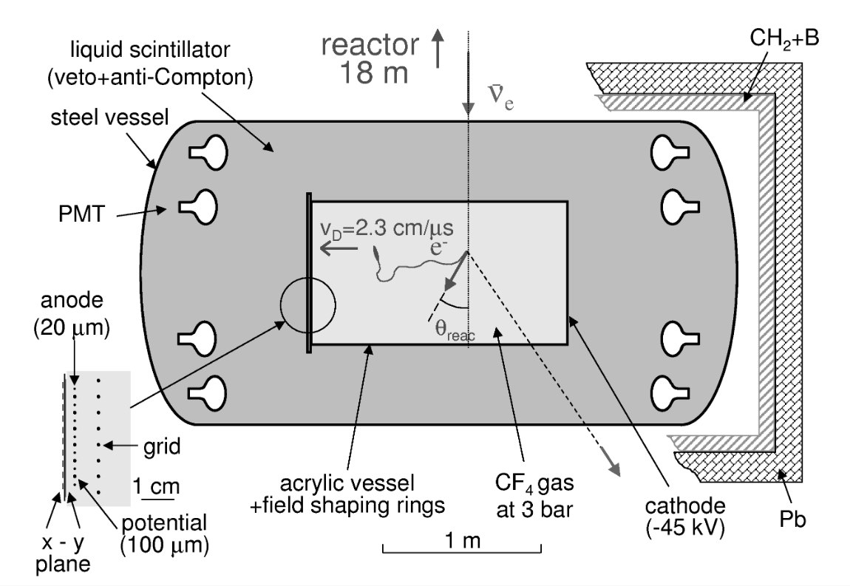
1m3 Time Projection Chamber (TPC) housed in an acrylic vessel (90 cm diameter and 162 cm long) filled with 3.8 kg of pure CF4 gas
organic liquid scintillator (NE-235).
8cm thick borated polyethylene and 15 cm thick lead shielding

Slide 5
metal-loaded liquid scintillator
Precise measurement of annihilation position
shorten the neutron capture range
The typical distance for neutron capture is 3.0 cm, 4.4 cm, and 6.5 cm for10B (1.0wt%), 6Li (0.15wt%) loaded, and KamLAND LS respectively.
n +10 B →7Li∗ + α (BR = 94%, Q = 2.3MeV ) 7Li∗ →7 Li + γ (Eγ = 0.48MeV )
The typical value for the reconstructed distance is 12.8 cm, 4.4 cm, and 15.0 cm for10B, 6Li loaded, and KamLAND LS respectively.

Slide 6
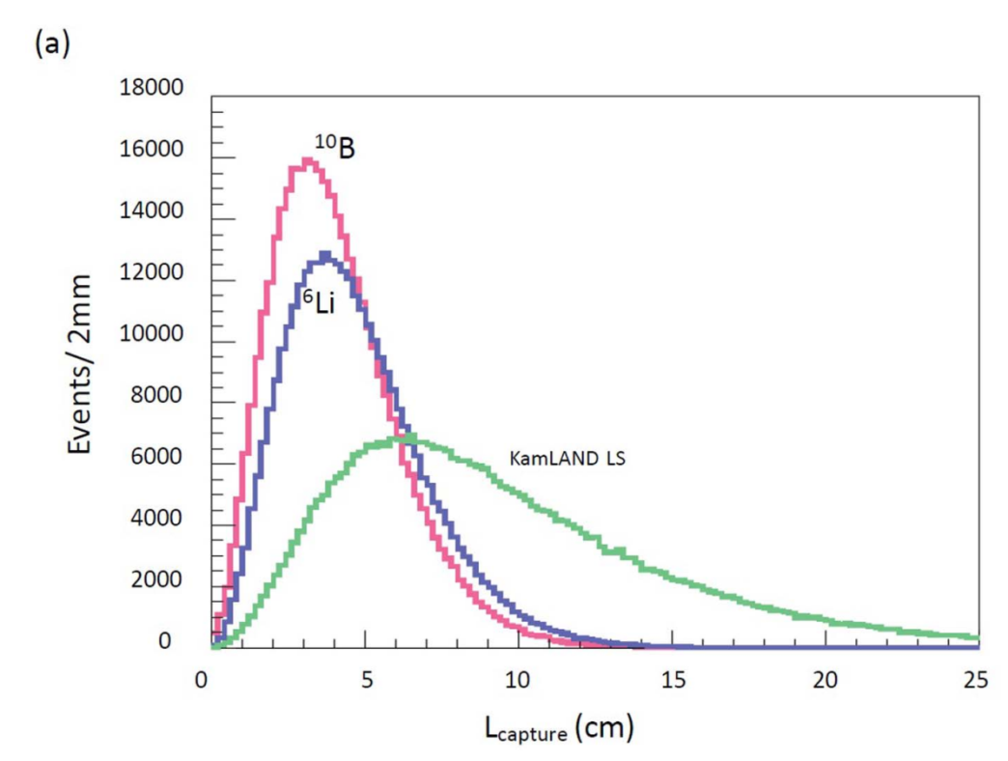
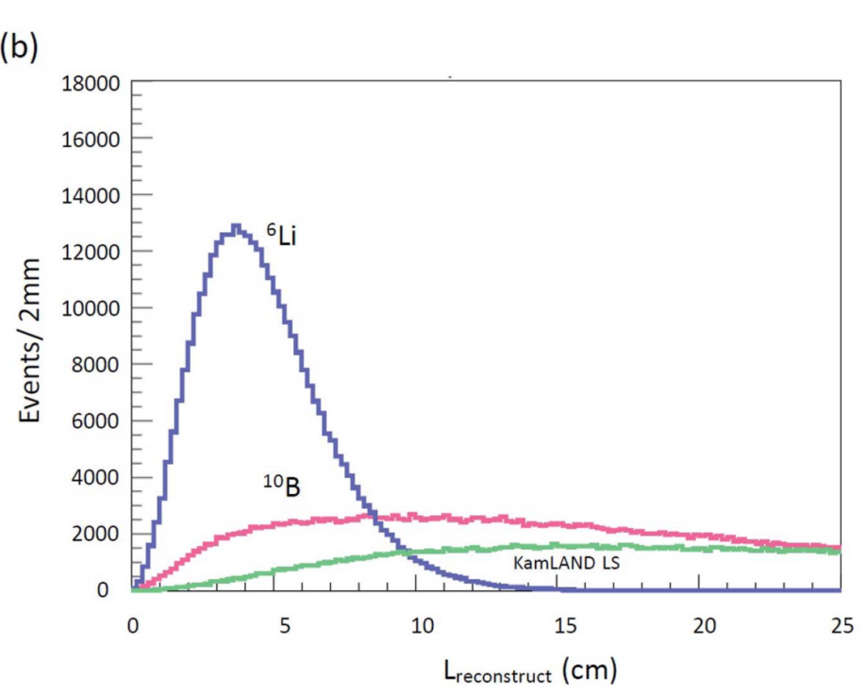

Slide 7
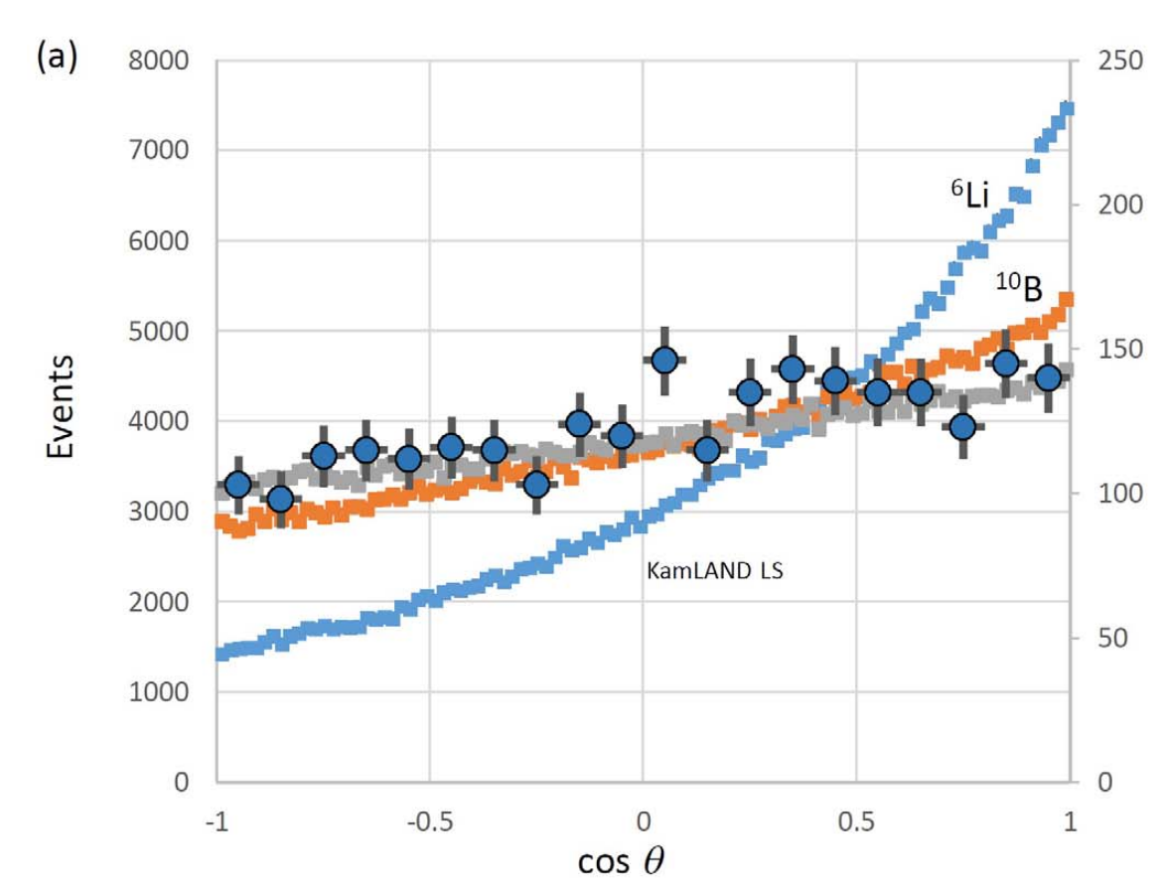
The angular resolutions are calculated for (a), 10B, 6Li loaded, KamLAND liquid scintillator,

Slide 8
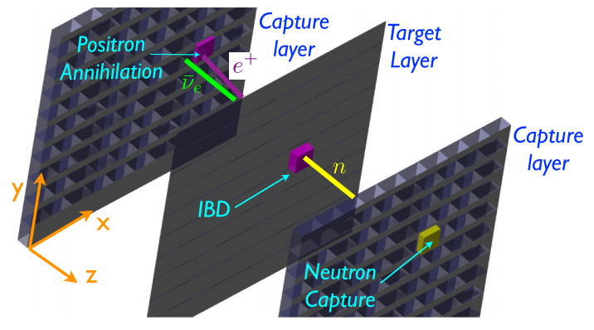
PRL 114, 071802 (2015)

Slide 9
the capture layers loaded with boron. IBD events take place in the thin target layers, positron deposits energy in the target layer and annihilates in adjacent thick capture layer .
The neutron propagates freely to the capture layer and captured on 10B,
The target layer should be thin enough for most neutrons to escape without elastically scattering off hydrogen or carbon;
Most neutrons are captured on 10B within a few centimeters in the boron-loaded plastic scintillator.

Slide 10
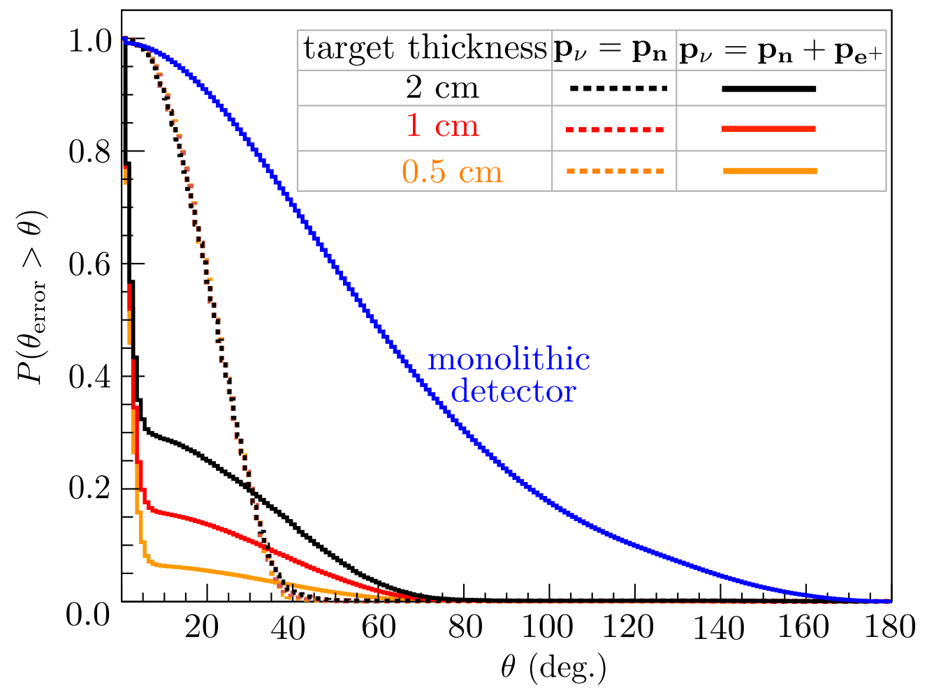
4 MeV antineutrinos
the target layer thickness: 0.5, 1, and 2 cm
The first method only uses the neutron’s reconstructed momentum the second method uses the reconstructed neutron momentum and the positron momentum

Slide 11
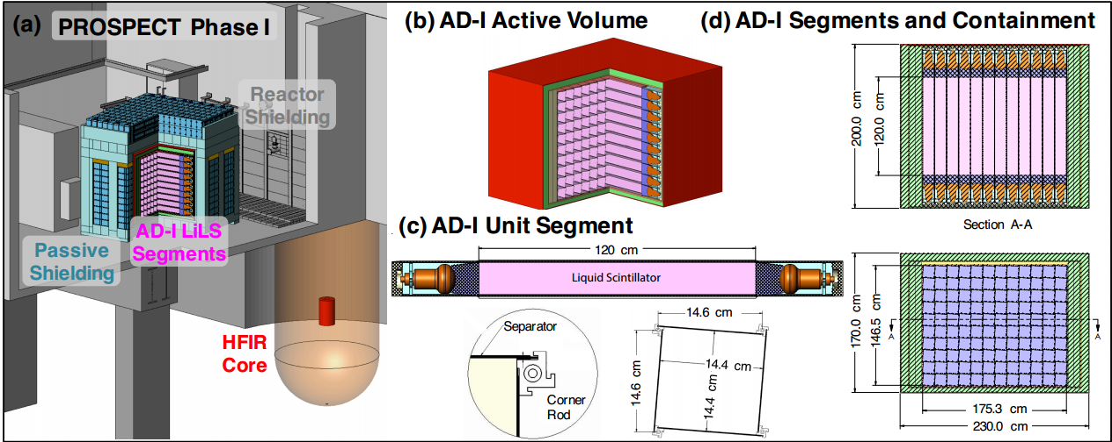
PROSPECT
Light sterile neutrinos search
Precision Measurement of the Reactor νe Spectrum
n+6Li→ α + t + 4.78 MeV highly localized ( 1 mm)
background rejection (PSD)

Slide 12
WBLS
Cherenkov light can be used for the directional reconstruction of charged particles as in the Super Kamiokande Experiment, while scintillation light can be used for the energy reconstruction of particles as in the Borexino Experiment.
Furthermore, Cherenkov light yield and scintillation light yield have different dependencies on particle momentum. In principle, this feature can be exploited to identified gamma, electron, muon, and proton.
A WbLS target allows for the high light yield and correspondingly high energy resolution and low threshold of a scintillator experiment in a directionally sensitive detector.

Slide 13
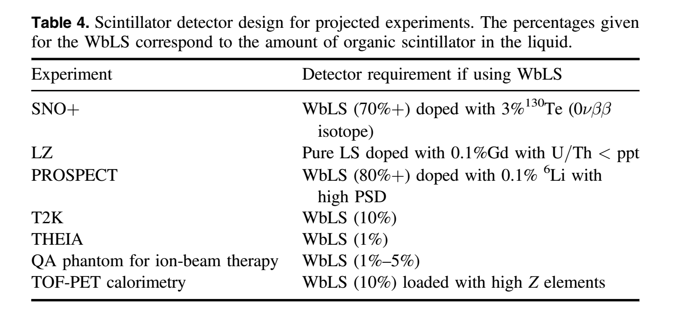
Potential WbLS contributions to proposed LS experiments
Near detector

Slide 14
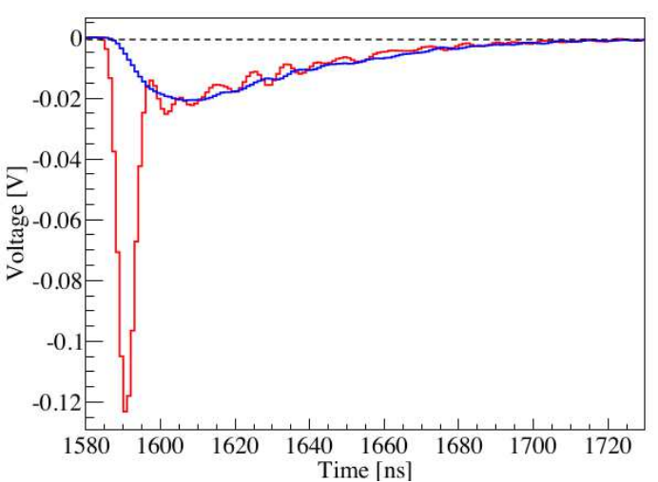
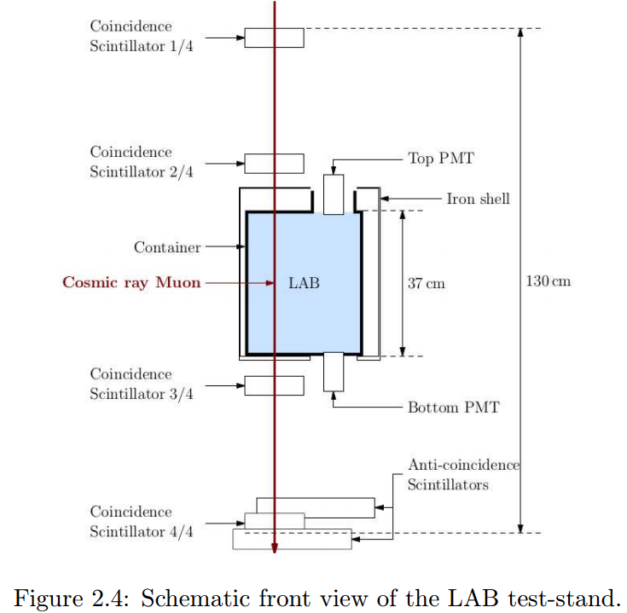



Slide 15
references
Arxiv: 0710.1049
Arxiv:1512.02202v1
6Li-loaded directionally sensitive anti-neutrino detector for possible geo-neutrinographic imaging applications DOI: 10.1038/srep04708

