Slide 1

Workout Buddy
Dilesh Fernando, Paul Charles, Purna Doddapaneni,
Cheng-yeh Lee, Kuei Hsien Chu

Slide 2
Product Demo
Users
Login/Create User
Display Interface/User Info
About/Contact
Groups
Add Group
View Group
Add Members
Join Group
Messaging
Send message
View Message
Inbox Icon

Slide 3
Product Demo
Routine
Create Routine
Add Exercise
View Routine Info Page
Edit Routine
Exercises
View Exercise Info Page
Edit Exercise
Log
Start Routine
View Log/Explain Stats

Slide 4
Product Demo
Calendar
Time Frame
Add Events
View Events
Challenges
Add Challenge
View Challenge

Slide 5
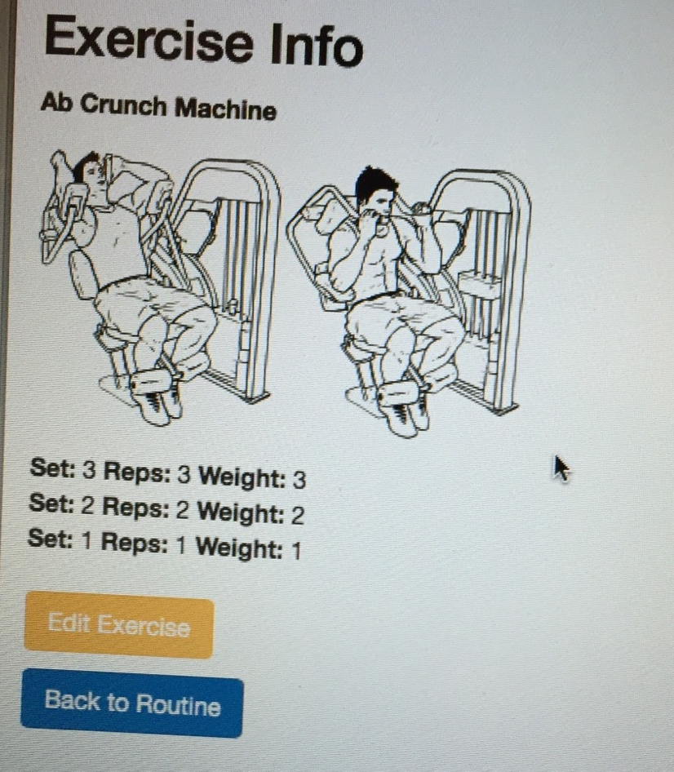
Current Bugs
Set Order: In view_exercises.php or Exercise Info, the set order sometimes shows in reverse order

Slide 6
Current Bugs
Blank Input: Safari does not support input attribute "required” so the form can be submitted without put in any input (Affected pages: add_routine.php, edit_routine.php, and addChallenges.php)

Slide 7
Current Bugs
Date Picker: In edit_routine.php, user can change to a date that has already passed or select a end date before start date

Slide 8
Current Bugs
Log entry: In view_exercise_log.php, the actual reps and weight sometimes display in reverse order

Slide 9
Deployment Plan
Deployment | Cost
T-shirts | $442.20
Convention | $6,600
Web Advertising | $100,000
Advertising Banner | $79.00
Totals | $107,121

Slide 10
Deployment Plan (cont.)
August
September
October
November
December
January
Finish and publish product
Advertise on Wescoe Beach
Finalize Internet Banner and App
Start Advertise on Other Websites
Launch App on Amazon App Store
Promote Workout Buddy at the Fit Expo™

Slide 11
Maintenance Plan
Component | Specification
Number of CPU’s | 1
RAM | 3.75 GB
Hard Drive Storage | 8GB
Backup Storage | 2GB

Slide 12
Maintenance Plan (cont.)
 | Cost | Recurring
Data Storage | $652 | Yes
Domain Name | $12 | Yes
Fitness Consultant | $36,000 | Yes
Android App | $10,000 | No
Android App Maintenance | $5,000 | Yes
Data Analyst | $62,000 | Yes
Developers | $285,000 | Yes
Total Setup Cost | $10,664 | No
Total Recurring Cost | $388,000 | Yes
Total First Year Cost | $398,644 | No

