Slide 1
DFS(u)
{ DFS(u left);
DFS(u right);
}
Pre_order(u)
{ print u’s info;
Pre_order(u left);
Pre_order(u right);
}
G
1
D
A
In_order(u)
{ In_order(u left);
print u’s info;
Pre_order(u right);
}
Post_order(u)
{Post _order(u left);
Post _order(u right);
print u’s info;
}
B
H
C
Node
2
3
F
E
I
Pre-order: 1 → print
In-order: 2 → print
Post-order: 3→ print

Slide 2
1.
2.
3.
4.
8
8
8
8
10、16、18、20
4
10、16、18、20
4
10
4
10
4、5、7
7
7
16、18
、20
7
18
5
5
5
16
20

Slide 3
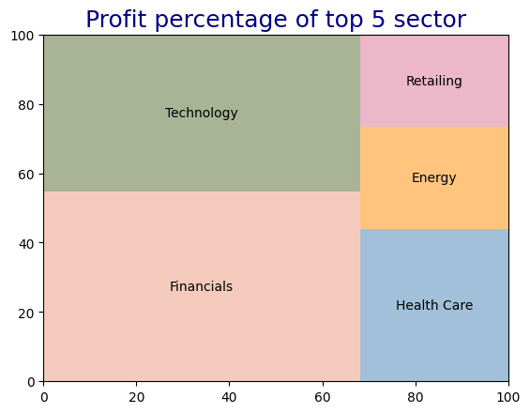
6.3%
22.7%
6.9%
27.6%
10.4%

