Slide 1
Syntax Analysis (Chapters 3-5)
Lexical Analysis
Syntax Analysis
Semantics Analysis
Iterm. Code Gen.
Code Opt.
Target Code Gen.

Slide 2
Parsing
Determine the syntax (structure) of a program based on the token sequence; Typically, parser drives scanner
token sequence
Parser
parse/syntax tree
getToken()
Scanner
Parser
parse/
syntax tree
a token
One-Pass

Slide 3
Context Free Grammars

Slide 4
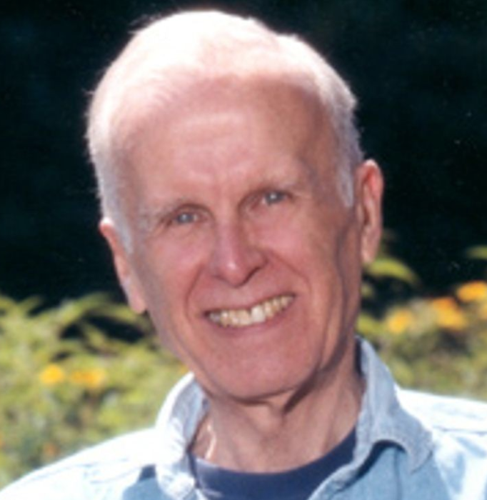
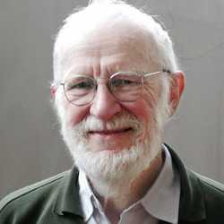
Context-Free Grammars
Backus-Naur Form (BNF)
first used for ALGOL 60
developed by John Backus and Peter Naur
<exp> ::= <exp> <op> <exp> | ( <exp> ) | number
<op> ::= + | - | *
Notes:
1960s
both are Turing awardees
Backus is the farther of Fortran

Slide 5
Context-Free Grammars
A Rule in BNF
left-hand side (LHS) defines the name of a structure (nonterminal)
right-hand side (RHS) gives its possible layouts (sequence of terminals & nonterminals)
exp → exp op exp | ( exp ) | number
structure name
possible layouts

Slide 6
Context-Free Grammars
Derivation
a sequence of replacements of structure names by layouts on RHS, starting from the start nonterminal
Start
Nonterminal
exp ⇒ exp op exp
(1) exp → exp op exp
(2) exp → ( exp )
(3) exp → number
(4) op → +
(5) op → -
(6) op → *
⇒ exp op number
⇒ number op number
⇒ number * number
a legal token string
with terminals only
CFG

Slide 7
Context-Free Grammars
Derivation
Leftmost derivation: the leftmost nonterminal is replaced in each step
exp ⇒ exp op exp
⇒ ( exp ) op exp
⇒ ( exp op exp ) op exp
⇒ ( number op exp ) op exp
⇒ ( number - exp ) op exp
⇒ ( number – number ) op exp
⇒ ( number – number ) * exp
⇒ ( number – number ) * number
(1) exp → exp op exp
(2) exp → ( exp )
(3) exp → number
(4) op → +
(5) op → -
(6) op → *
CFG

Slide 8
Context-Free Grammars
Derivation
Rightmost derivation: the rightmost nonterminal is replaced in each step
exp ⇒ exp op exp
⇒ exp op number
⇒ exp * number
⇒ ( exp ) * number
⇒ ( exp op exp ) * number
⇒ ( exp op number ) * number
⇒ ( exp – number ) * number
⇒ ( number – number ) * number
(1) exp → exp op exp
(2) exp → ( exp )
(3) exp → number
(4) op → +
(5) op → -
(6) op → *
CFG

Slide 9
Context-Free Grammars
Exercise
Use leftmost/rightmost derivation to construct the token string
exp ⇒
⇒ ( number * (number – number))
(1) exp → exp op exp
(2) exp → ( exp )
(3) exp → number
(4) op → +
(5) op → -
(6) op → *

Slide 10
Context-Free Grammars
Language
the set of token strings obtained from all possible derivations is the language defined by the CFG
L(G) = { s | exp ⇒* s}
exp → exp op exp | ( exp ) | number
op → + | - | *
derive
( number - number ) * number
a legal token string
Notes:
here it is programming language (legal token strings)

Slide 11
Context-Free Grammars
Comparison to Regex
both use alternation, concatenation, and name
no repetition “*”, but recursion (“→” instead of “=”)
more powerful (balanced parentheses S → ( S ) S | ε )
terminals are tokens
recursion
exp → exp op exp | ( exp ) | number
op → + | - | *
CFG
tokens
regex
number = digit digit*
digit = 0|1|2|3|4|5|6|7|8|9
Notes:
repetition can be represented as A → aA and A → \epsilon (right recursive); can also be left recursive
replaced by the right-hand side, instead of equal to the RLS
token names

Slide 12
Context-Free Grammars
Exercise
What is the language of the following grammar?
E → ( E )
E → E + a
E → a
{a, a+a, (a), (a)+a, (a+a), ...}

Slide 13
Context-Free Grammars
Example
Nested if-statments in a C-like form
statement → if-stmt | other
if-stmt → if ( exp ) statement
| if ( exp ) statement else statement
exp → 0 | 1
other
if (0) other
if (1) other
if (0) other else other
if (0) if (0) other
...

Slide 14
Context-Free Grammars
Example
A sequence of statements
;
s;
s;s;
s;s;s;
...
stmt_sequence → stmt ; stmt-sequence | stmt ;
stmt → s | ε
Notes:
stmt_seq → s; stmt_seq
stmt_seq → s | epsilon
as we may have different statments, it’s better to introduce a stmt nonterminal

Slide 15
Parse/Syntax Tree

Slide 16
Parse Tree
A labeled tree corresponding to a derivation
Internal nodes: nonterminals
Leaf nodes: terminals
Children – parent relation: a derivation step
(1)
exp
(1)
(2)
(3)
(4)
exp ⇒ exp op exp
⇒ number op exp
⇒ number + exp
⇒ number + number
(3)
(2)
exp
op
exp
(4)
number
+
number
Leftmost Derivation
Notes:
preorder traversal of internal nodes

Slide 17
Parse Tree
A labeled tree corresponding to a derivation
Internal nodes: nonterminals
Leaf nodes: terminals
Children – parent relation: a derivation step
(1)
exp
(1)
(2)
(3)
(4)
exp ⇒ exp op exp
⇒ exp op number
⇒ exp + number
⇒ number + number
(3)
(4)
exp
op
exp
(2)
number
+
number
Rightmost Derivation
Notes:
Not necessarily the same: a – b + c

Slide 18
Parse Tree
Exercise: what is the parse tree of this derivation?
(1)
(2)
(3)
(4)
(5)
(6)
(7)
(8)
exp ⇒ exp op exp
⇒ exp op number
⇒ exp * number
⇒ ( exp ) * number
⇒ ( exp op exp ) * number
⇒ ( exp op number) * number
⇒ ( exp - number) * number
⇒ ( number - number) * number
Notes:
derivation direction?

Slide 19
Parse Tree
Issue: match derivation well, but not in a concise form
exp
exp
op
exp
*
( exp )
*
number
42
-
exp
op
exp
34
3
number
-
number
Notes:
ver’bose

Slide 20
Abstract Syntax Tree (AST)
a.k.a. Syntax Tree
abstract syntactic structure (may miss some syntax details)
token sequence may NOT be recoverable from the AST
still contains all necessary info for translation
*
(34 – 3) * 42
-
42
((34 – 3)) * 42
((34 – 3) * 42)
34
3
Notes:
superficial differences captured by parse tree, ignored by AST

Slide 21
Abstract Syntax Tree (AST)
2nd Example
if (0) other else other
statement → if-stmt | other
if-stmt → if ( exp ) statement
| if ( exp ) statement else statement
exp → 0 | 1
statement
Parse Tree
if-stmt
if
(
exp
)
statement
else
statement
0
other
other

Slide 22
Abstract Syntax Tree (AST)
2nd Example
if (0) other else other
statement → if-stmt | other
if-stmt → if ( exp ) statement
| if ( exp ) statement else statement
exp → 0 | 1
if
AST
condition
else-part (if present)
then-part
0
other
other

Slide 23
Abstract Syntax Tree (AST)
3rd Example
s;s;s;
stmt_sequence → stmt; stmt-sequence | stmt;
stmt → s | ε
stmt-sequence
stmt
;
stmt-sequence
Parse Tree
s
stmt
;
stmt-sequence
s
stmt
;
s

Slide 24
Abstract Syntax Tree (AST)
3rd Example
s;s;s;
stmt_sequence → stmt; stmt-sequence | stmt;
stmt → s | ε
;
seq
seq
s
;
AST
child
s
s
s
s
;
s
s
s
sibling
sibling
(leftmost-child right-sibling)
s
Notes:
need an extra field in the node struct: “sibling or child”

Slide 25
Ambiguous Grammar

Slide 26
Ambiguous Grammar
A grammar allowing a string to have
more than one parse tree
exp → exp op exp | ( exp ) | number
op → + | - | * | /
34 – 3 * 42
exp
exp
exp
op
exp
exp
op
exp
exp
op
exp
*
number
number
-
exp
op
exp
number
-
number
number
number
*
Notes:
for this grammar, which one is the correct parse tree? both
similar to the ambiguity in lexical analysis: a substring can be interpreted as different tokens

Slide 27
Ambiguous Grammar
A grammar allowing a string to have
more than one parse tree
exp → exp op exp | ( exp ) | number
op → + | - | * | /
34 – 3 * 42
*
-
-
42
34
*
34
3
3
42

Slide 28
Ambiguous Grammar
Problem – multiple leftmost / multiple rightmost
derivations
exp → exp op exp | ( exp ) | number
op → + | - | * | /
34 – 3 * 42
exp ⇒ exp op exp
⇒ exp op exp op exp
⇒ number op exp op exp
⇒ number – exp op exp
⇒ number – number op exp
⇒ number – number * exp
⇒ number – number * number
exp ⇒ exp op exp
⇒ number op exp
⇒ number – exp
⇒ number – exp op exp
⇒ number – number op exp
⇒ number – number * exp
⇒ number – number * number
Two leftmost derivations
Notes:
similar to regex, but cannot be simply addressed with priority (sometimes need to use “number”, sometimes need to use “exp op exp”)

Slide 29
Ambiguous Grammar
Disambiguation rule needed → * has precedence over -
✖️
exp
34 - 3 * 42
✔️
exp
exp
op
exp
exp
op
exp
exp
op
exp
*
number
number
-
exp
op
exp
number
-
number
number
number
*

Slide 30
Ambiguous Grammar
Disambiguation rule needed → - is left associative: left to right calculation
✔️
exp
34 - 3 - 42
✖️
exp
exp
op
exp
exp
op
exp
exp
op
exp
-
number
number
-
exp
op
exp
number
-
number
number
number
-
Notes:
31-42 = -11
34 – (-39) = 73

Slide 31
Ambiguous Grammar
Add disambiguation rules to grammars
* and / have precedence over - and +
- and / are left associative
exp → exp op exp | ( exp ) | number
op → + | - | * | /
Notes:
we may also want to declare + and * as left associative, though both interpretations are correct; this can avoid warnings from the bison compiler

Slide 32
Ambiguous Grammar
Precedence Rules
Rewrite the grammar
group operators of same precedence;
write a different production rule for each precedence group
exp → exp op exp | ( exp ) | number
op → + | - | * | /
exp → exp addop exp | term
addop → + | -
term → term mulop term | factor
mulop → * | /
factor → ( exp ) | number
Notes:
draw the parse tree for 34 – 3 * 42
how about 34 – 3 - 42

Slide 33
Ambiguous Grammar
What is the parse tree with the new grammar?
34 - 3 * 42
exp
exp → exp addop exp | term
addop → + | -
term → term mulop term | factor
mulop → * | /
factor → ( exp ) | number
addop
exp
exp
term
-
term
mulop
term
factor
factor
*
factor
number
number
number
Notes:
draw on the whiteboard
more complex than the tree before rewriting, but has some ambiguity removed (associativity ambiguity still exists).
operators with higher precedence appear lower in the tree.

Slide 34
Ambiguous Grammar
Some ambiguity still exists due to associativity rules
34 - 3 - 42
exp → exp addop exp | term
addop → + | -
term → term mulop term | factor
mulop → * | /
factor → ( exp ) | number
recursion occuring on both sides
Notes:
draw on the whiteboard
more complex than the tree before rewriting, but has some ambiguity removed (associativity ambiguity still exists).
operators with higher precedence appear lower in the tree.

Slide 35
Ambiguous Grammar
Associativity Constraints
Rewrite the grammar
Replace one of the recurisons with the base case
exp → exp op exp | ( exp ) | number
op → + | - | * | /
exp → exp addop term | term
addop → + | -
term → term mulop factor | factor
mulop → * | /
factor → ( exp ) | number
Notes:
a nonterminal must have at least a rule that is not recursive (called base cases), otherwise a string will never be derived.
this makes it left-recursive

Slide 36
Ambiguous Grammar
Example parse tree for the new grammar
34 - 3 - 42
exp → exp addop term | term
addop → + | -
term → term mulop factor | factor
mulop → * | /
factor → ( exp ) | number
Notes:
draw on the whiteboard
more complex than the tree before rewriting, but has no ambiguity.

Slide 37
Ambiguous Grammar
Revisit the if-statments
statement → if-stmt | other
if-stmt → if ( exp ) statement
| if ( exp ) statement else statement
exp → 0 | 1
if (0) if (1) other else other
“Dangling Else” Problem
Notes:
two parse trees

Slide 38
Ambiguous Grammar
Revisit the if-statments
statement → if-stmt | other
if-stmt → if ( exp ) statement
| if ( exp ) statement else statement
exp → 0 | 1
✖️
if (0) if (1) other else other
✔️
disambiguation rule:
most closely nested rule

Slide 39
Ambiguous Grammar
Revisit the if-statments
statement → if-stmt | other
if-stmt → if ( exp ) statement
| if ( exp ) statement else statement
exp → 0 | 1
statement → matched-stmt | unmatched-stmt
matched-stmt → if (exp) matched-stmt else matched-stmt
| other
unmatched-stmt → if (exp) statement
| if (exp) matched-stmt else unmatched-stmt
exp → 0 | 1
Harder to write (often not used in practice)
Notes:
if there is a mismatch, it happens only to the nested one in the else part. So we cannot interpret it as “ if { if } else ”, it must be “if { if else }”
for each “if-else”, the “if” is always followed by a matched-stmt

Slide 40
Ambiguous Grammar
Harmless Ambiguity
ambiguous grammar may always produce unique AST
(but may produce different parse trees)
stmt_sequence → stmt-sequence ; stmt-sequence | stmt ;
stmt → s | ε
seq
s; s; s;
s
s
s

Slide 41
Ambiguous Grammar
Harmless Ambiguity
even for ambiguous grammar producing different ASTs
34 + 3 + 42
+
+
+
42
34
+
34
3
3
42
Both carry the same semantics

